Slide 1
Health Care Reform: What Individuals and Employers Should Know
Christine Moehl
Employee Benefits Attorney
Saalfeld Griggs PC
503-399-1070
cmoehl@sglaw.com

Slide 2
Agenda
Overview of HCR
Impact on Individuals
Individual Mandate
Coverage Changes
Health Insurance Exchanges
Increased Taxes
Impact on Employers
Employer Penalties
Tax Credits for Small Employers
Changes to Group Plans
Reporting & Disclosure Requirements
Future of Health Care Reform

Slide 3
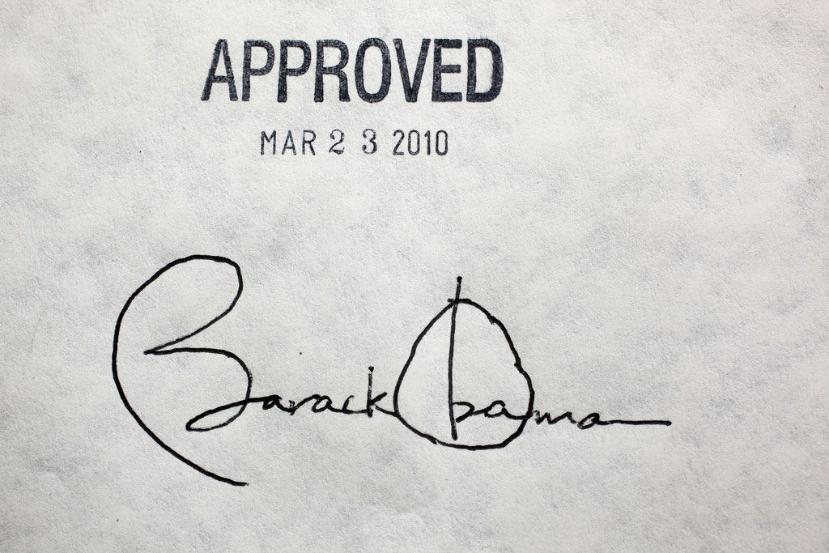
Notes:
Health Care Reform: Group of laws and regulations, Patient Protection and Affordable Care Act; Health Care and Education Reconciliation Act; guidance from HHS, DOL, IRA – laws made amendments to Code, Social Security Act, Public Health Services Act, Fair Labor Standards Act
Significantly changed health policy in the US
Staggered effective dates (2010 – 2018)
Imposed new requirement on individuals / employers / insurers / providers
Individuals: imposes penalties on individuals that don’t have coverage
Insurers: imposes requirements on how they run their businesses and what products they offer
Providers: tries to improve quality of care & control healthcare costs
Presentation focuses on employer responsibilities:
Provides incentives for employers to provide group benefits
Imposes penalties on certain employers
Affects design and administration of group health plans
Provides mechanisms to make it easier to obtain coverage (SHOP exchange)

Slide 4
Challenges to HCR
2010
3/23/10: AGs of 13 states initiate first lawsuit against HCR
9/23/10: First HCR changes become effective
12/22/10: Delay of nondiscrimination requirements for fully insured plans
1/19/11: House passes bill to repeal HCR
3/1/11: Delay of W-2 reporting requirements for smaller employers
8/12/11: 11th Circuit finds individual mandate unconstitutional
6/28/12: US Supreme Court upholds HCR
11/6/12: Obama elected to 2nd term
7/2/13: Delay of large employer reporting and penalties to 2015
10/1/13: Individual exchanges “opened”
11/27/13: Delay of SHOP to 2015
Late 2013: Several other delays . . .
2/10/14: Delay of employer mandate for medium employers to 2016
11/4/14: Mid-term elections
2011
2012
2013
2014
Notes:
Bumpy Ride:
3/23/10: Date the bill was signed into law – Patient Protection and Affordable Care Act
3/23/10: AGs filed first, but not the last, lawsuit against HCR
9/23/10: First changes effective (dependent coverage for kids under 26)
Early days – confusion, misinformation
my first few presentations . . .
calendar year plans were scrambling . . .
12/22/10: Feds realized that we needed more guidance – first delay was announced
non-discrimination requirements for fully insured plans
1/19/11: 2 weeks after Republicans gained a majority in the House, they voted to repeal HCR in its entirety
later died in the Senate
since that time the House has voted about 40 times to either repeal, defund, cut IRS’ budget
most recently (5 days ago) – house budget bill that “defunds” HCR; will not be passed by the Senate
8/12/11: 11th Circuit finds individual mandate unconstitutional – first federal appeals court to find parts of the law unconstitutional
Supreme court agreed to review
6/28/12: Found individual mandate constitutional (Congress had the authority to pass because “tax” rather than penalty)
Struck down Medicare expansion plan that would take money away from states that refused to expand
Election: Romney promised to repeal Obamacare
11/6/12: Obama elected to 2nd term
Started to get ready for 2014 (individual and employer mandates)
7/2/13: Delay of employer mandate to 2015
-later announced no penalty if don’t distribute health exchange notice
We won’t stop hearing about it: 2014 mid-term elections – big topic of discussion
My thoughts: (grain of salt)
-future court challenges won’t be successful in overturning the entire law
-efforts to repeal or defund will not be successful
-we will go forward with some form of HCR, but it will be messy
Enough of the history, let’s talk about what HCR did . . .

Slide 5
HCR Timeline
2010
Plan Design Changes: Annual limits on essential health benefits restricted Appeals process and external review Dependent coverage under age 26 No lifetime limits on essential health benefits Patient protections (primary care provider designations / ER/ etc.) Preexisting condition prohibition for under age 19 Preventative health services Recession prohibition | Plan years beginning on or after 9/23/10
Small Business Health Care Tax Credit | 2010 tax year
Nondiscrimination rules for fully insured plans | Plan years beginning on or after 9/23/10; now delayed
Notes:
Plan design changes:
Restricted annual limits on essential health benefits - established limits for “core” health services
New appeals process and external review for participant claims
Dependent coverage under age 26
No lifetime limits on essential health benefits
Patient protections (primary care provider designations / ER/ etc.)
Preexisting condition prohibition for under age 19
Preventative health services- required health insurance to cover
Prohibition on rescinding coverage, except in cases of fraud
Early Retiree Reinsurance Program: fund that reimbursed employers some of the cost of early- retiree health; $5B; closed in Dec. of 2011
Small Business Health Care Tax Credit: tax credit for small employers who offered health insurance to employees
Amount: 35% of employer’s premium costs; up to 50% in 2014 – sliding scale
Eligible: Under 25 FTEs and average wages of less than $50K
Full premium to employees with under 10 FTEs and less than $25K in annual wages
Wellness Program Assistance: increase in the maximum permissible reward under a health-contingent wellness program from 20 to 30% of the cost of individual coverage under the group health plan, and up to 50% for programs designed to prevent or reduce tobacco use
Nondiscrimination rules for fully insured plans:
Just like the rules that apply to self-insured plans
Will go over in some detail later

Slide 6
HCR Timeline
2011
No FSA/HRA/HSA reimbursements for OTC drugs | Plan years beginning on or after 1/1/11
Medical loss ratio rebates | 2011 calendar year
Simple cafeteria plans | Plan years beginning on or after 1/1/11
HSA penalty tax increase | Distributions after 1/1/11
2012
Patient-Centered outcomes research institute (PCORI) fees | Plan years ending after 9/30/12
Summary of benefits and coverage (SBC) | First open enrollment following 9/23/12
W-2 reporting (250+ employees) | 2012 tax year
Coverage for additional women’s preventative care | Plan years beginning on or after 8/1/12
Notes:
No FSA/HRA/HSA reimbursements for OTC drugs: health FSAs, HRAs, and other employer-provided accident and health plans can only reimburse medicines and drugs other than insulin if the medicine or drug is prescribed
Medical loss ratio rebates: Requires insurers to issue rebates to their policy holders if the insurer didn’t spend enough of each dollar on medical care or quality improvements
Simple cafeteria plans: Exempt for nondiscrimination testing if under 100 employees, required employer contributions
HSA penalty tax increase: increase penalty tax from 10% to 20% for non-qualifying expenses from an HSA
Wellness program grants: Grants to small businesses that set up wellness programs

Slide 7
HCR Timeline
2013
Health FSA annual limitation | Plan years beginning on or after 1/1/13
Health insurance exchange notice | 10/1/13
Additional Medicare tax on higher-income employees | Wages earned after 1/1/13
Open enrollment in the Individual Exchange | 10/1/13
Notes:
Health FSA annual limitation – deferrals into a cafeteria plan were limited to $2,500 for plan years on or after 1/1/13; plans must be amended by 2014
Health insurance exchange notice – October 1, 2013; no penalty for not distributing
Additional Medicare tax on higher-income employees: additional .9% for high-income wages earners; employers have to withhold the additional tax from wages earned in excess of $200K
Open enrollment in the exchange

Slide 8
HCR Timeline
2014
Individual Exchange opens | 1/1/14
Reinsurance Contributions | 1/1/14
Individual Mandate / Premium Assistance Credits | 1/1/14
Additional Plan Design Changes No annual dollar limit on essential health benefits No pre-existing condition limits No waiting periods over 90 days Limits on deductibles and out-of pocket maximums Clinical trail coverage | Plan years beginning on or after 1/1/14
Guaranteed availability / renewability of coverage | Plan years beginning on or after 1/1/14
Notes:
Individual Exchange / SHOP opens – marketplace where individuals and small businesses can go to purchase insurance
Reinsurance Contributions: 2014 – 2016 addt’l fee to be used to help insurers pay for high expenses; $63 per person; pd by insurer for fully insured plan
Individual Mandate / Premium Assistance Credit – individuals are required to have coverage for themselves and their dependents or pay a penalty; premium assistant subsidies and credits will be available to help individuals pay for the premiums
Additional Plan Design Changes
No annual dollar limit on essential health benefits
No pre-existing condition restrictions for any age
No waiting periods over 90 days
Limits on deductibles and out-of pocket maximums
Clinical trail coverage
Guaranteed availability / renewability of coverage- all employers must be offered coverage or renewal of coverage

Slide 9
HCR Timeline
2015
Employer reporting & disclosures for large employers (over 50 FTEs) | 1/1/15
Employer penalties for employers with over 100 FTEs | 1/1/15
2016
Exchange opens to employers under 100
Employer penalties for all employers with over 50 FTEs
2018
Cadillac plan tax
Notes:
2015: Pay or play penalties that Wally will discuss next
2017: Exchange opens to all employers
2018: Cadillac plan tax - 40% nondeductible excise tax on high-cost health coverage

Slide 10
HCR Timeline
Someday . . .
Automatic enrollment for large plans
W-2 reporting for all employers
Non-discrimination in fully-insured plans
Notes:
Automatic enrollment for large plans - require certain large employers
to—
• automatically enroll new full-time employees in one of the employer’s health benefit plans and
• continue the enrollment of current employees.
The automatic enrollment requirement applies to employers that (1) are subject to the FLSA, (2) have more than 200 full-time employees, and (3) have one or more health benefit plans. Employers must provide “adequate notice” to employees, and employees must be given an opportunity to opt out of coverage
W-2 reporting for all employers
Non-discrimination in fully-insured plans – we’ll talk about this in detail in a bit

Slide 11
HCR: Impact on Individuals
Individual Mandate
Beginning in 2014, taxpayers will be assessed a “shared responsibility” penalty for any months during which they or their spouse or dependents lack “minimum essential coverage.”
Limited transition relief for employees whose employers have non-calendar year plans

Slide 12
HCR: Impact on Individuals
Individual Mandate
Minimum Essential Coverage:
Coverage under a government program (Medicare, Medicaid, Healthy Kids)
Employer-sponsored health plan (including COBRA)
Individual policy purchased on or off the Exchange
Does not include:
Limited policies (dental / vision)
FSAs
Wellness plans

Slide 13
HCR: Impact on Individuals
Individual Mandate
Penalty Amount: Greater of flat dollar amount or percentage of income
Year | Flat $ for Adult | Flat $ for Child (<18) | % of Income | Family Maximum
2014 | $95 | $47.50 | 1% | Greater of $285 or 1% of household income
2015 | $325 | $162.50 | 2% | Greater of $975 or 2% of household income
2016 | $695 | $347.50 | 2.5% | Greater of $2,085 or 2.5% of household income

Slide 14
HCR: Impact on Individuals
Individual Mandate
Example: No insurance, household income = $65,000
 | Single Adult | Married Couple with 1 child | Married Couple with 10 children
2014 | Flat $ = $95 1% of income = $650 | Flat $ = $237.50 1% of income = $650 | Flat $ = $285 1% of income = $650
2015 | Flat $ = $325 2% of income = $1,300 | Flat $ = $812.50 1% of income = $1,300 | Flat $ = $975 1% of income = $1,300
2016 | Flat $ = $695 1% of income = $1,625 | Flat $ = $1,737.50 1% of income = $1,625 | Flat $ = $2,085 1% of income = $1,625

Slide 15
HCR: Impact on Individuals
Individual Mandate
Exempt Individuals:
Religious conscience
Taxpayers who are below the tax filing threshold
Members of Indian Tribes
Incarcerated individuals
Illegal immigrants
Individuals residing in US territories or outside of the US
Individuals without coverage for less than 3 months
Individuals without “affordable” coverage
Cost is over 8% of household income
Example: Employee-only coverage is 4% of income and
family coverage is 10% of income; employee will pay
penalty, no penalty for spouse or kids

Slide 16
HCR: Impact on Individuals
Individual Mandate
Reporting
Reported annually on individual federal income tax return
Joint filers are jointly liable
If filer claims a dependent on their tax return, they are responsible for that dependent’s penalty
Collection & Enforcement
IRS cannot impose a levy or lien for non-payment
No criminal sanctions
Can use a tax refund to offset the amount due

Slide 17
HCR: Impact on Individuals
Coverage Changes for 2014
No Lifetime or Annual Limits on Essential Health Benefits
Essential Health Benefits:
Ambulatory patient services
Emergency services
Hospitalization
Maternity and newborn care
Mental health and substance use disorder services, including behavioral health treatment
Prescription drugs
Rehabilitative and habilitative services and devices
Laboratory services
Preventive and wellness services and chronic disease management
Pediatric services, including oral and vision care

Slide 18
HCR: Impact on Individuals
Coverage Changes for 2014
Maximum Out of Pocket Expense.
Maximum out of pocket cost for “In-network” medical expenses is $6,350 for an individual and $12,700 for a family
Includes deductible, co-insurance, co-payments and prescription costs
“Out of Network” expenses are not limited
No Pre-existing Conditions Exclusions
Regardless of age

Slide 19
HCR: Impact on Individuals
Coverage Changes for 2014
Dependent Coverage – up to child’s 26th birthday and until the last day of month they turn 26
Individual Coverage: Individual is charged for first 3 children under 20 years old and then for each child older than 21 to 26 based on age. Example: 6 children, 4 under 20 and 2 over 20 years old, you would pay for yourself and 5 children (3 under 20 years old and 2 over 20 years old).
Group Coverage: Carriers will load their rates for dependents, but currently there is not an additional charge for “extra” children.

Slide 20
HCR: Impact on Individuals
Individual Insurance Exchange
October 1, 2013: Open enrollment “began”
January 1, 2014: Coverage begins for individuals (if signed up prior to 12/15)
March 31, 2014: Open enrollment ends

Slide 21
HCR: Impact on Individuals
Premium Assistance Subsidy
Subsidy received by eligible individuals and families who purchase health insurance through an Exchange
Eligible Individuals:
Group insurance is not available through employer, or group insurance is “not acceptable”
Household income is between 100% – 400% of
federal poverty level
Based on prior year income
Notes:
Starts 1/1/14

Slide 22
HCR: Impact on Individuals
Premium Assistance Subsidy
Annual Premiums for Family of 3
% of Federal Poverty Guidelines

Slide 23
HCR: Impact on Individuals
Premium Assistance Subsidy
Family of 3, wages of $25,000 (133% of FPL)

Slide 24
HCR: Impact on Individuals
Premium Assistance Subsidy
Family of 3, wages of $50,000 (250% of FPL)

Slide 25
HCR: Impact on Individuals
Premium Assistance Subsidy
Family of 3, wages of $80,000 (over 400% of FPL)

Slide 26
HCR: Impact on Individuals
Premium Assistance Subsidy
Subsidy can either be paid on a monthly basis by the Exchange to the insurer or received as a credit on the individual’s tax return
Employer will be notified when an employee qualifies for the subsidy
Notice will include information about employer penalties
Notes:
Starts 1/1/14

Slide 27
HCR: Impact on Individuals
Tax Impacts on Individuals
Additional Medicare Tax
Additional 0.9% tax on income earned over the threshold amount ($200K single; $250K married)
Increase in Medical Expense Deduction Threshold
Medicare Tax on Investment Income

Slide 28
HCR: Impact on Employers
Employer Penalties
“Applicable Large Employers” will be subject to a penalty if one or more of their employees receives a premium assistance credit
Remember: Employees are only eligible for a
premium assistance credit if their employer does
not offer coverage, or the coverage is “not acceptable”

Slide 29
HCR: Impact on Employers
Employer Penalties
“Applicable Large Employers” = 50 FTEs
Employee working 30 hours per week = 1 FTE
Employee working less than 30 hours per week = partial FTE = Hours worked per month/120 hours
Based on the average of the months in 2014

Slide 30
HCR: Impact on Employers
Employer Penalties
FTE Calculation:
Based on an average of months of prior year
= 50 FTEs
Start counting in 2014
J | F | M | A | M | J | J | A | S | O | N | D
45 | 46 | 50 | 50 | 46 | 46 | 59 | 57 | 59 | 49 | 49 | 44

Slide 31
HCR: Impact on Employers
Employer Penalties
FTE Calculation:
Seasonals may be taken out of the calculation
=40 FTEs
Workforce cannot exceed 50 FTEs for more
than 120 days of the year
“Good faith” interpretation of “seasonal”
J | F | M | A | M | J | J | A | S | O | N | D
40 | 40 | 40 | 40 | 40 | 120 40 | 120 40 | 120 40 | 120 40 | 40 | 40 | 40

Slide 32
HCR: Impact on Employers
Employer Penalties
Coverage Offered: | Annual Penalty Amount:
Safe Coverage “Affordable” and “Minimum Value” coverage offered to 95% of all full-time employees & dependents | No Penalty
If Safe Coverage is not offered and at least one full-time employees receives a Premium Assistance Credit, amount of penalty depends on the coverage offered:
No Coverage: Coverage not offered to 95% of full time employees & dependents | $2,000 x all full-time employees minus 30
Not Acceptable Coverage: Coverage offered to 95% of full time employees & dependents but does not meet “affordability” and “minimum value” requirements | $3,000 x the number of full-time employees who receive a Premium Assistance Credit

Slide 33
HCR: Impact on Employers
Employer Penalties
“No Coverage” Penalty
Employers must offer minimum essential coverage to at least 95% of all Full Time Employees (note: 70% in 2016) and their dependents to age 26 within 90 days of hire or pay a “no coverage” penalty
Who is a “Full Time Employee”?
Employee who works an average of at least 30 hours per week or 130 hours per month

Slide 34
HCR: Impact on Employers
Employer Penalties
“No Coverage” Penalty
Variable & Seasonal Hour Employees
Ongoing Employees
Standard Measurement Period (3 – 12 months)
Stability Period (greater of 6 months or SMP)
Administrative Period – optional (up to 90 days)
New Employees
Initial Measurement Period
Stability Period
Administrative Period
Put a policy into place

Slide 35
HCR: Impact on Employers
Variable & Seasonal Hour Example #1a
Ongoing Employee
Employee averages 30 hours per week from 10/15/13 to 10/14/14
Coverage as of 1/1/15 through 12/31/15, regardless of hours worked
Employer Variable & Seasonal Employee Policy:
Measurement period (Oct. 15 to Oct. 14)
Administrative Period (Oct. 15 to Dec. 31)
Stability Period (Jan. 1 to Dec. 31)

Slide 36
HCR: Impact on Employers
Variable & Seasonal Hour Example #1b
Ongoing Employee
Employee does not average 30 hours per week from 10/15/13 to 10/14/14
No coverage offered as of 1/1/15
Must count hours every 10/15 to 10/14 to determine if coverage for the following yr
Employer Variable & Seasonal Employee Policy:
Measurement period (Oct. 15 to Oct. 14)
Administrative Period (Oct. 15 to Dec. 31)
Stability Period (Jan. 1 to Dec. 31)

Slide 37
HCR: Impact on Employers
Variable & Seasonal Hour Example #2a
New Employee
Employee averages 30 hours per week in year after hire
Coverage for 1 year as of first day of month following 1 year of employment
Employer Variable & Seasonal Employee Policy:
Measurement period (12 m. after DOH)
Administrative Period (ends first day of month following end of measurement period)
Stability Period (12 month period following entry)

Slide 38
HCR: Impact on Employers
Variable & Seasonal Hour Example #2b
New Employee
Employee does not average 30 hours per week in year after hire
No coverage after 1 year
Converts to ongoing employee (look at your policy)
Employer Variable & Seasonal Employee Policy:
Measurement period (12 m. after DOH)
Administrative Period (ends first day of month following end of measurement period)
Stability Period (12 month period following entry)

Slide 39
HCR: Impact on Employers
Employer Penalties
“No Coverage” Penalty
Monthly Amount: # of full time employees minus 30 * $167
Calculated on a monthly basis
Example: 35 full time employees & 20 part time employees who work 24 hrs/wk
Monthly penalty = 35 - 30 x $167 = $833

Slide 40
HCR: Impact on Employers
Employer Penalties
“Not Acceptable Coverage” Penalty
Employers offer coverage but either:
coverage has less than 60% minimum value, or
coverage is not affordable
will pay a “not acceptable coverage” penalty.

Slide 41
HCR: Impact on Employers
Employer Penalties
“Not Acceptable Coverage” Penalty
Minimum Value: The plan must pay for at least 60% of all benefits provided
Calculator available at cciio.cms.gov/resources/files/mv-calculator-final-2-20-2013.xlsm
Affordable: The lowest cost option for self-only coverage is less than 9.5% of household income
Determined using 3 methods (Easiest is W-2 method (adjusted down for deferrals))

Slide 42
HCR: Impact on Employers
Employer Penalties
“Not Acceptable Coverage” Penalty
Monthly Amount: The lesser of
“no coverage” penalty, or
$250 x # of employees receiving the subsidy

Slide 43
HCR: Impact on Employers
Employer Penalties
Example: 35 full time employees & 20 part time employees who work 24 hrs/wk
2 employees receive a subsidy
“No coverage penalty” = 35 - 30 x $167 = $833
“Not acceptable coverage” penalty = 2 x $250 = $500
$500 / month

Slide 44
HCR: Impact on Employers
Employer Penalties
Reporting of Health Insurance Coverage
Annual report to IRS
Employer information
# of full-time employees
Certification of “minimum essential coverage”
Premium costs (employee & employer)
Length of waiting period
Provide written statement to employees
Applies to coverage provided after 1/1/15
Reports will be due in 2016

Slide 45
HCR: Impact on Employers
Small Employer Tax Credit
Available through 2013, and for two consecutive years after 2013
2014 & beyond, group health coverage must be purchased through SHOP
Amount:
2013: 35% of employer’s premium costs
2014 & beyond: 50% of employer’s
premium costs

Slide 46
HCR: Impact on Employers
Small Employer Tax Credit
Eligible Employer:
Fewer than 25 FTE employees
Average annual wages less than $50K
Qualifying Arrangement:
50% of premiums paid by employer
Uniform amount for each employee
Does not include HRA/HSA/FSA
Notes:
FTEs: owners/family not counted
Comp pd to owners / family not counted

Slide 47
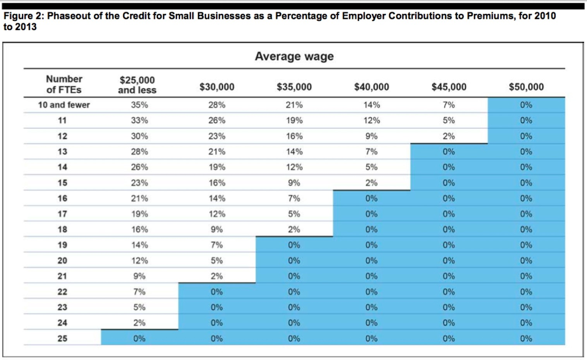
HCR: Impact on Employers
Small Employer Tax Credit
Phase Out : % of Employer Premiums Paid
Notes:
FTEs: owners/family not counted
Comp pd to owners / family not counted

Slide 48
HCR: Impact on Employers
SHOP Exchange
October 1, 2013: Open enrollment “begins” for employers with under 50 employees
January 1, 2014: Coverage begins for plans purchased through the Exchange
2016: Opens to employers with under 100 –ees
2017: Opens to all employers

Slide 49
HCR: Impact on Employers
Changes to Group Health Plans
Dependent and spouse coverage
No excessive waiting periods (90 days)
Non-discrimination requirements
Delayed pending further guidance
Effective date will be after guidance is issued
Penalties of $100 per day

Slide 50
HCR: Impact on Employers
W-2 Reporting
Applies if filed 250+ W-2s in prior year
Cost of health coverage in Box 12, Code DD
Includes both employee and employer paid benefits
Does not include:
Cafeteria plan if no –er contributions
Stand-alone dental/vision
HSA/HRA contributions
Union plans
Notes:
250 W-2s for 2011 (not based on controlled group)
Small employer exemption – won’t last
Calendar year reporting
Informational – not taxable

Slide 51
HCR: Impact on Employers
Notice of Exchange
October 1, 2013: Employers must provide notices to their employees about the Exchange
New Hires: within 14 days
Model notices available at
http://www.dol.gov/ebsa/pdf/FLSAwithplans.pdf
http://www.dol.gov/ebsa/pdf/FLSAwithoutplans.pdf
Complete with current year information
Notes:
250 W-2s for 2011 (not based on controlled group)
Small employer exemption – won’t last
Calendar year reporting
Informational – not taxable

Slide 52
HCR: Impact on Employers
Timing:
New hires: 1st day of eligibility
Ongoing employees: 30 days prior to the 1st day of plan year
Summary of Benefits and Coverage
Penalties
Now: $1,000 per “willful violation” (good faith period)
January 1, 2015: End of “good faith” period; $1,000 per violation
Notes:
Required after open enrollment after Sept. 22, 2012

Slide 53
HCR: Impact on Employers
Tax Treatment of Employer vs.
Individual Coverage
Individual coverage:
$ paid by employer or employee to purchase individual policies; taxed
Contributions by employee to an HSA or FSA; income tax free
Employer coverage:
$ paid by employer; income tax free
$ paid by employee through an FSA; income tax free
Contribution by employee or employer to an HSA; income
tax free

Slide 54
HCR: Impact on Employers
Cadillac Plan Tax
40% excise tax on employer-sponsored plans spending more than $10,200 per employee (or $27,500 per family)
includes employer and employee-paid premiums and employer contributions to HSAs and FSAs
adjusted for areas where healthcare is more expensive and for employees in high-risk jobs

