Slide 1
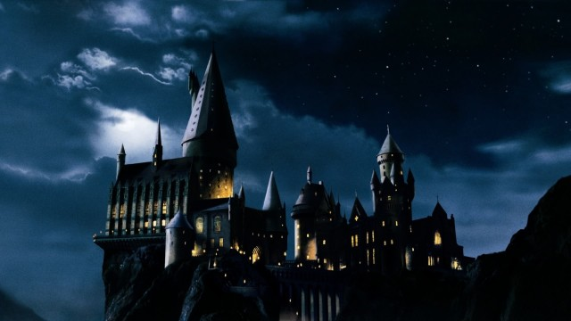
Hogwarts School of Appellate Wizardry
James S. Bowman American Inns of Court
Bordonaro/Brown Pupilage Group
March 12, 2014
http://wallike.com/hogwarts-castle.html

Slide 2

Potion For Written Appellate Advocacy

Slide 3

Recipe For An Appellate Brief
RECIPE
  Two parts Pa.R.A.P 2147
  Nine parts Pa.R.A.P 2111
  Huge scoop of power of persuasion
http://nuridarahmanovianti.blogspot.com/2013/04/harry-potter-powerpoint-template.html

Slide 4
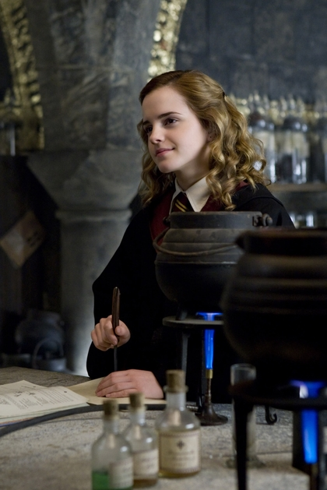
Ingredients
Type Size — Must be in 14 point type. Pa.R.A.P. 124
Word Count — Pa.R.A.P. 2135
  Principal Brief — Shall not exceed 14,000 words (Count each numbered page)
  Cross Appeals — Shall not exceed 16,500 words
  Reply briefs — Shall not exceed 7,000 words
© 2011 WallpaperName.com.

Slide 5

INGREDIENTS
Table of Contents
Table of Citations

Slide 6

ingredients
Statement of Jurisdiction
Usually is found in Chapter 7 of Judicial Code
Not found in the appellate rules

Slide 7

ingredients
Scope of Review
“What the Court may look at”
Can be defined by:
Content of record
Issues preserved
Issues addressed by trial court
©2012-2014 GennadyKalugina

Slide 8

INGREDIENTS
Order
Just the text of order appealed
Check… Is order appealable?
Final Order? Pa.R.A.P. 341
Interlocutory but appealable by right? Pa.R.A.P. 311
Discretionary appeal? Pa.R.A.P. 312; 313; 1311

Slide 9
INGREDIENTS
Statement of Issues
Pique reader’s interest; do not use “Is prior order wrong?”
Be selective – only one page worth of issues

Slide 10

INGREDIENTS
Statement of Case
Relevant facts as shown in original (and reproduced) record presented favorably
Keys to building strong case and professional credibility

Slide 11
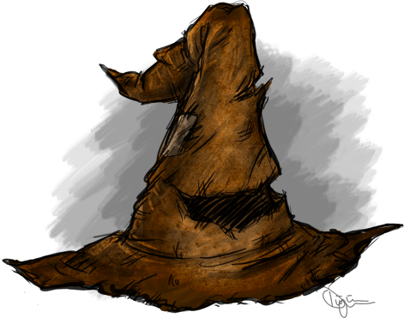
ingredients
Summary of Argument
Concise
Highlights of position
©2011-2014 sahinduezguen

Slide 12
INGREDIENTS
Argument
Headings in distinctive type or distinctively displayed
Organized
Logical
Persuasive

Slide 13
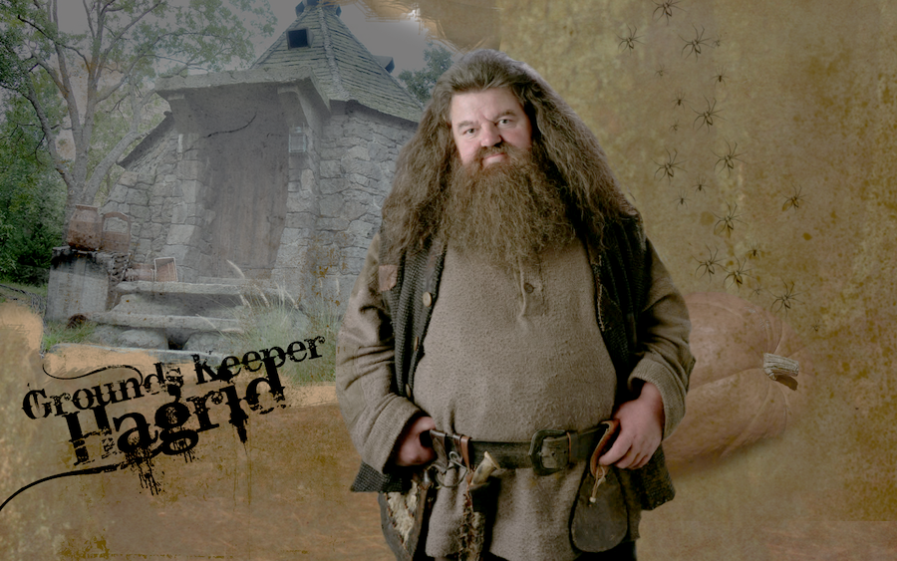
INGREDIENTS
Conclusion
What do you want?
What should court order say?
©2010-2014 DefyingGravityxoox

Slide 14
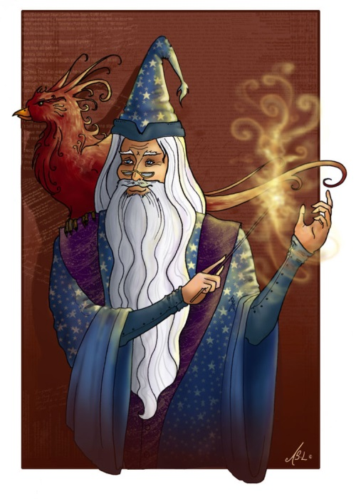
INGREDIENTS
Appendix
Prior opinions in this case
©2006-2014 WhiteElzora

Slide 15
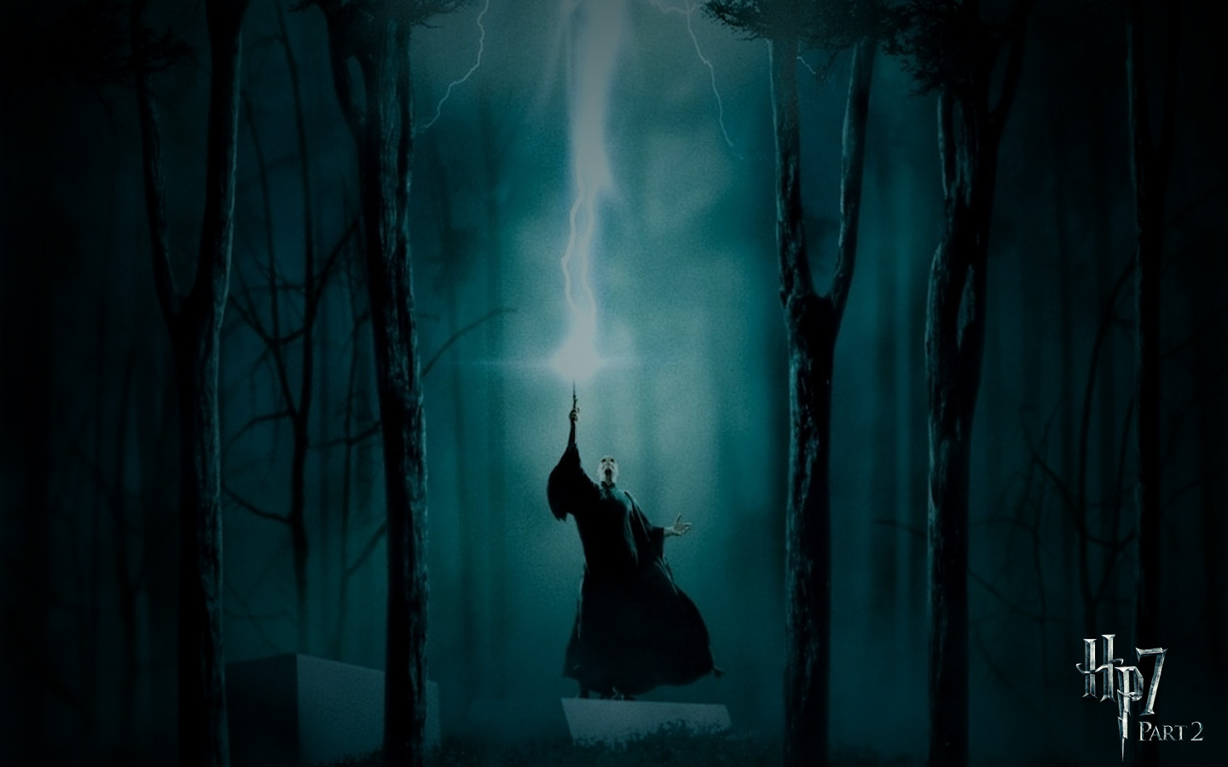
Cast Your Spell
http://www.dvd-ppt-slideshow.com/blog/harry-potter-and-the-deathly-hallows-part-2-wallpapers/

Slide 16
Keys to successful oral argument preparation

Slide 17
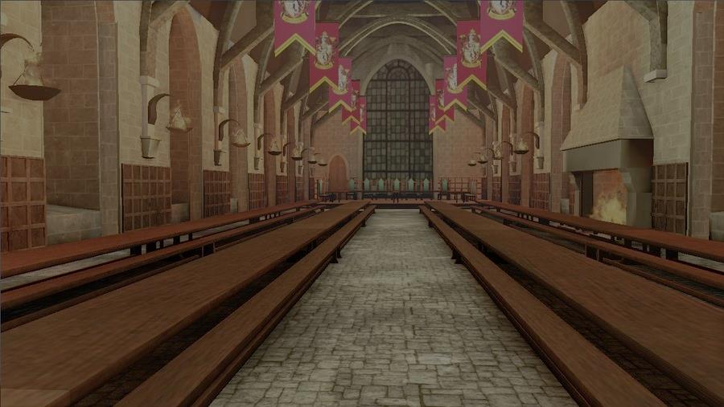
PREPATATION-
VISIT THE COURTROOM
Note differences from other courtrooms
  No court reporter
  No jury
  Time limits
  Stand to speak at podium
  More than one judge
  No reading of argument is allowed
Become familiar with courtroom
  Observe surroundings
  Try out seats and podium
  Watch other cases being argued
©2012-2014 StudentOfMayhem

Slide 18

Preparation argument folder or notebook
Bullet points outlining most important arguments, case law and key references to record-minimal notes
Tab the record for referencing
No more than two pages for bullet points
Update cases cited in brief and check for any new cases

Slide 19

PREPARATION
MOCK ARGUMENT
Know your argument points
Rehearse your argument points
Anticipate questions and challenges and prepare your responses
Practice your arguments with colleagues
Make sure your argument makes sense to laypersons
©2007-2014 Azkaban-Dementor

Slide 20
Argument day
Begin argument “May it please the Court” and your name and party
Speak Loudly
Do Not BS the Court on Anything

Slide 21

ARGUMENT DAY
Be Cool-Preparation Pays Off
  Butterflies are normal
  Be focused and confident – especially when responding to difficult questions
  Maintain eye contact with questioner
  Be concise – get to issues promptly and respond directly to questions
  Be honest and candid
http://www.dvd-ppt-slideshow.com/blog/harry-potter-and-the-deathly-hallows-part-2-wallpapers/

Slide 22
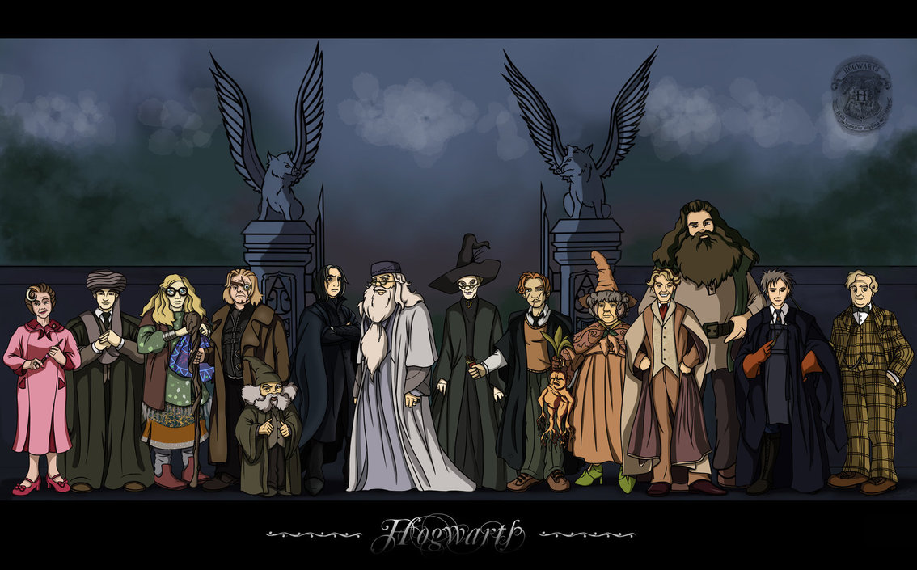
Argument day
Know when to shut up – when the questioner says “I think we understand your position” that is a BIG hint to stop and sit down
NEVER EVER let your cell phone ring in the courtroom
©2010-2014 Belegilgalad

Slide 23
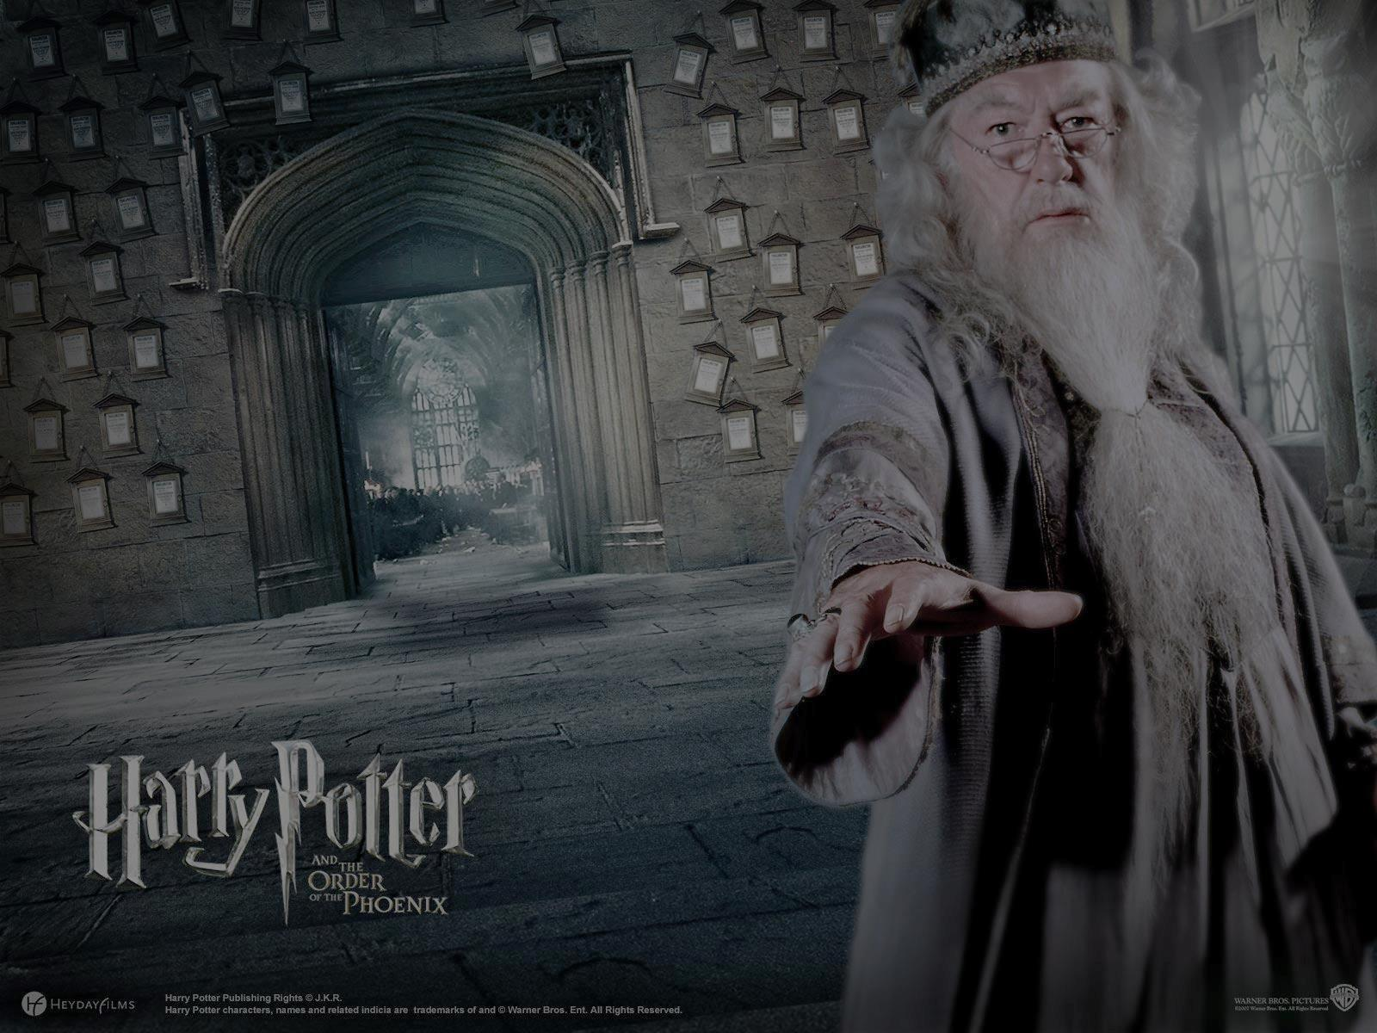
ARGUMENT DAY-
APPEARANCE
Dress business formal
Don’t grip the podium or let your hands hang at the side
Don’t over gesture
Don’t hug yourself, hum, tap fingers or a pen
If you look confident, you will feel confident

Slide 24
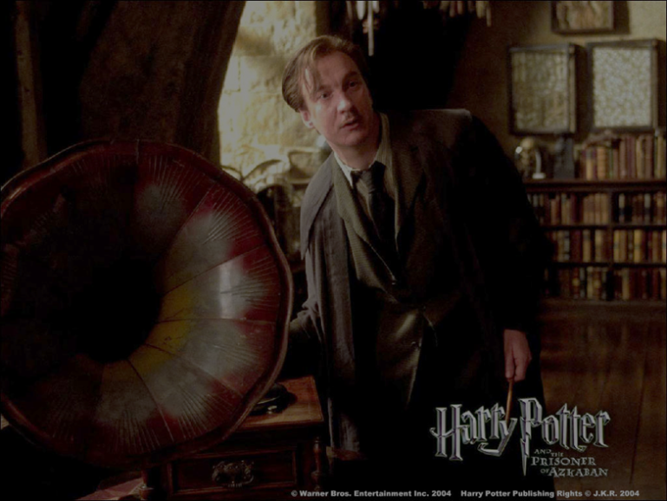
Argument advice
Start with strongest argument first – sum it up quickly and come back to it at the end
Do Not Recite the Facts
Speak clearly and slowly
Weave in fairness
Concede if necessary
Earn and Maintain credibility with the Court

Slide 25
cast
Voice of the Sorting Hat/Professor McGonagall….………Nicole Bordonaro
Dumbledore…………………………………………The Honorable Kevin Brobson
Harry………………………………………………………………………Alex Marcinko
Hermione……………………………………………………………………Brigid Landry
Ron……………………………………………………………………………Mitchell Jones
Nearly Headless Nick…………………………………………….………John Lavelle
Malfoy…………………………………………………………………Daryl Christopher
Dobby/Professor Trelawney……………………………………………Barb Darkes
Hagrid……………………………………………………………………………Matt Haar
Written Materials…………Kristen Brown/The Honorable Kevin Brobson
Chocolate Frogs…………………………………….courtesy of Nicole Bordonaro
Technical Wizardry…………………………………Lindy Randby/Page Darney
and extra gratitude to fellow Inn colleague Sean Kirkpatrick for his exceptional technical assistance to our group

Slide 26

THE END
http://www.dvd-ppt-slideshow.com/blog/free-harry-potter-and-the-deathly-hallows-part-2-templates-download

