Slide 1

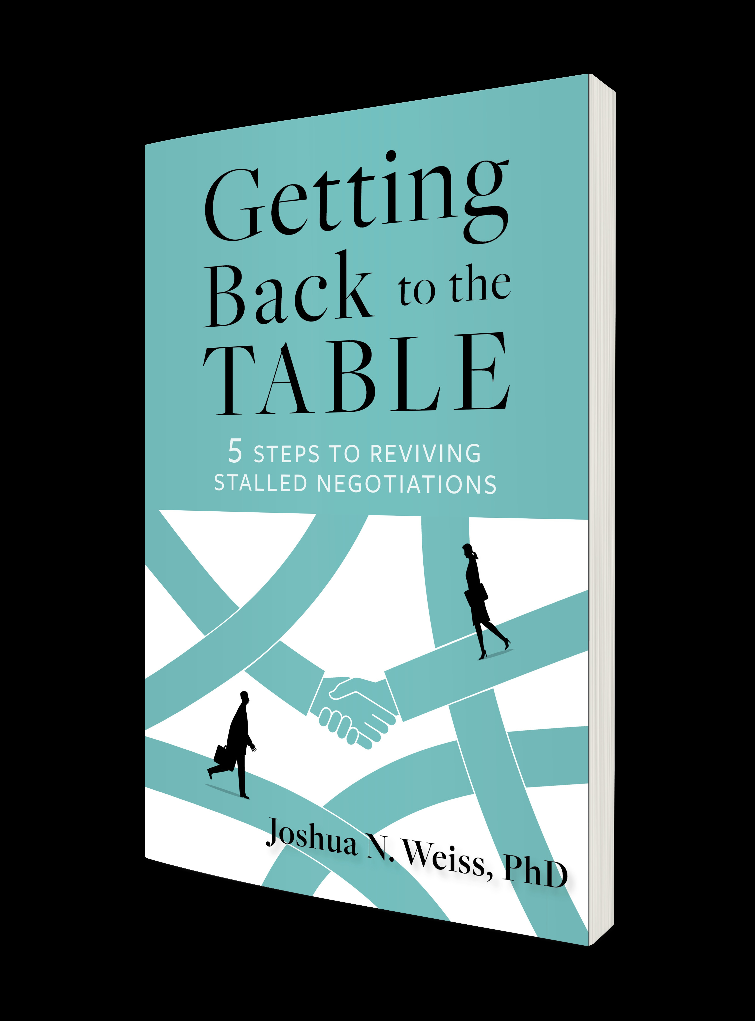
Recognizing and avoiding impending failures in your mediations and dealing with setbacks
By Joshua N. Weiss, Ph.D.
February 2026

Slide 2

Why Getting Back to the Table?
“Loved your book, but why the focus on successes?”
“Thank goodness! I feel like all we read about is success. It feels like if we don’t succeed all the time we are bad negotiators.”
To recognize that setbacks/failures are part of the negotiation/mediation landscape
To create awareness about the different ways people can fail to avoid them
To separate shame from failure
Notes:
2020 book – real world nego – success why not failures
Student convo
My own life – plenty of failure. But it has helped me to become resilient and persistent
We all know setbacks and failure are part of nego but we don’t seem to talk about it enough or embrace it is part of the nego landscape
Identify ways people fail to go deeper
To help people learn from these failures and not fall into traps

Slide 3
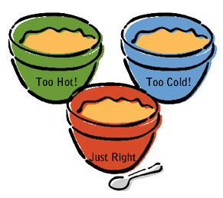
3 Typical Responses to Failure in general
Rationalization
Anxiety
Learning

Slide 4

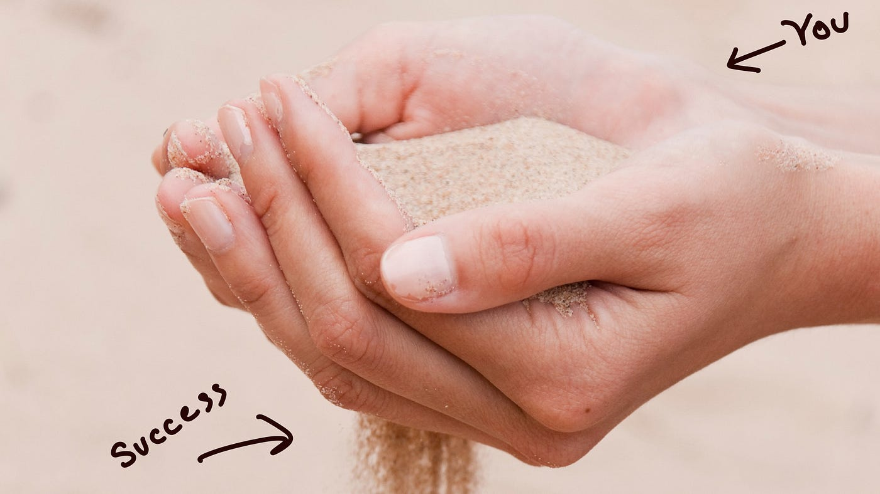
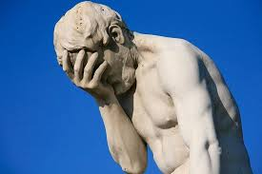
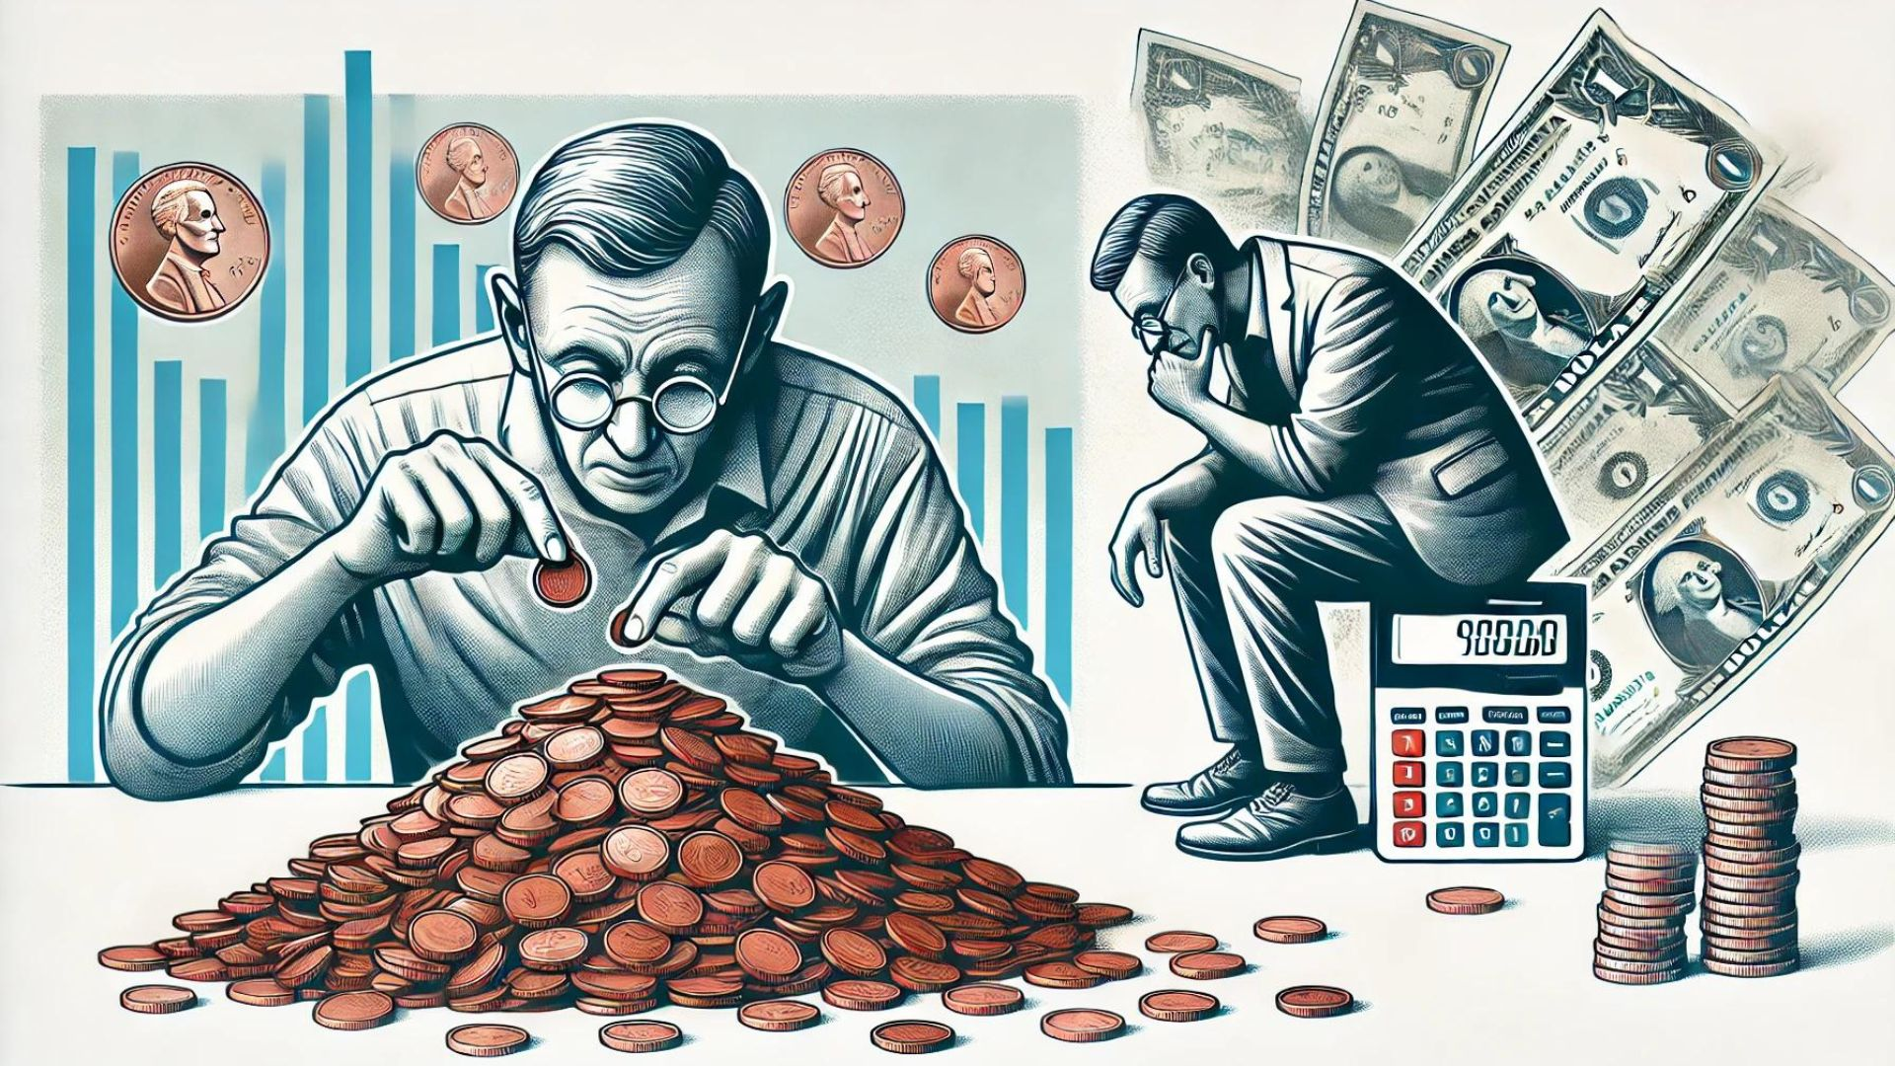
Recognizing the 7 types of types of failures and their magnitude (4 point scale)
Take a Crack at It Failure: Expecting to fail
Slipping through the Fingers Failure: When agreement made sense but did not happen
What Were You Thinking Failure: Not meeting one’s interests or objectives
Penny-Wise and Pound-Foolish Failure: Reaching an agreement that is short sighted and damages the relationship

Slide 5
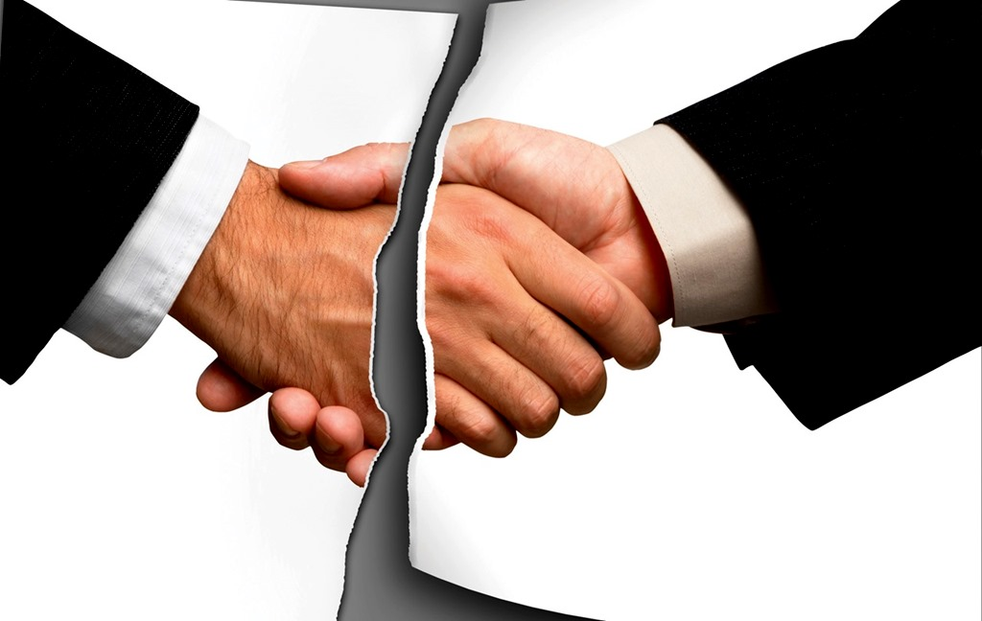


Types of failure continued…
Bad Agreement Failure: Reaching an agreement that is worse than your BATNA
Emotionally Unintelligent Failure: When emotions overwhelm the process and failure ensues
Under-The-Table Failure: Not recognizing a hidden dynamic or an intangible issue that dooms the process

Slide 6
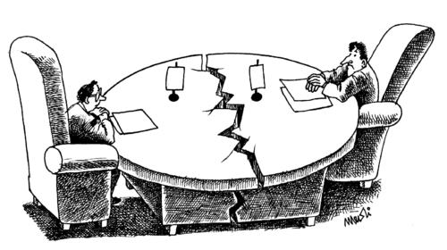
Diagnosing party behaviors – helping them see what is going on
Blame and Rationalization
Biases – some include self serving, the backfire effect, and tendency toward loss aversion
Heuristics (mental shortcuts)
Notes:
SELF SERVING -- tendency to attribute positive outcomes and successes to internal factors like our personal traits, skills, or actions but attribute negative results or failures to external factors
BACKFIRE – WHEN CHALLENGED DON’T EXAMINE VIEW BUT DEFEND EVEN MORE

Slide 7
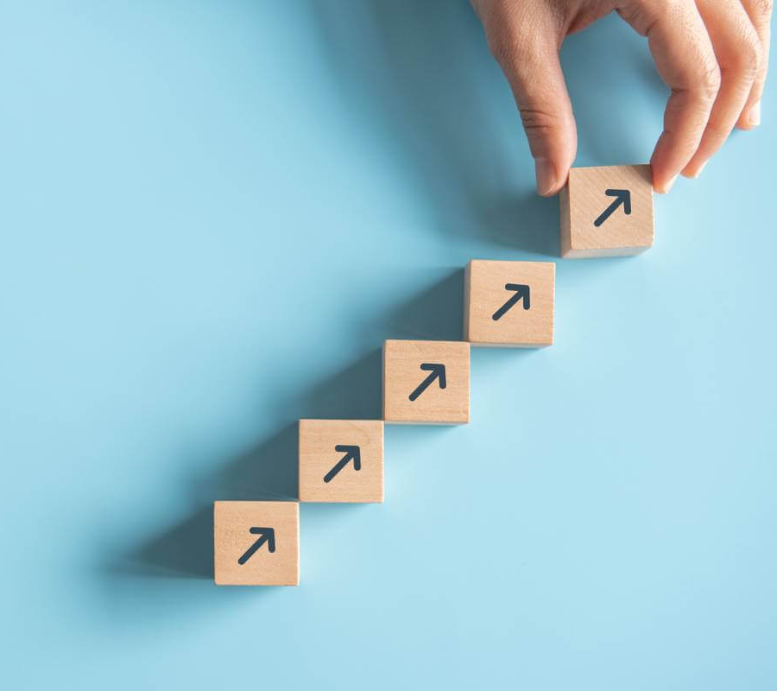
Encouraging Positive Behavior in the Parties: The Five Steps for Getting Back to the Table
Step 1: Accept where you are
Step 2: Analyze the Forest and the Trees -- What Went Wrong?
Step 3: Not Just Any Lessons – Help Them Learn the Right Ones
Step 4: Help the Parties to Actively Unlearn Their Weaknesses
Step 5: Return to the table smarter and stronger

Slide 8




Step 1: Accept where you are
Notes:
Henry Wadsworth Longfellow stated -- "There is no grief like the grief that does not speak".
How to cope with this and process, If you don’t there will be a block. Crude analogy but think of a backed up sink – nothing gets through. Like that we have to process
Kubler ross curve – added to it. Starting point. Not everyone goes through all of these. Determine which of these you go through as a way to deal with your loss

Slide 9
The Five Steps for Getting Back to the Table
Step 1: Accept where you are
Step 2: Analyze the Forest and the Trees -- What Went Wrong?
Step 3: Not Just Any Lessons – Help Them Learn the Right Ones
Step 4: Help the Parties to Actively Unlearn Their Weaknesses
Step 5: Return to the table smarter and stronger

Slide 10


Step 2: Analyze the Forest and the Trees – What Went Wrong?
The forest is the big picture – back to the seven types of failure and their magnitude
The trees are the moves and turns of a negotiation process that can shed insight on where a process broke down and why
Notes:
Back to the categories and magnitude – forest
Then minutia of critical moments that Mike Wheeler has spoken alot about and then moves and turns Debbie Kolb introduced
Pinpoint places that caused the problems and hold onto that info for when you try to get back to the table

Slide 11
The Five Steps for Getting Back to the Table
Step 1: Accept where you are
Step 2: Analyze the Forest and the Trees -- what went wrong?
Step 3: Not Just Any Lessons – Help Them Learn the Right Ones
Step 4: Help the Parties to Actively Unlearn Their Weaknesses
Step 5: Return to the table smarter and stronger

Slide 12
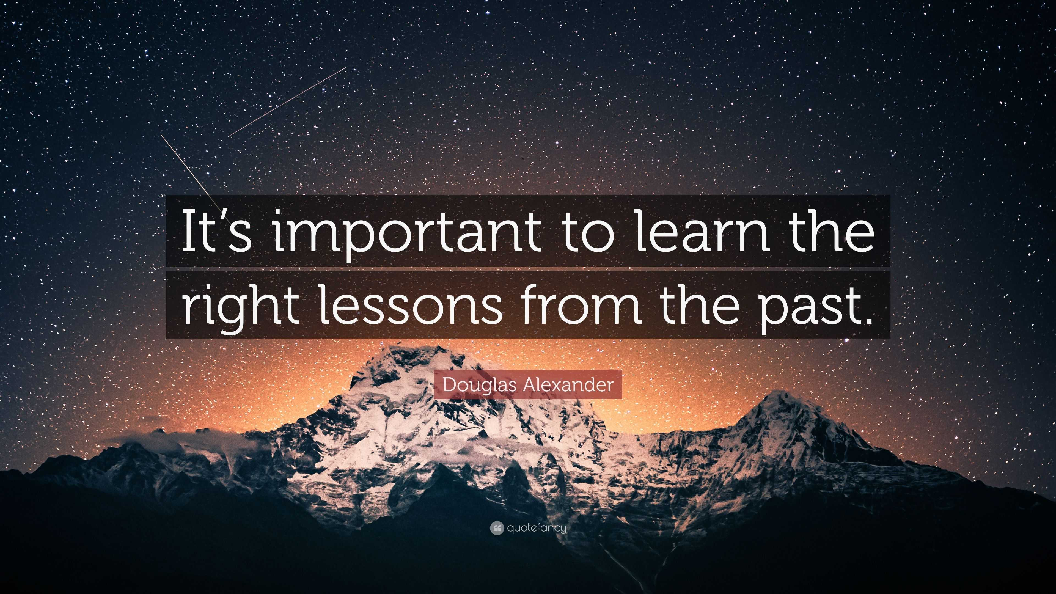
Step 3: Help the Parties Learn the Right Lessons
“Experience is not the best teacher, evaluated experience is.” John C. Maxwell
Too often most people have one core approach and apply it to every scenario
Be careful of the problem of transference rooted in the subconscious
We don’t look hard enough for the similarities and differences – one off vs. long term scenarios, dynamics, etc.
It is easy to learn the wrong lessons unless you really examine things in great detail
Notes:
My experience working with many over the years is if people have success with a core approach they try to apply it to many places – a lot times it has caused them to learn the wrong lessons and apply them incorrectly
Have to compare negotiations very carefully – apples to apples or apples to watermelons
Transfer comes in strategy, mindset, and behaviors. Behaviors are easiest to notice. Mindset and things that live in the subconscious guide our approach without our giving it much thought

Slide 13
The Five Steps for Getting Back to the Table
Step 1: Accept where you are
Step 2: Analyze the Forest and the Trees -- what went wrong?
Step 3: Not Just Any Lessons – Help Them Learn the Right Ones
Step 4: Help the Parties to Actively Unlearn Their Weaknesses
Step 5: Return to the table smarter and stronger

Slide 14
Step 4: Help the Parties to Actively Unlearn Their Weaknesses
Notes:
Management guru Peter Drucker Stated, “If you want to start doing something new you have to stop doing something old.”
Weaknesses or previously held beliefs about what effective negotiations look like can be part of thew reason we failed and can be leading us astray
Examine your core beliefs as a nego and ask if those are still applicable or perhaps a bit outdated
Actively unlearn means a conscious choice to examine and then replace
A cyclical process you need to review

Slide 15
The Five Steps for Getting Back to the Table
Step 1: Accept where you are
Step 2: Analyze the Forest and the Trees -- what went wrong?
Step 3: Not Just Any Lessons – Help Them Learn the Right Ones
Step 4: Help the Parties to Actively Unlearn Their Weaknesses
Step 5: Return to the table smarter and stronger

Slide 16
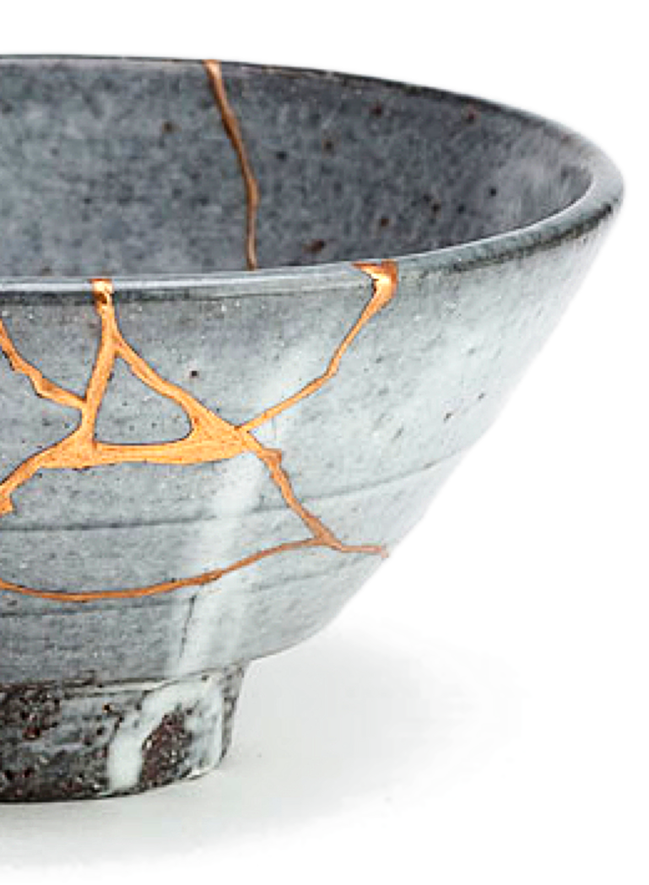
Two Ways to Return to the Table
If a setback occurs how will you get the parties back to the table?
Encourage each to knock on the door first
Have the parties start with the other
In caucus, explore what went wrong and how can they modify their approach
If the process really failed, how can you grow over the long term as a mediator from this experience?
Talk to colleagues
Think about your own unlearning seriously
Work on key realms – uncertainty, adaptability etc.…
Embrace the lesson of Kintsugi
Notes:
Getting back to the table
Setback process – onus on you
Failed – how grow
Final thought. Kintsugi – Meaning “joining with gold”, this centuries-old art is more than an aesthetic. For the Japanese, it’s part of a broader philosophy of embracing the beauty of human flaws. Important lesson in there for us as negotiators.

Slide 17
