Slide 1
Pardon you? Pardon me! Everything you ever wanted to know and more about receiving a literal get out of jail free card if you cross the line
Gus J. Solomon Inn of Court May 2024

Slide 2
pardons Commutation clemency

Slide 3
pardons
Article II, Section 2, of Clause I of the U.S. Constitution
“The President ... shall have Power to grant Reprieves and Pardons for Offenses against the United States, except in Cases of impeachment.”
Full Pardon - Unconditionally absolves the person of the conviction and all of the crime's consequences.
Partial. Only relieves the person from some of the crime's punishment or consequences.
Absolute. Granted without any conditions.
Conditional. Some condition—usually to be fulfilled by the person seeking the pardon—must occur before the pardon takes effect. For instance, a pardon could be conditioned on helping the police solve a crime or locate a suspect. Some conditional pardons become void when a specified condition occurs, such as the former offender committing another crime.

Slide 4
clemency
Amnesty - typically applies to a group of people. It comes into play typically when someone has not yet been convicted. For example, Jimmy Carter granted amnesty to all the individuals who dodged the draft.
Remission: Complete or partial cancellation of the penalty, but you are still considered guilty of said crime (i.e., reduced penalty).
Reprieve: Temporary postponement of a punishment, usually so that the accused can file an appeal
Respite: The delay of an ordered sentence, or the act of temporarily imposing a lesser sentence upon the convicted, whilst further investigation, action, or appeals can be conducted.

Slide 5
commutation
Substituting the imposed penalty for a crime with a lesser penalty

Slide 6
Federal Pardons
How do they work?

Slide 7
Where do you send the petition?
Regulations contained in 28 CFR 1.1 through 1.11 govern the pardon process
Advisory and for internal guidance of DOJ
Do not create an enforceable right in persons applying for a pardon
Only the President of the United States can pardon a federal crime
President receives but does not require a recommendation from DOJ
Applications are addressed to the President of the United States
Non-military offenses → Office of the Pardon Attorney
Military offenses → Military branch that handled the court-martial
Do not need a lawyer to apply for a pardon

Slide 8
What if your petition is denied?
No right to appeal
If denied, petitioner may submit a new petition immediately
Reasons for denying or granting a petition are generally not disclosed
Deliberative documents are exempt from disclosure under FOIA

Slide 9
Who is eligible for a Presidential pardon?
Committed a federal crime in the past
Cannot pardon impeachment
Cannot pardon state offenses
Cannot pardon future acts
Committed a crime in violation of the District of Columbia Code
Do not have to be convicted to be eligible for a pardon
President can pardon past criminal acts before, during, or after the courts are involved (Ex parte Garland, 71 U.S. 333 (1866)
Highly unusual

Slide 10
When can you petition for a Presidential pardon?
Must wait five years after your most recent conviction or release from confinement (whichever is later)
Whether or not that offense is the offense for which you seek a pardon
Must complete any period of probation, parole, supervised release before applying
Can apply for a waiver from the waiting period and pre-application conditions but waiver is rarely granted

Slide 11
How long does the process take?
Can take several years
Pardon petitions are under consideration until the President takes final action
No need to resubmit application if the person occupying the Office of President changes – applications remain under consideration even if the administration changes

Slide 12
Wilson, 32 U.S. (7 Pet.) 150 (1833)

Slide 13
What information must be disclosed?
A LOT
Any other federal convictions, arrests (federal or state), or criminal charges (federal or state)
All civil lawsuits
All delinquent credit obligations
All unpaid tax obligations (federal, state, local)
Any court-ordered restitution
And more…

Slide 14
What information can the applicant disclose?
An applicant – or any third party – can send any documentation or other written information he or she believes is relevant to the applicant’s suitability for clemency
Copies not originals
No digital media (e.g., videos, other recordings)

Slide 15
What about character?
Character counts
Petitioner must submit at least three primary character references
Cannot be from any persons related by blood or marriage
Cannot be from the attorney representing the petitioner in the pardon process
Reference must “have knowledge of” the offense for which the pardon is sought

Slide 16
What happens after the petition is submitted?
A very thorough investigation into petitioner’s post-conviction conduct, character, and reputation
Correctness of the underlying conviction is assumed

Slide 17
What is investigated?
The FBI will investigate everything in the application
Character references
Neighbors
Former and past employers
Associates
Any other individuals with relevant information
Post-conviction conduct

Slide 18
Who is involved in the investigation?
The Office of the Pardon Attorney
U.S. Attorney(s) for the district of resident, district of conviction, or district of cooperation
Relevant Main Justice division (e.g., Tax Division for tax-related charges)
FBI

Slide 19
What will the President consider?
Results of investigation
Severity of the offense
How recently the offense was committed
Petitioner’s need for relief
Official recommendations and reports
Petitioner’s acceptance of responsibility, remorse, and atonement

Slide 20
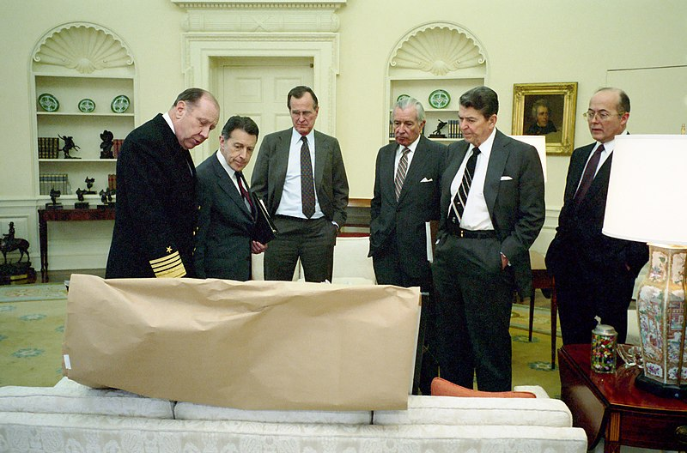
Caspar Weinberger and five others
(Left) Proclamation 6518 Dec 1994 107 STAT 2607
(Right) President Reagan meeting in the oval office with staff (left to right) Admiral Crowe, Caspar Weinberger, George Bush, Don Regan, President and Admiral Poindexter regarding the Libya air strike in the oval office. 03/24/1986.

Slide 21
What can public know about the application?
Presidential pardons are a matter of public record
Name, district in which they were convicted, year of sentencing, offense, and the date the President granted their application
Website for the Office and the Pardon Attorney (and maybe even the website for The White House)

Slide 22
What can the public know about the application
The names of people whose applications have been denied must be disclosed to anyone who submits a FOIA request for such information. Lardner v. DOJ, 638 F. Supp. 2d 14 (D.D.C. 2009), aff’d, 2010 WL 4366062 (D.C. Cir. Oct. 28, 2010)
Office of the Pardon Attorney has started to proactively disclose the names of those peoples whose application as been denied

Slide 23
Does the applicant have an opportunity to be heard or present evidence?
No
There are no hearings on applications for a federal pardon
There are no exceptions

Slide 24
So you’ve been pardoned, now what?
Does not erase or expunge the applicant’s criminal record
Must continue to disclose conviction if required (e.g., job application)
Both the conviction and the pardon appear on your record
Does not restore civil rights granted under state
Restoring the right to vote is a state process
Does not guarantee that you can hold state public office
It is currently the only way to restore the right to bear arms

Slide 25
What about federal commutations?
Similar to the process for federal pardons
Only the President has the power to commute sentences
Applications are addressed to the President of the United States
Non-military offenses → Office of the Pardon Attorney
Military offenses → Military branch that handled the court-martial
No appeal from denial of application
Reasons for granting or denying application are not disclosed
Deliberative documents are exempt from disclosure under FOIA

Slide 26
What is the effect of a commutation?
Does not imply forgiveness (unless a pardon)
Only reduces the sentence imposed (incarceration, fine, restitution, probation, supervised release, special parole)
Does not change applicant’s immigration status
Is not available for special assessments
Special assessments fund the Crime Victims Fund
No waiver available, even for the indigent

Slide 27
Who is eligible for a Presidential commutation?
Convicted of a federal crime
Currently serving the sentence sought to be commuted
Has completed all court challenges to the conviction before applying for commutation

Slide 28
What information must be disclosed?
A LOT
All arrests or charges (civilian, military, federal, state, local) whether they occurred before or after the offense for which the applicant seeks commutation
All traffic violations
All convictions – even if expunged
Like with pardon applications
An incomplete petition is grounds for denial
“Knowing and willing” falsification may be a violation of 18 USC 1011, 3571 and subject to 5 years imprisonment and $250K fine

Slide 29
What will the President consider?
Disparity/undue severity of the sentence sought to be commuted
Critical illness or old age
Meritorious service rendered to the government (e.g., cooperation)
Amount of time servied
Availability of other remedies
Request for compassionate release
Motion to reward substantial assistance
Motion for modification/remission of fine
Other equitable factors
Demonstrated rehabilitation while in custody
Exigent circumstances unforeseen at sentencing

Slide 30
What if the petitioner omits information from the petition?
Application is considered “incomplete”
Can be a reason to deny the petion
May be construed as “falsification”
Does not include failing to provide a SSN
If omission is “knowing and willful” → violation of 18 USC 1001 and 3571
Up to five years imprisonment and $250K fine

Slide 31
Does the applicant have an opportunity to be heard or present evidence?
Generally, no
Except application to commute a death sentence
Hearing may be available upon request
Must move to vacate the sentence
Must complete all direct appeals
Petition due no later than 30 days after petitioner notified of the execution date
All supporting papers due no later than 15 days after the petition filed
If the execution is stayed, the clemency proceedings are suspended

Slide 32
Can the President pardon him/herself?
In short: It’s unclear
Self-pardons not discussed during the 1787 Constitutional Conventions when giving the President the power to pardon federal crimes
They did discuss whether the President can pardon persons convicted of treason
Argument in favor of excluding treason from President’s power to pardon: The President him/herself might be involved in the plot (Edmund Randolph, VA)
Argument in favor of giving President power to pardon treason: If the President is involved in the plot, he/she can be impeached and removed from office. Once removed from office, he/she can be prosecuted for treason. (Justice James Wilson, PA)

Slide 33
Philip Weigel and John Mitchel
Oil on Canvas, Frederick Kemmelmeyer, George Washington reviewing the troops being deployed against the Whiskey Rebellion - Washington Reviewing the Western Army, at Fort Cumberland, Maryland, ca.1795.

Slide 34
Can the President pardon him/herself?
1974 DOJ Memo written by Acting A.G. Mary Lawton
Conclusion: No. “Under the fundamental rule that no one may be a judge in his own case, the President cannot pardon himself.”
BUT the 25th Amendment: President declares himself temporarily unable to perform the duties of the office under the 25th Amendment → VP becomes Acting President and pardons the “disabled” President → the “disabled” President either resigns from or resumes duties of the office
BUT Congress: Generally, Congress cannot enact amnesty or pardoning legislation because it would interfere with the pardoning power vested exclusively in the President. But the President does not have the power to pardon him/herself, so enacting amnesty or legislation pardoning the President would not interfere with the President’s pardoning power
Ponder: Who would have standing to mount a legal challenge to a presidential self-pardon?

Slide 35
STATE PARDONS & COMMUTATIONS

Slide 36
Oregon Const. Article V, Section 14. Reprieves, commutations and pardons; remission of fines and forfeitures.
He shall have power to grant reprieves, commutations, and pardons, after conviction, for all offences [sic] except treason, subject to such regulations as may be provided by law. Upon conviction for treason he shall have power to suspend the execution of the sentence until the case shall be reported to the Legislative Assembly, at its next meeting, when the Legislative Assembly shall either grant a pardon, commute the sentence, direct the execution of the sentence, or grant a farther [sic] reprieve.—
He shall have power to remit fines, and forfeitures, under such regulations as may be prescribed by law; and shall report to the Legislative Assembly at its next meeting each case of reprieve, commutation, or pardon granted, and the reasons for granting the same; and also the names of all persons in whose favor remission of fines, and forfeitures shall have been made, and the several amounts remitted[.]

Slide 37
The Oregon Constitution sates that the governor’s pardon power shall be “subject to such regulations as may be provided by law.”
However, the Oregon Supreme Court has recognized that the few statutory provisions enacted around the governor’s pardon powers address procedural issues. (Marteeny v. Brown, 321 Or App 250, 266 (2022) (quoting Article V, section 14); see also Ex parte Houghton, 49 Or 232, 234 (1907) (recognizing that there have been no regulations governing the exercise of the pardoning power, except what is now codified as ORS 144.649, which states that reprieves, commutations, and pardons may be granted by the governor upon such conditions and with such restrictions and limitations as she may think proper.)

Slide 38
ORS 144.649 Granting reprieves, commutations and pardons generally remission of penalties and forfeitures
Upon such conditions and with such restrictions and limitations as the Governor thinks proper, the Governor may grant reprieves, commutations and pardons, after convictions, for all crimes and may remit, after judgment therefore, all penalties and forfeitures. (Formerly 144.640)

Slide 39
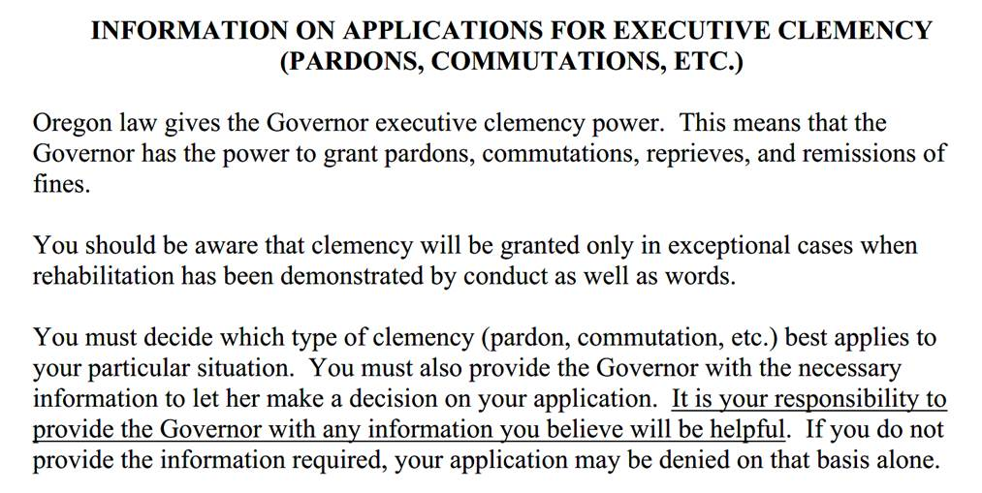
ORS 144.650 requires that a clemency application be signed by the applicant and state fully the grounds for the application.
There is no specific form for a clemency application, but the Governor’s office does provide a form that applicants can use as a guide:
See https://www.oregon.gov/gov/Documents/information%20on%20applications%20for%20executive%20clemency.pdf

Slide 40
ORS 166.650 requires that a copy of the application be served on a number of people:
The district attorney where the conviction occurred; if the applicant is incarcerated
The DA in the county in which the applicant is currently incarcerated
The State Board of Parole and Post-Prison Supervision
The ODOC Director
The applicant must include proof by affidavit of service in their application to the governor. (ORS 166.650(2)).

Slide 41
Gov. Brown effectively ends the death penalty in Oregon
In Dec. 2022 Gov. Kate Brown commuted the sentence of all 17 Oregon death-row prisoners to life without the possibility of parole, noting “this commutation is not based on any rehabilitative efforts by the individuals…it reflects the recognition that the death penalty is immoral.”
Brown was the seventh governor to issue a broad grant of clemency to all death-row prisoners in the last 50 years.
2003, Illinois Gov. George Ryan pardoned four death-row prisoners and commuted 167 death sentences.
2011, Illinois Gov. Pat Quinn commuted 15 death sentences.
2007, New Jersey Gov. Jon Corzine commuted 8 death sentences.
1986, New Mexico Gov. Toney Anaya commuted 5 death sentences.
2015, Maryland Gov. Martin O’Malley commuted 4 death sentences.
2013, Colorado Gov. Jared Polis commuted 3 death sentences.

Slide 42
The Role of Victims in Executive Clemency

Slide 43
Victims’ Rights During Significant Stages of Criminal Justice Process: In General
Source: National Crime Victim Law Institute, “Victims’ Rights During Significant Stages of Criminal Justice Process,” 2018

Slide 44
Victims’ Rights During Significant Stages of Criminal Justice Process: Post-Conviction
Source: National Crime Victim Law Institute, “Overview of Select Post-Conviction Moments: State Adult Criminal Cases,” 2017

Slide 45
Victims are Directly Affected by an Executive Decision to Grant Clemency
Cal. Gov. Arnold Schwarzeneggar pardoned teen who pleaded guilty to stabbing a victim more than a decade prior without notifying the victim or the DA.
Ore. Gov. Kate Brown pardoned Kyle Hedquist in 2022. The victim’s family was unaware that Hedquist was being released until they were contacted by KOIN 6 News.
Miss. Gov. Haley Barbour pardoned 200+ before he left office in Jan. 2012. The Miss. Supreme Court upheld validity of these pardons. In Re Hooker, 87 So.3d 401 (Miss. 2012).

Slide 46
A Brief History of Victims’ Rights
Victims’ rights have foundations in common law.
The practice of private prosecution, whereby the crime victim initiated and controlled criminal prosecutions, dates back to the Middle Ages.
The monarch could not pardon convictions obtained by “appeal of felony,” which were convictions resulting from private prosecutions initiated by the victims of crime.
The private prosecution model served as the foundation for the U.S. criminal justice system.
See, e.g., Steele Co. v. Citizens for a Better Environment, 523 US 83, 127-28 (1998) (Stevens, J., concurring) (“[I]n England, in the American Colonies, and in the United States, private persons regularly prosecuted criminal cases.”)

Slide 47
The Evolution of Victims’ Rights in the U.S.
Public prosecution system became the norm by the early 20th century, and victims’ role progressively reduced from private prosecution model.
At one point, the United States Supreme Court observed in dicta that “in American jurisprudence at least, a private citizen lacks a judicially cognizable interest in the prosecution or non-prosecution of another.” Linda R.S. v. Richard D., 410 US 614, 619 (1973).
Victims’ rights movement emerged in the 1960s & 1970s.
Release of President Reagan’s Final Report on the Task Force on Victims of Crime in 1982 generated wider national discussion of role of victims in criminal proceedings.

Slide 48
Results of the Victims’ Rights Movement
36 states (including Oregon) have amended their constitutions to afford victims’ rights in criminal proceedings.
All 50 states + District of Columbia + Federal government have enacted statutory and rule-based protections for victims.

Slide 49
Ten Most Common Victim Rights
Right to Be Treated with Fairness, Dignity and Respect
Right to Privacy
Right to Notice
Right to Confer
Right to be Present
Right to be Heard
Right to Reasonable Protection
Right to Information
Right to Timely Disposition
Right to Restitution

Slide 50
Primary Sources of Oregon Crime Victims’ Rights
Oregon Constitution
Art. I, § 42 – Sets forth the rights of victims in criminal prosecutions and juvenile court delinquency proceedings.
Art. I, § 43 – Sets forth the rights of victim and public to protection from accused person during criminal proceedings.
ORS 147.405 et seq.: Crime Victim Bill of Rights
“We, the people of the State of Oregon, declare that victims of crime are entitled to fair and impartial treatment in our criminal justice system. The purpose of chapter 2, Oregon Laws 1987, is to declare to our legislature and our courts that victims’ rights shall be protected at each stage of the criminal justice system. We reject the notion that a criminal defendant’s rights must be superior to all others. By chapter 2, Oregon Laws 1987, we seek to secure balanced justice by eliminating unbalanced rules.” ORS 147.410.

Slide 51
Participatory Rights: Right to Notice
Right to Timely Notification of Rights. Or. Const., Art. I, § 42; ORS 147.417(1).
Right to Notice of Critical Stage Proceedings. Or. Const., Art. I, § 42(1)(a); ORS 419C.273(1)(a); ORS 147.510.
Right to Notice of Court Dates. ORS 136.145.
Right to Notice of Appeal. ORS 147.433(1)(b).
Right to Notice of Post-Conviction Relief Filed Under ORS 138.510 to 138.680 or Post-Conviction DNA (deoxyribonucleic acid) Testing Under ORS 138.688 to 138.700. ORS 147.433(1)(c).
Right to Notice of Psychiatric Review Board Proceedings. ORS 161.326(1); ORS 419C.529; ORS 419C.531.
Right to Notice by Board of Parole and Post-Prison Supervision. ORS 144.750; ORS 144.260.
Right to Notice of Probation Violation/Revocation Hearings. ORS 137.545.
Right to Notice of Application to Set Aside Conviction/Arrest. ORS 137.225
Right to Notice of Pending Expungement Application. ORS 419A.262.

Slide 52
Participatory Rights: Right to be Present
Right to be Present at Critical-Stage Proceedings. Or. Const., Art. I, § 42; ORS 419C.273; see also ORS 40.385(4)(exempting crime victims from categories of witnesses subject to exclusion at trial at request of a party); ORS 137.013 (right to be present at sentencing).
Right to be Accompanied by Personal Representative. ORS 147.425.
Right to be Present at Appellate Proceedings. ORS 147.433.
Right to Have Schedule Taken into Account at Post-Conviction Proceedings. ORS 138.627.
Right to be Present at Probation Violation/Revocation Hearings. ORS 137.545.
Right to Court Appointed Interpreter. ORS 45.285(3); ORS 419C.285(4); see also ORS 45.275(1)(b).

Slide 53
Participatory Rights: Right to be Heard
Right to be Heard at Pretrial Release Hearings. Or. Const., Art. I, § 42; ORS 147.508; ORS 419C.273.
Right to be Heard at Sentencing. Or. Const., Art. I, § 42; ORS 147.512; ORS 137.013; ORS 163.150; cf. ORS 137.530(2) (victim statement may be included in presentence report). See also State v. Ball, 362 Or 807 (2018); State v. Barrett, 350 Or 390 (2011).
Right to be Heard at Hearing to Set Aside Conviction/Arrest. ORS 137.225.
Right to be Heard at Diversion Hearing. ORS 813.222.
Right to be Heard at Post-Conviction Hearing. ORS 138.627.
Right to be Heard at Psychiatric Review Board Hearings. ORS 419C.531.
Right to be Heard at Probation Violation/Revocation Hearings. ORS 137.545.
Right to be Heard at Specific Juvenile Proceedings. ORS 419C.273; ORS 419C.450(2); ORS 419C.531.
Victim’s Interest in Joint Trial of Defendants to be Strongly Considered. ORS 136.060.

Slide 54
Participatory Rights: Right to Consult
Constitutional Right to Consult Prior to Plea Offer. Or. Const., Art. I, § 42; see also State v. Acker, 175 Or App 145 (2001).
Statutory Right to Consult Prior to Plea Offer. ORS 147.512; ORS 419C.230.
Right to Consult on Settlement of Post-Conviction Petition. ORS 138.627.

Slide 55
Participatory Rights: Right to Speedy Trial
Right to “have the trial or adjudication, including the imposition and execution of the sentence or disposition, conducted with all practicable speed” and “to the prompt and final conclusion of the criminal or juvenile delinquency proceeding in any related appellate or post-judgment proceeding.” ORS 147.430(a)-(b); see also ORS 138.627(1)(a) (victims have the right to have their “schedule taken into account [by the trial court] in scheduling…post-conviction proceedings”).

Slide 56
Informational Rights
Right to Records of Court Proceedings. Or Const, Art I, § 42(1)(e); ORS 147.419; see also ORS 419A.256.
Right to Information About Offender. Or Const, Art I, § 42(1)(b); ORS 147.421; ORS 420A.122; ORS 163A.230.
Right to Information about HIV or Other Communicable Diseases. ORS 135.139; ORS 419C.475.
Duty of Hospital to Provide Victim of Sexual Assault with Information About Emergency Contraception. ORS 435.254.
Right to Information in DUII Proceedings. ORS 135.857; ORS 419C.270.
Right to Information in Post-Conviction Proceedings. ORS 138.627.
Right to Information about DNA Testing. ORS 138.692(9).

Slide 57
Privacy Rights
Constitutional Right to Refuse Discovery. Or. Const., Art. I, § 42; but see State v. Bray, 352 Or 809 (2012).
Statutory Right to Refuse Discovery. ORS 135.970; see also ORS 138.625 (similar right in post-conviction proceeding); ORS 419C.276 (similar right in juvenile delinquency proceeding).
Nondisclosure of Certain Personal Information. ORS 135.970; ORS 135.815; ORS 419C.276; see also ORS 192.820 - 192.868 (address confidentiality program for certain victims).
Prohibition on Victim Polygraphs in Certain Sex Crime Cases. ORS 163.705.
Protective Orders in Sex-Offense Proceedings. ORS 135.873; ORS 419C.270.
Limitations on Subpoena of Victim in Post-Conviction Proceedings. ORS 138.625.

Slide 58
Protection Rights
Constitutional Right to Protection. Or. Const., Art. I, § 43.
Pre-Trial Release No-Contact Orders & Conditions. ORS 135.970; ORS 135.250; ORS 135.247; ORS 419C.276.
Post-Prison / Probation Conditions. ORS 144.270; see also Martin v. Board of Parole, 327 Or App 147 (1998).
Protection Rights at Appellate and Post-Conviction Proceedings. ORS 147.433.
Protection Rights at Board of Parole and Post-Prison Supervision Proceedings. ORS 144.750.

Slide 59
Restitution Rights
Constitutional Right to Restitution. Or. Const., Art. I, § 42; but see State v. Algeo, 354 Or 236 (2013).
Statutory Right to Restitution. ORS 137.106; see also ORS 137.103; ORS 31.710.
Restitution in Deferred Adjudication and Set-Aside for Drug Charges. ORS 475.245.
ORS 475.245 provides for a “probation agreement” that omits the requirement of a guilty plea or finding of guilt, but requires waiver of certain rights, including right to appeal. In addition, the agreement “must include a requirement that the defendant pay any restitution owed to the victim as determined by the court, and any fees for court-appointed counsel ordered by the court under ORS 135.050.” ORS 475.245(1)(d).
Restitution in Juvenile Delinquency Proceedings. ORS 419C.450.
Compensatory Fines. ORS 137.101; ORS 419C.459.

Slide 60
Oregon Victim Involvement in Executive Clemency Proceedings
In Oregon, pardon power rests exclusively in the governor, except for cases of treason for which the legislature has the pardon power. Or. Const. Art. V, § 14; ORS 144.649.
ORS 144.649 recognizes the broad power of clemency and states that power is subject to the conditions and with such restrictions and limitations as the Governor thinks proper.
ORS 144.650 creates the procedure for pardon applications, including notification to district attorneys and victims, empowers the governor to gather information, and provides certain timing mechanisms.
ORS 144.660 requires the Governor to report clemency actions to the legislature.

Slide 61
ORS 144.650 - Notice of intention to apply for pardon, commutation or remission
(3) Upon receiving a copy of the application [for pardon, commutation or remission], the district attorney of the county where the conviction occurred shall:
(a) Notify the victim of the crime concerning the application and the victim’s right to provide the Governor with any information relevant to the Governor’s decision;
(b) Provide the Governor with any information relevant to the Governor’s decision that the victim wishes to have provided; and
(c) Provide the Governor with copies of the following documents:
(A) Police and other investigative reports;
(B) The charging instrument;
(C) The plea petition, if applicable;
(D) The judgment of conviction and sentence;
(E) Any victim impact statements submitted or filed; and
(F) Any documents evidencing the applying person’s payment or nonpayment of restitution or compensatory fines ordered by the court.
(4) In addition to providing the documents described in subsection (3) of this section, upon receiving a copy of the application for pardon, commutation or remission, any person or agency named in subsection (1) of this section shall provide to the Governor as soon as practicable such information and records relating to the case as the Governor may request and shall provide further information and records relating to the case that the person or agency considers relevant to the issue of pardon, commutation or remission, including but not limited to:
(a) Statements by the victim of the crime or any member of the victim’s immediate family, as defined in ORS 163.730 (Definitions for ORS 30.866 and 163.730 to 163.750);
(b) A statement by the district attorney of the county where the conviction occurred; and
(c) Photos of the victim and the autopsy report, if applicable.

Slide 62
Marteeny v. Brown, 321 Or App 250 (2022)
When an application for a pardon, commutation or remission is not made to the Governor, ORS 144.650, and the procedural requirements that it establishes, simply do not apply.
ORS144.650 is properly understood, through its text, content, and history, as creating a statutory mechanism, not to benefit district attorneys, but largely to benefit governors.
ORS 144.650 and the procedural requirements it creates applies only when an application for a pardon, commutation or remission is made to the Governor. When the Governor exercises her constitutional pardon power of her own initiative, ORS 144.650 simply does not apply.
As the Oregon Supreme Court observed in the predecessor of ORS 144.650(1) does not purport to regulate the Governor's power. It merely prescribes a procedure to be followed by the applicant for a pardon, commutation or remission.

Slide 63
Primary Sources of Federal Victims’ Rights
18 U.S.C. § 3771 – Crime Victims Rights Act (“CVRA”)
18 U.S.C. § 3663A – Mandatory Restitution to Victims of Certain Crimes
34 U.S.C. § 20141 – Victims Rights and Restitution Act
28 CFR § 45.10 - Procedures to Promote Compliance with Crime Victims’ Rights Obligations under CVRA

Slide 64
Crime Victim Rights Act (18 U.S.C. § 3771)
Passed in 2004, the CVRA is a statutory bill of rights for the victims of crimes committed in violation of federal law or the laws of the District of Columbia.
The CVRA passed after multiple failed attempts to enact a Constitutional Amendment; the last such attempt prior to passage of the CVRA was in the 108th Congress.
Rights afforded under the CVRA include:
(1) the right to be reasonably protected from the accused;
(2) the right to notification of public court and parole proceedings and of any release of the accused;
(3) the right not to be excluded from public court proceedings under most circumstances;
(4) the right to be heard in public court proceedings relating to bail, the acceptance of a plea bargain, sentencing, or parole;
(5) the right to confer with the prosecutor;
(6) the right to restitution under the law;
(7) the right to proceedings free from unwarranted delays;
(8) the right to be treated fairly and with respect to one’s dignity and privacy;
(9) the right to be informed in a timely manner of any plea bargain or deferred prosecution agreement; and
(10) the right to be informed of the statutory rights and services to which one is entitled

Slide 65
CVRA: Public Proceedings Limitation
The CVRA has several distinctive features, one of which is that the rights generally apply only with respect to public court proceedings or parole proceedings.
“The right to reasonable, accurate, and timely notice of any public court proceeding, or any parole proceeding, involving the crime or of any release or escape of the accused.” 18 USC 3771(a)(2)
“The right not to be excluded from any such public court proceeding…” 18 USC 3771(1)(3)
“The right to be reasonably heard at any public proceeding in the district court involving release, plea, sentencing, or any parole proceeding.” 18 USC 3771(a)(4).
Public proceedings limitation means rights only attach to those proceedings.
See, e.g., United States v. Ebbers, 432 F. Supp. 3d 421, 425 (S.D.N.Y. 2020) (“Congress thus gave victims the right to speak at public proceeding in court, but Congress did not create any separate right to be heard when a decision on a motion for compassionate release is made based only on written presentations of the parties.”) (citing United States v. Burkholder, 590 F.3d 1071, 1075 (9th Cir. 2010).

Slide 66
CVRA: Application to Presidential Pardons
The crime victim rights constitutional amendment proposals in the 108th Congress provided victims with a right to be heard at public pardons proceedings. As currently written, however, Section 3771 has no such provision.
“A victim of violent crime shall have the right to . . . reasonably be heard at public release, plea, sentencing, reprieves, and pardon proceedings.” S.J.Res. 1 (108th Cong.); H.J.Res. 48 (108th Cong.).
Right to notice and to be heard under CVRA attaches to public proceedings, as noted.
The presidential pardon process is generally governed by an administrative process; it is not traditionally considered a public proceeding.
The Constitution vests the pardoning power in the President. U.S. Const. Art. II, § 2, Cl. 1.
The power is exercised through an administrative process that does not involve public court proceedings. 28 C.F.R. §§ 0.35, 0.36.
Section 3771(a)(2) does, however, entitle victims to notice of the release of the prisoner pursuant to the President’s pardoning power.
“The right to reasonable, accurate, and timely notice of any public court proceeding, or any parole proceeding, involving the crime or of any release or escape of the accused.” 18 USC 3771(a)(2).

Slide 67
28 CFR 1.6 – Attorney General Notification to Victims
(a) Upon receipt of a petition for executive clemency, the Attorney General shall cause such investigation to be made of the matter as he or she may deem necessary and appropriate, using the services of, or obtaining reports from, appropriate officials and agencies of the Government, including the Federal Bureau of Investigation.
(b)
(1) When a person requests clemency (in the form of either a commutation of a sentence or a pardon after serving a sentence) for a conviction of a felony offense for which there was a victim, and the Attorney General concludes from the information developed in the clemency case that investigation of the clemency case warrants contacting the victim, the Attorney General shall cause reasonable effort to be made to notify the victim or victims of the crime for which clemency is sought:
(i) That a clemency petition has been filed;
(ii) That the victim may submit comments regarding clemency; and
(iii) Whether the clemency request ultimately is granted or denied by the President.
(2) In determining whether contacting the victim is warranted, the Attorney General shall consider the seriousness and recency of the offense, the nature and extent of the harm to the victim, the defendant's overall criminal history and history of violent behavior, and the likelihood that clemency could be recommended in the case.
(3) For the purposes of this paragraph (b), “victim” means an individual who:
(i) Has suffered direct or threatened physical, emotional, or pecuniary harm as a result of the commission of the crime for which clemency is sought (or, in the case of an individual who died or was rendered incompetent as a direct and proximate result of the commission of the crime for which clemency is sought, one of the following relatives of the victim (in order of preference): the spouse; an adult offspring; or a parent); and
(ii) Has on file with the Federal Bureau of Prisons a request to be notified pursuant to 28 CFR 551.152 of the offender's release from custody.
(4) For the purposes of this paragraph (b), “reasonable effort” is satisfied by mailing to the last-known address reported by the victim to the Federal Bureau of Prisons under 28 CFR 551.152.
(5) The provisions of this paragraph (b) apply to clemency cases filed on or after September 28, 2000.
(c) The Attorney General shall review each petition and all pertinent information developed by the investigation and shall determine whether the request for clemency is of sufficient merit to warrant favorable action by the President. The Attorney General shall report in writing his or her recommendation to the President, stating whether in his or her judgment the President should grant or deny the petition.

Slide 68
US Presidential Pardons & Commutations

Slide 70
Impact of Bankruptcy on Order for Restitution?

Slide 71
None!
Generally speaking, debtors that file for bankruptcy protection may be afforded a discharge of all debts that arose prior to their filing
U.S. Supreme Court has explicitly held that debts imposed by restitution orders are non-dischargeable
Kelly v. Robinston, 479 U.S. 36 (1986)
Statutory interpretation of 11 U.S.C. § 523(a)(7)
State Sovereignty
Congressional intent
Purpose of restitution

Slide 72
The Automatic Stay
Bankruptcy is purely a creature of federal law
Bankruptcy creates an “automatic stay” that prevents creditors from taking any action to collect on debt that arose prior to the debtor’s bankruptcy filing. See 11 U.S.C. § 362(a)
But, 11 U.S.C. § 362(b) provides exceptions to the “automatic stay”, including “the commencement or continuation of a criminal action or proceeding against the debtor”

Slide 73
Rates of Recidivism and Restitution Payments
Impact of order to pay restitution on offender
Reducing Harm of Criminal Victimization: The Role of Restitution – Article by Cares, Haynes and Ruback published in Assumption University – Sociology and Criminology Department Faculty Works (2015)
Lower rates of recidivism in those ordered to pay restitution
Heinz, Galaway, & Hudson, 1976
Outlaw & Ruback, 1999
Farrington & Welsh, 2005
Schneider, 1986

Slide 74
Marc Rich and Pincus Green
Feb 14, 2001, HEARING: COMMITTEE ON THE JUDICIARY, UNITED STATES SENATE
“pardons given to Marc Rich and Pincus Green were…outrageous…they were fugitives… indicted in the largest tax evasion case in U.S. history. The record is replete with their stonewall tactics and…an effort…to ship subpoenaed documents out of the country in steamer trunks--a plan which was thwarted by law enforcement, after a tip allowed them to stop the airplane with the documents on it before it took off.”
Sen. ORRIN G. HATCH
Denise Rich, left, Michael Jackson, Hillary Clinton and President Clinton Associated Press Photo, 2000.

Slide 75
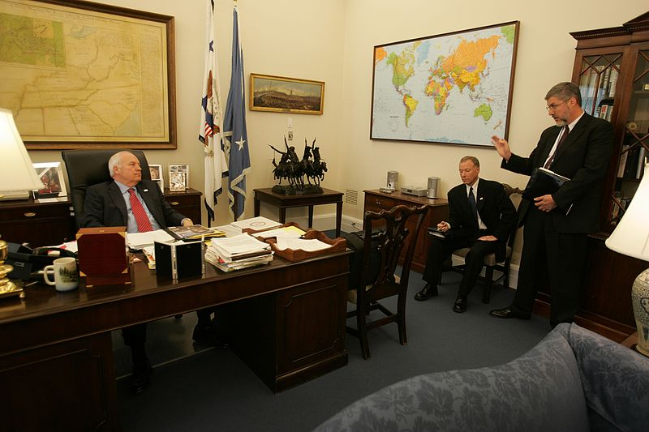
Lewis ‘Scooter’ Libby
WHEREAS Lewis Libby was convicted…a sentence of 30 months' imprisonment, 2 years' supervised release, a fine of $250,000, and a special assessment of $400 was imposed on June 22, 2007;
NOW, THEREFORE, I, GEORGE W. BUSH, President of the United States of America, pursuant to my powers under Article II, Section 2, of the Constitution, do hereby commute the prison terms imposed by the sentence upon the said Lewis Libby to expire immediately, leaving intact and in effect the two-year term of supervised release, with all its conditions, and all other components of the sentence.
Vice President Cheney Meets with David Addington and I. Lewis "Scooter" Libby in His Office, Vice Presidential Records of the Photography Office (George W. Bush Administration), 1/20/2001 - 1/20/2009

