Slide 1
Table 5 Presentation
Client Interviewing:
Groundhog Day All Over Again!
February 7, 2024

Slide 2
Scenario 1
Wood(Chuck) Woes

Slide 3
The Prospective Client
Attorney Connor Philips is meeting with Mr. Charles Wood-Graham, the owner of a regional pet store chain – Grahanimals Pet Emporiums, Inc. Chuck, as he prefers to be called, is dealing with an employment dispute at his flagship store related to two of his oldest employees, Mary Mot and Willie Whistlepig, and the new Assistant Regional Manager, George Opher.

Slide 4
The Interview
FEB
7
Chuck
Attorney Philips
“Can’t wait for some LEGAL ADVICE!”
“Ugh, another client interview?”

Slide 5
PAUSE! What do you observe?
How do we think Attorney Connor Philips is doing?
What has he done well?
What has he struggled with or missed?
What have you seen?
What would you recommend?
Okay, let’s see how this PLAYS out…

Slide 6
He takes the case!
Grahanimals Pet Emporiums, Inc.* is Attorney Philips’ client.
*Do you think Chuck Wood-Graham is the client, too?

Slide 7
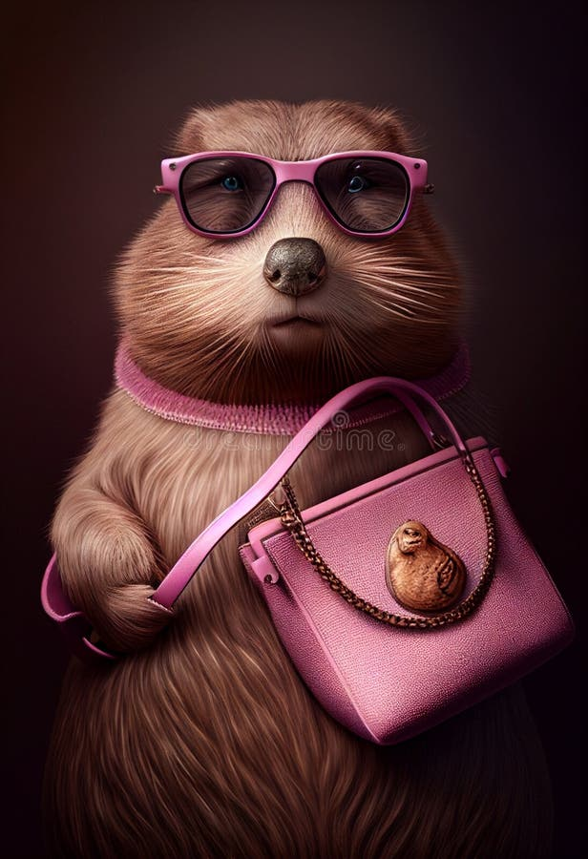
Fast Forward: Chuck’s Deposition
A few months later…
Attorney Sophie Siffleux
Chuck
(Mary Mot’s Attorney)
(Attorney Philips’ Client*)

Slide 8
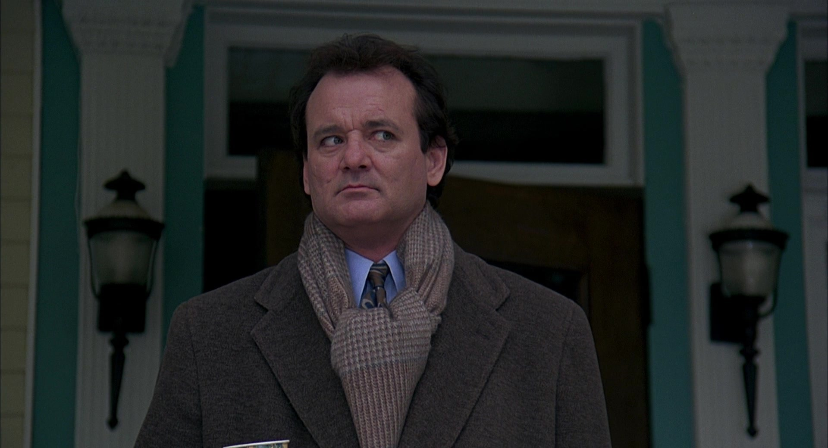

Slide 9
Fast Forward: Chuck’s Deposition
A few months later…
Attorney Sophie Siffleux
Chuck
(Mary Mot’s Attorney)
(Attorney Philips’ Client*)

Slide 11
Fast Forward: Chuck’s Deposition
A few months later…
Attorney Sophie Siffleux
Chuck
(Mary Mot’s Attorney)
(Attorney Philips’ Client*)

Slide 13
Fast Forward: Sophie’s Cross of Chuck
Several months later…
Chuck
Attorney Sophie Siffleux
(Attorney Philips’ Client*)
(Mary Mot’s Attorney)

Slide 14
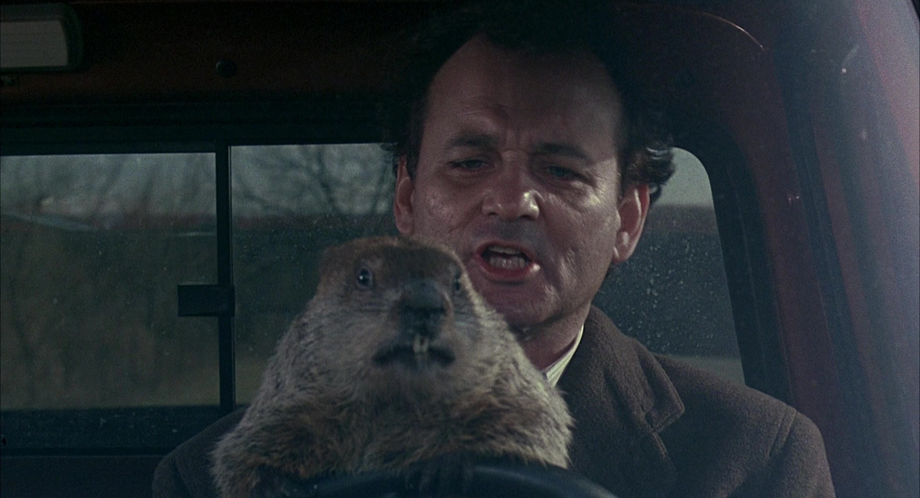

Slide 15
Fast Forward: Sophie’s Cross of Chuck
Several months later…
Chuck
Attorney Sophie Siffleux
(Attorney Philips’ Client*)
(Mary Mot’s Attorney)

Slide 16
THE EXHIBIT

Slide 17
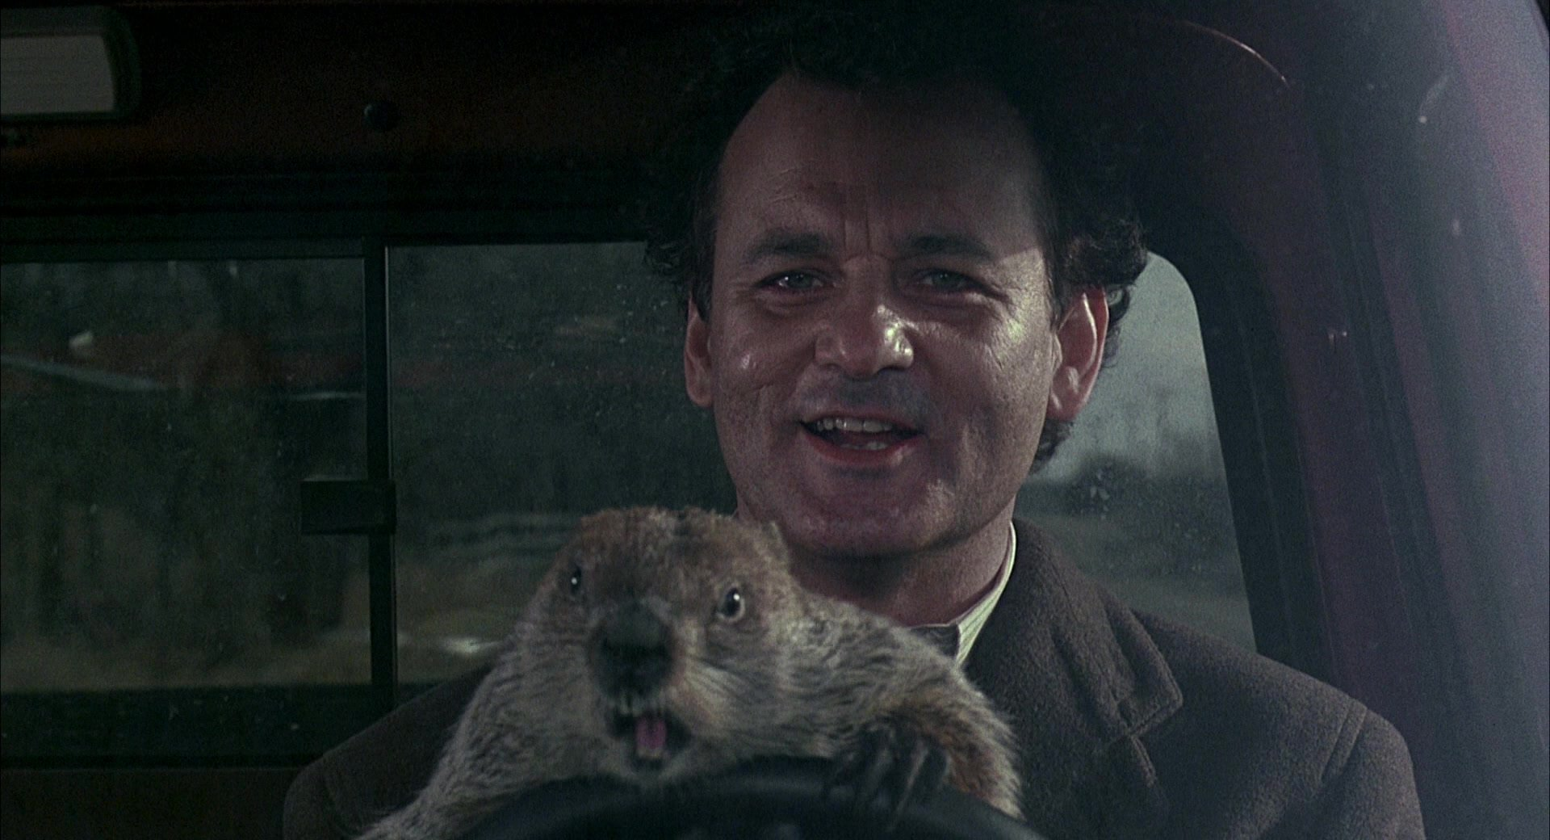

Slide 18
Uh oh, Let’s start this over!

Slide 19
Let’s Go Back to the Interview!
Now that we know Attorney Philips missed some key details in the interview, how can he do better this time?!
What facts did Attorney Philips miss?
What questions did Attorney Philips not ask?
What other tips or recommendations do you have for Attorney Philips?

Slide 20
IT IS INTERVIEW DAY ALL OVER AGAIN…

Slide 21
The Interview (again)
Attorney Philips
FEB
7
Chuck
“STILL can’t wait for some LEGAL ADVICE!”
“Okay, thanks to the Daniel Webster Batchelder Inn of Court, I can do this!”

Slide 22
Let’s Review Some Takeaways!
Ask Questions!
Keep in mind ethics!
Active Listening!
“[A]ctive listening goes well beyond mechanical hearing…As the label suggests, the listener is an active participant in the conversation … probing, encouraging, and supporting the speaker. In this way, the listener and speaker are actually creating a shared meaning together.”
“If a speaker's narrative fails to provide key information, then the listener may ask open-ended questions intended to redirect the conversation while still showing a commitment and engagement with the conversation.”
From determining who is your client in the corporation context (Rule 4.2) to briefly explaining confidentiality (Rule 1.6) and conflicts (e.g., Rule 1.9) to a prospective client, and further understanding other related obligations to said prospective client (Rule 1.18), your ethical responsibilities cannot be overlooked at this stage!
Quotes from Lindsey P. Gustafson et. al., Teaching and Assessing Active Listening As A Foundational Skill for Lawyers As Leaders, Counselors, Negotiators, and Advocates, 62 Santa Clara L. Rev. 1, 12–13 (2022) (included in your materials).

Slide 23
Scenario 2
THREE’S A CROWD!
(IT’S THE GROUNDHOG’S FAULT)

Slide 24
The Case
Ralph Lancaster IV was recently in a car accident with Doris Ground in Smalltown, New Hampshire. Doris had a serious injury in the accident. She was hospitalized for two weeks, and claims that she has permanent debilitating injuries, including traumatic epilepsy, significant ongoing neck and back pain that impacts her mobility, and post-concussive syndrome. She claims she can no longer work and has incurred at least $125,000 in medical expenses to-date. Doris has sued Ralph, and Ralph contacted his insurance company. His insurance company hired Rita Hanson to represent him in the lawsuit. Rita asked him to come to her office so they could talk about the case.

Slide 25
The Interview
Attorney HANSON
FEB
7
RALPH
Nancy
“Uh oh, a helicopter mom…”
“It was the groundhog’s fault!”

Slide 26
Fast Forward: Ralph’s Deposition
A few months later…
Attorney Nelly Ryerson
Ralph
(Doris Ground’s Lawyer)
(Attorney Hanson’s Client*)

Slide 27
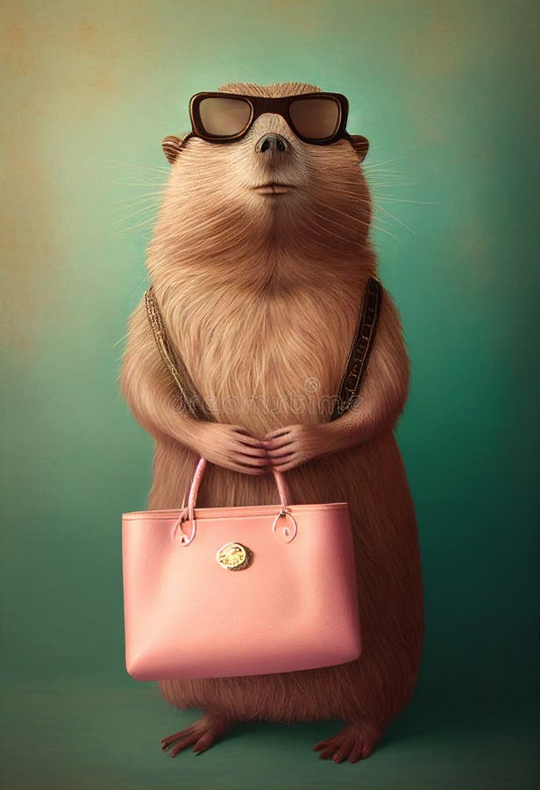
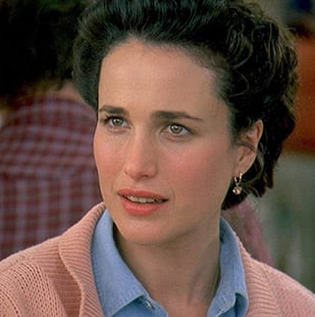
Fast Forward: The Aftermath of the Deposition
Shortly after...
Attorney Hanson
Nancy
(Ralph’s Mom/Co-Defendant)

Slide 29
Uh oh, Let’s start this over!

Slide 30
PAUSE! What do you observe?
How do we think Attorney Rita Hanson is doing?
What has she done well?
What has she struggled with or missed?
What have you seen?
What would you recommend?
Okay, let’s see how this PLAYS out…

Slide 31
IT IS INTERVIEW DAY ALL OVER AGAIN…

Slide 32
The Interview (AGAIN!)
Attorney Hanson
FEB
7
RALPH
“I’ve got this under control!”
“Dude, where’s my mom?!”

Slide 33
THE TRIPARTITE RELATIONSHIP
Attorney
Owes duties to...insured? Insurer? Both?!
Insurer
insured
Focused on the bottomline and a low cost defense
Looking for the best defense possible

Slide 34
Words Of Wisdom
“The duty to defend in a liability policy at times makes for an uneasy alliance. The insured wants the best defense possible. The insurance company, always looking at the bottom line, wants to provide a defense at the lowest possible cost. The lawyer the insurer retains to defend the insured is caught in the middle. There is a lot of wisdom in the old proverb: He who pays the piper calls the tune. The lawyer wants to provide a competent defense, yet knows who pays the bills and who is most likely to send new business. This so-called tripartite relationship has been well documented as a source of unending ethical, legal, and economic tension.” State Farm Mut. Auto. Ins. Co. v. Traver, 980 S.W.2d 625, 633 (Tex. 1998) (Gonzalez, J., joined by Abbott, J., concurring).
.

Slide 35
THANKS!
We hope you enjoyed this fun, entertaining (hopefully!) presentation heavily influenced by the film Groundhog Day (1993), the holiday celebrated on February 2, and the cute but fiesty rodent known by some (according to Wikipedia) as huck, wood-shock, groundpig, whistlepig, whistler, thickwood badger, Canada marmot, monax, moonack, weenusk, red monk, land beaver, and, among French Canadians in eastern Canada, siffleux.
Additional graphics from online sources. This template is being used for educational purposes only. All images (and video clips) belong to their own creators, and are used here for educational purposes. Please don’t get mad at us!

