Slide 1
Civility in the Legal Profession
Markey Inn of Court Group 5

Slide 2
Outline of Discussion
Introduction and Case Exemplars: Ahmad Takouche
Communicating Civilly: Joe Re
Judge Q&A: Anne Brody, Judge Guilford, and Judge Holcomb
Our Inn and its Role in a More Civil Practice: Mariam Ghapantsyan and Kevin Schraven

Slide 3
Why Do We Need to Talk About Civility?
Ethical Rules
State Bar Oath
C.D. Cal Civility Guidelines
OCBA Civility Guidelines
Incivility Can Lead to Sanctions, State Bar Discipline, and Embarrassment
New Required MCLE!

Slide 4
Civility Oath
California Rule of Court 9.7, adopted in 2014
“In addition to the language required by Business and Professions Code section 6067, the oath to be taken by every person on admission to practice law is to conclude with the following: ‘As an officer of the court, I will strive to conduct myself at all times with dignity, courtesy, and integrity.’”
Public Comment period to amend Rule of Court 9.7 to Require Annual Certification of Civility Oath for All Attorneys

Slide 5
Cal. Rules of Prof. Conduct
Right now, no Rule specific to Civility
But see the spirit of the Rules, e.g.:
Rule 3.2 Delay of Litigation;
Rule 3.3 Candor Toward the Tribunal;
Rule 3.4 Fairness to Opposing Party and Counsel;
Rule 3.10 Threatening Criminal, Administrative, or Disciplinary Charges;
Rule 8.3 Reporting Professional Misconduct;
Rule 8.4 Misconduct.
State Bar Considering New Rule Directed to Civility
2021 Civility Report Recommending to Amend California’s Rules of Professional Conduct 1.2 and 8.4 and adopt proposed new rule 8.4.2, to make incivility (as defined) a disciplinary offense. Proposed rule 8.4.2 defines incivility as “significantly unprofessional conduct that is abusive or harassing and shall be determined on the basis of all the facts and circumstances surrounding the conduct.”

Slide 6
Rule 8.3: Reporting Professional Misconduct
A lawyer shall, without undue delay, inform the State Bar, or a tribunal . . . when the lawyer knows of credible evidence that another lawyer has . . . engaged in conduct involving dishonesty, fraud, deceit, or reckless or intentional misrepresentation . . . that raises a substantial question as to that lawyer's honesty, trustworthiness, or fitness as a lawyer in other respects.

Slide 7
C.D. Cal. and OCBA Civility Guidelines and their Commonalities
https://www.cacd.uscourts.gov/attorneys/admissions/civility-and-professionalism-guidelines; https://www.ocbar.org/Portals/0/pdf/docs/civility_guidelines.pdf
Be Professional
Be courteous with deadlines, don’t play discovery games, be conscious of your communications
Avoid Burdening Parties, Counsel, and Court
Be Smart and Targeted With Discovery
Avoid Hiding the Ball in Depositions; State Targeted, Meritorious Objections
Conversely, Don’t Ask Unnecessary, Harassing Questions
Avoid Filing Motions for the Sake of Filing Motions
Utilize the meet and Confer Process
Remind Clients and Witnesses Of Their Duties
Be honest and respectful towards counsel and Court

Slide 8
Sanctions
Anger Spills Over in Coffee Incident
“At 10:27 a.m., there was an exchange of colloquy on the record (Page 40-41), following which I witnessed Attorney Calafiore Healy stand up and then start to exit the conference room. She then threw a large cup of iced coffee across the room. It landed on a chair beside Attorney Wallerstein. I saw that the coffee was all over the chair, the rug, dripping down Mr. Wallerstein's suitcase, across the width of the suitcase, on his phone, computer, and on the table. I saw that the side of his shirt and his pants were also wet.” Loop AI Labs Inc. v. Gatti, No. 15-cv-00798-HSG (DMR), 2017 U.S. Dist. LEXIS 62021, at *5-6 (N.D. Cal. Apr. 24, 2017).
Attorney sanctioned $250 for outburst, capped with existing discovery abuses and failure to acknowledge or accept responsibility for actions.
Further referred to District Judge to analyze whether further sanctions warranted.
Nasty Emails Lead to State Bar Reproval
Alan Baker et al v. Allstate Insurance Company et al., 2:19-cv-08024-ODW-JC (C.D. Cal.).

Slide 11
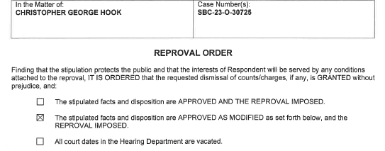
In 2023, State Bar Accepts Reproval Stipulation Following Referral

Slide 12
Communicating Civilly in Litigation

Slide 13
Communicating Civilly in Litigation
Problem: Most of the Communication is Done by Email
Less chance to speak in person or by phone to work out a solution.
All nonverbal communication lost when not in person.
Tone and nuances lost when not on the phone.
More likely to say things you would not say in person or in a letter.
Less likely to ever develop any relationship with opposing counsel.

Slide 14
Solutions to The Communication Problem
Use email with a purpose in mind.
Assume it will be an exhibit in your case.
Start and end the email in a friendly tone.
Be accurate, especially when confirming a prior conversation.
Give the recipient a chance to clarify, confirm, or disagree.
Be reasonable and explain when setting a responsive deadline.

Slide 15
Solutions to The Communication Problem
Type and delete to get out any frustration.
Take a night to think about the draft response.
Always avoid ad hominem attacks
Avoid “I and you” but use client names.
Stick to the subject at hand.
Avoid attributing an intent to opposing counsel’s actions.

Slide 16
Civility In and Out of Courtroom

Slide 17
In a Courtroom
What were the most outrageous, uncivil behaviors among attorneys who appeared before you?
Courtroom
Deposition
Email correspondence
Meet and confer
The problems of pro se?

Slide 18
Alternative Dispute Resolution
Are the parties less civil in mediation or arbitration compared to before a court?
Special ADR issues with clients?

Slide 19
Safeguards
Other than sanctions, what steps have you taken to ensure that the parties are civil to one another?
Escalating warnings leading up to a statement to the jury
Consideration of civility in determining reasonable fees
Attorney fee award in exceptional cases under Section 285 and Octane Fitness
Should a judge reference an attorney’s aggressive advertising?

Slide 20
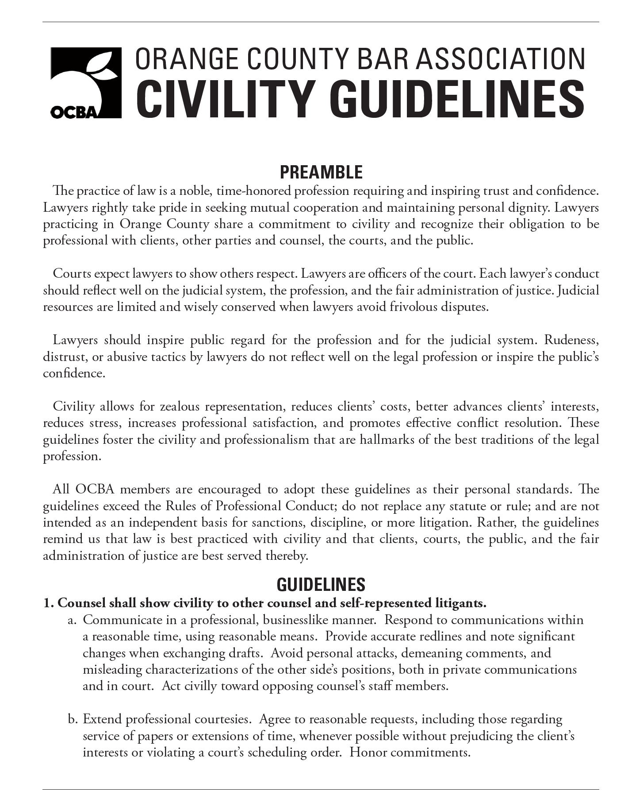
Best Practices
Does every jurisdiction have its own civility guidelines?
Why are local views of reasonableness important?

Slide 21
Inns and Civility

Slide 22
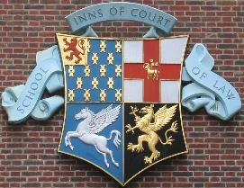
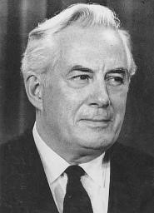
The Origins
American Inns of Court are based on English Inns
Four English Inns
Must be a member to become a barrister, part of training
American Inns began with intention to provide practical guidance to law students
First Inn founded in 1980
In 1985 American Inns of Court Foundation organized to support the Inns + promote the goals of legal excellence, civility, professionalism and ethics on a national level
Today, nearly 400 Inns with 30,000 active members

Slide 23
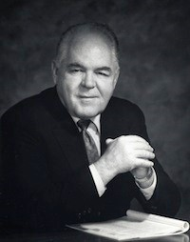
The Howard T. Markey IP Inn of Court
Judge Howard T. Markey
Chief Justice of Federal Circuit Court of Appeals
Part of Ad Hoc Committee that developed the American Inns concept
“I harbor a fervent, fevered hope, and an unquenchable belief, that when the American Inns of Court have reached their full potential, there will be accepted though-out our society another unchallenged accolade. I believe that day will come when our total society will accept as a given and use daily as a measure, the phrase, ‘ethical as a lawyer’”.

Slide 24
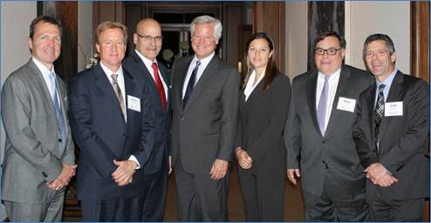
Our Inn founded in 2013
Founding officers: Ronald Oines, Steven Hanle, Joseph Re, Hon. Andrew J. Guilford, Christy Von der Ahe Rayburn, Mark Wine, and John Sganga
Dedicated to upholding the standards of the legal profession, practicing law with dignity and respect, and encouraging respect for our system of justice through strong mentoring

