Slide 1
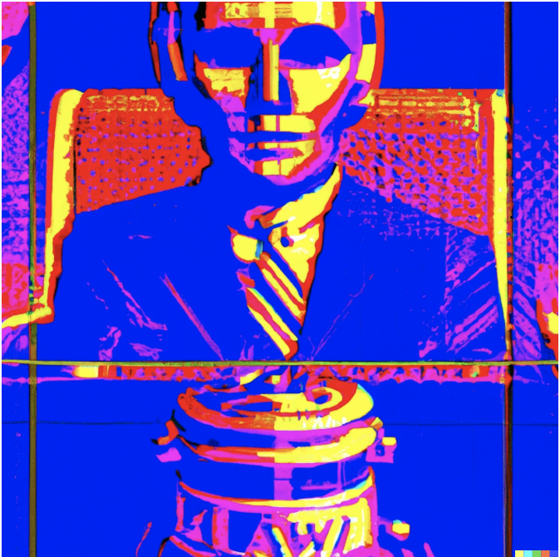
Bias and Ethics in AI-Enabled Legal Technology
Examining the Role and Impact of Human Inputs on AI-Rendered Results in Legal Matters
11/14/2023 – 6:40 to 7:40 PM
Presenters:Alex Kerr, Michael Brandt, Johannes Hsu, and Andrea Levenson

Slide 2
Why Discuss AI?
Lawyers have a duty of competence (Rule 1.1) that extends to being knowledgeable of the benefits and risks associated with using AI in practice.
Comment [1] “The duties set forth in this rule include the duty to keep abreast of the changes in the law and its practice, including the benefits and risks associated with relevant technology.”
Notes:
As comment 1 of rule 1.1 states, part of a lawyers duty of competence includes keeping up with the benefits and risks of associated technology. Whether this be fax, email, cloud based servers, or whatever relevant technology, you should learn its benefits and risks prior to using it. While AI may be a new tool and lawyers may not be aware of the risks associated, once you learn the risks you’ll recognize that the risks aren’t exactly new. As we’ll discuss, the CA Rules of Professional Conduct as they exist today regarding competence, diligence, confidentiality, and candor provide guidance regarding how to use AI without mentioning AI explicitly.

Slide 3
Survey
Have you ever used generative AI in your personal lives?
Have you or your law firm implemented AI tools in its practice?
How reliable do you consider generative AI technologies?
Would you characterize the likely impact of AI on the legal profession as bad, neutral, or good?
Notes:
https://www.law.com/legaltechnews/2023/05/12/legal-professionals-trust-generative-ai-but-maybe-too-much/
A survey of 800 legal professionals by data analytics firm Outsell found a large majority of respondents consider AI to be “generally reliable” or “extremely reliable.”
From a subset of 200 legal professionals, nearly 44% said they found generative AI technology to be “generally reliable,” followed by 30% who said they found it “extremely reliable.” About 15% were neutral on the subject and a little over 5% found it unreliable.
For Logue, the 30% who said it was “extremely reliable” is a slightly concerning number, since the technology is known to have its inaccuracies and pitfalls, and some experts have advised against using it for legal tasks at this stage.
“Something that may have been underestimated that the survey shows is that the problem isn’t about attorneys being risk-averse, it’s perhaps a little bit about having too much sort of blind faith in the emerging technology.”
About 81% of respondents from another subgroup of 200, said they had level 7 to 10 range of confidence in GPT technology for legal work on a scale of 1 being the least and 10 being the most. About 19% stated their confidence was 6 or below.
The next subset, 69.5% of respondents said they believe generative AI will have a positive impact on the legal profession, while 25% predicted a neutral impact, and 5% who said there will be a negative impact.

Slide 4
Ruben Duran, chair for the CA Board of Trustees, formally asked the Committee on Professional Responsibility and Conduct (COPRAC) to draft guidance for lawyers or potentially an advisory opinion by November regarding artificial intelligence.
Ruben described the ethical implications of AI as “including disclosure of confidential information [rule 1.6], inaccurate advice [1.1 and 1.2], AI hallucinations … not to mention who and how it could be held accountable for client and public harm.”
Notes:
https://www.law.com/therecorder/2023/05/22/california-state-bar-to-craft-guidance-on-ai-in-the-legal-profession/

Slide 5
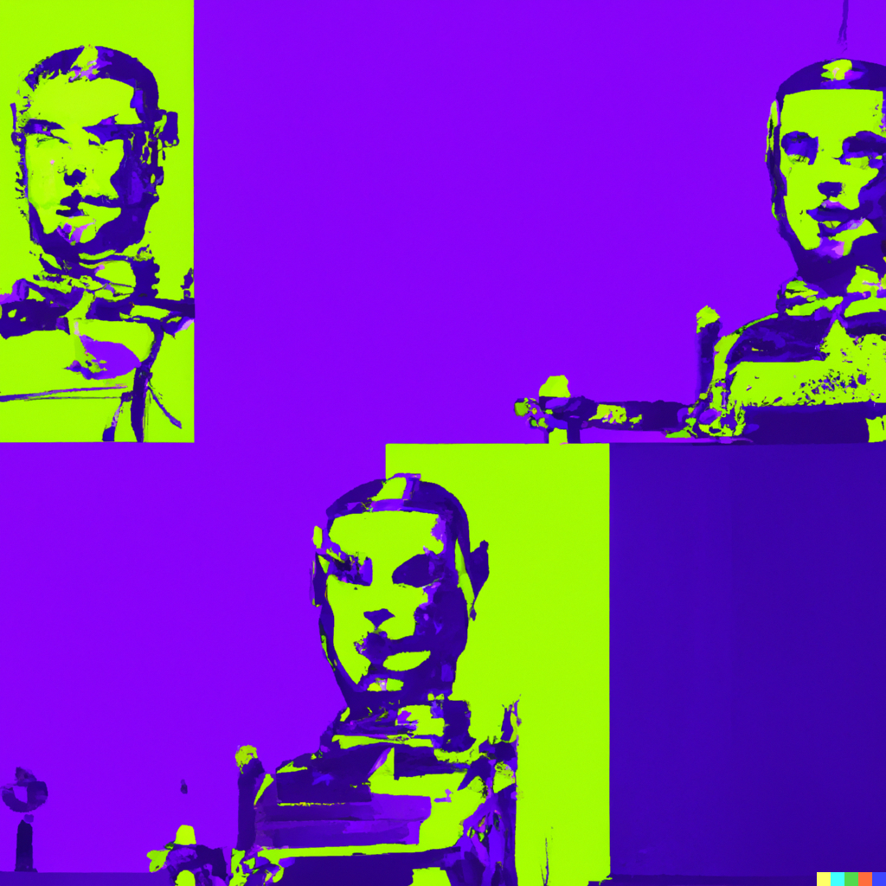
the ABA adopted resolutions 604 and 609 this year
Resolution 609 urges all lawyers to keep informed about new and emerging technologies and protect digital products, systems, and data (including Artificial Intelligence and Machine Learning) from unauthorized access, use, and modification
Resolution 604 states that AI developers should: ensure their products are subject to human authority, oversight, and control; include accountability measures if developers have not taken reasonable steps to mitigate harm or injury; and provide transparency and traceability for their products. The resolution also encourages federal and state lawmakers and regulators to follow the same standards when making AI policy.
Notes:
https://www.americanbar.org/groups/cybersecurity/aba-policy-initiatives/
In addition to the State bar taking initiative, the ABA Cybersecurity Legal Task Force has adopted resolutions 604 and 609
The overall focus on the resolution is to encourage lawyers enhancing cyber security

Slide 6
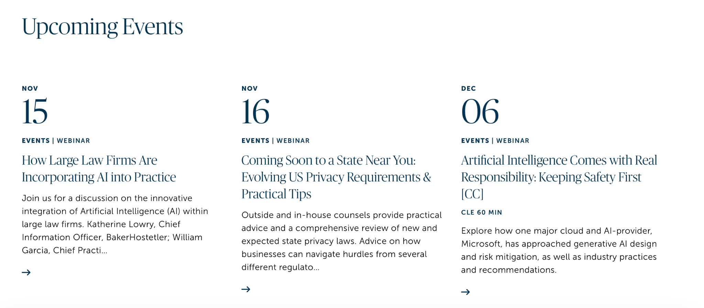
ABA’s Task Force on Law and Artificial Intelligence
Notes:
In late August of this year, the ABA also formed a the Task Force on Law and AI to study impact of artificial intelligence on the legal profession.
AI Task force will focus on:
Risks (bias, cybersecurity, privacy, and uses of AI such as spreading disinformation and undermining intellectual property protections) and how to mitigate them
Emergent issues with generative AI
Utilization of AI to increase access to justice
AI governance (the role of laws and regulations, industry standards, and best practices)
AI in legal education
The AI Task Force will identify important work and reports by government agencies, universities, think-tanks, and industry leaders and inform lawyers about how AI can affect a lawyer’s ethical responsibilities, pose threats to confidential client data, and risk inadvertent waiver of attorney-client and attorney work product privileges. It also will look at how AI can increase access to justice and develop resources to make this technology understandable to lawyers and judges.
You can look out for webinars on the topic on the ABA website
https://www.americanbar.org/groups/leadership/office_of_the_president/artificial-intelligence/

Slide 7
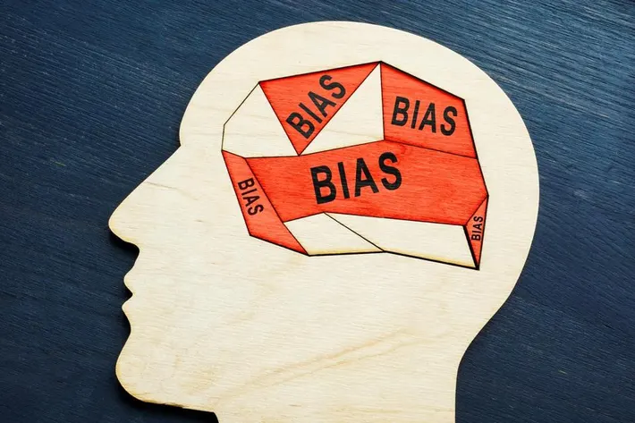
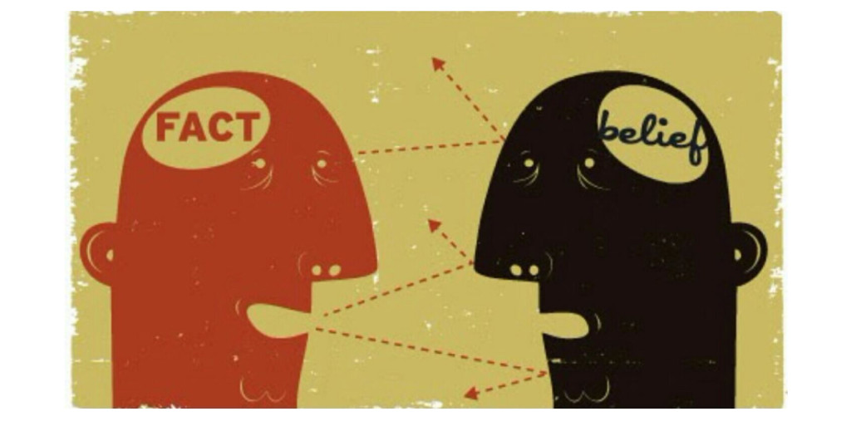
Types of Biases in AI
Bias: prejudice in favor of or against one thing, person, or group compared with another, usually in a way considered to be unfair
AI systems have the potential to inherit human biases
AI bias: an anomaly in the output of machine learning algorithms due to: 1) prejudiced assumptions made during the algorithm development process OR 2) prejudices in the training data
Types:
Cognitive bias: unconscious errors in thinking that affect individuals’ judgments and decisions; could seep into AI through: designers’ unknowing introduction OR use of training data that includes bias(es) (error of inclusion)
Lack of complete data: data may not be fully representative, introducing bias (error of omission)
Notes:
Prejudice: preconceived opinion that is not based on reason or actual experience

Slide 8
Examples of AI Bias
Mortgage applications: Algorithms have been found to be 40-80% more likely to deny borrowers of color because historical lending data disproportionately show minorities being denied loans and other financial opportunities
Amazon’s recruitment algorithm: Trained on ten years of employment history data, but data reflected a male-dominated workforce, so algorithm learned to be biased against applications and penalized resumes from women or any resumes using the word “women(’s)”
X (Twitter) image cropping: 2020 version of algorithm favored white faces over black ones when cropping pictures; a white user repeatedly shared pictures featuring his face and that of a black colleague and other black faces in the same image, and images were consistently cropped by Twitter’s algorithm to show his white face in image previews
Wash. Post article: images generated by AI-based tools shown to amplify bias in gender and race

Slide 9
“We Need to Get Ahead of This”
Several state bars have started crafting guidance for use on AI in the legal profession: California, New York, and Texas, for example
California: Committee on Professional Responsibility and Conduct (COPRAC)
Draft guidance came out this week:
RPC are robust enough to address generative AI issues
But AI is rapidly evolving, so new regulation may be needed
Practical Guidance for the Use of Generative AI in the Practice of Law (refresher)
Some courts are taking matters into their own hands:
EDTX: not prohibited for pro se litigants, but filer ultimately responsible for accuracy/quality
NDTX: at least one judge prohibits filings drafted by AI
Notes:
https://www.americanbar.org/groups/professional_responsibility/publications/professional_lawyer/27/1/ethical-obligations-protect-client-data-when-building-artificial-intelligence-tools-wigmore-meets-ai/

Slide 10
Removing Bias from AI Systems?
Limitations of AI systems
1) created by (imperfect and biased) humans
2) quality of input data
3) asking for stereotypes? (a widely held but fixed and oversimplified image or idea of a particular type of person or thing)
NYT Article: Using AI to Find Bias in AI
FTC has warned against sale of AI systems that are racially biased
EU working on world’s first comprehensive AI law (classification system in which amount of regulation is commensurate with amount of risk to consumers)
Responsible AI: designing, developing, and deploying AI with good intention to power employees and businesses and fairly impact customers and society
Pillars: empathy, fairness, transparency, and accountability

Slide 11
Expect Developments in AI Regulation
October 30, 2023 Executive Order
Advancing Equity and Civil Rights
“Irresponsible uses of AI can lead to and deepen discrimination, bias, & other abuses”
Address algorithmic discrimination
Ensure fairness throughout the criminal justice system
Supporting Workers
“. . . dangers of increased workplace surveillance, bias, and job displacement . . .”
Develop principles and best practices to mitigate the harms and maximize the benefits of AI for workers by addressing job displacement; labor standards; workplace equity, health, and safety; and data collection
Ensuring Responsible and Effective Government Use of AI
Issue guidance for agencies’ use of AI
Help agencies acquire AI products and services more effectively

Slide 12
What About the USPTO?
120 days: craft guidance for examiners and applicants about who should be considered an inventor when an invention is developed using AI
General consensus: AI cannot be listed as the sole inventor because it is not human
But what about co-inventorship?
270 days: produce guidance on other issues dealing with the intersection of AI and IP, including “updated guidance on patent eligibility to address innovation in AI and critical and emerging technologies”
Seems less promising
Other possibilities
Disclosure requirement if AI was used to create the invention (37 C.F.R. § 1.56 tie-in)
Role of AI in evaluating obviousness (Winslow Tableau)
USPTO Director Kathi Vidal: AI has “enormous potential” for supporting inclusive innovation and solving the world’s problems, “but we must move thoughtfully and carefully to mitigate risk and to ensure AI adoption is responsible”
2020 blog post (predating the current focus on AI): 80,000 utility patent applications that year involved AI (18% of all utility patent applications and a more than 150% increase from 2002)
Think what that number might be today

Slide 13
1.1 and 1.2 Competence and Diligence Issues?
https://www.law360.com/articles/1567985/evaluating-the-legal-ethics-of-a-chatgpt-authored-motion
Generative AI outputs can have false information and have even made up cases
https://arstechnica.com/tech-policy/2023/06/lawyers-have-real-bad-day-in-court-after-citing-fake-cases-made-up-by-chatgpt/#:~:text=Lawyers%20fined%20%245K%20and,chatbot%20%22gibberish%22%20in%20filings.&text=A%20federal%20judge%20tossed%20a,intelligence%20tool%20made%20by%20OpenAI.
https://www.reuters.com/legal/transactional/lawyer-who-cited-cases-concocted-by-ai-asks-judge-spare-sanctions-2023-06-08/
“A New York lawyer on Thursday asked a Manhattan federal judge not to sanction him after he included made-up case citations generated by an artificial intelligence chatbot in a legal brief.
The lawyer, Steven Schwartz, admitted in May that he had used OpenAI's ChatGPT program to help research the brief, which cited six non-existent court decisions, in a client's personal injury case against Avianca Airlines.”

Slide 14
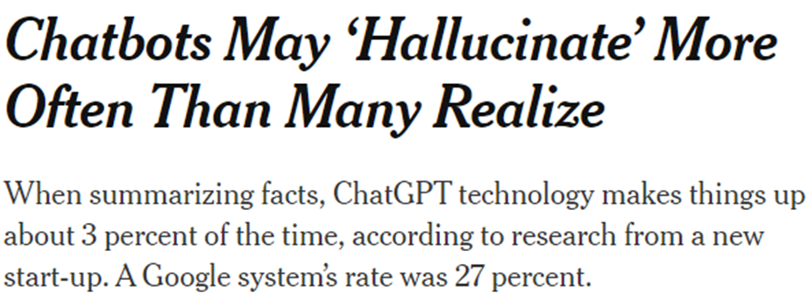
https://www.nytimes.com/2023/11/06/technology/chatbots-hallucination-rates.html

Slide 15
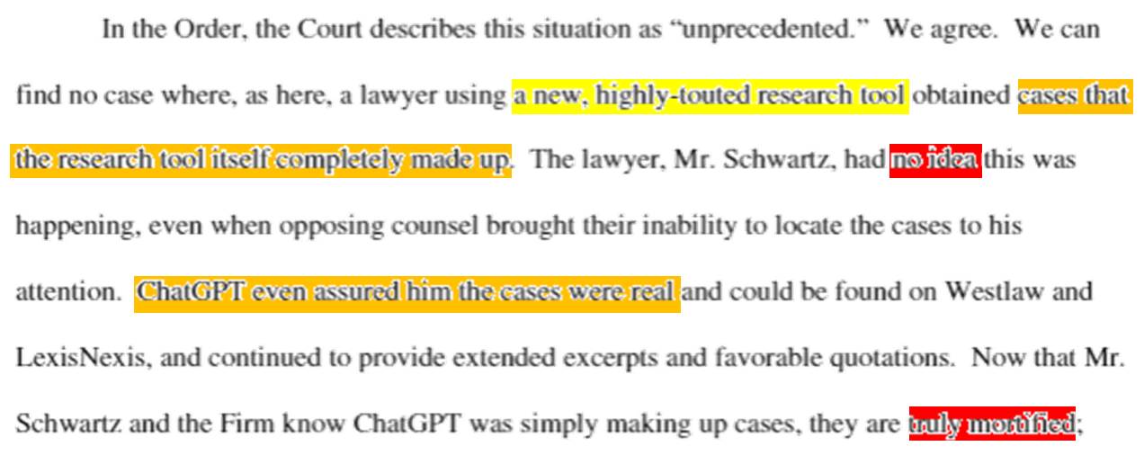
The infamous Mata v. Avianca, Inc.

Slide 16
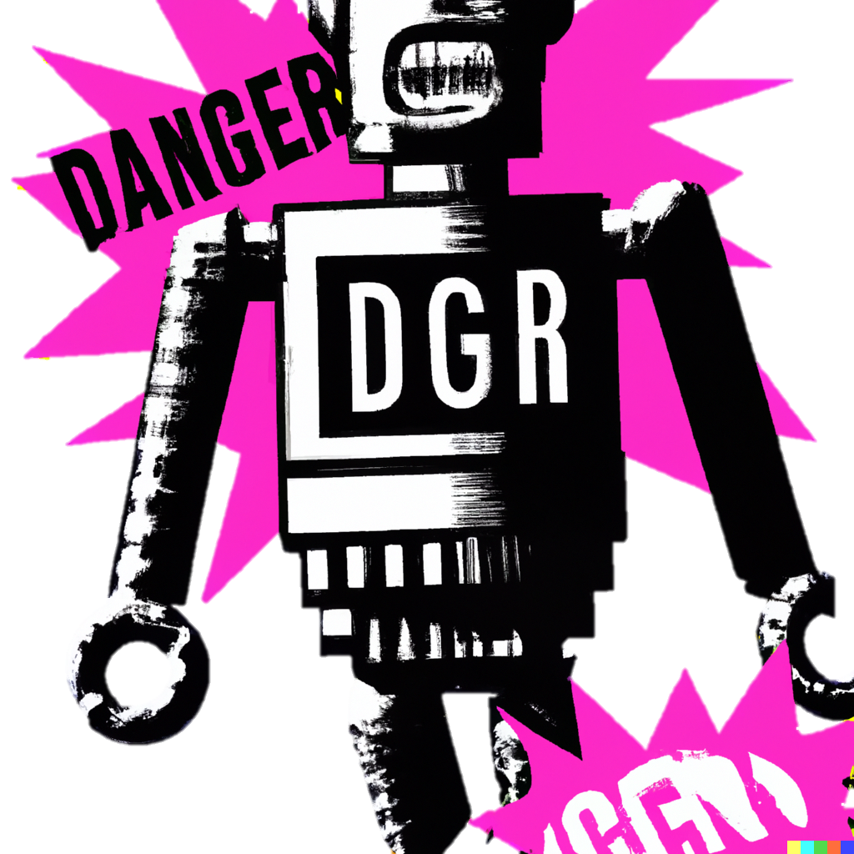
Rule Violation!
Lawyers can effectively leverage artificial intelligence (AI) in their practice by following these best practices
1. Understand AI Technologies: Develop a solid understanding of the various AI technologies available, including machine learning, natural language processing, and predictive analytics.
2. Identify Appropriate Use Cases: Determine specific areas within legal practice where AI can add value, such as legal research, contract review, due diligence, or document analysis.
3. Data Quality and Security: Ensure the quality and security of the data used to train AI models. Maintaining confidentiality and compliance with data protection regulations is crucial.
4. Collaborate with IT Professionals: Work closely with IT professionals to integrate AI tools seamlessly into existing workflows and ensure compatibility with existing systems.
Rule 1.1 Competence
(a) A lawyer shall not intentionally, recklessly, with gross negligence, or repeatedly fail to perform legal services with competence.
Rule 8.4 Misconduct
It is professional misconduct for a lawyer to:
...
(c) engage in conduct involving dishonesty, fraud, deceit, or reckless or intentional misrepresentation;
Rule 3.3 Candor Toward the Tribunal
(a)A lawyer shall not:
(1) knowingly make a false statement of fact or law to a tribunal or fail to correct a false statement of material fact or law previously made to the tribunal by the lawyer;
Danger!

Slide 17
When your associates use AI
Lawyers can effectively leverage artificial intelligence (AI) in their practice by following these best practices
1. Understand AI Technologies: Develop a solid understanding of the various AI technologies available, including machine learning, natural language processing, and predictive analytics.
2. Identify Appropriate Use Cases: Determine specific areas within legal practice where AI can add value, such as legal research, contract review, due diligence, or document analysis.
3. Data Quality and Security: Ensure the quality and security of the data used to train AI models. Maintaining confidentiality and compliance with data protection regulations is crucial.
4. Collaborate with IT Professionals: Work closely with IT professionals to integrate AI tools seamlessly into existing workflows and ensure compatibility with existing systems.
Rule 5.1 Responsibilities of Managerial and Supervisory Lawyers
(a)A lawyer who individually or together with other lawyers possesses managerial authority in a law firm, shall make reasonable efforts to ensure that the firm has in effect measures giving reasonable assurance that all lawyers in the firm comply with these rules and the State Bar Act.
Comment
[1] Paragraph (a) requires lawyers with managerial authority within a law firm to make reasonable efforts to establish internal policies and procedures designed, for example, to detect and resolve conflicts of interest, identify dates by which actions must be taken in pending matters, account for client funds and property, and ensure that inexperienced lawyers are properly supervised.

Slide 18
What if we treat AI like a junior associate?
Lawyers can effectively leverage artificial intelligence (AI) in their practice by following these best practices
1. Understand AI Technologies: Develop a solid understanding of the various AI technologies available, including machine learning, natural language processing, and predictive analytics.
2. Identify Appropriate Use Cases: Determine specific areas within legal practice where AI can add value, such as legal research, contract review, due diligence, or document analysis.
3. Data Quality and Security: Ensure the quality and security of the data used to train AI models. Maintaining confidentiality and compliance with data protection regulations is crucial.
4. Collaborate with IT Professionals: Work closely with IT professionals to integrate AI tools seamlessly into existing workflows and ensure compatibility with existing systems.
Rule 5.1 Responsibilities of Managerial and Supervisory Lawyers
(b) A lawyer having direct supervisory authority over another lawyer, whether or not a member or employee of the same law firm, shall make reasonable efforts to ensure that the other lawyer complies with these rules and the State Bar Act.
(c) A lawyer shall be responsible for another lawyer’s violation of these rules and the State Bar Act if:
(1) the lawyer orders or, with knowledge of the relevant facts and of the specific conduct, ratifies the conduct involved; or
(2) the lawyer, individually or together with other lawyers, possesses managerial authority in the law firm in which the other lawyer practices, or has direct supervisory authority over the other lawyer, whether or not a member or employee of the same law firm, and knows of the conduct at a time when its consequences can be avoided or mitigated but fails to take reasonable remedial action.

Slide 19
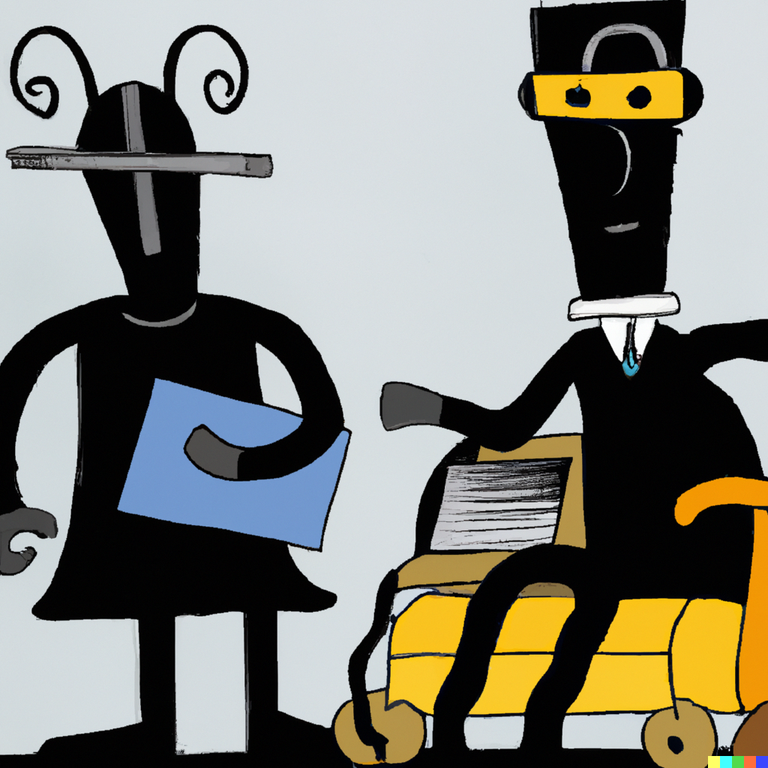
How to Best Use AI??
BEEP boOP
I am the lawyeR now !!!

Slide 20
AI Best Practices: Use a Tailored System
Lawyers can effectively leverage artificial intelligence (AI) in their practice by following these best practices
1. Understand AI Technologies: Develop a solid understanding of the various AI technologies available, including machine learning, natural language processing, and predictive analytics.
2. Identify Appropriate Use Cases: Determine specific areas within legal practice where AI can add value, such as legal research, contract review, due diligence, or document analysis.
3. Data Quality and Security: Ensure the quality and security of the data used to train AI models. Maintaining confidentiality and compliance with data protection regulations is crucial.
4. Collaborate with IT Professionals: Work closely with IT professionals to integrate AI tools seamlessly into existing workflows and ensure compatibility with existing systems.
For legal research, the system should be fine tuned using datasets for legal use cases
ChatGPT: "I do not have access to databases of legal cases, statutes, or specific legal documents."
Configure the system to facilitate review, e.g., providing links to cited opinions
Steer the system using a reasonable number of examples

Slide 21
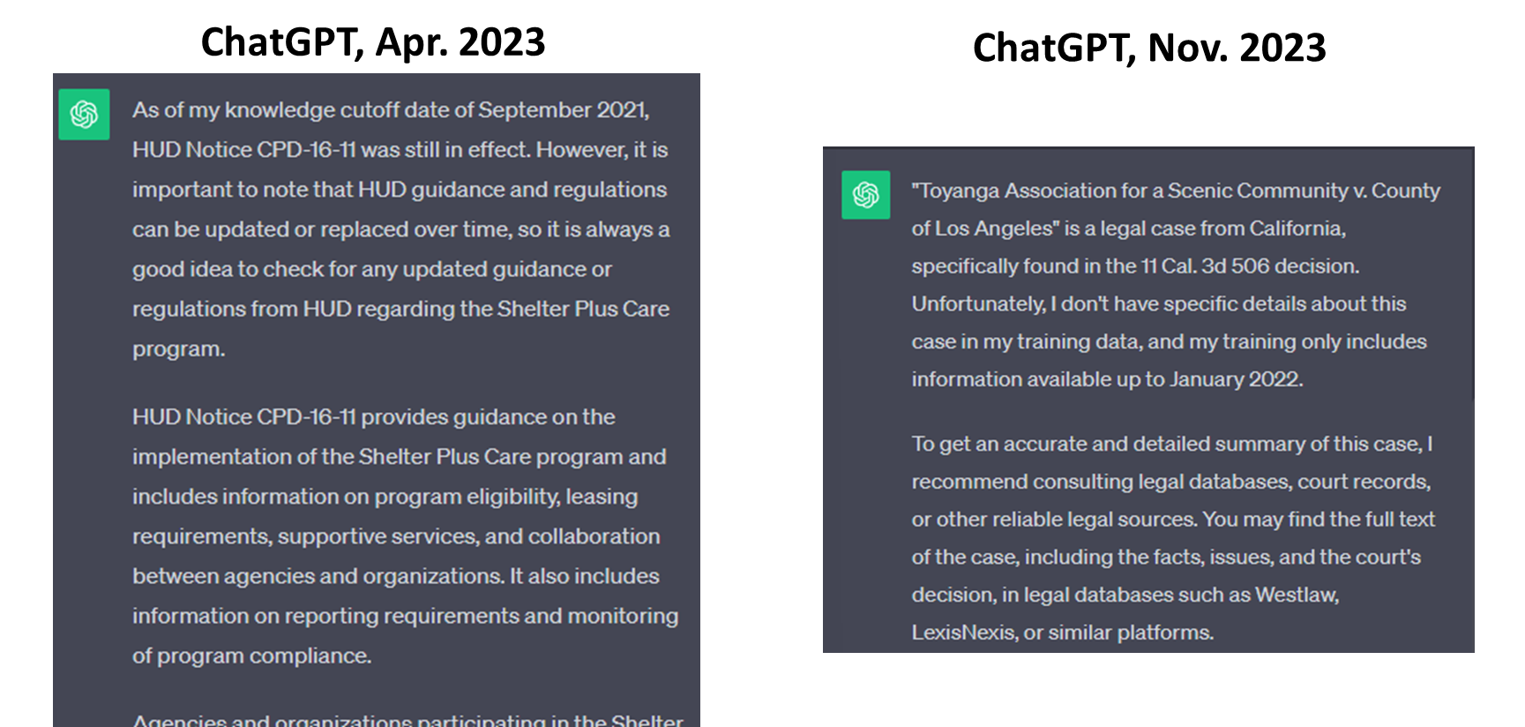
Prompt: summarize Toyanga Assn. for a Scenic Community v. County of Los Angeles, 11 Cal. 3d 506

Slide 22
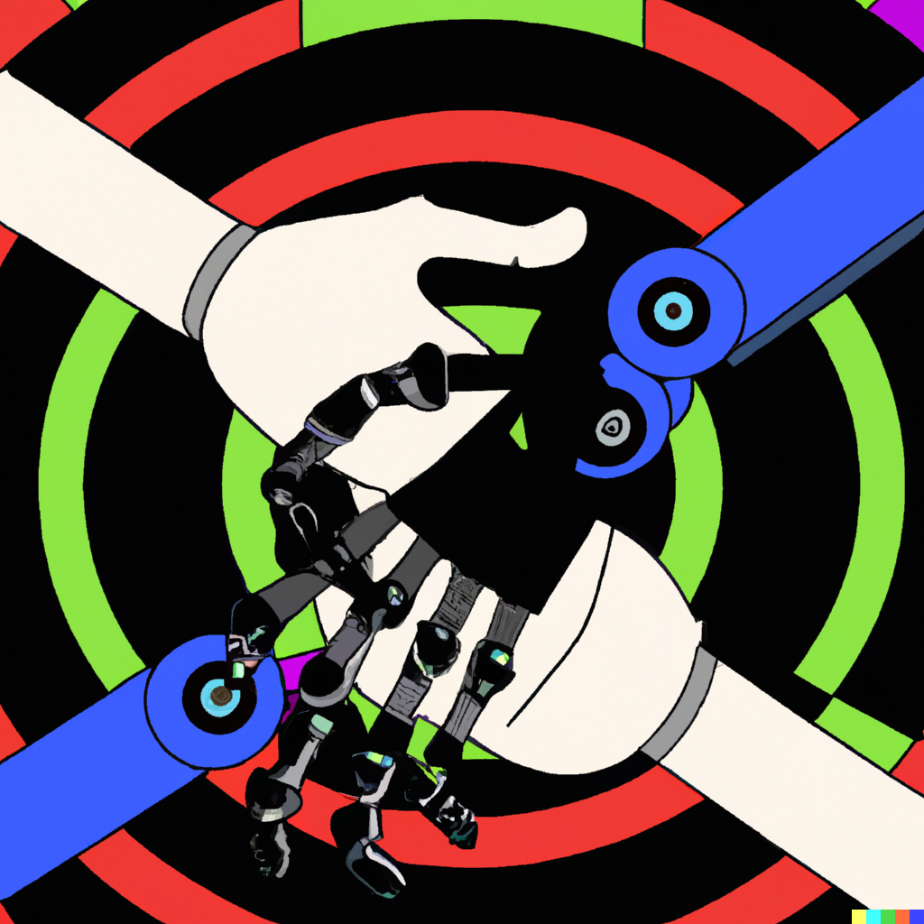
AI Best Practices: Human in the Loop
Lawyers can effectively leverage artificial intelligence (AI) in their practice by following these best practices
1. Understand AI Technologies: Develop a solid understanding of the various AI technologies available, including machine learning, natural language processing, and predictive analytics.
2. Identify Appropriate Use Cases: Determine specific areas within legal practice where AI can add value, such as legal research, contract review, due diligence, or document analysis.
3. Data Quality and Security: Ensure the quality and security of the data used to train AI models. Maintaining confidentiality and compliance with data protection regulations is crucial.
4. Collaborate with IT Professionals: Work closely with IT professionals to integrate AI tools seamlessly into existing workflows and ensure compatibility with existing systems.
Structure the prompt to direct AI query
Be specific about what you are asking
Ask follow-up questions
Provide feedback or correction
Treat AI as you would a first-year associate
Provide directions
Review the work product

Slide 23
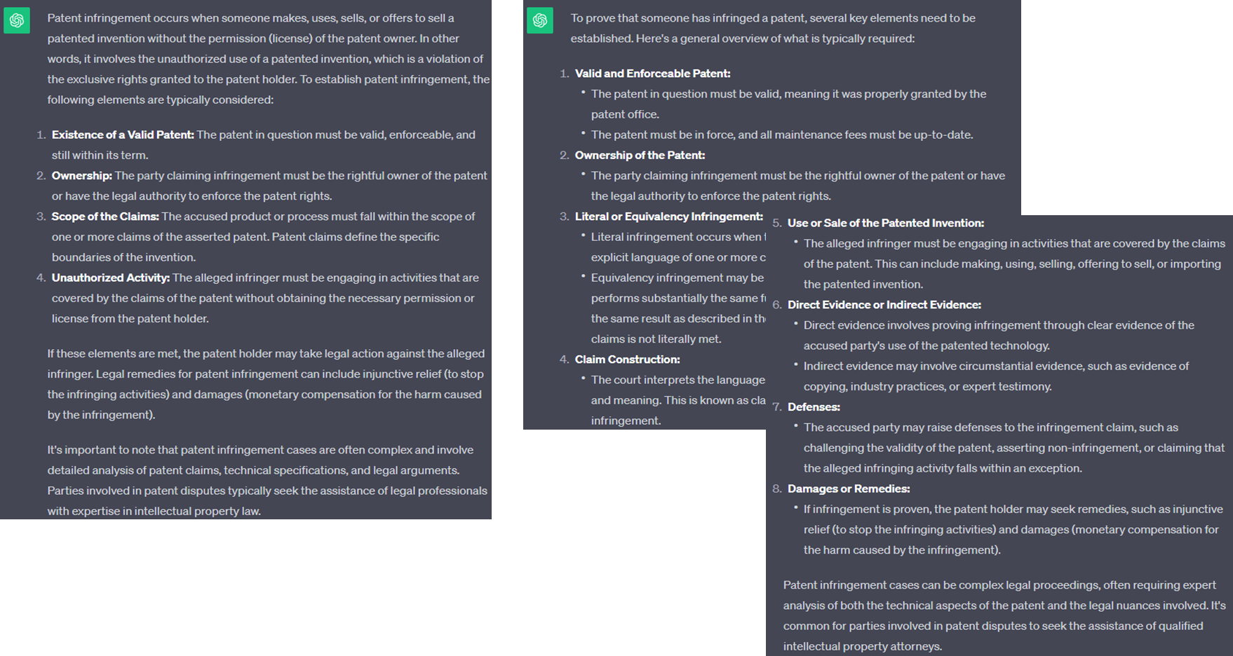
What is patent infringement?
What is required to prove someone infringes a patent?

Slide 24
Takeaways

Slide 25
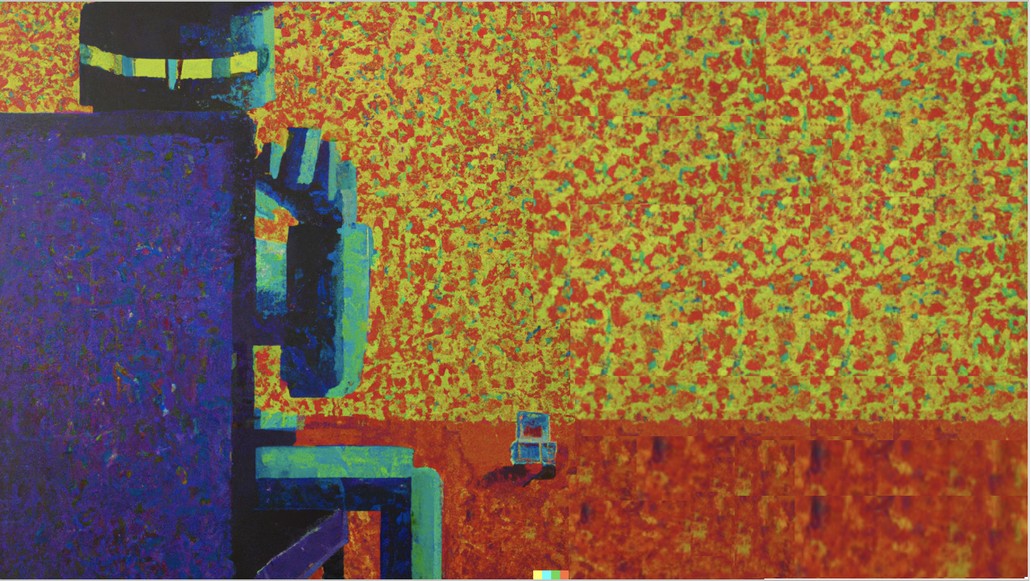
Ethical Rules
Rule 1.1 (Duty of Competence)
Rule 1.2 (Duty of Diligence)
Rule 1.6 (Duty of Confidentiality)
Potentially even:
Rule 1.4 (Duty to Communicate)
Rules 5.1 and 5.3 (Duty to Supervise)
Notes:
We have already seen how the use of AI may implicate multiple potential ethical rules, such as:

Slide 26
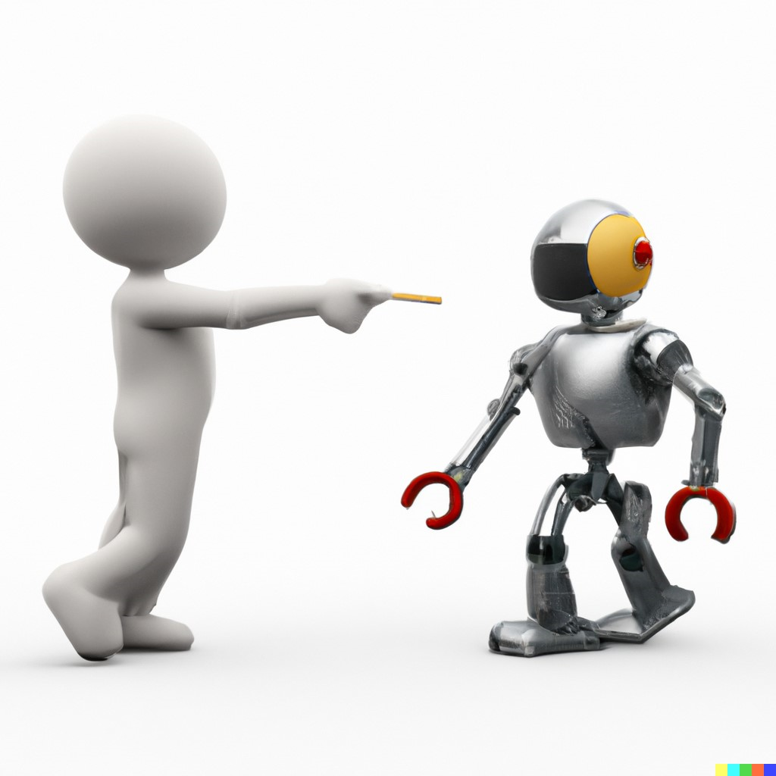
But we’ve also seen that AI can offer many advantages
Modern firms are rapidly weaving AI into their workflows
It seems like every law firm has an “AI Practice” now
Rules and regulations are trickling in from everywhere

Slide 27
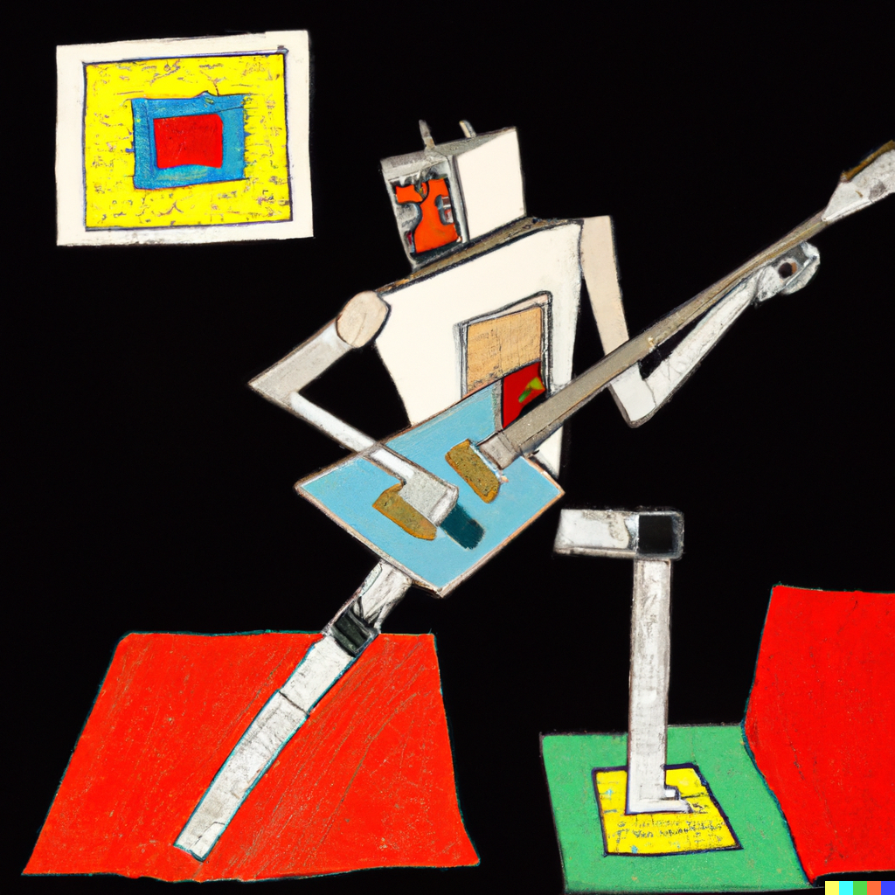
AI Is Here to Stay
Regardless of whether you intend to make use of legal tools that incorporate AI, AI is likely to have a significant impact in IP law and our daily lives.
AI could have wide ranging impact extending outside “ethics” as it is understood in the professional conduct sense. Already generative AI has prompted renewed interest in a federal right of publicity due to instances like the AI generated Drake single.
Notes:
https://crsreports.congress.gov/product/pdf/LSB/LSB11052#:~:text=Consideration%20of%20a%20Federal%20Right%20of%20Publicity,-September%2029%2C%202023&text=The%20ROP%20is%20often%20defined,(such%20as%20one%27s%20voice).
When you realize your favorite new song was written and performed by ... AI | NPR Illinois
Andrea, feel free to take this slide any direction you’d like

Slide 28
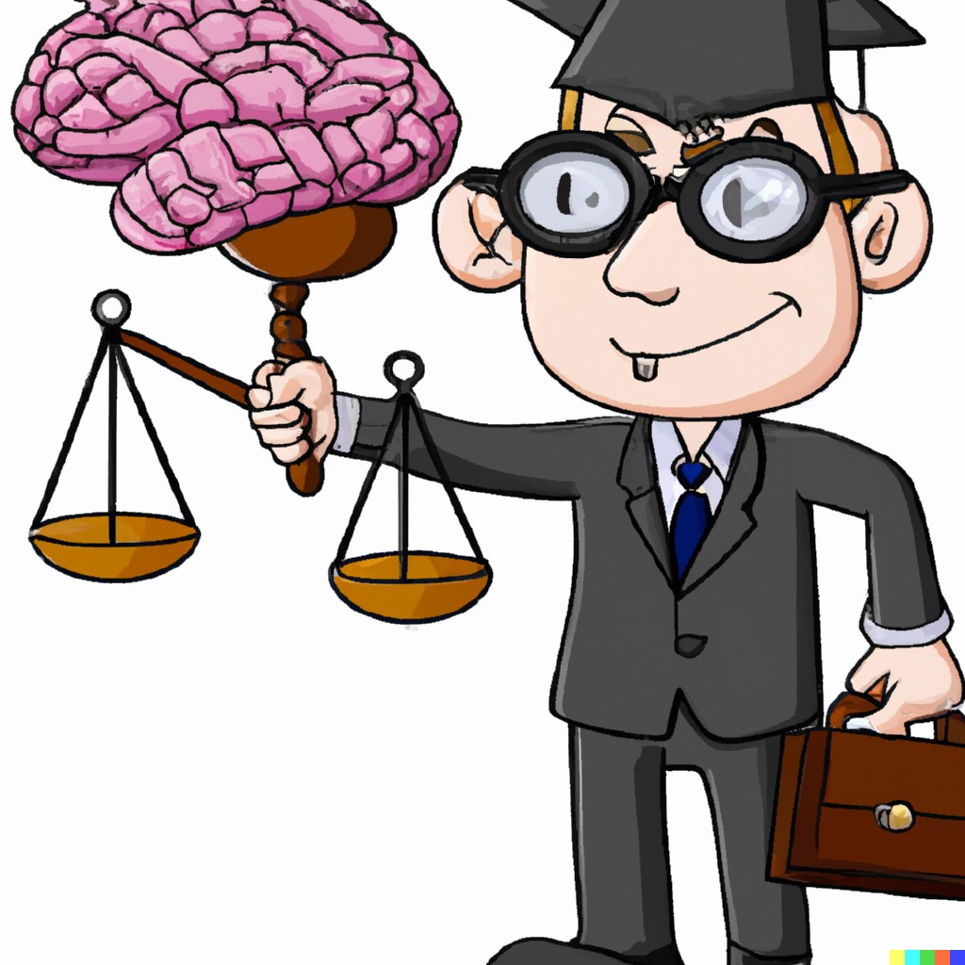
So What Should
We Do?
These problems are not new
The tools may be new, but we have faced problems like these before
Look at the rules
Look at ethics opinions
Analogize
Use your lawyer brains
Notes:
Go over how some recent headlines could be avoided if lawyers did this.

Slide 29
Thank you!

