Slide 1
Labor Law

Slide 2
Governing Structure - Private
National Labor Relations Act
(NLRA or The Act)
National Labor Relations Board
(NLRB or The Board)
Jurisdiction
Covers most private sector
Excludes public sector and railway/airline industry
Unfair Labor Practice Charges
Investigates Charge
Prosecutes Complaints
Adjudication
General Counsel
Responsible for investigation and prosecution of unfair labor practice cases and supervision of NLRB field offices
5 Members
Appointed by President for five (5) year terms
Quasi-judicial body
ALJ conduct unfair labor practice hearings and issue recommended orders, which are subject to Board review

Slide 3
What is a Union?
The Act defines a labor organization as: any organization of any kind, or any agency or employee representation committee or plan, in which employees participate and which exists for the purpose, in whole or in part, of dealing with employers concerning grievances, labor disputes, wages, rates of pay, hours of employment, or conditions of work.

Slide 4
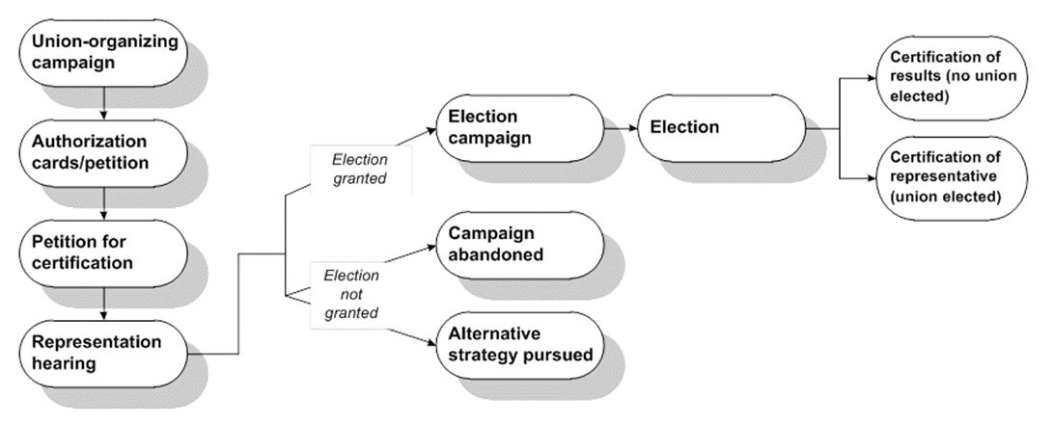
Forming a Union The Organizing Process

Slide 5
Showing of Interest
Showing of interest is a statement from an employee regarding union representation
Traditionally established by an authorization card or a union card
Informal talking, sharing of ideas, concerns
Reach out to Union Organizing group
File a petition with nearest NLRB Regional Office showing at least 30% of employees in a “unit” support the Petition. Smaller or “micro” units are permissible.
Example, a grocery store may have 4 different units/unions
Bakery – Bakery, Confectionery, Tobacco Workers and Grain Millers' International Union
Retail Clerks – United Food Commercial Workers Union
Janitorial – Service Employees International Union
Stockers – International Brotherhood of Teamsters
Employers must post a Notice of Petition for Election
NLRB agents will investigate for:
Jurisdiction
Qualified union
No existing contracts or recent elections

Slide 6
Voluntary Recognition
Employer accepts a union after a majority showing of support
Status as bargaining rep cannot be challenged during a reasonable period for bargaining (6 mo – 1 year)
Voluntary Recognition – why?
Avoids contentious election
Can make Contract bargaining smoother – lack of hard feelings
Cemex, 372 NLRB No. 13 (Aug 25, 2023)
If Employer commits a ULP during the election, an order to bargain will issue

Slide 7
Election
Agents arrange an election agreement
Time, place, language, eligibility
Employer must provide Union with contact information of employee
Employer must post a notice of election
Employer and/or Union campaign for votes
Both sides are afforded free speech rights and engage in a campaign
Union campaigns started before the petition, involves taking with employees, holding offsite meetings, and explains the benefits of union representation
Employer campaigns involves employee meetings, FAQs, and explains the process and the Employer’s position on unionization
No captive audience meetings 24 hours before election
Peerless Plywood, 107 NLRB 427 (1953)

Slide 8
Certification
If the union loses, the NLRB regional director certifies the election results.
Results are subject to NLRB review.
Union may opt to continue to pressure the employer to agree to a voluntary card check.
If the union wins, the NLRB certifies it as the exclusive representative of the bargaining unit.
Employer must bargain with the union

Slide 9
Collective Bargaining
Union becomes representative for workers
Collective Bargaining Agreement (CBA)
Covers terms and conditions of employment
Mandatory subjects: required by law
Wages, hours, overtime, bonuses, safety practices, grievance procedures
Permissive subjects: may be negotiated, but not required
Illegal subjects: closed shops or illegal discrimination
Two types
Contract
Effects

Slide 10
Impasse Issues/Options
Implement final offer
At impasse, notice to union
Strike
A refusal by employees to work
Lockout
Management shutdown of operations to prevent union employees from working

Slide 11
Unfair Labor Practice Charges
Allegations of Violating The Act.
Against Employer or Labor Organization
ULP Charge
Investigated by Board agents
Finding evaluated by Regional Director (may be reviewed by NLRB attorneys)
Majority are settled, withdrawn, or dismissed by the Regional Director
Sufficient Evidence Finding
Attempt to facilitate a settlement
Otherwise issues a complaint which leads to a hearing before an ALJ
Remedies
No penalties
Reinstatement/back-pay
Informational remedies

