Slide 1
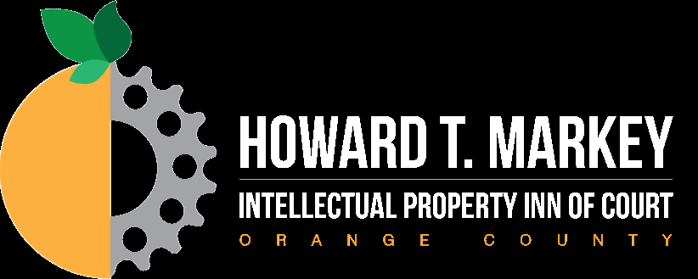
Group 4
1. Video call best practices
2. Thryv v. Click-to-Call
3. USPTO v. Booking.com
4. Romag v. Fossil

Slide 2
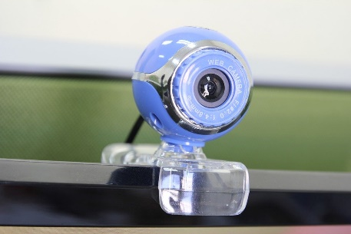
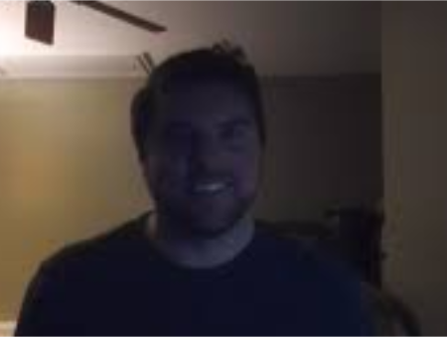
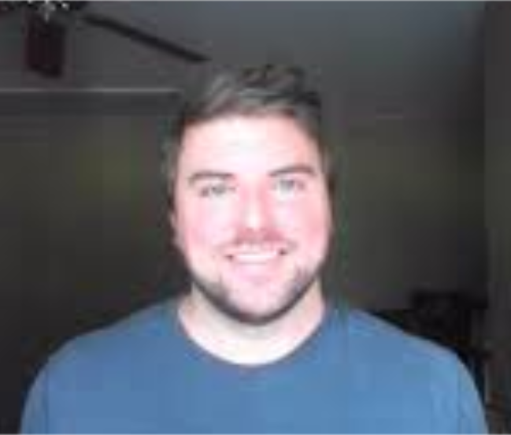
Video Call Best Practices
Tip 1: Get Gear: Hardware
Tip 2: Think Lights, Camera, Action
Notes:
Webcam: Using your laptop built-in webcam is fine . . . but, if you can, consider an external webcam to create the perfect angle and imagine quality
Headphones: These may allow you to avoid nasty feedback and allow you to hear better. They can also be useful for people with children or other noise issues at home. However, they can make you look less professional. Do not wear them for Court zoom Hearings - ED Tex judge ordered attorneys to take them off.
Microphone: Some headsets have great microphones. A stand alone mike might be nice for court. For some, the phone might provide better sound than computer audio. If using phone, important to link to your video using the code.
Light your front – light source should be in front of you to brighten your face, not behind you, which will make your look dark
Close curtains or cover with screen if window in wrong spot
Keep background basic
Consider Japanese screen
Avoid plain white wall if possible
Clean bookshelves are interesting
Virtual backgrounds are okay if professional.

Slide 3
Video Call Best Practices
Tell everyone in your house you are going on a videocall. Let dogs out.
Quickly do camera and microphone check before going live (check hair, teeth, etc)
Do sweat the small stuff (go to bathroom, get water, have pen/paper)
Have links or documents that you plan to reference or share ready.
Create an agenda, send ahead of time, post in chat
Tip 3: Be Early and Be Prepared
Tip 4: Avoid Video Awkwardness
If meeting organizer, sign in 5 minutes early. If attendee, sign in 2-3 minutes early to allow time to get on camera and on sound (especially if calling in from phone)
Confirm right people are on call. Wait 2-5 minutes to start.
Wave, smile, have small talk ideas ready
Turn on listening ears. Stay tuned in 100%
Notes:
Posting agenda in chat is a great tip to make it easer for everyone to see. Your client may not have multiple screens like you do.
Turn off other applications to eliminate distractions and increase internet speed
Think about features that might be annoying on zoom. If your computer beeps every time it gets an email, that causes zoom to think you are speaking and your box lights up. Turn this feature off.
Whatever you do, don’t have an internet browser open that might start randomly playing video.
We cannot say enough to open with a wave and a smile.
Be conscious of resting facial expressions - Downward slope of lips and eyes makes you look mad

Slide 4
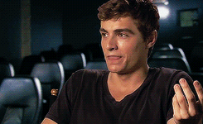
Video Call Best Practices
Tip 5: Back Up!
Tip 6: Use Your Hands
Notes:
Boost charisma by pushing camera back so can see hands and upper torso
Hands need to be visible so people can see
You wave hello
Your explanatory gestures
Visible hands while you are listening
TED Talks that go viral have speakers who use their hands twice as often as the least popular TED speakers
People who use their hands are seen as more warm, agreeable, and energetic
Hand gesture ideas
• Listing: 1, 2, 3
• To show agreement: Thumbs up
• Raise hand: to speak
• To show amount: a lot, a tiny bit
• Listen up!
• Steeple – helps center, portrays wisdom
• This and that (keep two ideas separate)
• DO NOT POINT

Slide 5
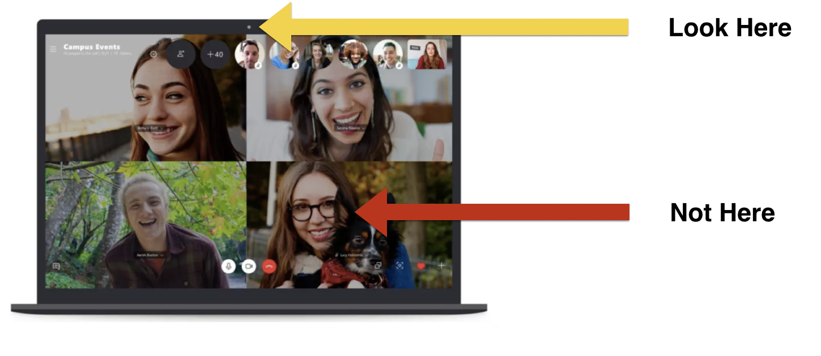
Video Call Best Practices
Tip 7: Look at the Dot
Tip 8: Designate a Driver
Notes:
Look into the camera while speaking
Teams should decide ahead of time who will lead the meeting, each topic, etc.
Or, if needed, designate a driver on the spot by calling out their name (use names to pass the baton; watch people’s faces)
Have a hand signal or chat with each other

Slide 6
Video Call Best Practices
Tip 9: Dress to Impress
Notes:
Princeton study – people dressed in clothes perceived to be “richer” were rated as more competent
Clothes boost confidence and help make good first impression
But don’t be tone deaf; need happy medium
Everyone is working from home, so suit and tie seems like overkill (unless in court)
Scruffy beard, baseball cap, old t-shirt, stained clothes is underkill
No one can see pants or shoes, so be comfortable.
When in doubt, dress up more
If appearing in court or any official proceeding, wear a suit. If you know your client expects it, wear a suit or consider a jacket over a (nice) sweatshirt.
Some people/clients might prefer dressier, others might show up looking pretty scruffy (don’t be like them).
Generally avoid
Patterns or stripes
Large, bulky shirts
Clothing that blends into background
Big dangling earrings or necklaces

Slide 7
Video Call Best Practices
War stories for the trenches – What is your best pro tip for video calls?

Slide 8
Thryv v. Click-To-Call
Facts and Procedural History
In 2001, an exclusive license of the ’836 patent was granted to Inforocket which then sued Keen for infringement (SARS, H1N1, Ebola, Zika, COVID)
In 2003, Keen acquired Inforocket and the infringement suit against Keen was dismissed (SARS, H1N1, Ebola, Zika, COVID)
’836 patent → Click-to-Call
Click-To-Call (CTC) sued Thryv/Ingenio/Keen in 2012 (SARS, H1N1, Ebola, Zika, COVID)
In 2014, PTAB invalidated 13 claims of the ’836 patent rejecting CTC’s argument that Ingenio’s petition was time-barred due to the 2001 suit (SARS, H1N1, Ebola, Zika, COVID)
According to PTAB, a complaint dismissed without prejudice does not trigger 315(b)’s one-year limit

Slide 9
Thryv v. Click-To-Call
Facts and Procedural History
CTC appealed but the Federal Circuit dismissed the appeal for lack of jurisdiction and CTC petitioned for a writ of certiorari.
In 2016, the Supreme Court granted petition for writ of certiorari and remanded the case to the Federal Circuit for further consideration in light of Cuozzo Speed Technologies (SARS, H1N1 flu, Ebola, Zika, COVID)
Cuozzo held that 314(d) precludes review of the Patent Office’s institution decisions at least “where the grounds for attaching the decision to institute inter partes review consists of questions that are closely tied to the application and interpretation of statutes related to the Patent Office’s decision to initiate inter partes review.”
On remand, a Federal Circuit panel held that the PTAB’s time-bar determination was not subject to judicial review

Slide 10
Thryv v. Click-To-Call
Facts and Procedural History
However, contemporaneously in Wi-Fi One, the full Federal Circuit decided the issue differently, holding that time-bar determinations were subject to judicial review because they were not “closely related” to the institution decision falling within the scope of § 314(a)
In 2018, based on Wi-Fi One, the Federal Circuit reheard CTC’s appeal, vacated the PTAB’s decision and remanded for further proceedings
In 2020, the Supreme Court held that PTAB’s decision to institute IPR is not reviewable (SARS, H1N1 flu, Ebola, Zika, COVID)

Slide 11
Thryv v. Click-To-Call
Holding
The agency's application of § 315(b)'s time limit is closely related to its decision whether to institute inter partes review and is therefore rendered nonappealable by § 314(d).
Cuozzo: 315(b) expressly governs institution and nothing more and a 315(b) challenge thus raises “an ordinary dispute about the application of” an institution related statute and Cuozzo held such challenges overcome the presumption favoring judicial review.
Statute’s purpose and design: Congress designed inter partes review to weed out bad patent claims efficiently. “Congress prioritized patentability over 315(b)’s timeliness requirements.”
Broader reading of 314(d): 314(d) text does not limit the review bar to 314(a). Rather it “encompasses the entire determination whether to institute an inter partes review”
Unlike the appeal held reviewable in SAS Institute, Click-to-Call's appeal challenges not the manner in which the agency's review proceeds once instituted, but whether the agency should have instituted review at all

Slide 12
Thryv v. Click-To-Call
Which aspects of an institution decision, if any, are appealable after Thryv?
Matters "closely tied to the application and interpretation of statutes related to the institution decision" are non-appealable. Thryv, slip op. at 7, quoting Cuozzo Speed Technologies, LLC v. Lee, slip op. at 11.
Is this a "but-for" test, such that only matters that were dispositive to institution are non-appealable?
Does Thryv/Cuozzo extend to discretionary denials under either § 314(a) or § 325(d)?
To constitutional questions (e.g. Due Process)?
Is mandamus available?
How about APA challenges? (e.g. instituting an IPR on a ground barred by statute, or on a clearly flawed record such as using a reference that clearly failed to qualify as prior art)

Slide 13
Thryv v. Click-To-Call
Will IPRs continue to "Thryv"?

Slide 14
USPTO v. Booking.com
Facts and Procedural History
In 2011 and 2012, Booking.com filed four applications with the U.S. Patent and Trademark Office (USPTO) to trademark the name Booking.com.
USPTO denied the applications on the grounds that the name was generic and not a protectable mark. Booking.com appealed to the Trademark Trial and Appeal Board (TTAB), which upheld the USPTO's decision.
In 2016, Booking.com appealed the TTAB's ruling in the U.S. District Court for the Eastern District of Virginia, arguing Booking.com was eligible for trademark protection.
The district court affirmed in part Booking.com's motion for summary judgement, ordering the USPTO to accept two of the trademark applications, and remanded the case for further proceedings on the remaining two applications
The 4th circuit affirmed the district court's ruling and denied the government's petition for a rehearing
USPTO petitioned the U.S. Supreme Court for review.

Slide 15
USPTO v. Booking.com
Issue: Whether the addition by an online business of a generic top-level domain (".com") to an otherwise generic term can create a protectable trademark.
Outcome: The court held that "generic.com" term is not a generic name for a class of goods or services if consumers do not recognize the term as generic.
The Court found one of main cases, Goodyear's India Rubber Glove Mfg. Co. v. Goodyear Rubber Co., 128 U.S. 598 (1888), inapplicable to Booking.com.
Proper test for precluding a generic term from registration.
The primary significance of the registered mark to the relevant public . . . shall be the test for determining whether the registered mark has become the generic name of goods or services. 15 U.S.C. § 1064(3)
Notes:
GINSBURG, J., delivered the opinion of the Court.
SOTOMAYOR, J., filed a concurring opinion.
Added two observations:
consumer surveys can be an unreliable method to determine whether a term is generic, and
the USPTO may have properly concluded that "Booking.com" is generic based on dictionary and usage evidence, but that question was not before the court.
BREYER, J., filed a dissenting opinion.
- A generic term is not eligible for use as a trademark. To hold otherwise “would grant the owner of the mark a monopoly, since a competitor could not describe his goods as what they are.” ...
Granting trademark protection to “generic.com” marks threatens serious anticompetitive consequences in the online marketplace

Slide 16
USPTO v. Booking.com
What does this mean going forward?
Ruling will allow clients that otherwise may not have been able to get a Trademark to now be able to get trademark protection as long as the consuming public would easily recognize their name as a particular company rather than just a generic name for goods or services.
The Court agreed that the protection of marks like booking.com is narrow.
Evaluating domain marks’ validity and similarity would be fact heavy questions and difficult to resolve before trial.
Could it result in a land grab of registrations?
How well does this fit with Romag ruling?

Slide 17
Romag v. Fossil
Question Presented on Petition for Certiorari
“Whether, under section 35 of the Lanham Act, 15 U.S.C. § 1117(a), willful infringement is a prerequisite for an award of an infringer’s profits for a violation of section 43(a), id. § 1125(a).”

Slide 18
Parties - Romag
https://www.romag.com/

Slide 19
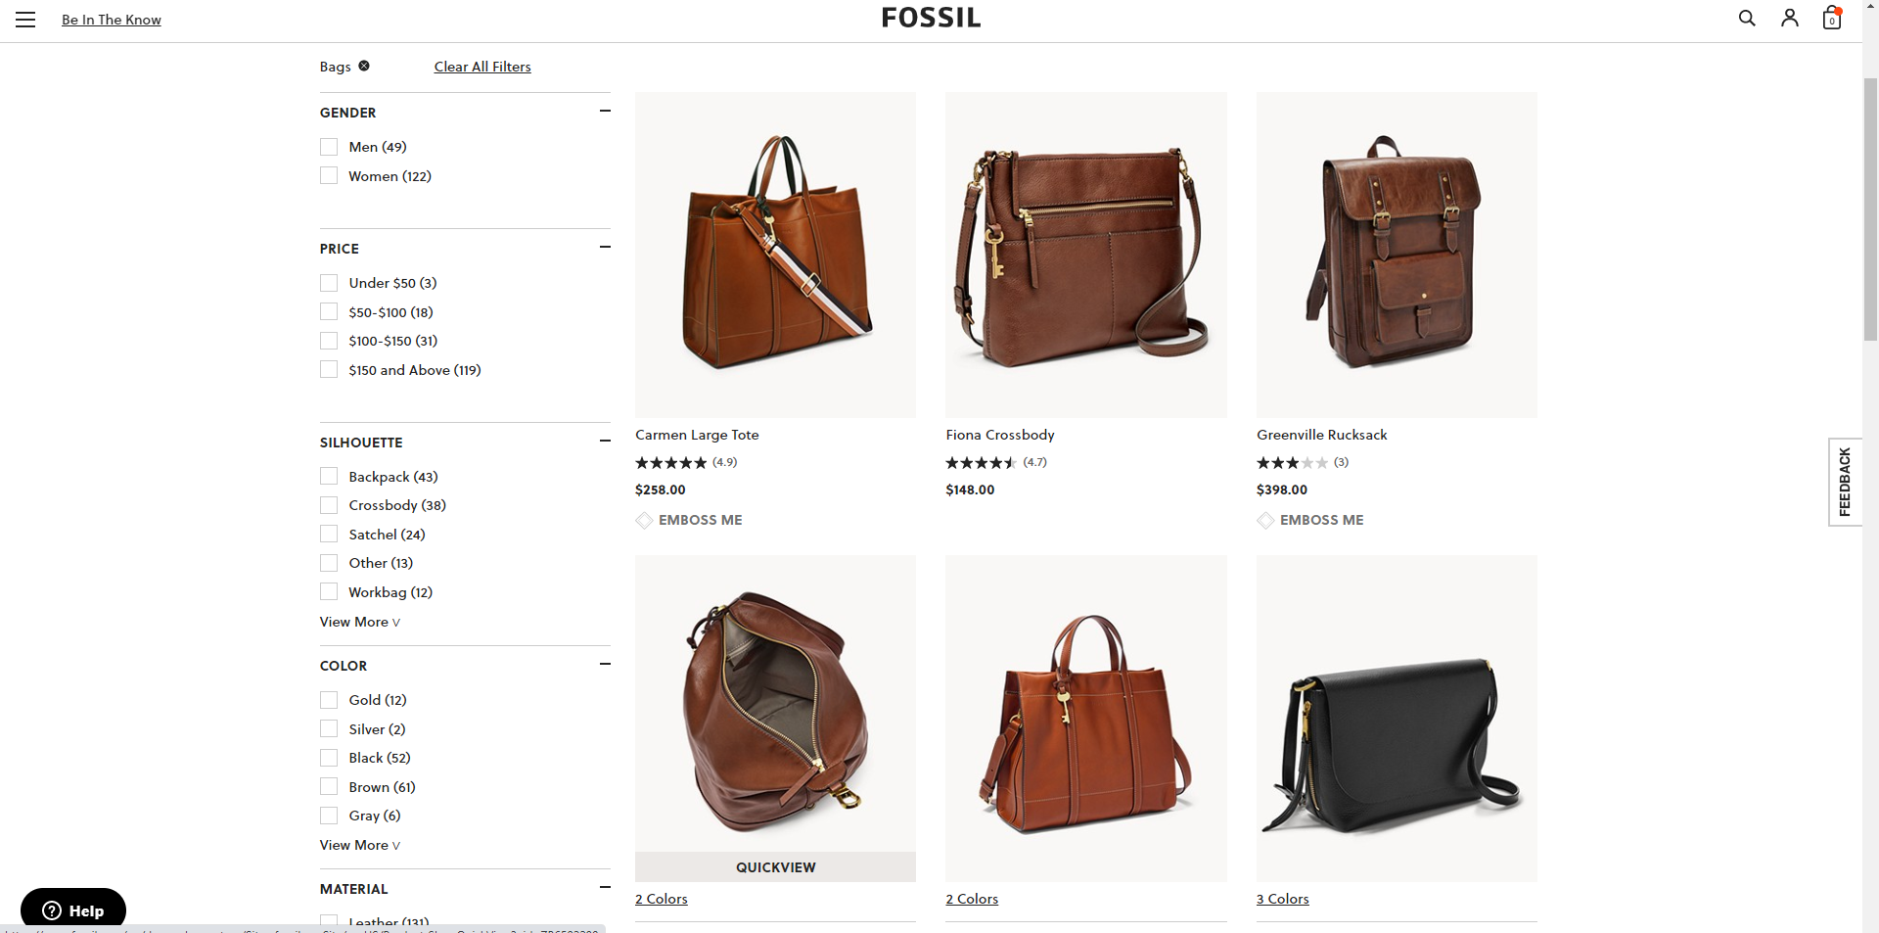
Parties - Fossil
https://www.fossil.com/en-us/bags/

Slide 20
Basic Facts & History
Contract for Fossil to use Romag fasteners
Chinese factories using counterfeit fasteners, passing off as Romag
Romag sues alleging TM infringement and false representations
Jury found Fossil acted “in callous disregard” of Romag’s rights
Jury rejected allegation that Fossil acted “willfully”
Romag sought an award of Fossil’s profits
D. Conn. denied request – conduct wasn’t willful
Fed. Cir. affirmed – 2nd Cir. requires willfulness

Slide 21
15 U.S.C. § 1117(a)
“When a violation of any right of the registrant of a mark registered in the Patent and Trademark Office, a violation under section 1125(a) or (d) of this title, or a willful violation under section 1125(c) of this title, shall have been established . . . , the plaintiff shall be entitled, subject to the provisions of sections 1111 and 1114 of this title, and subject to the principles of equity, to recover (1) defendant’s profits, (2) any damages sustained by the plaintiff, and (3) the costs of the action.”

Slide 22
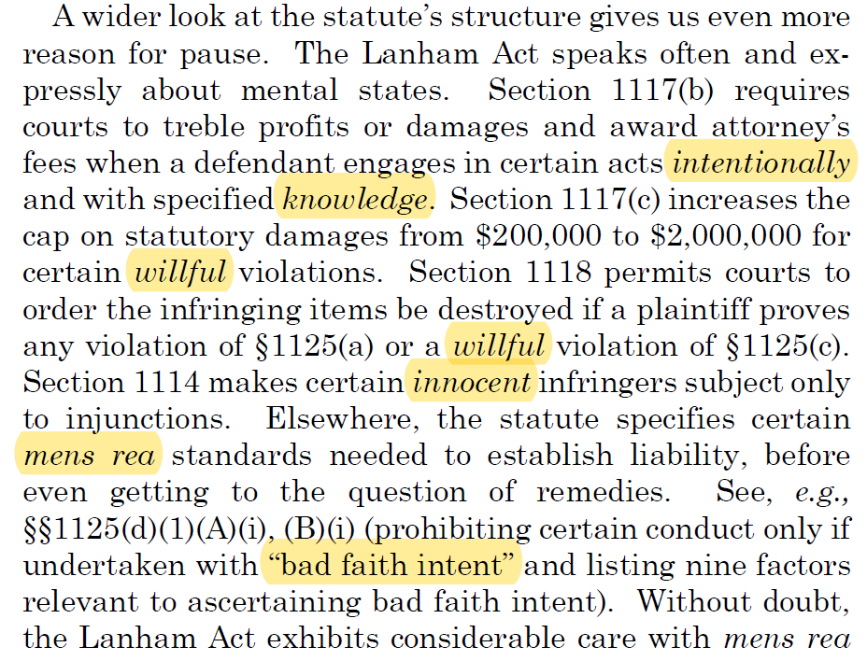
Mens Rea in Lanham Act

Slide 23
Mens Rea in Lanham Act
“The absence of any such standard in the provision before us, thus, seems all the more telling.”

Slide 24
Fossil’s Argument
Willfulness required for a profits award
“. . . subject to the principles of equity . . . .”
“In Fossil’s telling, equity courts historically required a showing of willfulness before authorizing a profits remedy in trademark disputes.”
“[A] willfulness requirement . . . rises to the level of a ‘principle of equity’ the Lanham Act carries forward.”

Slide 25
Principles of Equity
“The phrase ‘principles of equity’ doesn’t readily bring to mind a substantive rule about mens rea from a discrete domain like trademark law. In the context of this statute, it more naturally suggests fundamental rules that apply more systematically across claims and practice areas.”
These are “transsubstantive topics”
“[I]t seems a little unlikely Congress meant ‘principles of equity’ to direct us to a narrow rule about a profits remedy within trademark law.”

Slide 26
Principles of Equity
“Mens rea figured as an important consideration in awarding profits in pre-Lanham Act cases. This reflects the ordinary, transsubstantive principle that a defendant’s mental state is relevant to assigning an appropriate remedy. That principle arises not only in equity, but across many legal contexts.”

Slide 27
Holding
“[W]e do not doubt that a trademark defendant’s mental state is a highly important consideration in determining whether an award of profits is appropriate. But acknowledging that is a far cry from insisting on the inflexible precondition to recovery Fossil advances.”

Slide 28
Takeaway
An award of profits remedy in a trademark case does not require a finding that the defendant’s infringement was willful.

