Slide 1
Patent Pledges In Covid-19 Research
Howard T. Markey Intellectual Property American Inn of Court
June 11, 2020
Disclaimer
These presentation materials have been prepared for use by clients, alumni, and friends of O'Melveny & Myers LLP and are only intended for general information and/or continuing legal education purposes. The information presented is not legal advice, is not to be acted on as such, may not be current, and is subject to change without notice. Neither being invited to participate, nor participating, in this program creates an attorney-client relationship where one does not exist, or continues, or revives a prior attorney-client relationship.

Slide 2
The Open Covid Pledge
Immediate action is required to halt the COVID-19 Pandemic and treat those it has affected. It is a practical and moral imperative that every tool we have at our disposal be applied to develop and deploy technologies on a massive scale without impediment.
We therefore pledge to make our intellectual property available free of charge for use in ending the COVID-19 pandemic and minimizing the impact of the disease.
We will implement this pledge through a license that details the terms and conditions under which our intellectual property is made available.
https://opencovidpledge.org/

Slide 3
HOW TO MAKE THE OPEN COVID PLEDGE?
1. PUBLIC STATEMENT that organization is making IP relevant to COVID-19 freely available, on organization’s website
2. IMPLEMENT THE PLEDGE via a license
a. Adopt Open COVID License (OCL)
b. Adopt your own license
3. Fill out Pledgor Form or email opencovidpledge@gmail.com
https://opencovidpledge.org/

Slide 4
Open covid license
3 CATEGORIES OF LICENSES:
Open COVID Standard Licenses
Open COVID Compatible Licenses
Open COVID Alternative Licenses
https://opencovidpledge.org/licenses/

Slide 5
1. OPEN COVID Standard Licenses (OCL-STANDARD)
To date, 3 versions: OCL-PC v1.0, OCL-PC v1.1, & OCL-P v1.1
Terms & Conditions:
Grant & Scope
Time Limitation
Regulatory Exclusivity
Defensive Suspension
No Warranty
https://opencovidpledge.org/licenses/

Slide 6
1. OPEN COVID Standard Licenses (OCL-STANDARD)
OCL-PC v1.0 (patent and copyright)
Permitted Uses: For the purpose of ending the COVID-19 Pandemic as defined by WHO, and minimizing the impact of the disease, including without limitation the diagnosis, prevention, containment, and treatment of the COVID-19 Pandemic
Duration: From December 1, 2019 until 1 year post pandemic, as declared by WHO
OCL-PC v1.1 (patent and copyright) & OCL-P v1.1 (patent only)
Permitted Uses: For the purpose of diagnosing, preventing, containing, and treating COVID-19
Duration: From December 1, 2019 until the earlier of one year post pandemic, as declared by WHO, or January 1, 2023
https://opencovidpledge.org/faqs/

Slide 7
2. OCL Compatible licenses (OCL-Compatible)
Public Licenses deemed OCL-Compatible
Copyright only: CC BY 4.0 (copyright only), CC0 1.0 Public Domain Dedication
Copyright & Patent: MIT license, Apache 2.0 license, CERN OHL Version 2 – Permissive (P)
Custom Licenses – must meet certain criteria and contain the following minimum terms and conditions:
Public offer
Scope of rights granted
Royalty-free & fully paid
Regulatory Exclusions
Duration
Filed of use
Choice of law
Indemnification
No warranties (“as-is”)
Attribution
Covenant not to Sue
https://opencovidpledge.org/licenses/

Slide 8
3. OCL Alternative licenses (OCL-alternative)
Public licenses acceptable as OCL-Alternative Licenses
Copyright only: CC BY-SA
Copyright & Patent: GNU General Public License, CERN OHL Version 2 – Strongly Reciprocal (S)
Examples of Acceptable terms in OCL-Alternative License:
Requiring that the licensee inform the licensor it is accepting the license or register as a user
License may terminate instead of being suspended if the licensee threatens or sues the Pledgor for infringement
Share-Alike, copyleft and grant back clauses that require the licensee to make modifications and derivatives of licensed IPR available on similarly open terms
Limiting licensees to organizations based in a particular country, or excluding particular countries, but only when required by legal regulations applicable to the licensor and/or when the licensor has country-limited rights
https://opencovidpledge.org/licenses/

Slide 9
3. OCL Alternative licenses (OCL-alternative)
Examples of terms deemed unacceptable for OCL-Alternative License:
Non-commercial use only
Requiring that the licensee make licensed products available at no charge, at cost or at “fair and reasonable” charges
Prohibiting the licensee from making derivatives or modifications of the licensed IP
Licenses that bear fees of any kind, including reimbursement of patent expenses
A duration that is shorter than the term that begins December 1, 2019, and end no earlier than the end of the COVID-19 Pandemic as declared by the World Health Organization (WHO) plus one year, or a specified firm end date if the WHO has not by then declared the end of the pandemic, so long as it is no earlier than January 1, 2023
https://opencovidpledge.org/licenses/

Slide 10
PRO - Patent Pledges In Covid-19 Research
Howard T. Markey Intellectual Property American Inn of Court
June 11, 2020

Slide 11
Pro-Patent Pledge
Disclaimer
These presentation materials have been prepared for use by clients, alumni, and friends of O'Melveny & Myers LLP and are only intended for general information and/or continuing legal education purposes. The information presented is not legal advice, is not to be acted on as such, may not be current, and is subject to change without notice. Neither being invited to participate, nor participating, in this program creates an attorney-client relationship where one does not exist, or continues, or revives a prior attorney-client relationship.

Slide 12
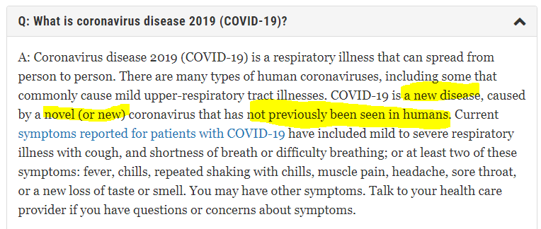
promoting collaboration & Innovation
A “novel” virus with many unknowns, e.g.,:
Mechanism
Prevention
Spread
Treatment
https://www.fda.gov/emergency-preparedness-and-response/coronavirus-disease-2019-covid-19/coronavirus-disease-2019-covid-19-frequently-asked-questions#:~:text=A%20novel%20coronavirus%20is%20a,like%20the%20common%20cold.
Notes:
Nature of virus and circumstances – compatible with patent pledges
Uncharted path; no clear precedent
Existing, conventional methods may not work, or not sufficient
(as evidenced by mixed/shifting analyses and recommendations)

Slide 13
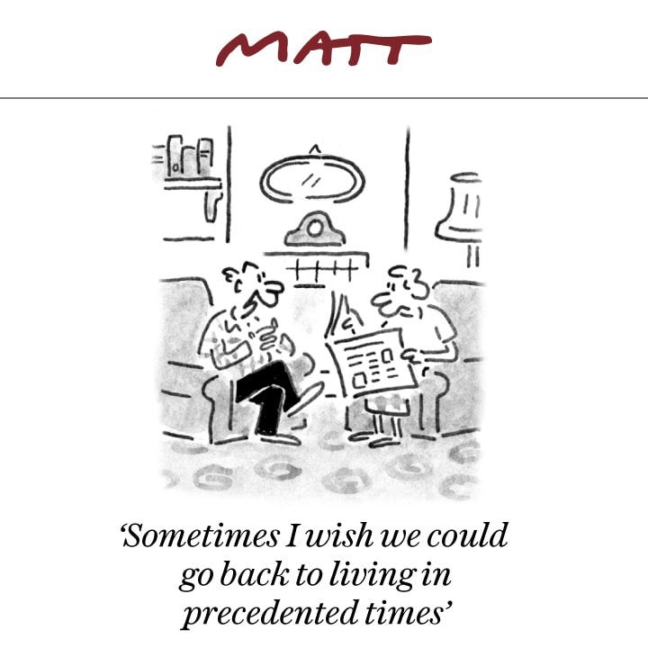
promoting collaboration & Innovation
A “novel” virus with many unknowns, e.g.,:
Mechanism
Prevention
Spread
Treatment
https://www.fda.gov/emergency-preparedness-and-response/coronavirus-disease-2019-covid-19/coronavirus-disease-2019-covid-19-frequently-asked-questions#:~:text=A%20novel%20coronavirus%20is%20a,like%20the%20common%20cold.
Notes:
Nature of virus and circumstances – compatible with patent pledges
Uncharted path; no clear precedent
Existing, conventional methods may not work, or not sufficient
(as evidenced by mixed/shifting analyses and recommendations)
-> supports more information, more sharing

Slide 14
promoting collaboration & Innovation
Circumstances call for a multi-pronged approach involving:
Underlying mechanism, signaling pathway (biochemistry)
Disease progression (physiology)
Community spread (epidemiology)
Prevention measures (protective equipment, sociology)
Detection and diagnostics (medical devices)
Tracking (telecommunications, government)
Treatment (medicine, pharmacology)
Prevention (vaccine development)
https://pxhere.com/en/photo/1452869
Notes:
Stakeholders. industries, entities
Different expertise
no single solution
Detection
Diagnosis
Tracking
Treatment
Prevention

Slide 15
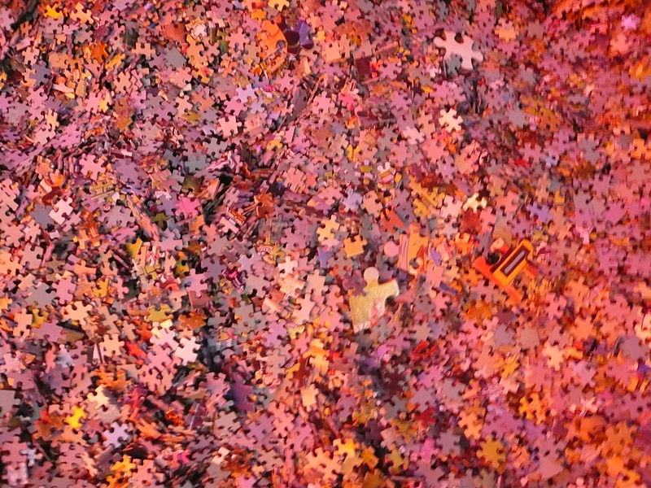
promoting collaboration & Innovation
Circumstances call for a multi-pronged approach involving:
Underlying mechanism, signaling pathway (biochemistry)
Disease progression (physiology)
Community spread (epidemiology)
Prevention measures (protective equipment, sociology)
Detection and diagnostics (medical devices)
Tracking (telecommunications, government)
Treatment (medicine, pharmacology)
Prevention (vaccine development)
https://commons.wikimedia.org/wiki/File:Puzzle_pieces.jpg
Notes:
Detection
Diagnosis
Tracking
Treatment
Prevention

Slide 16
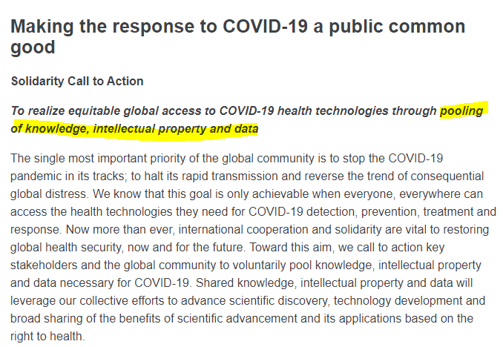
promoting collaboration & Innovation
Consistent with the goal of the patent system
“To promote the progress of science and useful arts. . . .”
Consistent with global/political direction
WHO “Solidarity Call for Action”
https://www.who.int/emergencies/diseases/novel-coronavirus-2019/global-research-on-novel-coronavirus-2019-ncov/covid-19-technology-access-pool/solidarity-call-to-action

Slide 17
New setting, familiar concept
Open Source Licensing
Copyleft
Previous Patent Pledges
https://en.wikipedia.org/wiki/Open-source_software#/media/File:Opensource.svg
https://en.wikipedia.org/wiki/Copyleft#/media/File:Copyleft.svg
https://en.wikipedia.org/wiki/File:GPLv3_Logo.svg

Slide 18
promoting collaboration & Innovation
Little to lose
Line-drawing problems in technology developed through collaboration
Potential difficulties of asserting patents
Arguments before a jury
Mine
https://www.pxfuel.com/en/free-photo-oskhr

Slide 19
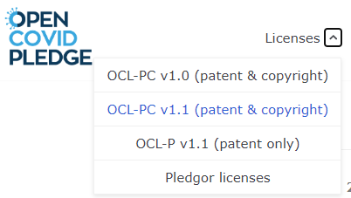
Profits and public good
Benefits to the company
Can limit types of IP and scope
Limitations on time
“lasts until one year after the World Health Organization declares the COVID-19 Pandemic to have ended, but in any event not beyond January 1, 2023. . . .”
Limitations on field of use
“solely for the purpose of diagnosing, preventing, containing, and treating COVID-19”
Notes:
Can adopt one of several model licenses
Can create own compatible license
Can make an alternative license

Slide 20
Profits and public good
Protection of pledger's rights
No sublicenses
No warranties or indemnification to licensee
No license to trademark or trade secret
Unpatentable inventions, combination methods, formulations
Shaping provisions re: governing law, venue
Leverage for future licenses
Regulatory exclusivity

Slide 21
Profits and public good
Corporate Social Responsibility (CSR)
Public message and the “Common Good”
Peer companies
Bayh-Dole Act
Notes:
Bayh-Dole: authorizes federal agencies to grant exclusive licenses to inventions owned by the federal government
- life sciences and tech research funded by the government

Slide 22
Against Patent Pledges In Covid-19 Research
Howard T. Markey Intellectual Property American Inn of Court
June, 2020

Slide 23
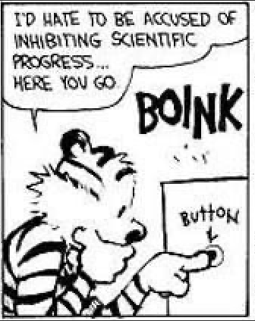
I. Are pledges good for companies?
Pro:
Provides “good press” or potential sales opportunities.
Incentivizes company to focus on core mission and not on Covid-19 innovation.

Slide 24
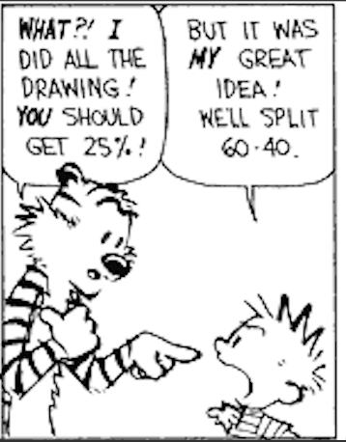
II. Are pledges good for companies?
Con:
Eliminates potential profit source, particularly for life-sciences companies.
Any Covid-19 inventions must be maintained as trade secrets or exposed to public without protection.
Small companies who pledge may have trouble obtaining funding or profiting if their invention is successful.
In extreme cases pledge may expose directors to liability.

Slide 25
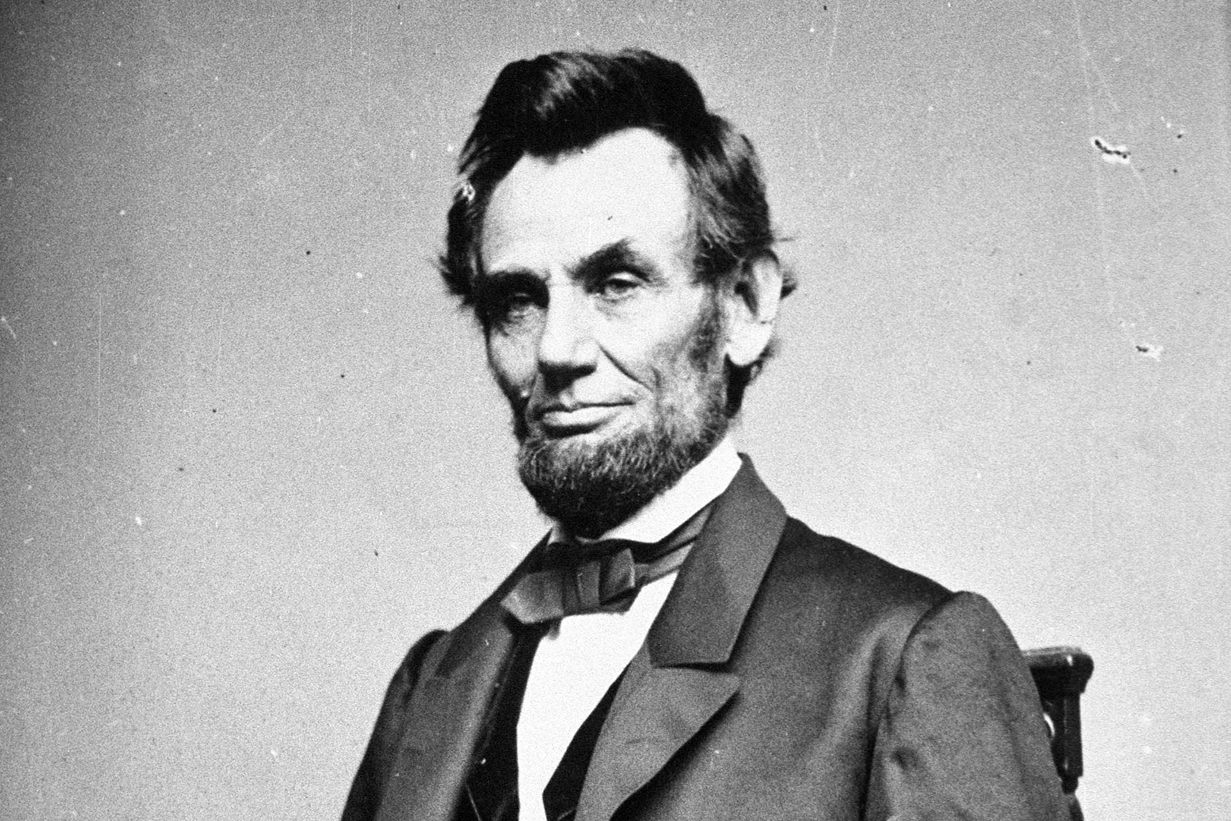
III. Patent System
Deeply engrained in American law, tradition, and economics:
“To promote the progress of science and useful arts, by securing for limited times to authors and inventors the exclusive right to their respective writings and discoveries.”
“The patent system…added the fuel of interest to the fire of genius in the discovery and production of new and useful things"

Slide 26
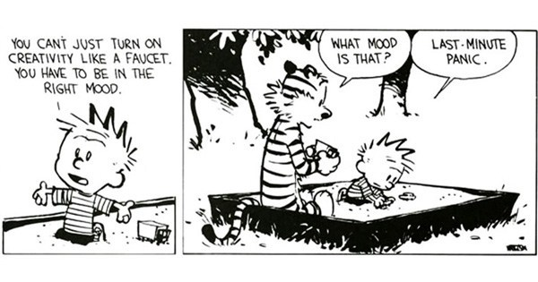
1V. Will pledges help society?
Pledge is a commitment not to exercise patent monopoly over Covid-19 relief efforts.
Pledging may help non-pledging organizations to have more confidence that their work will not be subject to infringement cases during epidemic.
But . . . pledging eliminates a major economic incentive for the pledgor to take risks towards creating new solutions to the Covid-19 problem

Slide 27
V. What should pledging organizations do instead?
Grant temporary free license only to patents/copyrighted materials that do not specifically mention Covid-19.
Quickly publish/patent new developments on Covid-19.
Publish patent licensing terms for Covid-19 research or commercialization.

Slide 28
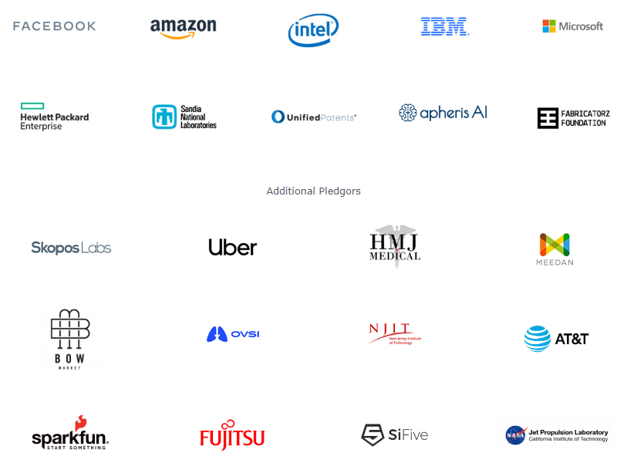
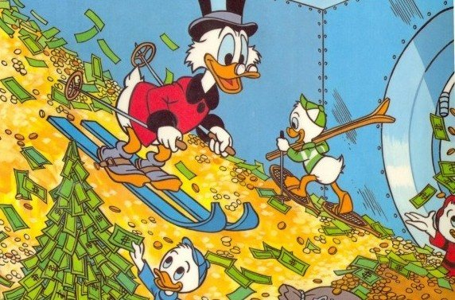
VI. What Can pledging organizations do to help solve covid-19?

Slide 29
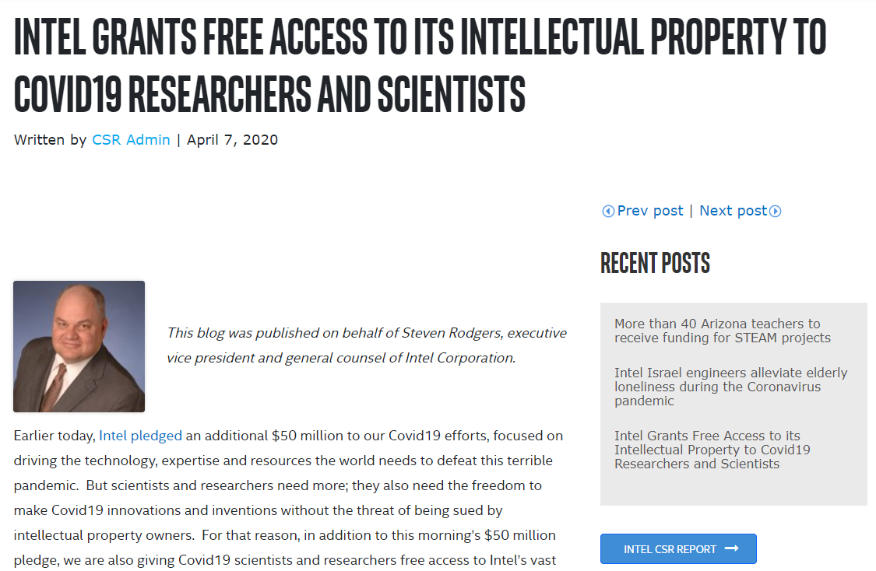
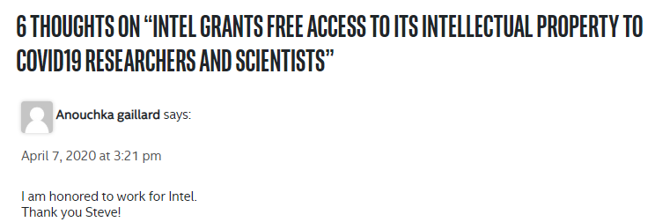
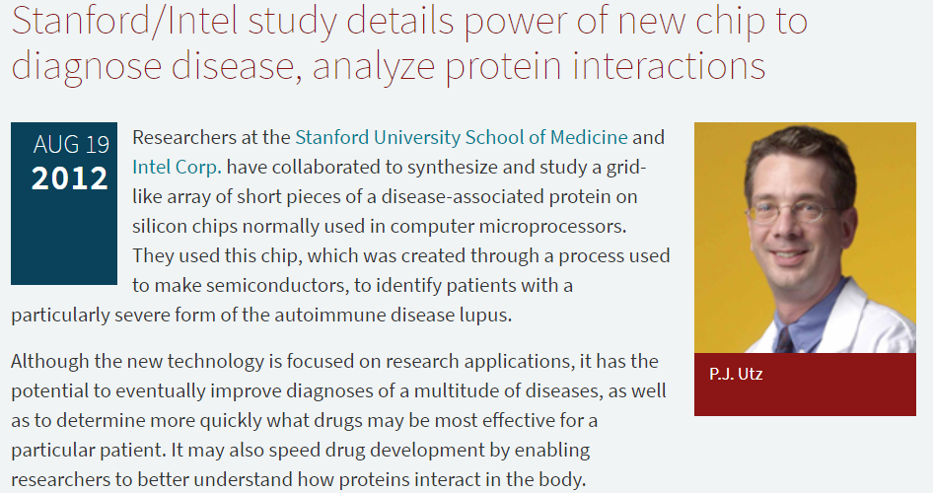
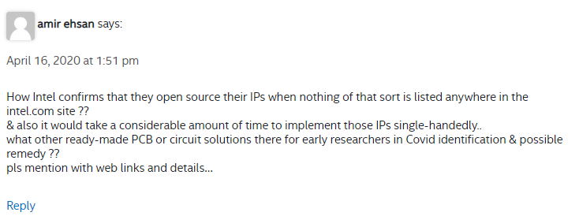
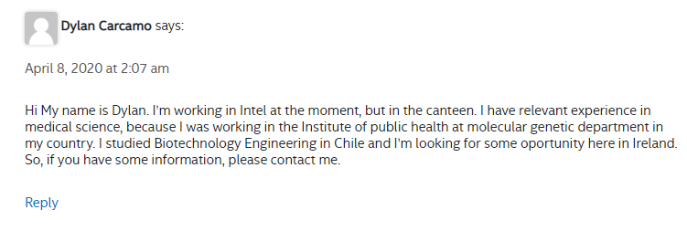
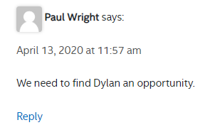
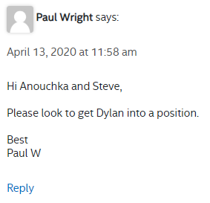
VII. What Can pledging organizations do to help solve covid-19?

