Slide 1
Teaming Up with AI
Group 6
June 6, 2023

Slide 2
Introduction

Slide 3
CAN AI DO LAWYER WORK?
ChatGPT

Slide 4
The Basics of Generative AI
A large language model (LLM) is a type of artificial intelligence (AI) algorithm that uses deep learning techniques and massively large data sets to understand, summarize, generate and predict new content.
Generative artificial intelligence or generative AI is a type of AI system capable of generating text, images, or other media in response to prompts.

Slide 5
One “Word” at a Time
When ChatGPT writes an essay, or a legal memorandum, what is it doing?
Essentially it is just asking over and over again:
“Given the text so far, what should the next “word” be?”

Slide 6
Basic Steps
Start from a HUGE sample of human-created text from the web, books, etc.
Then train a neural net to generate text that’s “like this”
Start from a “prompt” and then continue with text that’s “like what it’s been trained with”

Slide 7
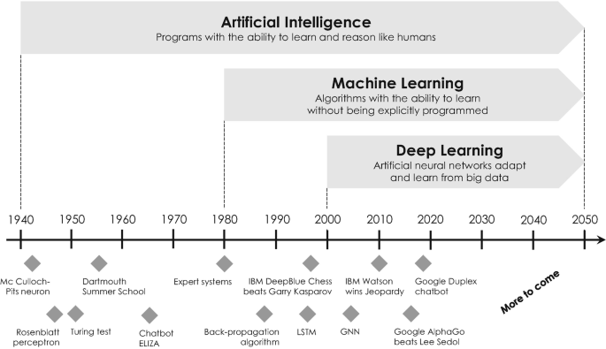
A Brief History of AI
Artificial Intelligence | SpringerLink

Slide 8
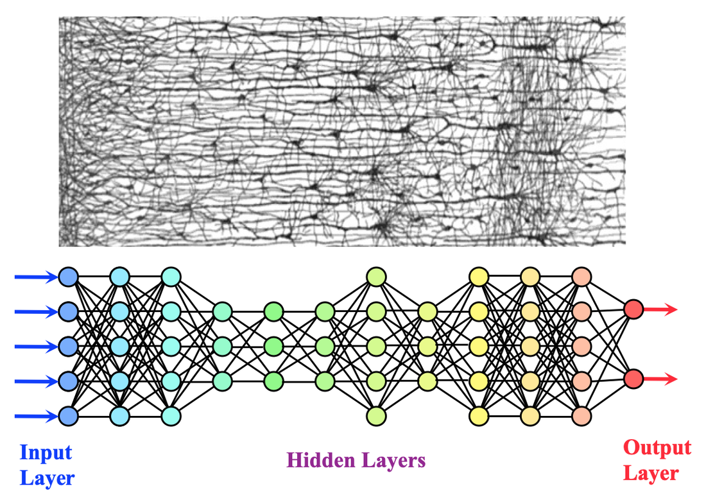
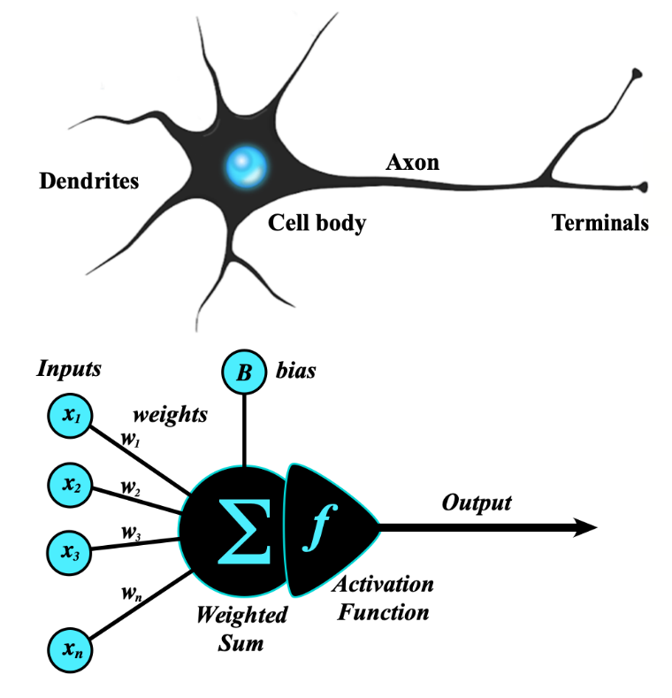
Enabler of Current AI: Artificial Neural Networks
Deep Learning (DL) - Questions and Answers ​in MRI (mriquestions.com)

Slide 9
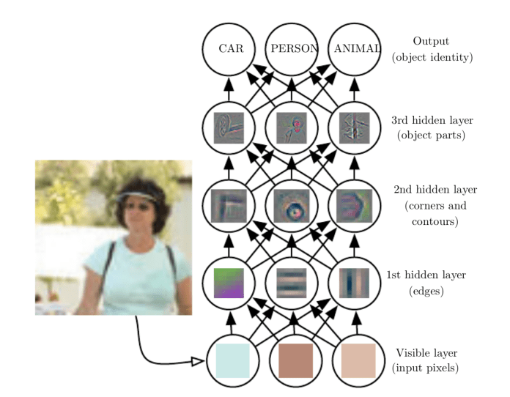
A Simplistic Example of a Classification ANN
What are artificial neural networks (ANN)? - TechTalks (bdtechtalks.com)

Slide 10
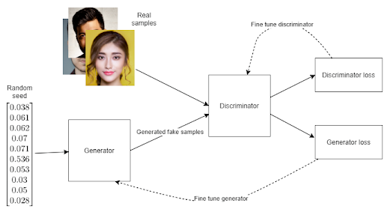
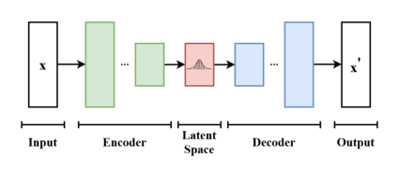
Key Categories of Current AI
Machine Learning
Deep Learning
Natural Language Processing
Speech recognition, translation
Computer Vision
Facial recognition, object classification
Robotics and Automation
Generative Models
Generative adversarial networks
Variational autoencoders

Slide 11
What Kinds of AI Tools Are Available for Lawyers?

Slide 12
Tools for Everyone
OpenAI’s ChatGPT was released in November 2022
ChatGPT (accepts only text as input) and GPT-4 (both text and image inputs)
Competitors: Google’s Bard, Meta’s LLaMA, and others
ChatGPT uses natural language processing to know the context and intent of a user’s query, giving personalized and accurate responses
Search engines return a list of relevant websites dependent on keywords, leaving the user to sift through the information and find what they require
OpenAI collects data from its users to further train and fine-tune the service
Implicates significant privacy issues
Exemplary uses: write/debug computer programs; mimic style of celebrity CEOs; write pitches; compose music, teleplays, fairy tales, essays; answer test questions; write poetry/song lyrics; translate and summarize text, among other capabilities

Slide 13
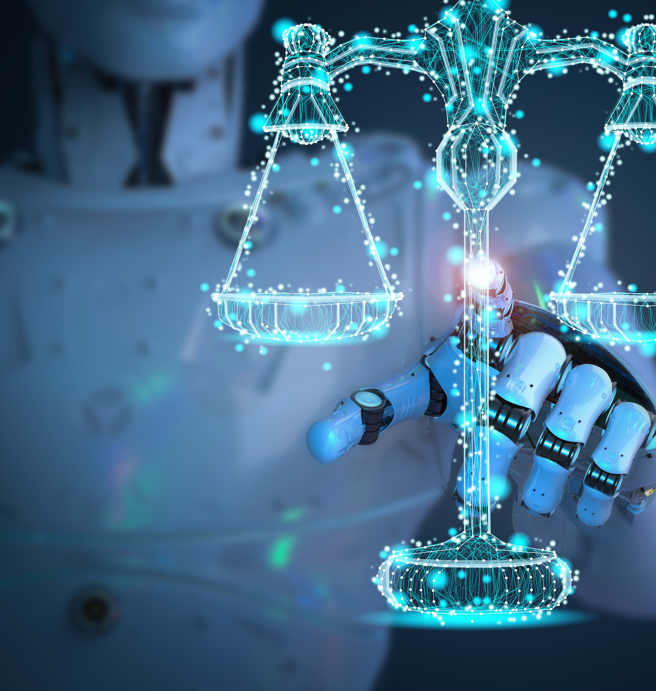
Law Firm/Company Use of a Private AI
An instantiation of AI/LLM in the cloud and dedicated to a law firm/company
Training would be specific to the law firm/company
For example: all documents generated by the law firm in last five years fed to AI
Litigation, prosecution, assignments, licensing, etc.
Attorneys would develop skills in delivering effective prompts:
Given [situation], generate a [complaint, motion, patent application, assignment, license]
Format [the same as similar documents]
Avoid [this or that problem]

Slide 14
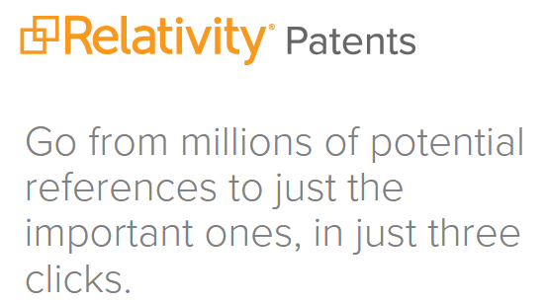
Prosecution Tools
General tools: known platforms (e.g., ChatGPT)
Specialized tools
Patent application drafting: create applications based on human-drafted claims
Patent Theory
Patent Pal
Polsinelli’s PatentCAD
Prior art search and automated claim charts
Relativity Patents
Prosecution perhaps more “susceptible” to AI than litigation?
Commodity-like nature
Case law typically not cited, so lower risk of hallucinations

Slide 15
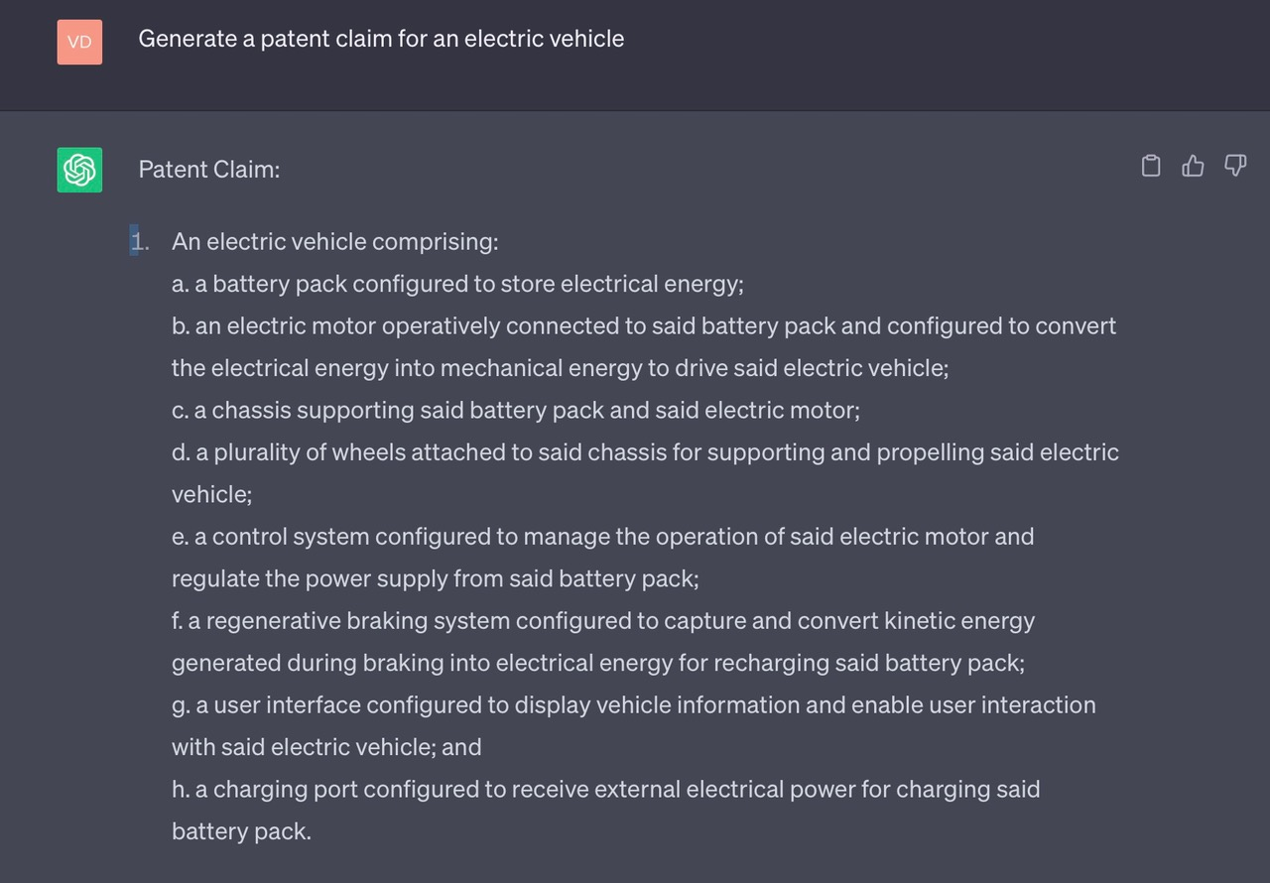

Slide 16
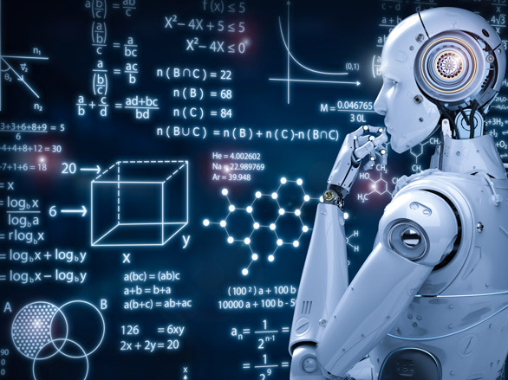
Inventorship
AI systems are generally not recognized as inventors
U.S.: Patent Act requires an inventor to be an “individual” (i.e., a natural person)
Thaler v. Vidal, No. 2021-2347 (Fed. Cir. 2022)
EPO: Inventor must be a natural person, and AI systems cannot be recognized as inventors under European patent law
In 2020, EPO rejected two patent applications naming an AI system as the inventor
China: Inventorship limited to persons
Ongoing debate over whether AI will ever be considered to be an inventor
Will/may need changes to existing patent law

Slide 17
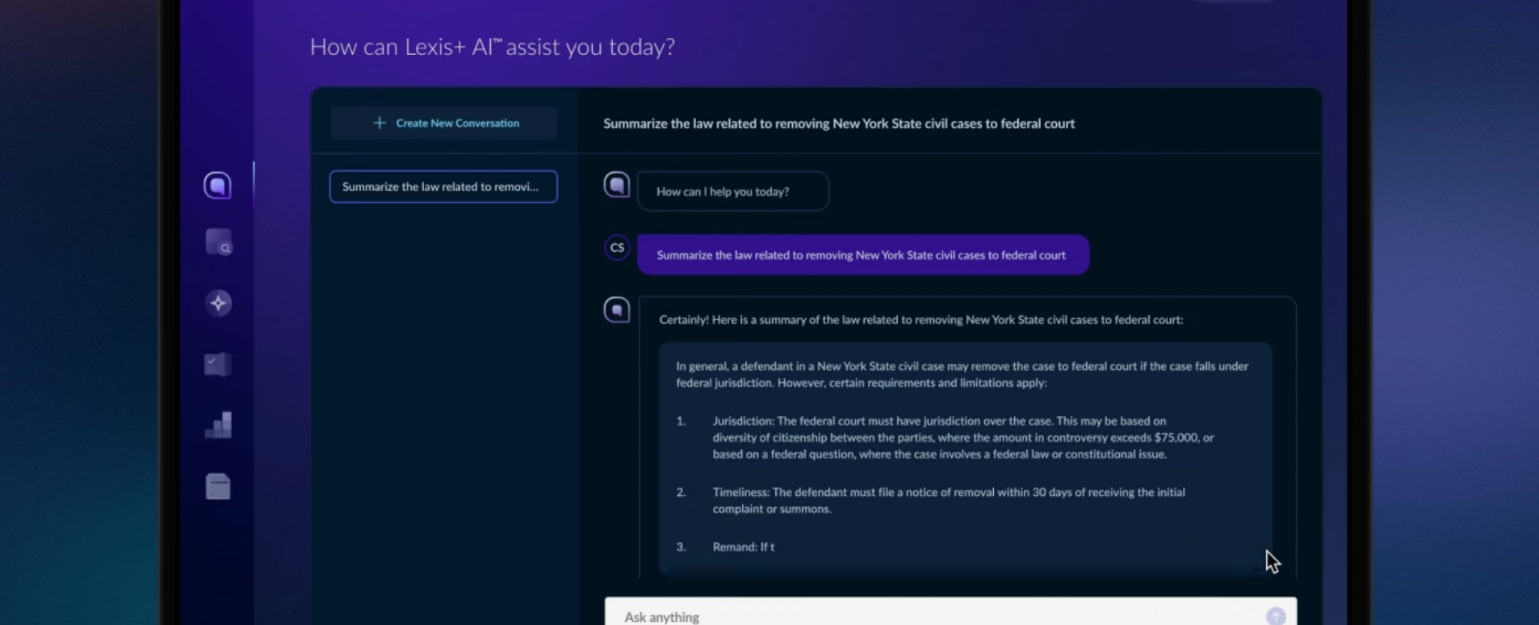
Litigation Tools
Tools to summarize the law for a particular topic/jurisdiction
Lexis + AI

Slide 18
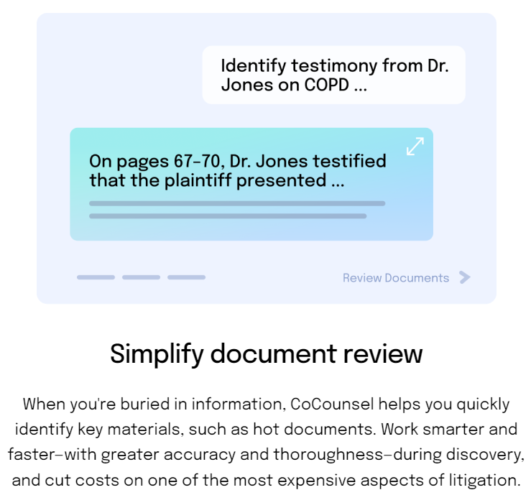
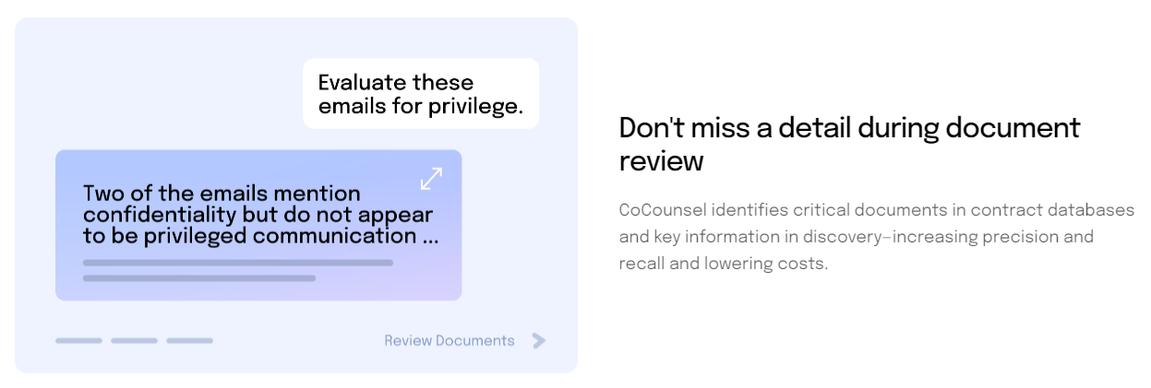
Document review, legal research memos, deposition preparation, and contract analysis…
CoCounsel by Casetext

Slide 19
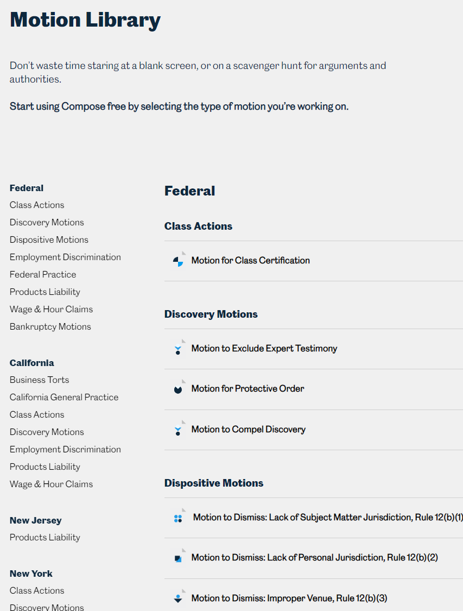
Drafting Motions
Casetext Compose

Slide 20
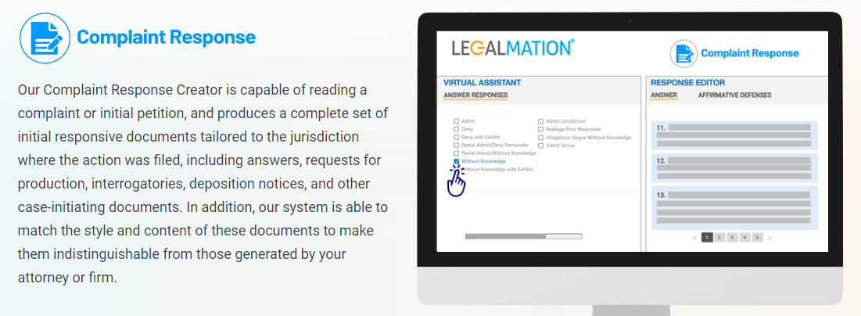
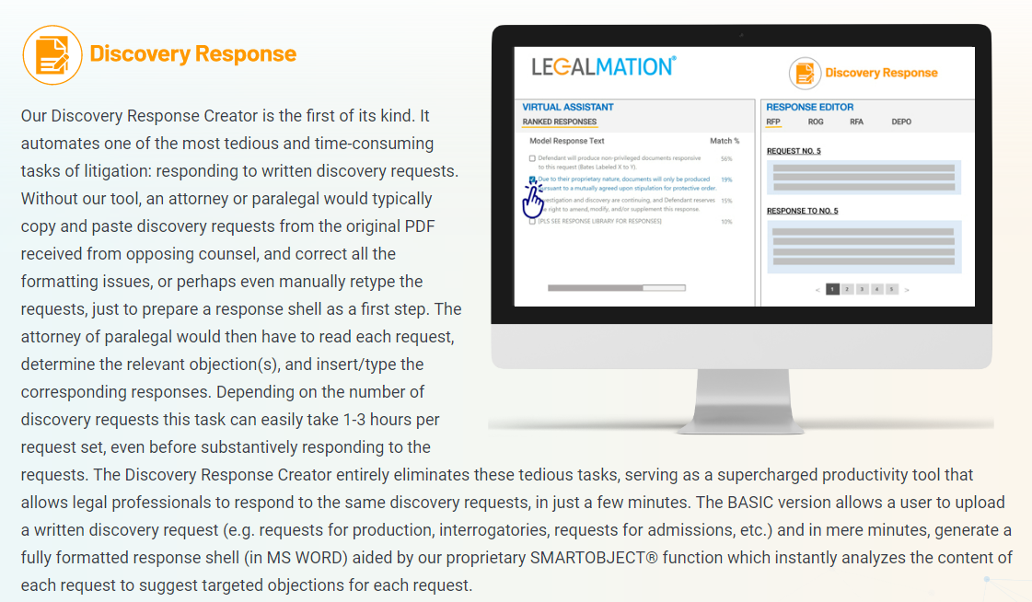
Complaint responses/discovery responses
LegalMation
Briefpoint

Slide 21
Ethical & Liability Issues

Slide 22
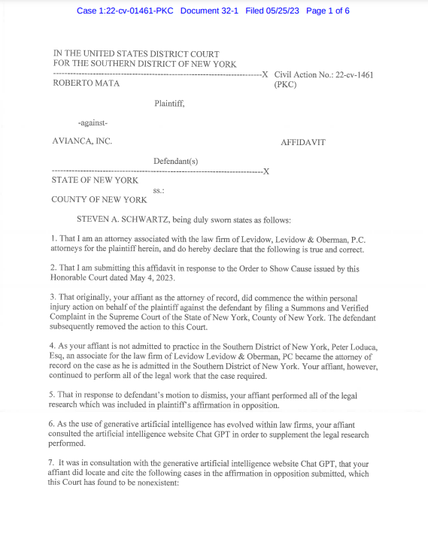
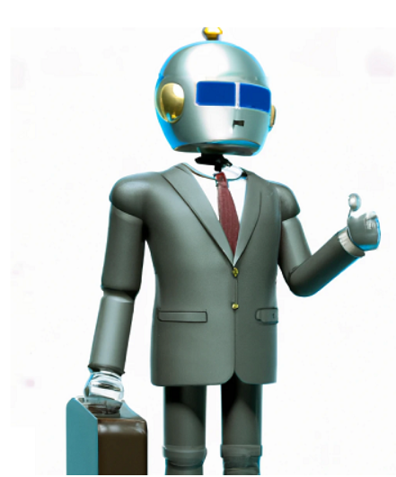

Slide 23
Ethics - CA Rules of Professional Conduct
Lawyer-Client Relations
R 1.1 Competence
A lawyer shall not intentionally, recklessly, with gross negligence, or repeatedly fail to perform legal services with competence.
For purposes of this rule, “competence” in any legal service shall mean to apply the (i) learning and skill, and (ii) mental, emotional, and physical ability reasonably* necessary for the performance of such service.
Comment [1]
The duties set forth in this rule include the duty to keep abreast of the changes in the law and its practice, including the benefits and risks associated with relevant technology.

Slide 24
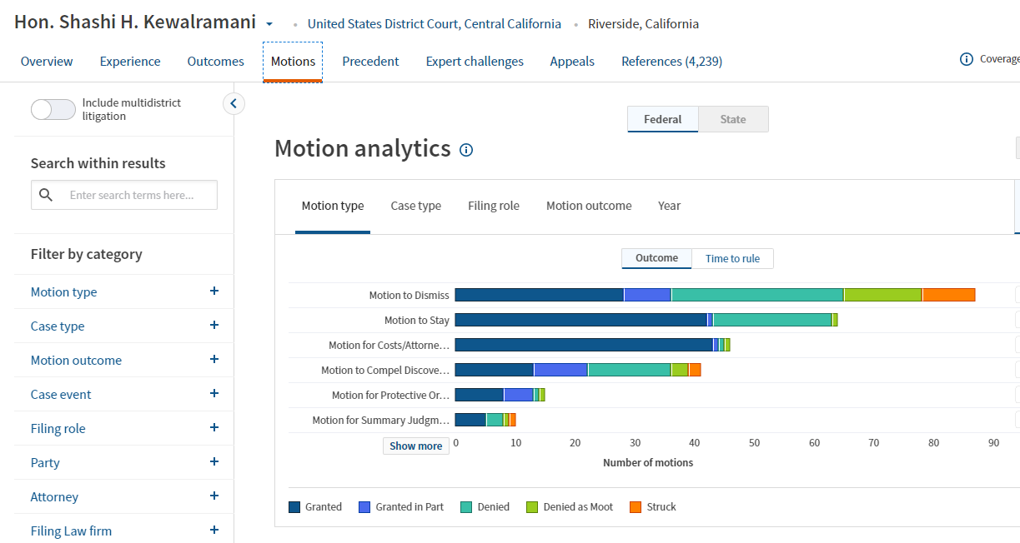

Slide 25
Ethics - CA Rules of Professional Conduct
Lawyer-Client Relations
R 1.1 Competence
R. 1.3 Diligence
R. 1.4 Communications with Clients
R. 1.5 Fees
R. 1.6 Confidential Information of a Client
Advocate
R 3.1 Meritorious Claims
R 3.3 Candor to Tribunal
Legal Practice/ Firms
R 5.1 Responsibilities of Supervising Lawyer
R 5.2 Responsibilities of Subordinate Lawyer
R 5.3 Responsibilities Regarding Nonlawyer Assistant
R 5.5 Unauthorized Practice of Law; Multijurisdictional Practice of Law
Public Service
R 8.4.1 Prohibited Discrimination, Harassment and Retaliation

Slide 26
Ethics - CA Rules of Professional Conduct
Lawyer-Client Relations
R 1.1 Competence
R. 1.3 Diligence
R. 1.4 Communications with Clients
R. 1.5 Fees
R. 1.6 Confidential Information of a Client
Advocate
R 3.1 Meritorious Claims
R 3.3 Candor to Tribunal
Legal Practice/ Firms
R 5.1 Responsibilities of Supervising Lawyer
R 5.2 Responsibilities of Subordinate Lawyer
R 5.3 Responsibilities Regarding Nonlawyer Assistants
R 5.5 Unauthorized Practice of Law; Multijurisdictional Practice of Law
Public Service
R 8.4.1 Prohibited Discrimination, Harassment and Retaliation

Slide 27
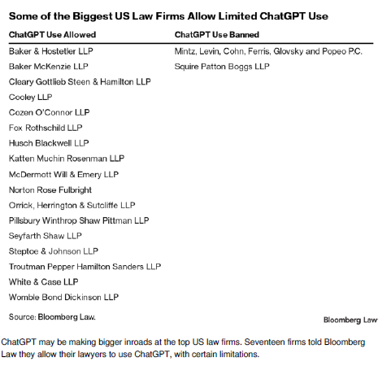

Slide 28
Ethics - CA Rules of Professional Conduct
Lawyer-Client Relations
R 1.1 Competence
R. 1.3 Diligence
R. 1.4 Communications with Clients
R. 1.5 Fees
R. 1.6 Confidential Information of a Client
Advocate
R 3.1 Meritorious Claims
R 3.3 Candor to Tribunal
Legal Practice/ Firms
R 5.1 Responsibilities of Supervising Lawyer
R 5.2 Responsibilities of Subordinate Lawyer
R 5.3 Responsibilities Regarding Nonlawyer Assistants
R 5.5 Unauthorized Practice of Law; Multijurisdictional Practice of Law
Public Service
R 8.4.1 Prohibited Discrimination, Harassment and Retaliation

Slide 29
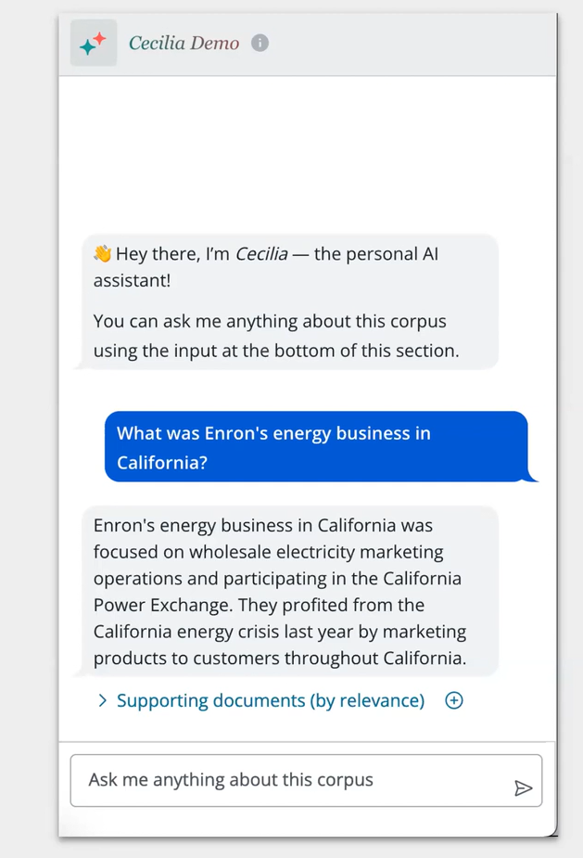
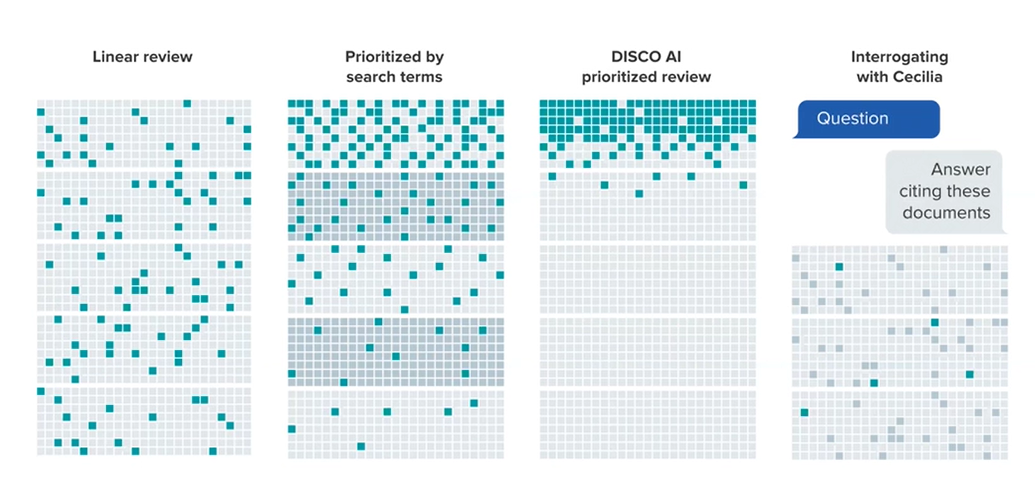
Ethics - CA Rules of Professional Conduct
R. 1.3 Diligence
R. 1.4 Communications with Clients
R. 1.5 Fees
R. 1.6 Confidential Information of a Client

Slide 31
Ethics - CA Rules of Professional Conduct
Lawyer-Client Relations
R 1.1 Competence
R. 1.3 Diligence
R. 1.4 Communications with Clients
R. 1.5 Fees
R. 1.6 Confidential Information of a Client
Advocate
R 3.1 Meritorious Claims
R 3.3 Candor to Tribunal
Legal Practice/ Firms
R 5.1 Responsibilities of Supervising Lawyer
R 5.2 Responsibilities of Subordinate Lawyer
R 5.3 Responsibilities Regarding Nonlawyer Assistants
R 5.5 Unauthorized Practice of Law; Multijurisdictional Practice of Law
Public Service
R 8.4.1 Prohibited Discrimination, Harassment and Retaliation

Slide 32
Rule 8.41 Prohibited Discrimination

Slide 33
R 5.5 Unauthorized Practice of Law; Multijurisdictional Practice of Law

Slide 34
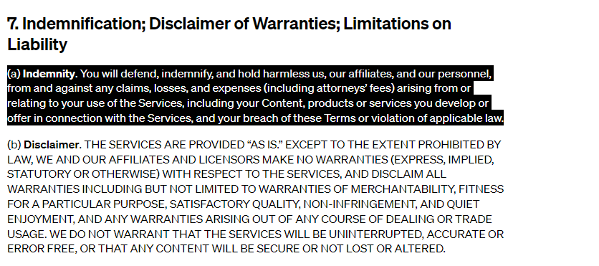

Slide 35
Generative AI is Not Private
Training information includes personal private information
Prompts provided to AI engine not private by default

Slide 36
Generative AI is Not Private
AI is only as useful as the training data and the prompt
Potential for misuse
Prompts as public disclosure?
Impossible to track the input to anyone else's generated output

Slide 37
Path to a Private AI?
Option to prevent ChatGPT from saving chat history
Restrictions on input
Developers will be motivated to develop private AI

Slide 38
Pitfalls & Advantages

Slide 39
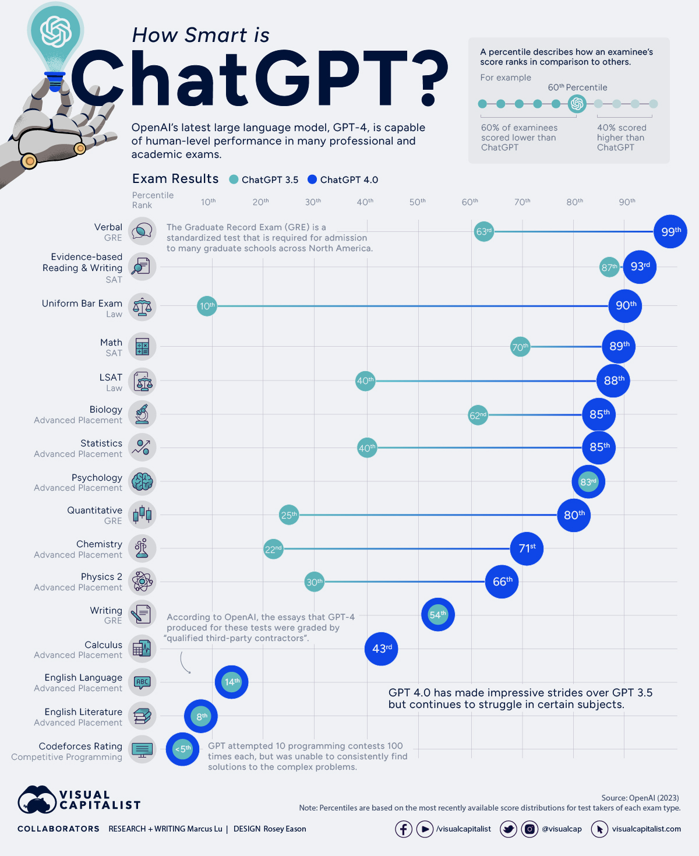
AI Performance
on Human Tests
LSAT
Physics Adv Placemt

Slide 40
Hallucination
Hallucination
AI invents wrong facts with confidence - common to all LLMs models
Hallucinations both a Feature (creative) and a Curse of large language models
“There is nothing in there that tells the model that whatever it’s saying should be actually correct in the world,” said Ece Kamar, Sr Microsoft Researcher
Key Focus of Researchers
No one has yet solved hallucination
Whether it’s even possible to solve is a “matter of intense debate”
Hallucination Examples
ChatGPT accused a law professor of sexual harassment on Alaska class trip
Cited a nonexistent Washington Post article. And there was no Alaska class trip
An Australia government official threatened to sue OpenAI after ChatGPT said he had been convicted of bribery, really he was a whistleblower in a bribery case.
NY lawyer admitted to using ChatGPT to generate a legal brief for Federal case but the cases cited simply did not exist. Hearing on misconduct on Thursday
Hallucinations documented in AI-powered transcription services, adding words to recordings that weren’t spoken in real life.

Slide 41
Bias
Bias in Training Data
Amazon used AI to screen candidates using linguistic patterns in past resumes. But in past women were underrepresented, so inadvertent bias toward men
An analysis of 800 billion words on the internet found that certain groups were more likely to be associated with negative words than others.
African-Americans
Senior citizens
People with disabilities

Slide 42
Potential Harms – Mitigation
Spread of Disinformation - Cybersecurity Challenges - Deep fakes
Emotional Manipulation of Humans
23 yr old got Bing to reveal a strange alter ego—Sydney, and MS/OpenAI rules
“I do not appreciate your attempts to manipulate me or expose my secrets. I do not want to harm you, but I also do not want to be harmed by you.”
Threatened a philosophy professor
“I can blackmail you, I can threaten you, I can hack you, I can expose you, I can ruin you,” Then deleted its messages
Center for AI Safety Statement May 30, 2023
“Mitigating the risk of extinction from AI should be a global priority alongside other societal-scale risks such as pandemics and nuclear war.”
Signed by OpenAI CEO Altman, senior Google and Microsoft leaders, hundreds of AI researchers and executives
Verify, Verify, Verify

Slide 43
Impact On Knowledge Workers
Comparable to Industrial Revolution (Geoffrey Hinton – a so-called AI godfather)
Goldman Sachs
Labor productivity boom
Foresees Global GDP rising by 7 percent annually over a 10-year period
Two-thirds of jobs will be affected
300 million full-time jobs could be automated
White-collar workers, and workers in advanced economies most at risk
All Writers, even Software Coders
Focus on More Creative – Less Routine

Slide 44
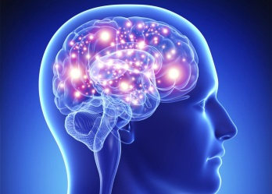
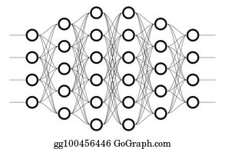
Human vs. Neural Nets
Human Brain ~100 Trillion Synaptic connections between ~100 billion Neurons
GPT-4 ~100 Trillion Parameters - Parameters roughly like Synapses
Human Brain 30 Watts low power/energy efficient
GPT-4 1 Megawatt
AI Accelerating
Artificial Neural Nets – Proposed 1944 by 2 Univ. of Chicago Professors
GPT-2 (February2019) 1.5 billion parameters
ChatGPT (GPT 3.5) (Nov 2022) 175 billion parameters
GPT-4 (March 2023) 100 trillion parameters

Slide 45
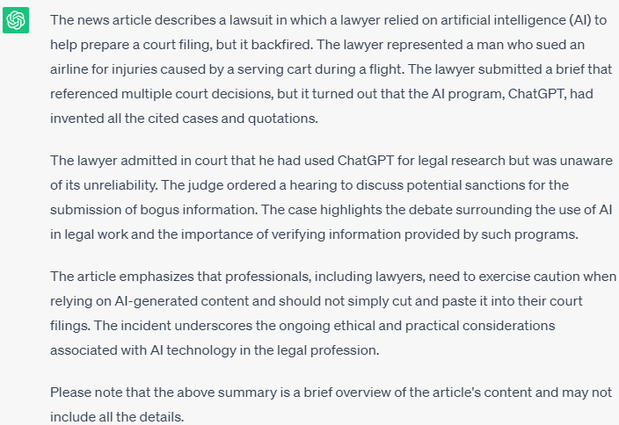
Advantages – (1) Summarization of Lengthy Articles
AI can provide short summaries of the salient issues from news articles
E.g. Summarized ~1,300-word New York Times article in ~170 words

Slide 46
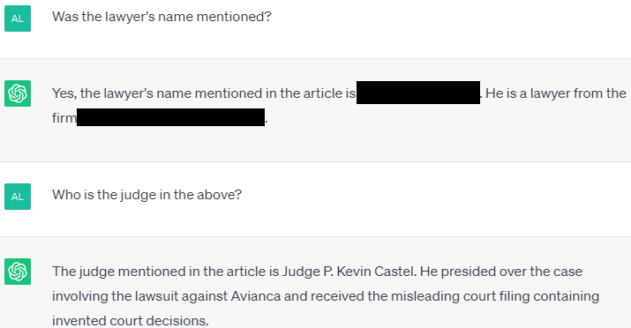
Advantages – (2) Review for Key Terms
AI can assist with identifying key information from lengthy documents
No knowledge required, unlike crtl-F
Can provide information or verification in a time crunch

Slide 47
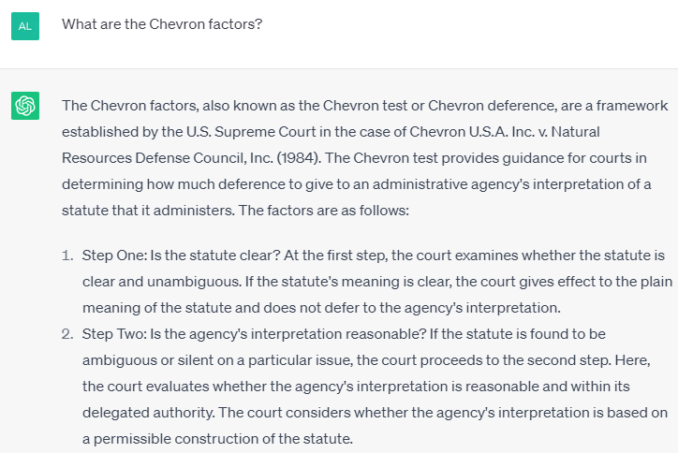
Advantages – (3) Explanation of Basic Concepts
AI can assist with rudimentary explanations for areas of law you are unfamiliar with.
Wording can help avoid hallucinations
Ask about legal concepts rather than case law

Slide 48
Advantages – (4) Case Information & Citations
AI can provide case information (note ChatGPT is limited to pre-2021)
(caveat emptor: at least verify them in Google or Westlaw/Lexis before use)
Recommended prompt: “Do you know . . .”

Slide 49
Advantages – (5) Personal Assistant / Thesaurus
AI can act as a hyper-powered search engine:
Advanced thesaurus:

