Slide 1

CASE UPDATES
Group 5
May 2, 2023

Slide 2
Where to Get Your News and Stats
Law360
Lex Machina
Docket Navigator
OCIPLA
Markey!

Slide 3
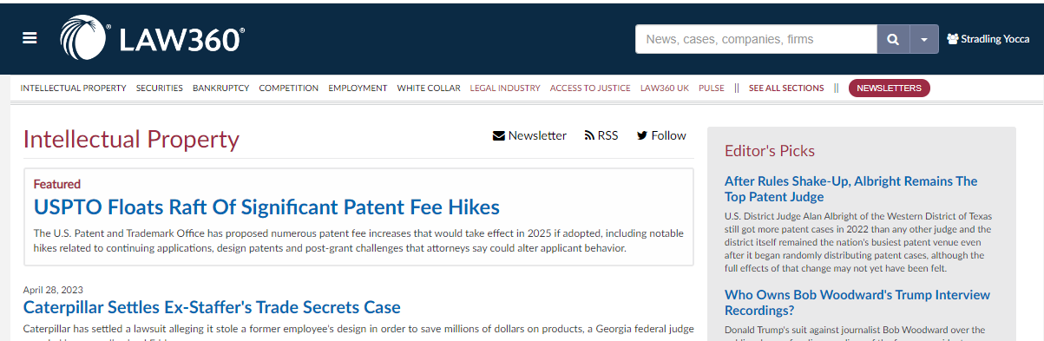
Law360
News Website Tailored to Happenings in the Law
Custom Newsletters
Breaking News

Slide 4
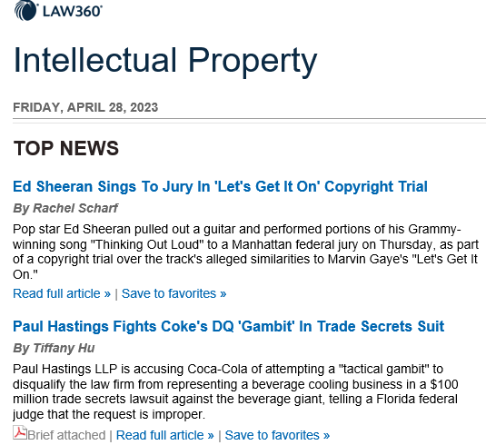
Law360

Slide 5
Lex Machina
Allows Detailed Statistical Research
Search Dockets
Provides Analytics Updates

Slide 6
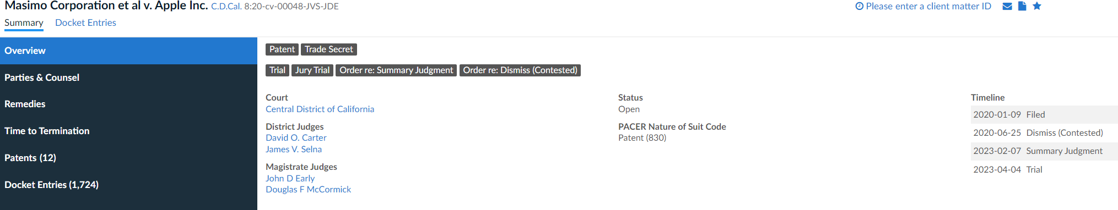
Lex Machina

Slide 7
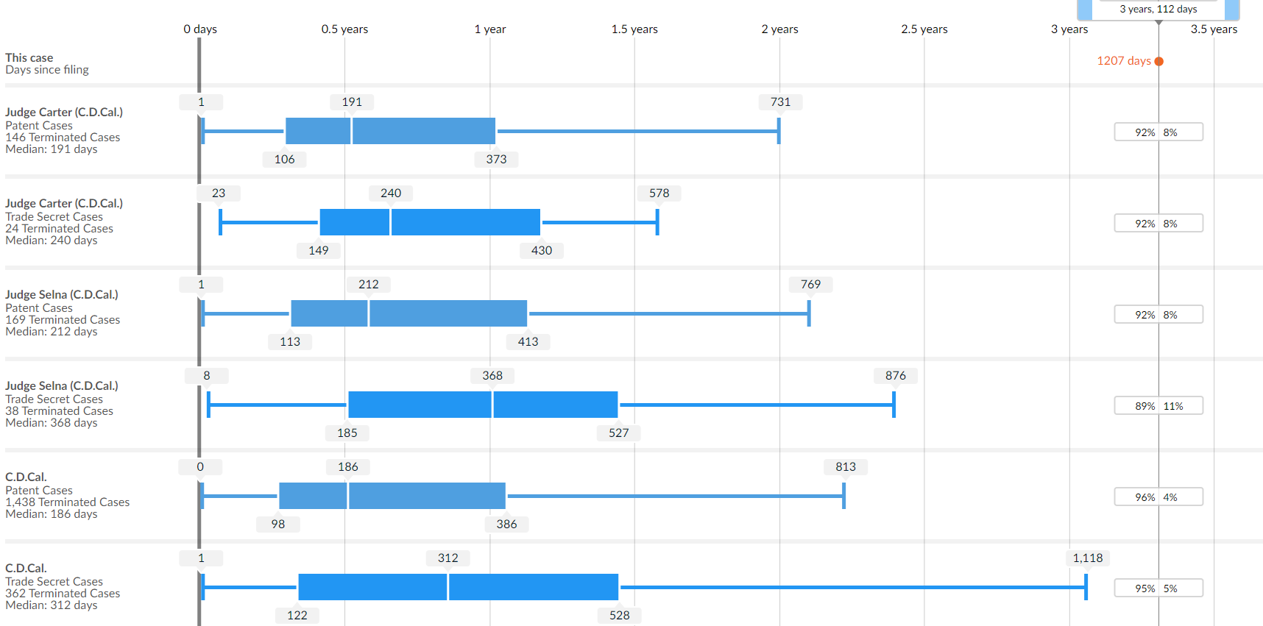
Lex Machina

Slide 8
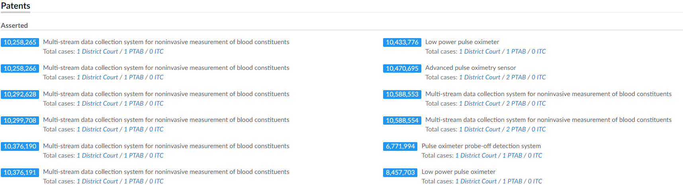
Lex Machina

Slide 9

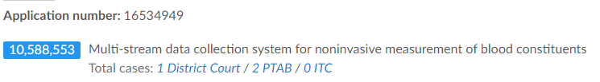
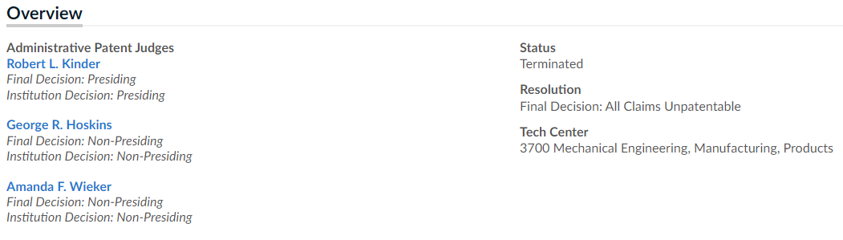
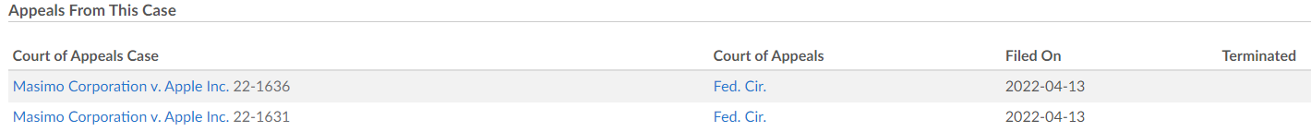
Lex Machina

Slide 10
Docket Navigator
Allows Comparisons of Courts and Judges
Analysis of Decisions on Certain Issues
Regular News Updates Specific to Patent Litigation

Slide 11
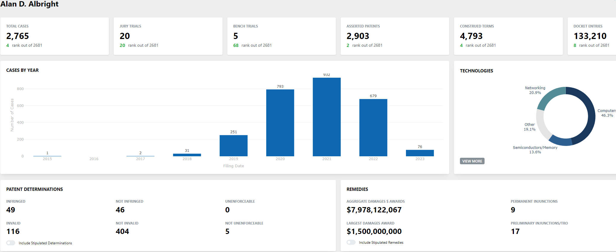
Docket Navigator

Slide 12
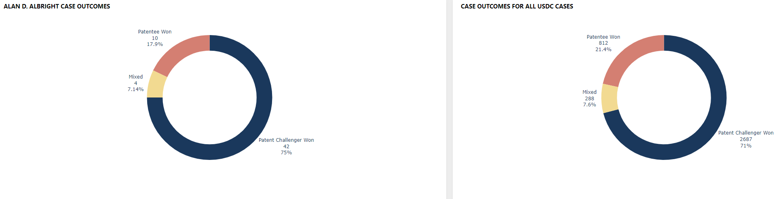
Docket Navigator

Slide 13
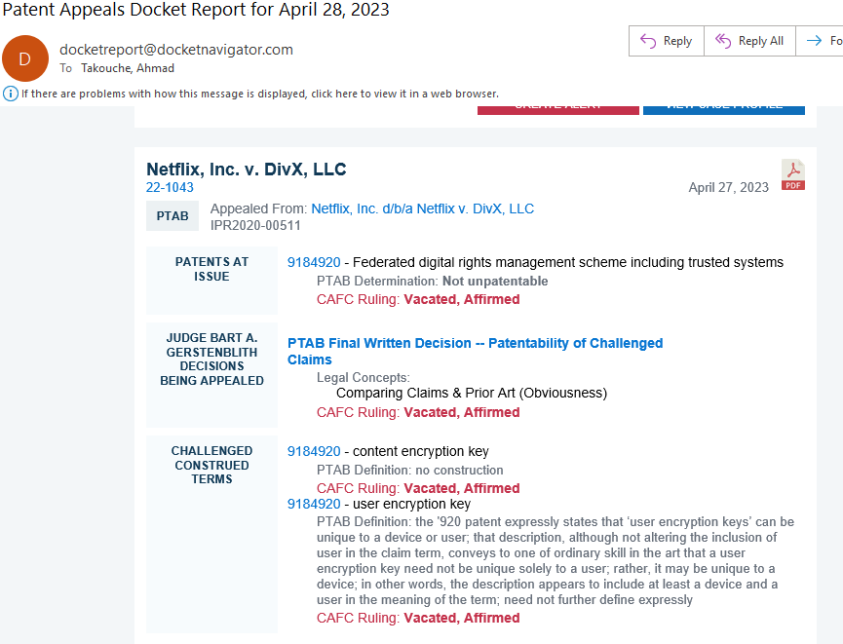
Docket Navigator

Slide 14
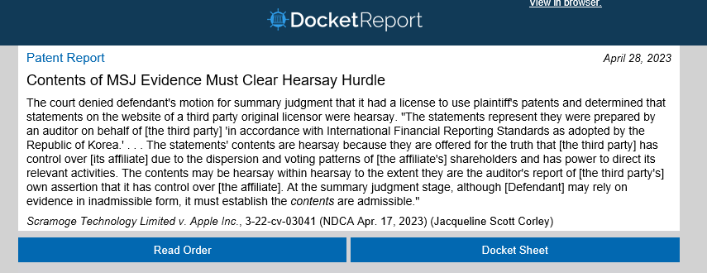
Docket Navigator

Slide 15
Cases to Keep an Eye On
Group 5
May 2, 2023

Slide 16
Jack Daniel’s Properties, Inc. v. VIP Products LLC

Slide 17
Jack Daniel’s Properties, Inc. v. VIP Products LLC
Lanham Act (15 U.S.C. § 1114)
  Standard for infringement: Likelihood of confusion as to origin, sponsorship, or approval

Slide 18

Jack Daniel’s Properties, Inc. v. VIP Products LLC
The ROGERS test:
Title of an expressive work does not violate Lanham Act unless title has:
  (1) no artistic relevance
  (2) explicitly misleads

Slide 19
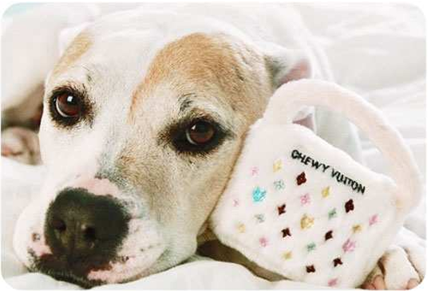
Jack Daniel’s Properties, Inc. v. VIP Products LLC
Should ROGERS be used to bypass likelihood of confusion?

Slide 20
Amgen, Inc. et al. v. Sanofi, et al.
Group 5
May 2, 2023

Slide 21
Summary of Case
Paten Subject Matter: Antibodies for Treating LDL-C
LDL-C (bad cholesterol) typically treated with statins
In the alternative, treated with PCSK9 inhibitor (medicine claimed by patents at issue)
Two patents at issue here (’165 Patent and ’741 Patent) that share the same specification

Slide 22
Summary of Case (cont’d)
Exemplary Claim:
An isolated monoclonal antibody, wherein, when bound to PCSK9, the monoclonal antibody binds to at least one of the following residues: S153, I154, P155, R194, D238, A239, I369, S372, D374, C375, T377, C378, F379, V380, or S381 of SEQ ID NO:3, and wherein the monoclonal antibody blocks binding of PCSK9 to LDL[-]R. Claim 1 of the ’165 Patent.

Slide 23
Summary of Case (cont’d)
In the Specification:
3,000 human monoclonal antibodies were “rescreened for binding to wild-type PCSK9 to confirm stab[ility] and narrowed to 85 antibodies that blocked interaction between the PCSK9 ... and the LDLR [at] greater than 90%
three-dimensional structures, obtained via x-ray crystallography, of two antibodies known to bind to residues recited in the claims—21B12 (Repatha) and 31H4.
Also discloses the amino acid sequences of twenty-two other antibodies that “bin” with Repatha or 31H4, meaning they compete with these antibodies for binding to PCSK9

Slide 24
Procedural History
First Trial:
  Amgen and Sanofi stipulated to infringement of selected claims and tried issues of validity in March 2016.
    District court granted JMOL of nonobviousness and of no willful infringement.
    Jury jury determined that the patents were not shown to be invalid for lack of enablement and written description.
Second Trial:
  Parties tried the issues of written description and enablement.
  Jury found Sanofi failed to prove that the asserted claims were invalid for lack of written description and enablement.
  The district court granted JMOL for lack of enablement and denied the motion for lack of written description.

Slide 25
Procedural History (cont’d)
Federal Circuit
Issue: Whether a POSITA would be able to practice the claims without undue experimentation (i.e., are the claims enabled).
Wands Factors:
  (1) the quantity of experimentation necessary, (2) the amount of direction or guidance presented, (3) the presence or absence of working examples, (4) the nature of the invention, (5) the state of the prior art, (6) the relative skill of those in the art, (7) the predictability or unpredictability of the art, and (8) the breadth of the claims.
Notes:
“Whether undue experimentation is needed is not a single, simple factual determination, but rather is a conclusion reached by weighing many factual considerations.” Wands, 858 F.2d at 737.
Amgen Inc. v. Sanofi, Aventisub LLC, 987 F.3d 1080, 1084 (Fed. Cir. 2021), cert. granted in part sub nom. Amgen Inc. v. Sanofi, 214 L. Ed. 2d 196 (Nov. 4, 2022).
What emerges from our case law is that the enablement inquiry for claims that include functional requirements can be particularly focused on the breadth of those requirements, especially where predictability and guidance fall short. In particular, it is important to consider the quantity of experimentation that would be required to make and use, not only the limited number of embodiments that the patent discloses, but also the full scope of the claim.
Amgen Inc. v. Sanofi, Aventisub LLC, 987 F.3d 1080, 1086 (Fed. Cir. 2021), cert. granted in part sub nom. Amgen Inc. v. Sanofi, 214 L. Ed. 2d 196 (Nov. 4, 2022)
Claims are broad [agree with district court]
Invention is in an unpredictable field of science re full scope of functional limitations (i.e., citing to testimony by Amgen’s various experts).
“In particular, it is important to consider the quantity of experimentation that would be required to make and use, not only the limited number of embodiments that the patent discloses, but also the full scope of the claim.” Amgen Inc. v. Sanofi, Aventisub LLC, 987 F.3d 1080, 1086 (Fed. Cir. 2021), cert. granted in part sub nom. Amgen Inc. v. Sanofi, 214 L. Ed. 2d 196 (Nov. 4, 2022)

Slide 26
SCOTUS ISSUE
Question Presented before SCOTUS:
Whether enablement is governed by the statutory requirement that the specification teach those skilled in the art to “make and use” the claimed invention, or whether it must instead enable those skilled in the art “to reach the full scope of claimed embodiments” without undue experimentation—i.e., to cumulatively identify and make all or nearly all embodiments of the invention without substantial “time and effort.”

Slide 27
SCOTUS ISSUE
Is the dispute re: enablement legal or factual?
Several Justices asked whether it was a legal or factual question.
Simply an application of Wands factors?
Cumulative effort test / full scope test?

Slide 28
Full Scope Test (Amgen Argument)
Federal Circuit’s Test: “reach the full scope of claimed embodiments” —i.e., to cumulatively identify and make all, or nearly all, possible variations of the invention—without ‘substantial time and effort.’”
Amgen: This heightened standard “has no basis in § 112’s text.”
Notes:
Amgen argues that the Supreme Court “has never suggested that enablement turns on the cumulative ‘time and effort’ that would be required to make all, or virtually all, of a claimed invention’s potentially numerous embodiments.” And since “two centuries of courts never articulated a reach-the-full-scope test ‘tends to negate the existence of’ any such standard.”

Slide 29
Full Scope Test (Amgen Argument)
(a)In General.—The specification shall contain a written description of the invention, and of the manner and process of making and using it, in such full, clear, concise, and exact terms as to enable any person skilled in the art to which it pertains, or with which it is most nearly connected, to make and use the same, and shall set forth the best mode contemplated by the inventor or joint inventor of carrying out the invention.
35 U.S.C. § 112 (a)
Notes:
Amgen argues that the Supreme Court “has never suggested that enablement turns on the cumulative ‘time and effort’ that would be required to make all, or virtually all, of a claimed invention’s potentially numerous embodiments.” And since “two centuries of courts never articulated a reach-the-full-scope test ‘tends to negate the existence of’ any such standard.”

Slide 30
Sanofi Argument
Enablement Test by Federal Circuit is just fine.
[T]he Amgen specification leaves skilled artisans seeking undisclosed embodiments exactly where they were before reading the specification: knowing from published research that certain undisclosed antibodies could be medically useful, and left to use well-known techniques to produce those potentially useful antibodies through trial and error. That is not a patent bargain at all, but a recipe for preempting useful research.
Notes:
An isolated monoclonal antibody, wherein, when bound to PCSK9, the monoclonal antibody binds to at least one of the following residues: S153, I154, P155, R194, D238, A239, I369, S372, D374, C375, T377, C378, F379, V380, or S381 of SEQ ID NO:3, and wherein the monoclonal antibody blocks binding of PCSK9 to LDL[-]R. Claim 1 of the ’165 Patent.

Slide 31
Amicus Briefing
For Appellants (Amgen):
Law professors
National Association of Patent Practitioners (NAPP)
AbbVie, Inc.
Alliance of US Startups
…
For Respondents (Sanofi):
Law professors
Pfizer
Eli Lilly
Genentech Inc., Astrazeneca, Johnson and Johnson
…
Notes:
8 briefs for… 15 against, 5 in favor of neither party.

Slide 32
SCOTUS ISSUE (cont’d)
Amgen: degree of experimentation to get all embodiments (plural) is irrelevant; how to make any singular antibody was adequately disclosed in its patents.
A company will not invest billions of dollars to find new antibodies if genus claims were unavailable.
Sanofi
Claims cover millions of antibodies binding sixteen different residues. But specification only discloses embodiments that bind nine.
Notes:
An isolated monoclonal antibody, wherein, when bound to PCSK9, the monoclonal antibody binds to at least one of the following residues: S153, I154, P155, R194, D238, A239, I369, S372, D374, C375, T377, C378, F379, V380, or S381 of SEQ ID NO:3, and wherein the monoclonal antibody blocks binding of PCSK9 to LDL[-]R. Claim 1 of the ’165 Patent.

Slide 33
Andy Warhol Foundation for the Visual Arts, Inc. v.
Goldsmith
Group 5
May 2, 2023

Slide 34
Copyright Infringement /
Fair Use
District Court:
Granted Summary Judgement to the Warhol Foundation
DC found that Warhol had “transformed” the original photograph by:
  Created a new “meaning and message”
Second Circuit Court of Appeals:
Reversed – Found Infringement and No Fair Use
  Prince remained recognizably derived from original
  Failure to transform

Slide 35
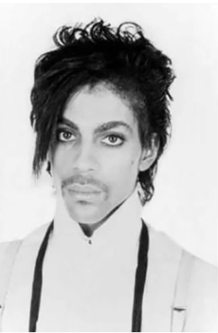
Copyright Infringement /
Fair Use
Background:
Goldsmith was on assignment from Newsweek
  She took several portraits of Price in her studio, but none ended up running in Newsweek
Years later, Vanity Fair was writing an article on Price and wanted an image to accompany it.
  VF licensed the Goldsmith photo from her agency for $400 to use as an artist reference.
  VF had Warhol use the photo to generate an image for VF

Slide 36
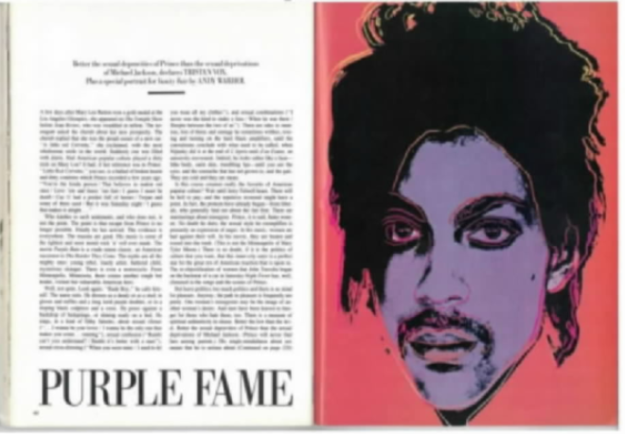
Copyright Infringement /
Fair Use
Background:
Warhol generated the image used in the 1984 Vanity Fair publication:

Slide 37
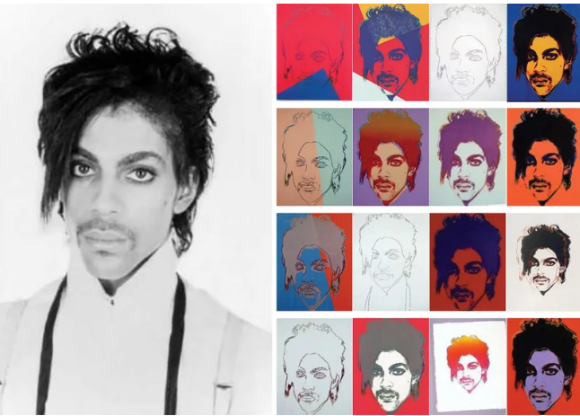
Copyright Infringement /
Fair Use
Background:
Warhol actually made a 16 image set.
12 are now sold and the hands of collectors and museums:

Slide 38

Copyright Infringement /
Fair Use
Background – Fast Forward 30 years:
  2016 (Conde Nast/ Vanity Fair) issues commemorative magazine:
  VF licensed “Orange Prince” for 10K from AWF
    Goldsmith allegedly unaware of the Price Series until publication:

Slide 39
Copyright Infringement /
Fair Use
Background – Registering and Filing Suit:
  Goldsmith then registered the copyright in the Prince photograph
  AWF then preemptively filed suit for a declaratory judgement of noninfringement
  AWF prevailed in the district court
  Second Circuit reversed
  AWF petitioned for cert.

Slide 40
Copyright Infringement
17 U.S. Code § 501 - Infringement of copyright
(a)Anyone who violates any of the exclusive rights of the copyright owner…
§ 502 - Remedies for infringement: Injunctions
§ 503 - Remedies for infringement: Impounding and disposition of infringing articles
§ 504 - Remedies for infringement: Damages and profits
§ 101. Definitions
§ 102. Subject matter of copyright: In general
§ 103. Subject matter of copyright: Compilations and derivative works
§ 104. Subject matter of copyright: National origin
§ 105. Subject matter of copyright: United States Government works
§ 106. Exclusive rights in copyrighted works
§ 107. Limitations on exclusive rights: Fair use

Slide 41
Copyright Infringement
17 U.S. Code § 106. Exclusive rights
(1)to reproduce the copyrighted work in copies or phonorecords;
(2)to prepare derivative works based upon the copyrighted work;
(3)to distribute copies or phonorecords of the copyrighted work to the public by sale or other transfer of ownership, or by rental, lease, or lending;
(4)in the case of literary, musical, dramatic, and choreographic works, pantomimes, and motion pictures and other audiovisual works, to perform the copyrighted work publicly;
(5)in the case of literary, musical, dramatic, and choreographic works, pantomimes, and pictorial, graphic, or sculptural works, including the individual images of a motion picture or other audiovisual work, to display the copyrighted work publicly; and
(6)in the case of sound recordings, to perform the copyrighted work publicly by means of a digital audio transmission.

Slide 42
Copyright Infringement
§ 107. Limitations on exclusive rights: Fair use
Notwithstanding the provisions of sections 106 and 106A, the fair use of a copyrighted work, including such use by reproduction in copies or phonorecords or by any other means specified by that section, for purposes such as criticism, comment, news reporting, teaching (including multiple copies for classroom use), scholarship, or research, is not an infringement of copyright.
In determining whether the use made of a work in any particular case is a fair use the factors to be considered shall include:
(1) the purpose and character of the use, including whether such use is of a commercial nature or is for nonprofit educational purposes;
(2) the nature of the copyrighted work;
(3) the amount and substantiality of the portion used in relation to the copyrighted work as a whole; and
(4) the effect of the use upon the potential market for or value of the copyrighted work.

Slide 43
Copyright Infringement
§ 107. Limitations on exclusive rights: Fair use
The Supreme Court has not ruled on fair use in art since 1994
Held: Rap group 2 Live Crew's parody of singer Roy Orbison's "Oh, Pretty Woman" made fair use of the 1960s song.

Slide 44
Copyright Infringement
So what are the real issues?
AWF frames this as an element 1 issue:
the purpose and character of the use, including whether such use is of a commercial nature or is for nonprofit educational purposes;
Case Law:
Campbell v. Acuff-Rose Music, Inc., 510 U.S. 569, 579, 114 S.Ct. 1164, 127 L.Ed.2d 500 (1994)
The central purpose of this investigation is to determine "whether the new work merely supersede[s] the objects of the original creation or instead adds something new, with a further purpose or different character, altering the first with new expression, meaning, or message.“ …Or in other words ”… to what extent the new work is "transformative”.

Slide 45
Copyright Infringement
Transformative?
District Court: YES Concluded that: (1) the Prince Series was "transformative" because:
Goldsmith Photograph portrays Prince as "not a comfortable person" and a "vulnerable human being,“
Prince Series portrays Prince as an "iconic, larger-than-life figure,"
The court noted: that although the Goldsmith Photograph is both creative and unpublished, which would traditionally weigh in Goldsmith's favor, this was "of limited importance because the Prince Series works are transformative works," id. at 327
2nd Cir: “That was error.”
Though it may well have been Goldsmith's subjective intent to portray Prince as a "vulnerable human being" and Warhol's to strip Prince of that humanity and instead display him as a popular icon, whether a work is transformative cannot turn merely on the stated or perceived intent of the artist or the meaning or impression that a critic — or for that matter, a judge — draws from the work. Were it otherwise, the law may well "recogniz[e] any alteration as transformative."
Also: “AWF asks this Court to affirm the district court's decision on the alternate grounds that the Prince Series works are not substantially similar to the Goldsmith Photograph. We decline that invitation, because we conclude that the works are substantially similar as a matter of law.”

Slide 46
Copyright Infringement
AWF:
Issue Presented Is:
    Whether a work of art is “transformative” when it
    conveys a different meaning or message from its
    source material (as this Court, the Ninth Circuit, and
    other courts of appeals have held), or whether a court
    is forbidden from considering the meaning of the
    accused work where it “recognizably deriv[es] from”
    its source material (as the Second Circuit has held).

Slide 47
Copyright Infringement
Goldsmith:
Issue Presented Is:
    The question presented is whether the Second Circuit
    correctly held that Warhol’s silkscreens of Prince did not
    constitute a transformative use, where Warhol’s silkscreens shared the same purpose as Goldsmith’s copyrighted photograph and retained essential artistic elements of Goldsmith’s photograph

Slide 48
Copyright Infringement
Judges Comments?
Kagan:
noted their 2021 Supreme Court ruling on fair use cited Warhol as an "example of how somebody can take an original work and make it be something entirely different” and said “that's exactly what the fair use doctrine wants to protect.”
Roberts:
Warhol's work "sends a message about the depersonalization of modern culture and celebrity status.”
Noted “It's a different purpose" from the photo …"One is a commentary on modern society; the other is to show what Prince looks like.“
I mean, if that's not a derivative work, it's hard to see what would be. (referencing putting a smile on the Prince photo)
Thomas:
Prince fan in the 1980s
Hypo: “But let's say that I'm also a Syracuse (Orange) fan and I decide to make one of those big blowup posters of (Warhol's) 'Orange Prince,'" and "put 'Go Orange' underneath. Would you sue me?" Thomas asked the estate's lawyer Mr. Martinez

Slide 49
Copyright Infringement
Judges Comments?
Sotomayor:
But then what do I do with the rest of Factor 1, the purpose and use and -- and character of the use? Because that's not just up to the author.
That's up to what was made, what use was made of Orange Prince.
  It was a highly commercial use.
Jackson:
Wasn’t that the purpose “to illustrate the Vanity Fair Article…this is where the commercial part comes in..”
Alito:
you make it sound simple, but maybe it's not so simple at least in some cases to determine what is the meaning or the message of -- of a work of art.
There can be a lot of dispute about what the meaning or the message is.
Coney Barrett:
He didn't need or Warhol didn't need Goldsmith's particular photo, right? I mean, it could have been a different photo of Prince. (Noting difference from 2 live crew needing the song)

Slide 50
Does Anyone Care?
Jan 10 2022 Brief amici curiae of Copyright Law Professors filed.
Jan 10 2022 Brief amici curiae of Barbara Kruger and Robert Storr filed.
Jan 12 2022 Brief amici curiae of Art Law Professors filed.
Jan 12 2022 Brief amici curiae of The Robert Rauschenberg Foundation, Roy Lichtenstein Foundation, and Brooklyn Museum filed.
Jun 15 2022 Brief amicus curiae of Royal Manticoran Navy: The Official Honor Harrington Fan Association, Inc. filed.
Jun 16 2022 Brief amicus curiae of Art Law Professors filed.
Jun 17 2022 Brief amici curiae of Electronic Frontier Foundation, et al. filed
Jun 17 2022 Brief amicus curiae of Floor64, Inc. d/b/a The Copia Institute filed.
Jun 17 2022 Brief amici curiae of Authors Guild, Inc., et al. in support of neither party filed.
Jun 17 2022 Brief amicus curiae of The Motion Picture Association, Inc. in support of neither party filed.
Jun 17 2022 Brief amici curiae of Art Institute of Chicago, et al. in support of neither party filed.
Jun 17 2022 Brief amicus curiae of Authors Alliance filed.
Jun 17 2022 Brief amici curiae of Library Futures Institute, et al. in support of neither party filed.
Jun 17 2022 Brief amicus curiae of New York Intellectual Property Law Association in support of neither party filed.
Jun 17 2022 Brief amicus curiae of American Intellectual Property Law Association in suppoprt of neither party filed.
Jun 17 2022 Brief amicus curiae of Art Professor Richard Meyer in support of neither party filed.
Jun 17 2022 Brief amici curiae of Artists, et al. filed.
Jun 17 2022 Brief amicus curiae of Copyright Alliance in support of neither party filed.
Jun 17 2022 Brief amici curiae of Copyright Law Professors filed.
Jun 17 2022 Brief amici curiae of Documentary Filmmakers filed.
Jun 17 2022 Brief amici curiae of The Robert Rauschenberg Foundation, et al. filed.

Slide 51
Does Anyone Care?
Aug 11 2022 Brief amici curiae of Professors Peter S. Menell, Shyamkrishna Balganesh, and Jane C. Ginsburg as Amici Curiae in Support of Respondents filed. (Distributed)
Aug 12 2022 Brief amici curiae of Graphic Artists Guild, Inc. and American Society for Collective Rights Licensing, Inc. filed. (Distributed)
Aug 12 2022 Brief amicus curiae of Philippa S. Loengard filed. (Distributed)
Aug 15 2022 Brief amicus curiae of Jeffrey Sedlik, Professional, Photographer and Photography Licensing Expert filed. (Distributed)
Aug 15 2022 Brief amicus curiae of Digital Media Licensing Association filed. (Distributed)
Aug 15 2022 Brief amicus curiae of Prof. Zvi S. Rosen filed. (Distributed)
Aug 15 2022 Brief amicus curiae of Senator Marsha Blackburn filed. (Distributed)
Aug 15 2022 Brief amicus curiae of Professor Guy A. Rub filed. (Distributed)
Aug 15 2022 Brief amicus curiae of Dr. Seuss Enterprises, L.P. filed. (Distributed)
Aug 15 2022 Brief amici curiae of Institute for Intellectual Property and Social Justice and Intellectual-Property Professors filed. (Distributed)
Aug 15 2022 Brief amici curiae of Photographers Gary Bernstein and Julie Dermansky filed. (Distributed)
Aug 15 2022 Brief amici curiae of American Society of Media Photographers, Inc., et al. filed. (Distributed)
Aug 15 2022 Brief amicus curiae of Screen Actors Guild-American Federation of Television and Radio Artists filed. (Distributed)
Aug 15 2022 Brief amicus curiae of Association of American Publishers filed. (Distributed)
Aug 15 2022 Brief amicus curiae of Professor Terry Kogan filed. (Distributed)
Aug 15 2022 Brief amicus curiae of Committee for Justice filed. (Distributed)
Aug 15 2022 Brief amici curiae of California Society of Entertainment Lawyers, et al. filed. (Distributed)
Aug 15 2022 Brief amici curiae of The Recording Industry Association of America and The National Music Publishers Association filed. (Distributed)
Aug 15 2022 Brief amicus curiae of Phoenix Center for Advanced Legal & Economic Public Policy Studies filed. (Distributed)
Aug 15 2022 Brief amicus curiae of United States filed. (Distributed)

Slide 52
InterDigital v. Lenovo
High Court of Justice
Business and Property Courts of England and Wales
Intellectual Property List (ChD)
Patents Court
March 16, 2023
[2023] EWHC 539 (Pat.)

Slide 53
Precedent: Unwired Planet v Huawei
Birss, J [2017] EWHC 711 (Pat); appealed and approved by UK Supreme Court
Concerned standards essential patents (SEPs) for the practice of numerous telecommunications standards, held by Unwired Planet, who had sued Huawei and ZTE for infringement.
  Unwired had an obligation to make the SEPs available on fair, reasonable and non-discriminatory terms ("FRAND") terms.
  Two of Unwired’s patents were found to be valid and essential to the standards, and Unwired obtained an injunction against Huawei for infringing the SEPs.
  Huawei appealed.

Slide 54
Issues in Unwired Planet
Does the English court have the power or jurisdiction, or is it a proper exercise of any such power or jurisdiction without the parties’ agreement:
  to grant an injunction restraining infringement of a UK SEP unless the defendant enters into a global licence under a multinational patent portfolio;
  to determine the rates/terms for such a licence; and
  to declare that such rates/terms are FRAND
If the English court has such power or jurisdiction, is England the proper forum for such a claim in the circumstances of the Conversant proceedings?
What is the meaning and effect of the non-discrimination component of the FRAND undertaking and does it mean that materially the same licence terms as offered to Samsung must be offered to Huawei in the circumstances of the Unwired case?
Does the CJEU’s decision in Huawei v ZTE mean that a SEP owner is entitled to seek an injunction restraining infringement of those SEPs in circumstances such as those of the Unwired case?

Slide 55
selected Unwired Planet conclusions of law
FRAND undertaking to ETSI is a legally enforceable obligation which any implementer can rely on against the patentee.
  FRAND is justiciable in an English court and enforceable in that court.
In a given set of circumstances, only one set of licence terms are FRAND
The legal effect of the FRAND undertaking relating to a SEP:
  An implementer who makes an unqualified commitment to take a licence on FRAND terms (settled in an appropriate way) cannot be the subject of a final injunction to restrain patent infringement.
  An implementer who refuses to take a licence on terms found by the court to be FRAND has chosen to have no licence. If they have been found to infringe a valid patent an injunction can be granted against them.
Notes:
(1) As a matter of French law the FRAND undertaking to ETSI is a legally enforceable obligation which any implementer can rely on against the patentee. FRAND is justiciable in an English court and enforceable in that court. (2) It is not necessary to rely on competition law to enforce the FRAND undertaking. (3) The boundaries of FRAND and competition law are not the same. A rate may be above the FRAND rate but not contrary to competition law. (4) There is only one set of licence terms which are FRAND in a given set of circumstances. The problem identified in Vringo v ZTE does not exist because there cannot be two sets of terms which are both FRAND in a given set of circumstances. That way the FRAND undertaking can be enforced. (5) The legal effect of the FRAND undertaking relating to a SEP is not that the implementer is already licensed. Its effect is that an implementer who makes an unqualified commitment to take a licence on FRAND terms (settled in an appropriate way) cannot be the subject of a final injunction to restrain patent infringement. Whereas an implementer who refuses to take a licence on terms found by the court to be FRAND has chosen to have no licence, and so if they have been found to infringe a valid patent an injunction can be granted against them. (6) FRAND characterises the terms of a licence but also refers to the process by which a licence is negotiated. Although an implementer does not owe a FRAND obligation to ETSI, an implementer who wishes to take advantage of the patentee’s FRAND obligation, must themselves negotiate in a FRAND manner. (7) Offers in negotiation which involves rates higher or lower than the FRAND rate but do not disrupt or prejudice the negotiation are legitimate. (8) An appropriate way to determine a FRAND royalty is to determine a benchmark rate which is governed by the value of the patentee’s portfolio. That will be fair, reasonable and generally non-discriminatory. The rate does not vary depending on the size of the licensee. It will eliminate hold-up and hold-out. Small new entrants are entitled to pay a royalty based on the same benchmark as established large entities. (9) The non-discrimination limb of FRAND does not consist of a further “hard edged” component which would justify a licensee demanding a lower rate than the benchmark rate because that lower rate had in fact been given to a different but similarly situated licensee. If FRAND does include such a component, then that obligation would only apply if the difference would distort competition between the two licensees. (10) A FRAND rate can be determined by using comparable licences if they are available. Freely negotiated licences are relevant evidence of what may be FRAND. A top down approach can also be used in which the rate is set by determining the patentee’s share of Relevant SEPs and applying that to the total aggregate royalty for a standard but this may be more useful as a crosscheck. (11) In assessing a FRAND rate counting patents is inevitable. (12) In assessing the dominant position of a SEP holder, the practical effect of the FRAND undertaking and the potential for hold out by an implementer are relevant factors and may lead to the conclusion that a SEP holder is not in a dominant position. (13) The principles to be derived from the decision of the CJEU in Huawei v ZTE are summarised at paragraph 744 above.

Slide 56
selected Unwired Planet conclusions of law
FRAND characterises licence terms AND negotiation process
  Implementer does not owe ETSI a FRAND obligation, but if taking advantage of the patentee’s FRAND obligation, must negotiate in a FRAND manner.
  Offered negotiation rates higher/lower than FRAND rate that don’t disrupt/prejudice the negotiation are legitimate.
Appropriate way to determine a FRAND royalty
  Determine a benchmark rate, governed by the value of patentee’s portfolio.
    Rate doesn’t vary depending on licensee size. It will eliminate hold-up and hold-out.
    Small new entrants are entitled to pay a royalty based on the same benchmark as established large entities.
  Use comparable licences, if available. Freely negotiated licences are relevant.
  Top down crosscheck: set rate by determining the patentee’s share of Relevant SEPs and applying that to the total aggregate royalty for a standard
Counting patents is inevitable.
Notes:
(1) As a matter of French law the FRAND undertaking to ETSI is a legally enforceable obligation which any implementer can rely on against the patentee. FRAND is justiciable in an English court and enforceable in that court. (2) It is not necessary to rely on competition law to enforce the FRAND undertaking. (3) The boundaries of FRAND and competition law are not the same. A rate may be above the FRAND rate but not contrary to competition law. (4) There is only one set of licence terms which are FRAND in a given set of circumstances. The problem identified in Vringo v ZTE does not exist because there cannot be two sets of terms which are both FRAND in a given set of circumstances. That way the FRAND undertaking can be enforced. (5) The legal effect of the FRAND undertaking relating to a SEP is not that the implementer is already licensed. Its effect is that an implementer who makes an unqualified commitment to take a licence on FRAND terms (settled in an appropriate way) cannot be the subject of a final injunction to restrain patent infringement. Whereas an implementer who refuses to take a licence on terms found by the court to be FRAND has chosen to have no licence, and so if they have been found to infringe a valid patent an injunction can be granted against them. (6) FRAND characterises the terms of a licence but also refers to the process by which a licence is negotiated. Although an implementer does not owe a FRAND obligation to ETSI, an implementer who wishes to take advantage of the patentee’s FRAND obligation, must themselves negotiate in a FRAND manner. (7) Offers in negotiation which involves rates higher or lower than the FRAND rate but do not disrupt or prejudice the negotiation are legitimate. (8) An appropriate way to determine a FRAND royalty is to determine a benchmark rate which is governed by the value of the patentee’s portfolio. That will be fair, reasonable and generally non-discriminatory. The rate does not vary depending on the size of the licensee. It will eliminate hold-up and hold-out. Small new entrants are entitled to pay a royalty based on the same benchmark as established large entities. (9) The non-discrimination limb of FRAND does not consist of a further “hard edged” component which would justify a licensee demanding a lower rate than the benchmark rate because that lower rate had in fact been given to a different but similarly situated licensee. If FRAND does include such a component, then that obligation would only apply if the difference would distort competition between the two licensees. (10) A FRAND rate can be determined by using comparable licences if they are available. Freely negotiated licences are relevant evidence of what may be FRAND. A top down approach can also be used in which the rate is set by determining the patentee’s share of Relevant SEPs and applying that to the total aggregate royalty for a standard but this may be more useful as a crosscheck. (11) In assessing a FRAND rate counting patents is inevitable. (12) In assessing the dominant position of a SEP holder, the practical effect of the FRAND undertaking and the potential for hold out by an implementer are relevant factors and may lead to the conclusion that a SEP holder is not in a dominant position. (13) The principles to be derived from the decision of the CJEU in Huawei v ZTE are summarised at paragraph 744 above.

Slide 57
selected Unwired Planet conclusions of fact
None of Unwired Planet’s offers or Huawei’s offers were FRAND.
Unwired did not abuse dominant position as SEPs holder by seeking injunction, worldwide licence, and attempting to impose unfair prices or by bundling SEPs and non-SEPs.
  Unwired established Huawei infringed valid patents; Huawei wasn’t prepared to take a licence on FRAND terms; Unwired didn’t breach competition law → final injunction to restrain patent infringement should be granted.
To the extent damages should be awarded, would be at appropriate FRAND rate.
Notes:
(1) None of Unwired Planet’s offers (April 2014, June 2014, June 2015 or August 2016) were FRAND. (2) None of Huawei’s offers (June 2015, August or October 2016) were FRAND. (3) The Revised MNPA overstates the value of Unwired Planet’s SEP portfolio. The HPA understates the value of that portfolio. (4) The value R for the relative strength of Unwired Planet’s portfolio as compared to Ericsson’s for 4G is 7.69%. The values of R for 2G, 3G, and 4G range from 2.38% to 9.52%. (5) The value S for Unwired Planet’s share of all SEPs relevant to 4G handsets is 0.70%. The values of S for 2G, 3G, and 4G for infrastructure and handsets range from 0.21% to 1.30%. Here and below handsets refers to multimode. (6) None of: the 2014 Unwired Planet-Lenovo licence, the 2016 Unwired PlanetSamsung licence, or the 2016 Ericsson-Huawei licence, are good comparables. The Ericsson-Samsung 2014 licence is the best place to start but other Ericsson licences are relevant. Page 163 of 166 THE HONOURABLE MR JUSTICE BIRSS Unwired Planet v Huawei: FRAND - public Approved Judgment (7) The right number E to use as a royalty rate which measures the value of Ericsson’s 4G SEPs in order to scale against Unwired Planet is 0.80% for 4G. The value E for Ericsson’s 2G and 3G SEPs is 0.67%. (8) The benchmark FRAND rates for Unwired Planet’s portfolio are: a) 4G/LTE: 0.062% for handsets, and 0.072% for infrastructure; b) 3G/UMTS: 0.032% for handsets, and 0.016% for infrastructure; c) 2G/GSM: 0.064% for handsets, and 0.064% for infrastructure; (9) As a cross-check, the value T for the total aggregate royalty burden implied by these rates for 4G handsets is 8.8%. The values of T for 2G, 3G, and 4G for infrastructure and handsets range from 3.1% to 8.8%. (10) The fact the 2016 Unwired Planet-Samsung licence is not a good comparable does not mean it is irrelevant for hard-edged non-discrimination if that concept is applicable to FRAND. However applying the non-discrimination aspect of FRAND to that licence does not justify setting a lower rate for Huawei than the benchmark rates because a distortion of competition between Huawei and Samsung was not established. (11) A UK portfolio licence is not FRAND. The FRAND licence between Unwired Planet and Huawei is a worldwide licence. (12) In a FRAND worldwide licence the rates for China would be substantially lower than the benchmark rates. The rest of the world outside China would be divided into Major Markets (MM) and Other Markets (OM). The OM rates would be the same as the China rates because that is where the goods are made. (13) The rates in a worldwide licence would be: Major Markets China and Other Markets Handsets Infrastructure Handsets Infrastructure 2G/GSM 0.064% 0.064% 0.016% 0.032% 3G/UMTS 0.032% 0.016% 0.016% 0.004% 4G/LTE 0.052% 0.051% 0.026% 0.026% (14) The detailed terms of a worldwide licence have been settled. They are FRAND. (15) In a UK portfolio licence the uplift on the rates relative to the benchmark would be 100%. (16) If a proper economic analysis had been done the answer might be different but in this case, as the holder of SEPs, Unwired Planet is in a dominant position. (17) Unwired Planet did not abuse their dominant position by issuing these proceedings for an injunction prematurely, by maintaining a claim for an Page 164 of 166 THE HONOURABLE MR JUSTICE BIRSS Unwired Planet v Huawei: FRAND - public Approved Judgment injunction in these proceedings, by seeking to insist on a worldwide licence, by attempting to impose unfair prices or by bundling SEPs and non-SEPs. (18) Since Unwired Planet have established that Huawei have infringed valid patents EP (UK) 2 229 744 and EP (UK) 1 230 818, and since Huawei have not been prepared to take a licence on the terms I have found to be FRAND, and since Unwired Planet are not in breach of competition law, a final injunction to restrain infringement of these two patents by Huawei should be granted. (19) If Unwired Planet had issued these proceedings prematurely, in the circumstances as they now are, refusal of an injunction would have been disproportionate. (20) The final injunction will be considered at a hearing in a few weeks’ time once Unwired Planet have drawn up a full set of the terms of the worldwide licence incorporating the decisions made in this judgment. (21) To the extent damages should be awarded, they would be at the same rate as the appropriate FRAND rate.

Slide 58

Unwired Planet FRAND rates
A UK portfolio licence is not FRAND.
The FRAND licence between Unwired Planet and Huawei is a worldwide licence.
In a FRAND worldwide licence China rates would be substantially lower than the benchmark rates.
  Rest of the world divided into Major Markets (MM) and Other Markets (OM).
  OM rates same as China rates because that is where the goods are made.

Slide 59
Background
ETSI Directives:
  Rules of Procedure
  Guide to IPRs
    Annex: IPR Policy
      Art. 4.1 requires members of ETSI to inform ETSI of “ESSENTIAL IPRs” in a timely fashion.
        e.g., SEP, patent which would inevitably be infringed by operating in accordance with a standard
      Art. 6.1, once an ESSENTIAL IPR has been declared by its owner to ETSI, the owner will be requested by ETSI to give an irrevocable undertaking in writing that it is prepared to grant irrevocable licences on FRAND terms
        whether/not ETSI member, asked to give FRAND undertaking

Slide 60
ETSI Art. 6.1
When an ESSENTIAL IPR relating to a particular STANDARD or TECHNICAL SPECIFICATION is brought to the attention of ETSI, the Director-General of ETSI shall immediately request the owner to give within three months an irrevocable undertaking in writing that it is prepared to grant irrevocable licences on fair, reasonable and non-discriminatory (“FRAND”) terms and conditions under such IPR to at least the following extent:
  MANUFACTURE, including the right to make or have made customized components and sub-systems to the licensee's own design for use in MANUFACTURE;
  sell, lease, or otherwise dispose of EQUIPMENT so MANUFACTURED;
  repair, use, or operate EQUIPMENT; and
  use METHODS.
  The above undertaking may be made subject to the condition that those who seek licences agree to reciprocate.

Slide 61

Unwired v Lenovo Timeline
Litigation re: Lenovo’s cellular products that implement 3G, 4G, 5G standards
  Q3 2013–Q2 2021: ~487m devices sold (1.1% 2G, ~30% 3G, 69% 4G, 0.6% 5G).
    22.6% of sales China, 34.6% Latin America, 12.9% U.S., 9% Europe
    Lenovo is the 9th largest mobile handset manufacturer globally.
InterDigital licenses SEPs to Samsung, Apple, Huawei, Xiaomi, LG, ZTE
2008: InterDigital approached Lenovo
  Intermittent discussions
  Lenovo acquired Motorola Mobility in 2014
  InterDigital made various lump sum, running royalty, and hybrid offers
  Lenovo did not accept them (through August 2021 offer)
Aug. 2019: InterDigital filed suit in London and in Delaware
  Lenovo brought an action in China.
Notes:
InterDigital: 10 fact witnesses, 23 witness statements, 17 expert reports
Lenovo served 13 expert reports.
The resulting judgment runs to nearly 1,000 paragraphs. 110 pages in public version alone.

Slide 62

A long road
Five technical trials
  Three rulings (A & C at first instance, B on appeal) that InterDigital’s patents are valid and essential; fourth judgment (D) is awaited; E still required?
  “At the time of the [FRAND] trial, InterDigital had established their right to a FRAND determination and their position has only been strengthened by subsequent events.”
January–February 2022: 17 day FRAND trial
  InterDigital: 10 fact witnesses, 23 witness statements, 17 expert reports
  Lenovo served 13 expert reports.
December 2022: further evidence submissions
January 2023: additional submissions
March 2023: Judgment issued (225 pp sealed, 110 pp public)
Notes:
InterDigital prevailed in Trial A and the Court of Appeal has recently dismissed Lenovo’s appeal: [2023] EWCA Civ 34.
Lenovo prevailed initially in Trial B, although my decision in that trial has very recently been overturned: see [2023] EWCA Civ 105.
Three further Technical Trials were scheduled after this FRAND/Non-Technical Trial, and indeed I have heard Trials C and D.
InterDigital have prevailed in Trial C and no appeal has been filed.
I aim to deliver judgment in Trial D shortly.
It remains to be seen whether Trial E is required.
At the time of the trial, InterDigital had established their right to a FRAND determination and their position has only been strengthened by subsequent events.
InterDigital: 10 fact witnesses, 23 witness statements, 17 expert reports
Lenovo served 13 expert reports.
The resulting judgment runs to nearly 1,000 paragraphs. 110 pages in public version alone.

Slide 63

Judgment (Mellor, J.)
Dispute: terms on which Lenovo should take a licence to InterDigital’s portfolio of patents, which had been declared essential (SEPs) to the European Telecommunications Standard Institute (ETSI) Standards.
Issues identified by parties:
  Whether Interdigital’s Jan. 2020 “5G Extended Offer” was FRAND
    If not, what terms were FRAND for such a license?
      comparables case
      top-down cross-check
  What is an appropriate remedy, and whether InterDigital was entitled to an injunction for any patents held valid and essential.
    Did Lenovo act as a “willing licensee” during extensive negotiations?
    Was InterDigital a “willing licensor” during the negotiations?
    Consequences of Lenovo’s failure to commit to take a FRAND licence

Slide 64
Willingness Arguments
Interdigital: Lenovo not entitled to enforce ETSI undertaking
  Sought unqualified injunction based on “fact sensitive case,” alleged Lenovo adopted at all material times a strategy of deliberate hold out -> conduct demonstrates no intention to work the standard under licence, therefore not a beneficiary
    Mellor J. found that this was “unreal,” and only used to force Lenovo to take a licence
      unwanted: “the last thing that InterDigital as a SEP licensor wants is to take an implementer off the market. They want the implementer on the market, selling products which are standard compliant and paying royalties on them.”
      not entitled to, unless Lenovo had unequivocally refused to take a FRAND licence because InterDigital’s undertaking to ETSI is irrevocable
    Instead truly driven by desire to get compensated for sales period w/o royalty payments
  Sought and entitled to FRAND injunction based on “fact insensitive case”

Slide 65
Willingness Counter-Arguments
Lenovo: InterDigital did not conduct themselves as a willing licensor
  SEP licensor can’t for years and years offer supra-FRAND rates and conduct to exort supra-FRAND rates and then agree retrospectively to Court-ordered FRAND rates
    alleged all offers were discriminatory multiples of those offered/agreed to with others
    adopted unsupportable set of comparables (yet not adopted for FRAND case)
  Whole licensing programme unreasonable
    rates not updated from 2012-2020 despite lower rate grants
    negotiations forced to be wholly cloaked by NDAs
    refusing to give transparent information/assurances about other licensees for years
    providing huge volume discounts to discriminate against smaller players

Slide 66
Mellor J.’s FRAND determination principles
Rejected the argument for a limitation period, saying that a willing licensee would not seek to avoid making payments of FRAND royalties by taking advantage of limitation periods.
Found that the scale of the volume discounts assumed to have been applied by InterDigital resulted in discrimination, and that InterDigital’s ‘program rates’ were not realistic indicators of FRAND rates for their SEP portfolio.
It was necessary to set aside any subjective views from the SEP licensor or SEP licensee.

Slide 67
FRAND Findings
price of device that infringes the SEPs is irrelevant to royalties payable on that device
  features such as screen size or “status of the brand” that may make it more attractive to a consumer (and contribute to the price of a phone) are unrelated to its use of SEPs technology
although a range of rates may be FRAND (Unwired), the range from Interdigital’s evidence was so wide that it would “provide a licence for discrimination and would positively hinder the endeavor to converge on FRAND rates which the industry can use.”
  Thus, “the task of the Court is to arrive at a much more precise range or even a single rate.”
  set a single blended rate for all sales, including all past sales

Slide 68
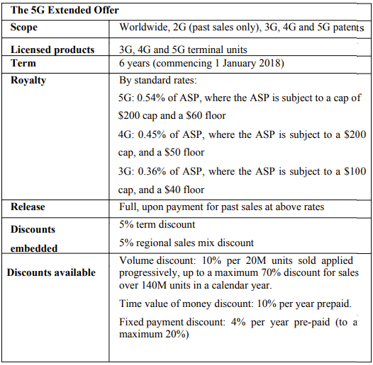
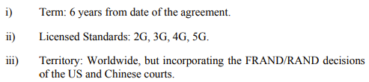
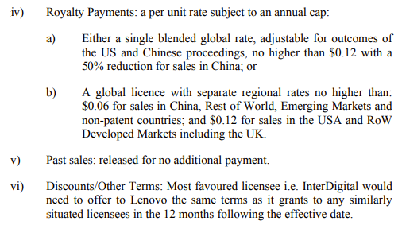
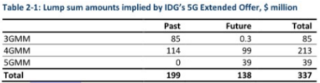
Competing offers
Lenovo’s Lump Sum Offer (Dec. 2021)
  $80m +/-15% for all sales in the 6-year term to EOY 2023, with a full release for all past sales
Notes:
14 to Lenovo, 2 countered, 4 pleaded to be FRAND
Lenovo:
$80m chosen as the ~mid-point of
$65.4m, calculated using weighted average past and future rates of $0.07 and $0.20 from what Lenovo alleges to be the six most probative comparable licences
$99.6m, based on a blended rate of $0.16.
Each cent accounts for approximately $6.22m.

Slide 69
Comparable licenses
72 InterDigital licences: 20 relied upon by InterDigital, 7 by Lenovo.
  No overlap between the parties as to the relevant comparables.
  “this sort of FRAND case is not well suited to adversarial litigation because there is (and was in this case) very little, if any, exploration of the middle ground between the positions taken by the two sides.”
Mellor J. only relied on a single comparable licence (LG 2017)
  This was the licence which reflected Lenovo’s situation whereas the other potential comparables differed, sometimes significantly.
  Mellor, J. used an adjustment ratio of 0.728 to reflect the differences between LG 2017 and Lenovo, chosen to reflect the different split between Developed and Emerging Markets as between LG 2017 and the licence for Lenovo.

Slide 70
Mellor, J. FRAND Findings
limitation periods have no role in the relationship of “willing licensor” and “willing licensee”
  (1) Lenovo must pay for all past sales; and
  (2) there is no justification for discounting past sales
only those discounts which relate directly to the time value of money were consistent with FRAND principles
  large volume discounts that may have been given in certain prior agreements resulted in discrimination against smaller licensees
  licences agreed with such smaller licensees couldn’t be FRAND and weren’t relevant for the purposes of the comparables analysis.
subjective views of the licensor must be set aside for the comparables analysis; only the objective analysis of the licences should be used

Slide 71
Relief available to patentee?
InterDigital an unwilling licensor since it consistently sought supra-FRAND rates.
For the most part Lenovo was a willing licensee
  Lenovo was “correct not to agree to any of InterDigital’s offers” (since these offers were not FRAND)
Lenovo became an unwilling licensee once liability had been established since it failed to undertake to take a FRAND licence
  Mellor J. expressed “regret” at having not granted a FRAND injunction following the finding of liability in the first Technical Trial
  However, Lenovo “retain the ability to have a change of heart down to the point where they are put to their election, provided that they accept the full consequences of adopting the status of a willing licensee”
    After the draft judgment, Lenovo undertook to the Court to take a FRAND licence on terms determined by the Court

Slide 72
Top-down cross-check
“no value” in InterDigital’s top-down cross-check “in any of its guises”
  InterDigital had contended that the cross-check supported the rates in its ‘5G Extended Offer’
  But, the comparables analysis undertaken by the Court did not provide any support for those rates, and Mellor J. found them to be “inflated and discriminatory”
  results of the comparables analysis were a “solid reason” for dismissing InterDigital’s top-down cross-check.
  Mellor J. decided that the hedonic price regression analysis relied on by InterDigital (a key part of its top-down cross-check), suffered from a number of substantive and procedural shortcomings

Slide 73
Mellor J.’s Willingness Findings
By consistently seeking supra-FRAND rates, InterDigital not willing licensor
  little/no downside for a licensor to do so, if can afford it (irrecoverable litigation costs, loss of management time and the possible loss of recoverable costs and/or interest) as likely a larger implementer
  Lenovo’s submissions really presented to reinforce counterpoint position
Lenovo wasn’t perfect, but generally a willing licensee
  Slow to move things along; but InterDigital caused delays of equal magnitude
    Excessive time taken to agree and renew NDAs.
    Causing significant delays in negotiations.
  For most of negotiations, correct not to agree to any of InterDigital’s offers/positions and justified in seeking information.
    Lack of authority to move the negotiations forward or do a deal.
    After an intense period of negotiation (2017-2018), Lenovo rejected deal and reverted with ‘an extremely low counteroffer’.
    Lenovo failed to engage with InterDigital’s proposals for dispute resolution re: FRAND terms.
Notes:
little or no downside for a licensor in pressing for supra-FRAND rates and thereby not acting as a willing licensor, apart from, irrecoverable costs of litigation, the loss of management time and the possible loss of recoverable costs and/or interest (which I acknowledge may amount to very substantial sums). The significant costs of this type of litigation put it out of reach of all but the larger implementers, even though it is to be hoped that it can be made less costly in the future as more FRAND issues are decided.
Lenovo’s submissions on this issue were really presented to reinforce their position on the counterpoint issue
*933. Once this litigation started, it is more difficult to characterise one side or the other as being unwilling, because each side must develop their case as they see fit. However, the circumstances in this action demonstrate that both sides can be unwilling at the same time.

Slide 74
FRAND rate
Court’s task was “to determine what a willing licensor and a willing licensee would agree by way of FRAND terms, in this context a lump sum, to cover the period from 2007 to the end of 2023”
  FRAND rate found was “$0.175 per cellular unit”
  “yields a lump sum payment of $138.7m”
  Mellor J. was “undecided on the issue” of whether interest should be awarded and at what rate
Mellor J concluded that neither InterDigital nor Lenovo’s offers were FRAND or within the FRAND range
  “very little, if any, exploration of the middle ground”
  Lenovo’s “Lump Sum Offer” $80m (±15%) = $68m–$92m with a full release for all past sales
  InterDigital’s “5G Extended Offer” sought $337m

Slide 75
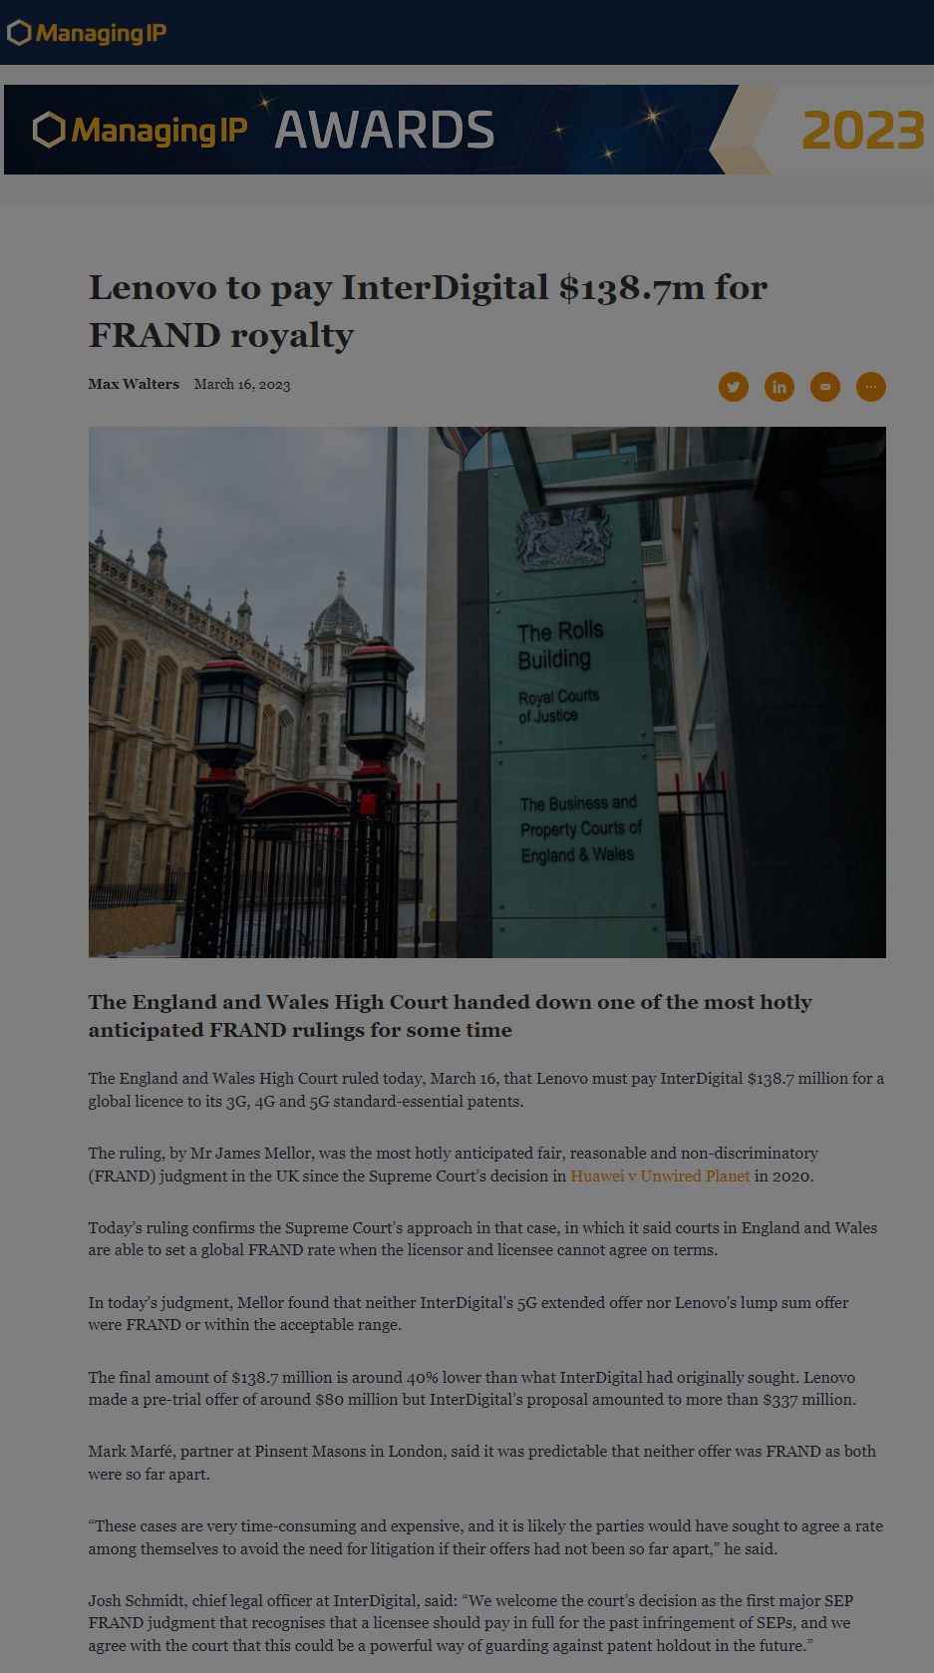
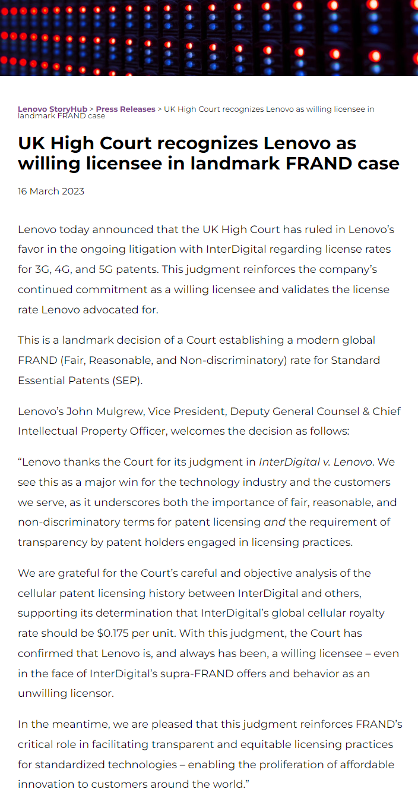
Who prevailed?

Slide 76
Mellor J. Suggestions for streamlining
have forensic experts use the same data source(s)
  “data sources should be identified at an early stage and the parties should endeavour to agree them,” else the Court should rule on the data to be used.
FRAND cases require much closer case management
  hedonic price regression evidence was/should have been case managed as an experiment.
utilize Court hearings to meaningfully preview issues for the finder of fact
  use pre-trial hearing to identify all of the issues requiring decision, not just to resolve procedural issues. List of Issues provided so high level “quickly became of no practical utility”
realistically estimate trial duration; focus only on the issues which really matter
  ensure trial duration realistic in view of materials volume and issues to be decided
    15 days inadequate, 4 days for pre-reading “woefully inadequate”
  rebuttal by expert should have been in additional report, not only on cross-examination
avoid information access issues
  agree to early disclosure of the “potentially comparable licences under a Court-monitored confidentiality regime”
  then agree to a stay of proceedings to enable negotiations to continue based on the shared information.
Notes:
52. In this case, the parties evidently decided they were going to (try to) fit everything into the original estimate. In order to do this, the parties wisely decided not to cross-examine where there were no disputes of real significance for example, on the expert evidence of US and Chinese Law. It also meant that cross-examination of important witnesses had to be restricted. After the trial had concluded, I was left with the impression that some important points in the evidence had not been the subject of proper challenge or, in some cases, any exploration at all in cross-examination or adequate focus in submissions, and this impression only increased as I prepared this judgment. Certain important issues were mentioned, if at all, only in passing but several were not adverted to at all.
53. Looking back at the trial, what happened in cross-examination was each side attempted to damage the case presented by the other side and promote their own case, as one expects to take place. InterDigital also attempted to suggest a measure of equivalence between the analyses of Messrs Bezant and Meyer, and I have to consider this below. I observe that this sort of FRAND case is not well suited to adversarial litigation because there is (and was in this case) very little, if any, exploration of the middle ground between the positions taken by the two sides. Whilst it is possible that the Court will adopt one side’s analysis wholesale, in practice this is unlikely. The consequence is that the Court is likely to be much more interested in the middle ground between the two side’s positions.
54. This is another reason why, in my view, much closer case management is required over future FRAND cases and trials. The pre-trial review (PTR) must be a proper review of the case and the issues which the parties wish the Court to decide at the trial. This may require the Judge to engage in several days pre-reading prior to the PTR to ensure he or she is on top of the issues. There was no opportunity to do that in this case. There was a brief PTR (lasting about ½ day) but this did not provide an opportunity to get properly on top of the issues, not least because important expert reports were served after the PTR and all the issues had yet to crystallise.

