Slide 1
Sentencing Advocacy and Restitution Agreements
Table 4 – Webster Batchelder Inn of Court
January 5, 2022

Slide 2
State of N.H. vs. Sirk Kimoneau
Mr. Kimoneau is the bookkeeper for the well-known septic company, Hicks Septic Services, LLC.
Over the course of the past year, Mr. Kimoneau has misallocated $60,000 of the company’s invoices to his own bank account. It went unnoticed until Mr. Kimneau got COVID, had serious complications, and was out for a month. The owner of Hicks Septic, Gerry, needs to write some checks and looks at the checkbook. He notices some suspicious checks.
Gerry confronts Mr. Kimoneau and Mr. Kimoneau admits to taking the money, but didn’t think it was $60,000
Through tears, Mr. Kimoneau said expenses were piling up, his daughter is in a private school she is thriving at (his daughter has an intellectual disability with many separate medical needs as well). He was having trouble paying the mortgage. His spouse also lost her job because of COVID.

Slide 3
State of N.H. vs. Sirk Kimoneau
Criminal History
Class A misdemeanor theft from 2003 (stole a pair of red sneakers)
This was amended down from a felony, was a theft from his employer (a shoe company), and they couldn’t make payroll one week because of the amount of money that was stolen, but Mr. Kimoneau could repay.
Mitigation
Mr. Kimoneau was in the Army Reserves. When his daughter was younger, he was deployed and the family moved a few times.
He has PTSD from his service and he feels like he abandoned his daughter when he was deployed.
He is an active leader of the local Scout troop.

Slide 4
State Sentencing Outline Classification of Crimes
Defined broadly in RSA 625:9/651:2
Crime Classification | Maximum Penalty
Violation Level Non-Criminal Offense | $1,000 fine
Class B Misdemeanor | $1,200 fine
Class A Misdemeanor | 12 months in jail, $2,000 fine
Class B Felony | 3.5-7 years in prison, $4,000 fine
Class A Felony | 7.5-7 years in prison, $4,000 fine
Special Felonies | Up to life in prison

Slide 5
State Sentencing Outline Additional sentencing terms/considerations
Probation (RSA 651:2, V)
Restitution (RSA 651:61-a through 651:67)
Victim Bill of Rights (21-M:8-k)
Conditional and Unconditional Discharges (651:2, VI and VIII)
Placed on file with/without a finding
Conditional Nolle Prosequi
Sentence Review (RSA 651:57 through 651:61)

Slide 6
Federal Sentencing Outline Classification of Crimes
Federal crimes classified in 18 U.S.C. § 3559; fines set forth in 18 U.S.C. § 3571
Crime Classification | Maximum Penalty
Infraction | 5 days in jail, $5,000 fine
Class C Misdemeanor | 30 days in jail, $5,000 fine
Class B Misdemeanor | 6 months in jail, $5,000 fine
Class A Misdemeanor | 1 year in jail, $100,000 fine
Class E Felony | 5 years in prison, $250,000 fine
Class D Felony | 10 years in prison, $250,000 fine
Class C Felony | 25 years in prison, $250,000 fine
Class B Felony | 25 years to life, $250,000 fine
Class A Felony | Life imprisonment/death, $250,000 fine
Notes:
This is vastly oversimplified for our purposes.
One big caveat: maximum sentence may increase where offender has repeated convictions for certain categories of offenses (e.g., violent offenses, sex offenses against children)
These fines are for individual defendants, not corporations (increased fines for them)
If a misdemeanor results in death, maximum fine can increase to $250,000

Slide 7
Federal Sentencing Outline Additional sentencing terms/considerations
United States Sentencing Guidelines (28 U.S.C. § 994)
Statutory factors (18 U.S.C. § 3553(a)):
Nature & circumstances of offense and history & characteristics of defendant
Need for sentence to reflect primary purposes of sentencing (retribution, deterrence, incapacitation, rehabilitation)
Kinds of sentence permitted (e.g., probations, mandatory minimums)
Guidelines & Policy Statements of U.S. Sentencing Commission
Need to avoid unwarranted disparities among defendants with similar records who have been found guilty of similar conduct
Need for restitution to victims of offense

Slide 8
Federal Sentencing Outline Additional sentencing terms/considerations (cont’d)
Restitution (18 U.S.C. § 3663)
Forfeiture (21 U.S.C. § 853)
Crime Victims’ Rights Act (18 U.S.C. § 3771)
Plea agreements (Federal Rule of Criminal Procedure 11(c))
(A), (B), and (C) pleas
Probation (18 U.S.C. § 3561 et seq.)
Supervised Release (18 U.S.C. § 3583)
Notes:
Probation prohibited by statute for class A/B felonies
Doesn’t address possibility for post-sentencing reduction (e.g., substantial assistance reduction on government motion under Fed R Crim P 35(b))

Slide 9
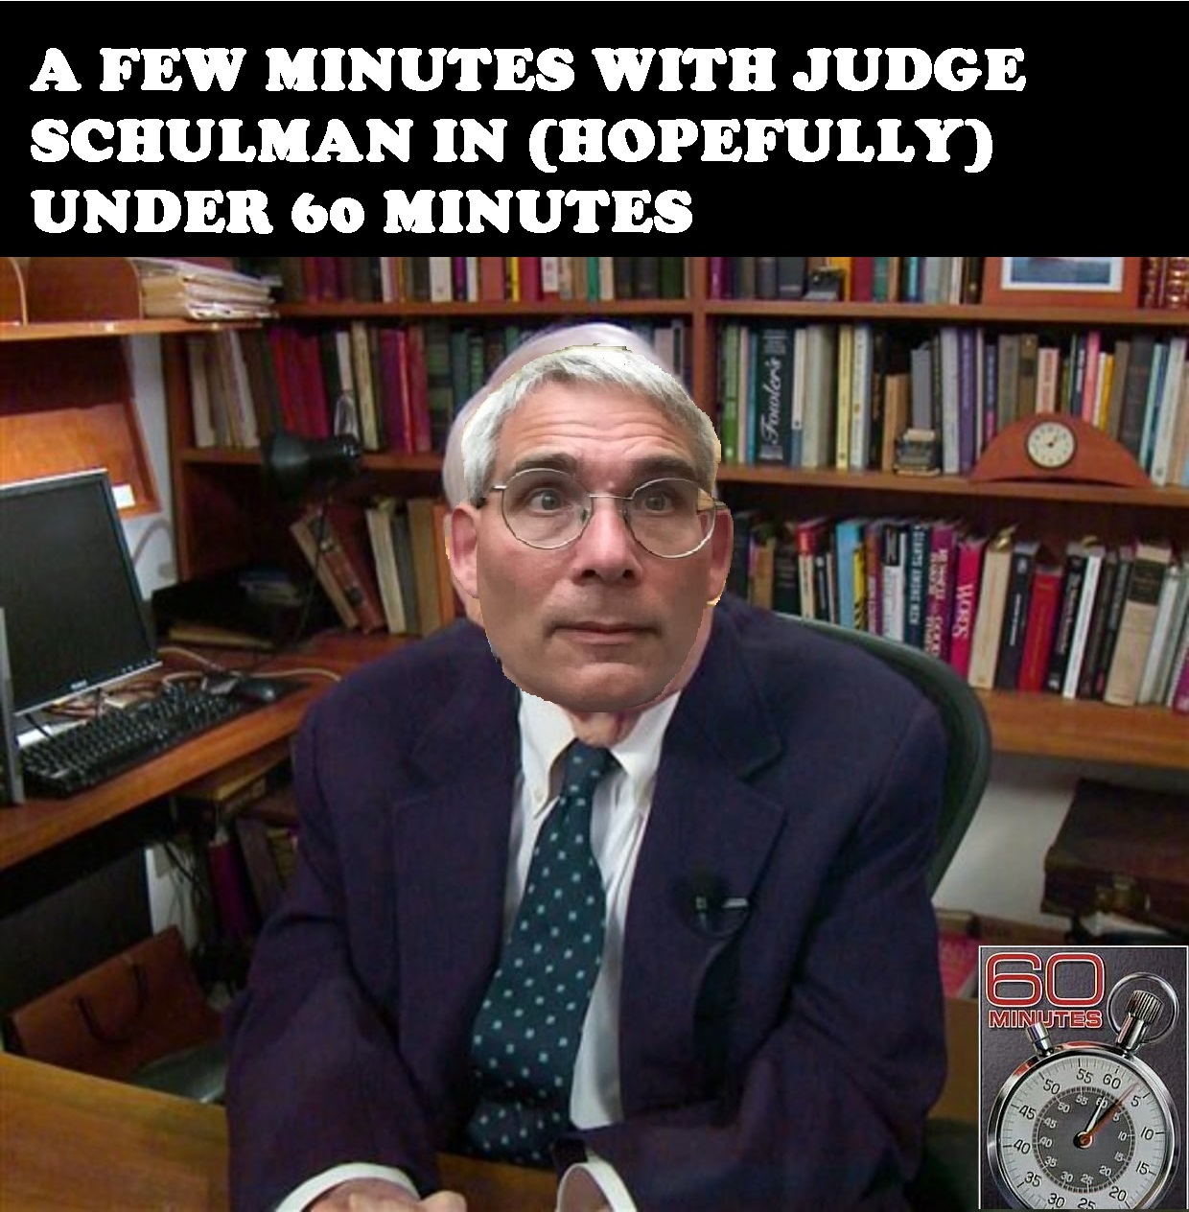

Slide 10
State v. Kimoneau
Sentencing part I

Slide 11
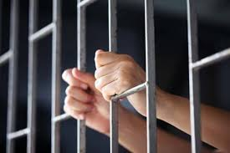
State v. Kimoneau
Sentencing Part II.

Slide 12
Questions?

