Slide 1
Oral Arguments in the Age of COVID-19

Slide 2
Tips for Remote Arguments
Before the argument date
Review the Court’s rules and any guidelines available online or that the Court sends to you
Tell the Court whether you will argue
Download and test the remote meeting software the Court will use
Ohio Supreme Court will arrange a pre-argument test run with you and its I.T. staff
9th District will send you the Zoom link on the day before the argument
Sign in with your real name

Slide 3
Check your surroundings
Be mindful of the scene around and behind you
Consider a virtual background
Quiet, non-distracting setting
Mind the lighting and camera position
Pay attention to your coffee mug, books, items on your desk
Avoid wearing all-white clothing or holding white papers if you’re using a virtual background
Notes:
Virtual background - pick something that isn’t distracting. You can use Zoom’s preferences to see what your camera will see. The 9th has a virtual background photo you can use.

Slide 4
Notes:
CASE IN POINT: How many distractingly nerdy things can you see in my office yesterday?
left to right:
Poe Dameron’s X-wing
RBG facemask
Red “Office Space” stapler
The Black Beast from “Monty Python and the Holy Grail”
Baby Yoda in the bookcase
Maybe you can see Kylo Ren in the bookcase above Baby Yoda
maybe you can see Wonder Woman near a plant
Sen. Elizabeth Warren action figure

Slide 5
Notes:
Are you in the Court of Appeals, or on the red carpet?
If you’re going to advertise your practice, make sure you comply with all the provisions of Prof.Cond.R. 7.2

Slide 6
Ooops…
Notes:
We’ve all heard about the flushing toilet.

Slide 7
Notes:
And then, Rudy Giuliani, uh…

Slide 8
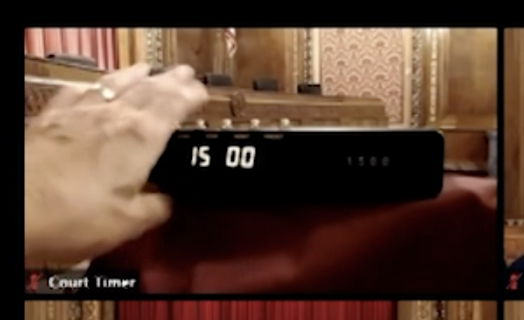
Remain aware of your time
The Ohio Supreme Court has a timer within view
Your computer will display the time somewhere on your screen

Slide 9
Kids and critters
If you have human or furry children who are likely to make noise or be distracting, try to find a place where you can exclude them
Notes:
Everybody, including the judges, knows that this may be impossible, though the 9th’s policy statement about virtual oral arguments notifies participants that children and pets must be excluded.

Slide 10
White papers, ringing doorbells
start at 11:45
Notes:
Start at 11:45, and note there are two things going on!
- Judge Callahan has a distracting 6-year-old playing with a doorbell in the background
- Judge Teodosio becomes a disembodied floating head

Slide 11
Notes:
Two things:
My light cuts out, and I have to get up and turn it back on
What’s on my desk? RBG

Slide 12
Tips for Virtual Arguments
During the argument
The Court will give you specific instructions on how to sign in to the argument
The Court expects you to dress as professionally as you would if you appeared in person
Whether you are standing or seated, expect to maintain that position through the entire argument
Make sure your camera is in a fixed, stable position
Mute your microphone when you are not speaking

Slide 13
What Not to Wear - Appellate Edition
Notes:
These are examples (generally of pro se litigants) appearing live at the Court of Appeals. If you shouldn’t wear it when you’re in the courtroom, don’t wear it in a virtual argument.

Slide 14
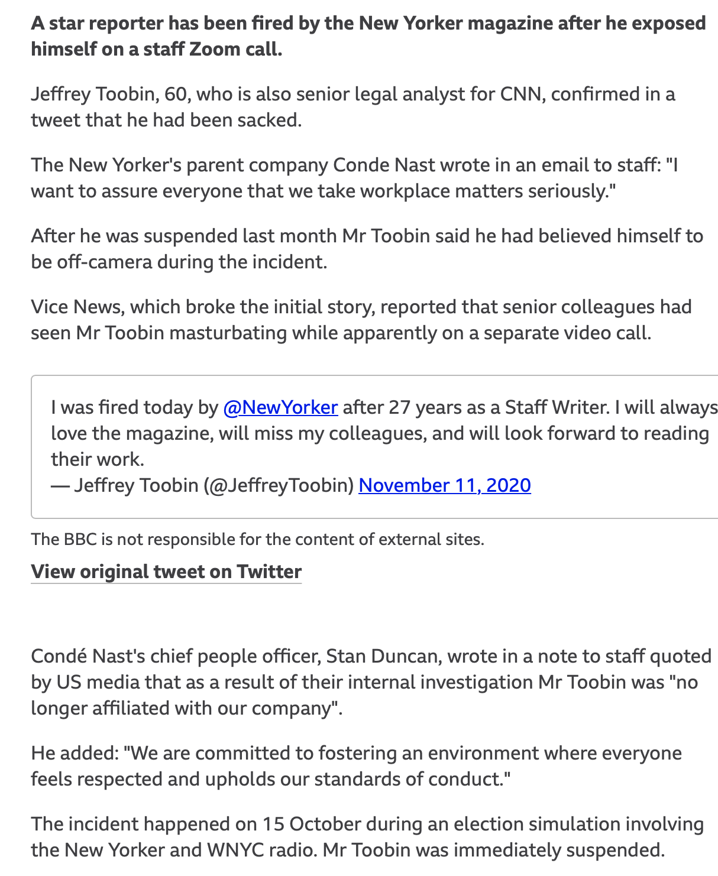
Assume you can be seen and heard at all times! DON’T embarrass yourself!

Slide 15
Notes:
Do you notice appellee’s counsel?

Slide 16
Finis.

