Slide 1
EVICTION IN THE TIME OF COVID: OUT ON THE STREET OR A TRIP TO THE POOR HOUSE? JANUARY 2021

Slide 2
PRESENTATION OVERVIEW:
Washington Evictions – Big Picture Issues
Washington’s Eviction Moratorium
Intent to Sell Premises Skit
Health & Safety Issue Skit
Early Resolution Program (ERP) – Brief Overview of New Program Available for King, Pierce, Snohomish, Thurston, Clark, and Spokane Counties.
Breakout Rooms

Slide 3
CONTEXT FOR WASHINGTON EVICTIONS:
Several general trends are apparent in Washington evictions:
Pervasive
Between 2013 and 2017, 1 in 55 Washington adults had an eviction (130,203 adults which equals 1.8% of the Washington’s adult population)
Frequently Unlitigated on Merits
In 2017, 3,238 unlawful detainers were filed in Pierce County and 1,476 resulted in default judgments (roughly 47%)
Lack of Legal Representation
From 2004 to 2017, only 8% of unlawful detainer defendants had legal representation at any point in the eviction process.

Slide 4
CONTEXT FOR WASHINGTON EVICTIONS:
4. Racially Disproportionate
In Pierce County, 1 in 6 black adults were evicted between 2013 and 2017. In King County, 1 in 11 black adults were evicted in King County over the same time period. For white adults, 1 in 50 in Pierce County and 1 in 100 in King were evicted.
5. Affordable Housing, Evictions, and Homelessness Appear Intertwined
6. Numerous Washingtonians are Rent-Burdened
Nearly 500,000 Washingtonians are rent-burdened (paying over 30% of monthly income to rent).

Slide 5
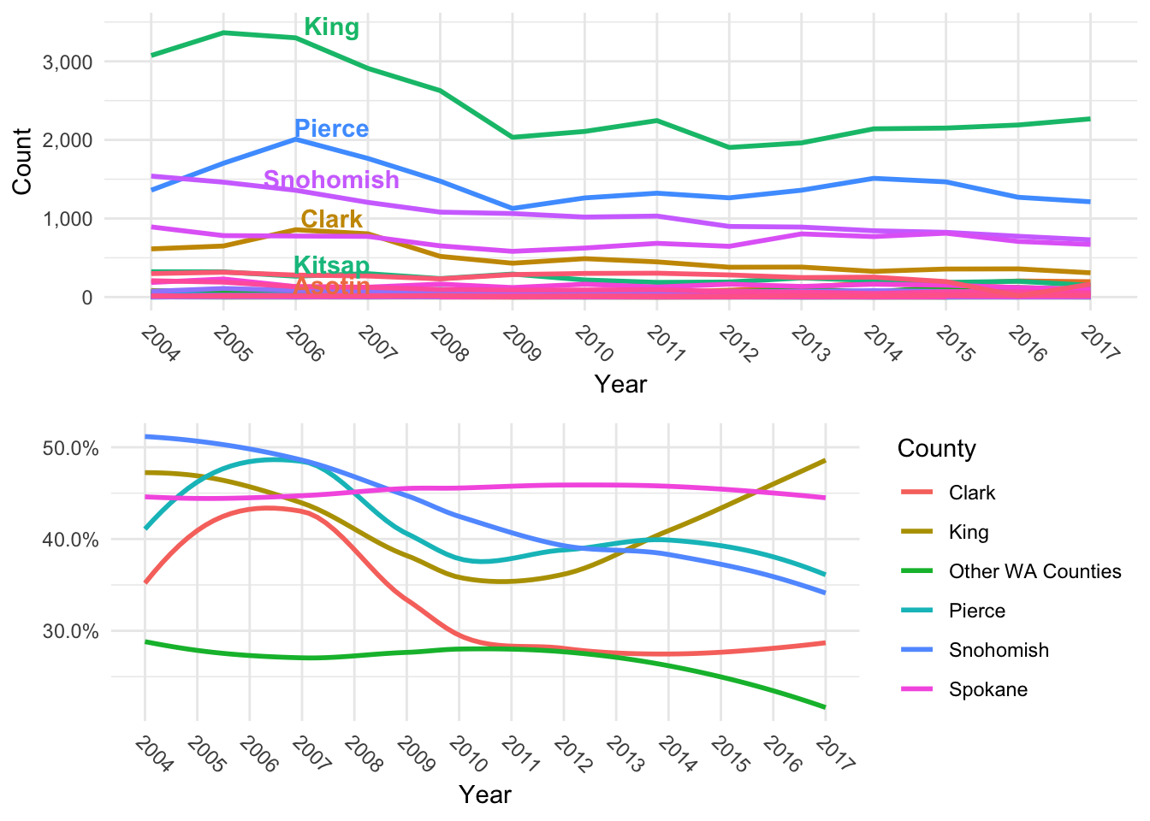
Unlawful Detainer Default Judgment Rates
4. Racially Disproportionate
In Pierce County, 1 in 6 black adults were evicted between 2013 and 2017. In King County, 1 in 11 black adults were evicted in King County over the same time period. For white adults, 1 in 50 in Pierce County and 1 in 100 in King were evicted.
5. Affordable Housing, Evictions, and Homelessness Appear Intertwined
6. Numerous Washingtonians are Rent-Burdened
Nearly 500,000 Washingtonians are rent-burdened (paying over 30% of monthly income to rent)

Slide 6
Unlawful Detainer Default Judgment Rates
A significant amount of unlawful detainer filings end in default judgment. The consequence of failing to respond to an eviction summons or a no-show at hearing almost surely guarantees that the tenant will face the strictest enforcement and costs of an eviction.
A 2017 study in Seattle found that the median court costs for over 1,000 eviction cases were $3,129.73, which included rent-owed, non-rent charges, and legal costs. In addition to the mark of an eviction, these costs compound the consequences of evictions. (Losing Home: The Human Cost of Eviction in Seattle, 2017)

Slide 7
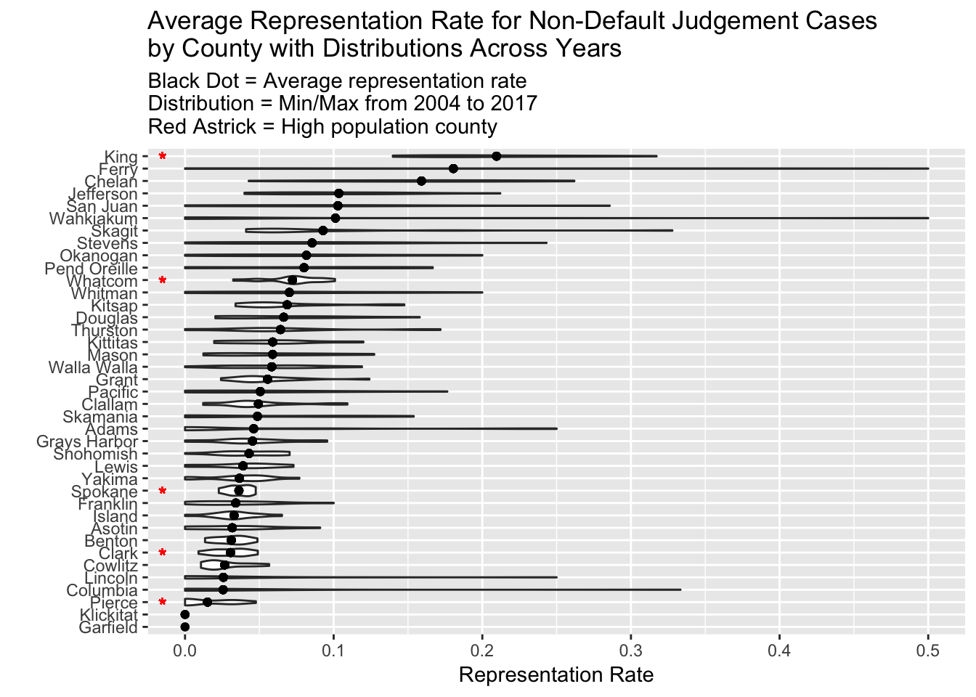
Tenant Legal Representation

Slide 8
Tenant Legal Representation
Legal representation during unlawful detainer greatly increases tenant outcomes. A single eviction can prevent families from public housing resources and impact credit scores. Evictions make housing searches more difficult and often lead to increased moving costs.
A 2017 study found that tenants with legal representation were twice as likely to stay in their homes as compared to self-representation.
From 2004 to 2017, less than 8% of all Washington tenants had an attorney at their eviction hearing, while over 90% of landlords were represented at hearing.

Slide 9
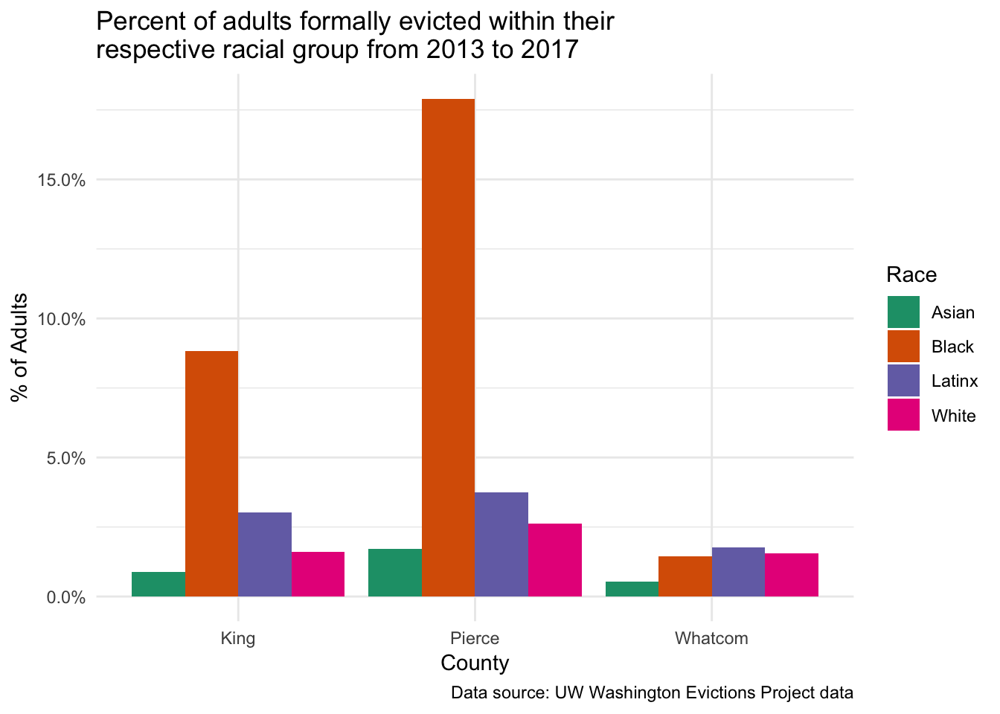
Racial Disparity in Washington Evictions

Slide 10
Racial Disparity in Washington Evictions
From the five-year period from 2013 to 2017, roughly 9% of black adults in King County and 17% of black adults in Pierce County faced an eviction.
Latinx adults, a population close in proportion to black adults in King and Pierce counties (compositions of 7.6% in King, and 8.1% in Pierce, respectively), faced much lower eviction rates of 3% in King, and 3.7% in Pierce.
White adults were third with roughly 1.5% and 2.6% eviction rates in King and Pierce Counties, while Asian adults composed the lowest rate of 0.5% and 1.7%.
Put another way, black adults are 5.5 times more likely than white adults in King County to be evicted, and 6.8 times more likely in Pierce County.
Latinx adults are evicted 1.9 times and 1.4 times more than white adults in King and Pierce Counties.
Asian adults were evicted almost half as much as white adults.
In 2019, the Tacoma-Pierce County HJP represented 268 clients at eviction show cause hearings: 46% black (122 clients); 34% white (92); 5% Hispanic/Latino (14); 3% Native American (9); 3% Pacific Islander (9); 2% Asian (6); and 7% Other (16).

Slide 11
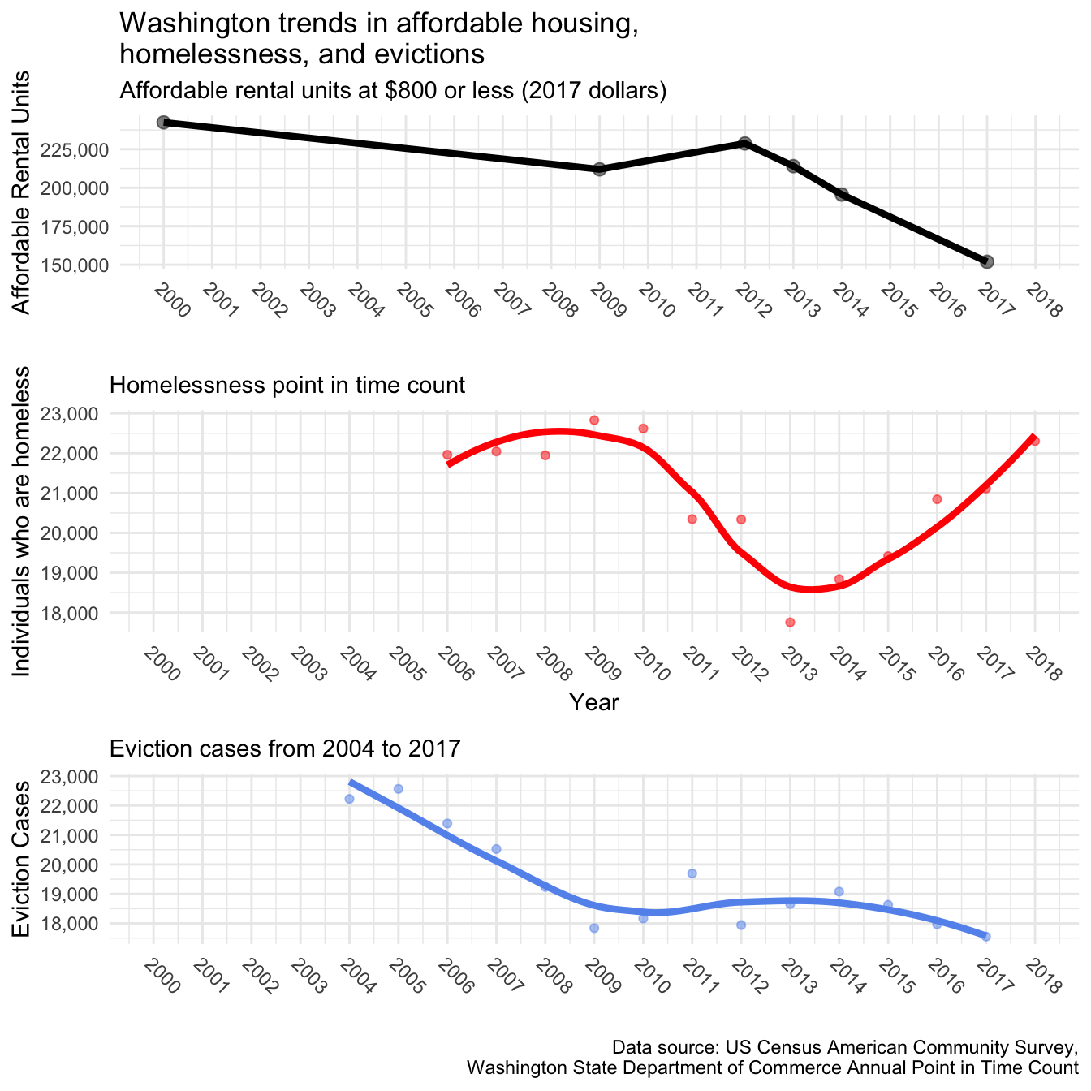
INTERTWINED TRENDS
:

Slide 12
INTERTWINED TRENDS
:
During the recovery from the recession, affordable units slightly increased along with declines in homelessness and evictions.
However, by 2012, Washington started to lose affordable housing largely to rising rents and the following year started an increase in homelessness. During this time, evictions kept a steady pace until about 2014 where it started to slump while homelessness took a drastic rise.
By 2017, we lose a large portion of affordable housing stock, see homelessness increasing beyond recession numbers, and evictions keeping a steady pace since 2009. While evictions seem down, there are still over 18,000 cases, only a few percentage points down from eight years earlier.
Note: Surveys during the point in time count show that each year, over 90% of those counted were from Washington state (contradicting the myth of migrant homelessness).

Slide 13
PIERCE COUNTY
:

Slide 14
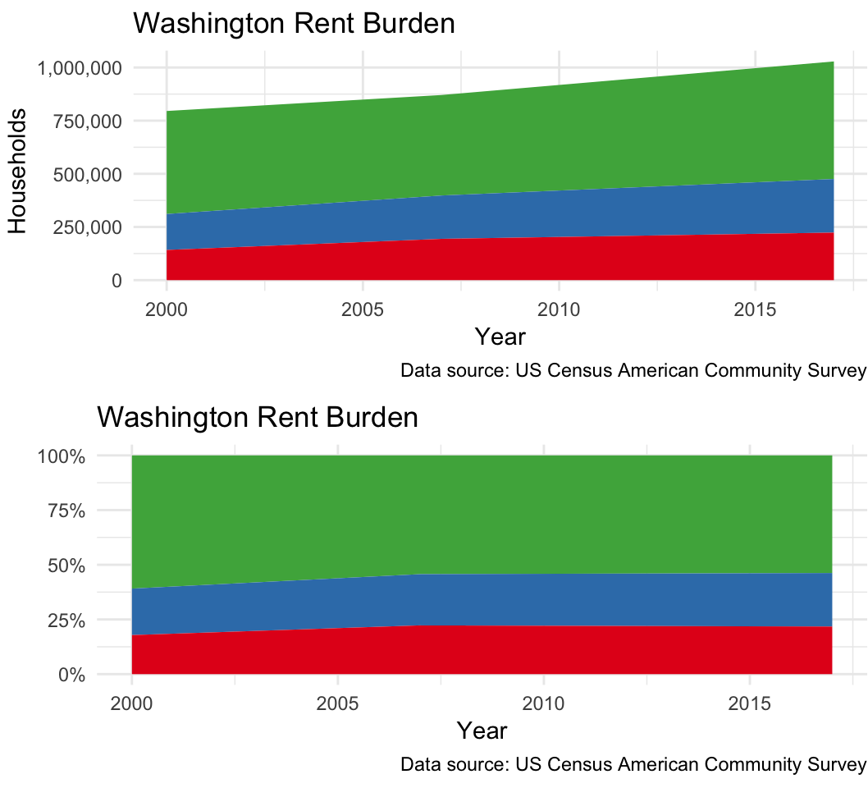
WASHINGTON RENT BURDEN
:

Slide 15
WASHINGTON RENT BURDEN
:
Almost half of all Washington renters (46%) are rent burdened. These renters are paying more than 30% of their income to rent.
250,000 households are paying between 30% to 50% of their income to rent and another 250,000 are paying over half their income to rent—a combined total of 500,000 households.
This leaves a large portion of the Washington’s renter population near the brink of losing their homes at any time with a disruption of income or unexpected expenses.
COVID-19 Situation: “[A]s of November 2020, current information suggests 165,000 tenants in Washington will be unable to pay their rent in the near future.” Governor Proclamation 20-19.5.

Slide 16
WASHINGTON eviction moratoria
:
March 18 – April 17, 2020 (no issuing evictions for non-payment or terminations of tenancy; landlords cannot start eviction proceedings for writs of restitution, unless health, safety and welfare issue)
April 16 – June 4, 2020 (expanded covered persons to include “non-traditional” tenancies; no issuing notices requiring tenants to vacate unless health, safety, and welfare, no assessment of late fees; no increases in rent; rent is an unenforceable debt unless a repayment plan is offered)
June 2 – August 1, 2020 (allowing terminations for landlords intent to personally occupy or sell premises)
July 24 – October 15, 2020 (DSHS transfers and discharges)
October 14 – December 31, 2020 (requiring affidavit for intent to occupy or sell; allowing customary contact between landlord and tenant; allowing increases in rent once moratoria expire; clarifying conduct creating health and safety risk for terminations)
December 31 – March 31, 2021 (expressly removing emergency shelters providing supportive services from moratorium protections)

Slide 17
Current moratorium provisions
:
Covered Situations: “residents of traditional dwellings . . . as well as those who have lawfully occupied or resided in less traditional dwelling situations for 14 days or more, whether or not documented in a lease, including . . . roommates who share a home; long-term care facilities; transient housing in hotels and motels; Airbnb's; motor homes; RVs; and camping areas”
Governor’s Proclamation 20-19.5.

Slide 18
Notable provisions
:
Landlords or agents are prohibited from serving—or threatening to serve—any eviction notice requiring a resident vacate a dwelling or parcel of land occupied as a dwelling
Exception #1: landlord attaches affidavit attesting that eviction is necessary to respond to a “significant and immediate risk to the health, safety, or property of others created by the tenant”
Must be “described with particularity”
Cannot be established by resident’s own “health condition or disability”
Excludes situations which a resident has been exposed to COVID-19 or is following Department of Health guidelines regarding quarantine or isolation
Excludes situations that “are not urgent in nature” such as conditions known or knowable prior to COVID-19, but which no action was taken.

Slide 19
Notable provisions
:
Exception #2: Landlord provides 60-day notice with affidavit indicating “property owner’s intent to personally occupy the premises as the owner’s primary residence.”
Exception #3: Landlord provides 60-day notice with affidavit indicating “property owner’s intent . . . to sell the property.”
Landlords or agents are prohibited from seeking or enforcing, or threatening to seek or enforce, judicial eviction orders, unless above-listed exceptions.
Law enforcement are prohibited from serving, threatening to serve, or otherwise acting on eviction orders, unless above-listed exceptions.
Landlords are prohibited from assessing, or threatening to assess, late fees for non-payment or late payment of rent from February 29, 2020.

Slide 20
Notable provisions
:
Landlords or agents are prohibited from treating any unpaid rent or other charges . . . as an enforceable debt or obligation that is owing or collectible” when such non-payment was a result of COVID-19 and occurred after February 29, 2020.
“This includes attempts to collect, or threats to collect, through a collection agency, by filing an unlawful detainer or other judicial action, withholding any portion of a security deposit, billing or invoicing, reporting to credit bureaus, or by any other means.”
Exception: “This prohibition does not apply to a landlord . . . who demonstrates by a preponderance of the evidence to a court that the resident was offered, and refused or failed to comply with, a re-payment plan that was reasonable based on the individual financial, health, and other circumstances of that resident”

Slide 21
Notable provisions
:
Landlords may engage in “customary and routine communications with residents of a dwelling or parcel of land occupied as a dwelling,” including, documenting a lease violation without threatening eviction, providing information to residents regarding financial resources, and providing residents with information on how to engage them regarding reasonable repayment plans.
Violators of this order may be subject to criminal penalties pursuant to RCW 43.06.220(5) (“Any person willfully violating any provision of an order issued by the governor under this section is guilty of a gross misdemeanor.”)

Slide 22
Skit presenTation
:

Slide 23
Eviction resolution pilot program (ERP)
:
Since February 2020, nearly one million people in Washington state lost their jobs or had employment hours curtailed because of the COVID-19 emergency. Recent information suggests 165,000 Washington tenants will not be able to pay rent in the near future.
Roughly 80% of all unlawful detainer filings in Washington are based on non-payment of rent.
Washington’s eviction moratoria are temporarily prohibiting issuing notices for non-payment of rent or seeking evictions based upon non-payment of rent. Also, for rent to be collectible debt, a reasonable payment plan must be offered to the tenant in arrears.
However, state and local rent assistance programs—funded by emergency federal, state, local, and philanthropic funds—have been established to preserve tenancies threatened due to the non-payment of rent.
The ERP is an initiative established by the courts to facilitate early resolution of disputes over non-payment of rent during and after Washington’s eviction moratorium. Six pilot counties: King, Pierce, Snohomish, Thurston, Clark, and Spokane.

Slide 24
Eviction resolution pilot program (ERP)
:
Notice 1: Sent to tenant with accompanying notice of non-payment of rent and informs tenant of ability to obtain Dispute Resolution Center and Housing Justice Project assistance.
Notice 2: Similar notice form as Notice 1, but sent to tenant, local DRC and HJP. DRC attempts to contact unresponsive tenants for seven days.
Local Dispute Resolution Center (DRC) receives landlord notices then engage tenants, Housing Justice Project attorneys, and administrators of rental assistance programs. DRC to provide conciliation efforts between tenants and landlords, with HJP and landlord attorneys present.
If conciliation successful, no unlawful detainer filed. If unsuccessful, parties provide optional mediation for non-payment issue. After an unsuccessful conciliation or mediation, DRC issues certification form required for landlord to file unlawful detainer action.

Slide 25
Sources and further information
:
The State of Evictions: Results from the University of Washington Evictions Project: https://evictions.study/washington/index.html#fn10
Governor’s Proclamation 20-19.5: https://www.governor.wa.gov/sites/default/files/proclamations/proc_20-19.5.pdf
Eviction Resolution Program Information: http://www.courts.wa.gov/newsinfo/index.cfm?fa=newsinfo.EvictionResolutionProgram
Tacoma-Pierce County Housing Justice Project: https://tacomaprobono.org/hjp/

