Slide 1
How to be Appealing Commonwealth Court Appeals
A Kirkpatrick/Gonder Pupilage Group Presentation

Slide 3
I. Know Your Audience: The Judge & The Law Clerk
The Judge:
Busy, busy, busy
Experienced
The Law Clerk:
Grunt Work
First year law clerk vs. seasoned career clerk

Slide 4
Know Your Audience: What’s at stake with your reader?
Your client’s fate
Your credibility/reputation before the Commonwealth Court

Slide 5
Brief Writing: Dos & Don’ts
Dos:
Do be clear and concise
Do use headings
Do tell clerks where things are in the record
Do check your attitude at the door before submitting a brief
Do proofread, proofread, proofread
Do follow the Pennsylvania Rules of Appellate Procedure

Slide 6
Brief Writing: Dos & Don’ts
Don’ts:
Don’t misrepresent legal authority, exaggerate facts, misquote something, fail to include pincites, or mischaracterize parts of the record
Don’t make unsupported arguments
Don’t attack opposing counsel
Don’t forget about the weaknesses in your case
Don’t forget to proofread your work!

Slide 7
Going Forward…
As you listen to this presentation, keep the following in mind:
Accuracy
Easy to read
Important Issues
Organization
Understandable

Slide 8
II. Typography
Pa.R.A.P. 124
“The 2013 amendment increased the minimum text font size from 12 point to 14 point and added a minimum footnote font size of 12 point. This rule requires a clear and legible font. The Supreme, Superior, and Commonwealth Courts use Arial, Verdana, and Times New Roman, respectively, for their opinions. The brief using one of these fonts will be satisfactory.”

Slide 9
Why Typography Matters
Good lawyering requires good writing
Good typography is an opportunity to improve writing
Conserves reader attention

Slide 10
Table of Contents Typography
Notes:
Note the differences between the readability of different typefaces. This is more of an issue for section subheadings than tables of contents, but it is worth considering here as well. (James’ comments)

Slide 11
Other Typography Tips
AVOID ALL CAPS
Avoid excessive use of acronyms
Pa.R.A.P. 2111 – requires distinctive typeface for headings
Use of default or goofy fonts
Typewriter habits
Use of two spaces between sentences
Underlining

Slide 12
Section III. Know Road Signs
Pa.R.A.P. 2111 & 2174
Notes:
Those experts in the group thought Pa.R.A.P. 2111 & 2174 are most important here.

Slide 13
Contents of the Brief
Pa.R.A.P. 2111
Provides specific guidance on the contents and order of a brief
Governs appellants’ briefs, but each element should be addressed by appellees
Notes:
[explain Pa.R.A.P. 2111]
The statute provides a specific structure… can anyone guess what it is?
Statement of jurisdiction
Order or other determination in question
Statement of both the scope of review and the standard of review
Statement of the questions involved
Statement of the case
Summary of argument
Argument for appellant
Conclusion stating the precise relief sought
The opinions and pleadings specified in paragraphs (b) and (c)
[in the Superior Court] Certificates of compliance
The order is designed to walk the reader through the legal argument
Hierarchy of importance
Logical

Slide 14
Table of Contents, specifically
Pa.R.A.P. 2174
Practice tip: Update your Table of Contents and the Table of Authorities automatically using Microsoft Word
One late edit to an early portion of your brief can cause many errors in your tables
Notes:
Explain Pa. R.A.P. 2174
- Separate tables of content are required for the brief and the reproduced record with specific rules for each
Bob– we suggest that you contact us. For the rest of you, either search google, or follow the article that is provided at the link.
Doing it through Word ensures mirrored headings and accurate page numbers… without having to worry that certain parts of the brief may have changed page numbers because you added/deleted material.

Slide 15
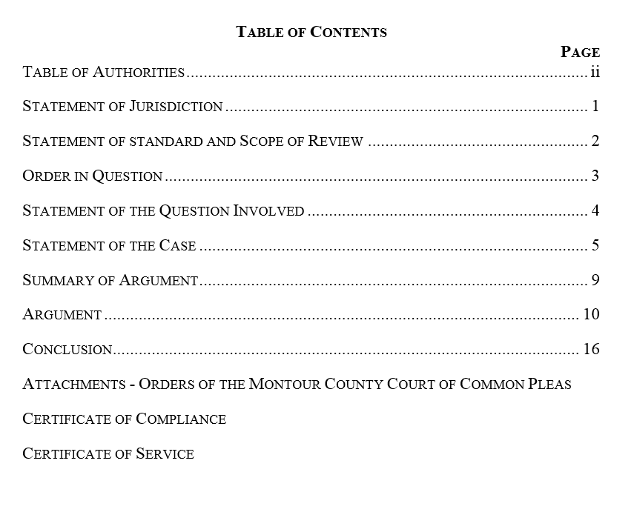
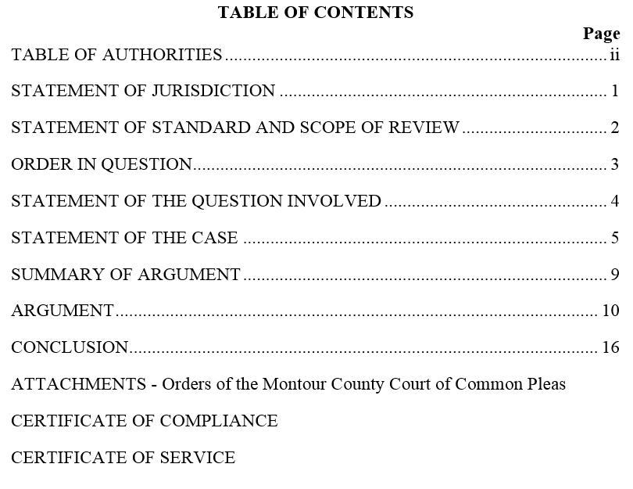
Notes:
Pa.R.A.P. 2111 & 2174 As Applied
Since the idea behind this CLE is insider tips… does anyone see anything wrong with this TOC?
Per Law Clerk →
DO NOT USE ALL CAPITAL LETTERS IN THE ISSUES LISTED IN THE TABLE OF CONTENTS OR IN HEADINGS. IT MAKES THESE ITEMS HARD TO READ. Consider using bolded text or Large and Small Caps instead, or even regular lowercase and uppercase text.
Reversal of the Order in Question and the Statement of the Standard and Scope of Review
Moving things into a different order may potentially be perceived by the judges and clerks as “playing games.” So that is important to keep in mind.

Slide 16
Citations, specifically
Pa.R.A.P. 126
Courts in PA do not require “Bluebook” citations, but be consistent
Notes:
Confirm with Molly what is the most preferred way for DOT.
Per the Prothonotary → Consistency is necessary, and longer the case the more important the pincite.
Per Law Clerk →
· Incorrect citations in briefs, generally – this happens a lot. I go to look up a case and the citation pulls up a case from some other state, etc., because it is wrong. Then I have to read the whole case once I actually find it (which I have *all* the time in the world to do) to find where you got a particular proposition.
· Inaccurate pincites (or none used at all) in citations to case law.
· Inaccurate pincites (or none used at all) to places in the record/reproduced record where particular facts are located – many times these are wrong.
DISCLAIMER: Citations have been modified.

Slide 17
Dep’t of Transp.,
Notes:
This is technically the correct way, but just be consistent!

Slide 18
Issue: Sticking to the Issue
You need to know the proper Scope and Standard of Review and remember that when drafting the issue.
Notes:
Story about the importance of issue spotting…
Member of the group who is a clerk recently had a case where the issues on appeal were determined by an order from the Commonwealth Court. The two issues were narrow. A large portion of appellant’s brief, however, was dedicated to issues outside the scope of the appeal. This was distracting and confusing as a clerk because it meant she couldn’t focus on the real issues at hand. Instead, she was sorting through what arguments were properly raised and those that were irrelevant. Further, this party conflated/combined her arguments so that she was searching through the brief and spending a lot of time organizing her arguments. What a waste of time--both for that attorney and me. This might be an extreme example, but I think parties could always work on improving the organization of their briefs. In short, parties should avoid repeating issues in different words or addressing issues not raised before the court or waived. Issues should be laid out clearly, too.
Scope and Standard of Review
Scope is how much
Standard of Review -

Slide 19
Issue: Framing the Issue
Pa. R.A.P. 2116
Distinct Question
Answer
Notes:
Carefully and persuasively frame the issue before the court and keep your argument tightly focused on that issue. Use actual facts from the case to make it worth reading and effective.
The Statement of the Question should include the answers of lower courts.

Slide 20
Proofreading and Random Thoughts
Be mindful of your audience
Proper use of apostrophes: “Appellants” is plural; “Appellant’s” is possessive
Remove or resolve all tracked changes

Slide 21
Proofreading and Random Thoughts
Entities like boards are referred to in the third person singular: A board issues “its” decision, not “their” decision
Also keep this in mind for subject-verb agreement: The board “is” five members, not “are” five members

Slide 22
Proofreading and Random Thoughts
Only cite to material that is actually relevant and in the record–potential to be stricken.
Potentially confuses your brief
Be mindful concerning acronyms

Slide 23
Proofreading and Random Thoughts
Be professional and ethical
Vigorously attack your opponent’s argument, not your opponent
Pick up a grammar guide: Gregg’s Reference Manual, The Grammar Desk Reference, etc.

Slide 24
IV. Argument Section
Basics of an Argument:
What To Do (Insider Tips):
Be concise and accurate
Clearly lay out your argument
Reference the record
Expose the weaknesses
Tell the Court what you want

Slide 25
What Not to Do (Insider Tips)
Misstate the law
Attack the other parties or the courts
Make conclusory statements
Include the kitchen sink
Avoid long quotes

Slide 26
V. Miscellaneous Items
Certifications
Public Access Policy
Proposed Amendments to Pennsylvania Rules of Appellate Procedure

