Slide 1
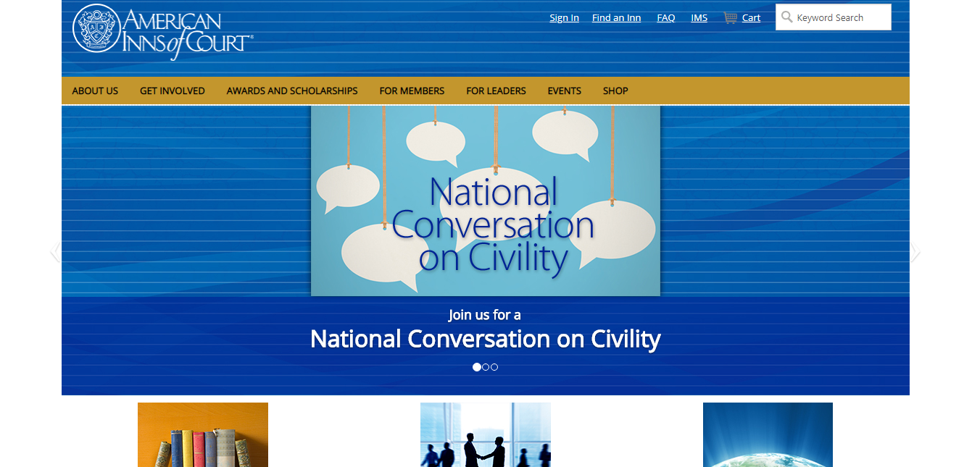
The AIC Website

Slide 2
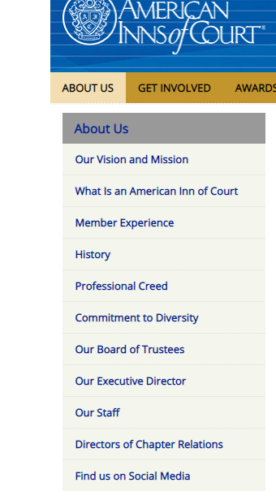
The AIC Website, cont.
The website provides the:
AIC’s history stretching from the English system and our early partnership to now,
The current form and leadership of the AIC in the U.S., and also
how interested individuals can get involved at local, national, and international levels.

Slide 3
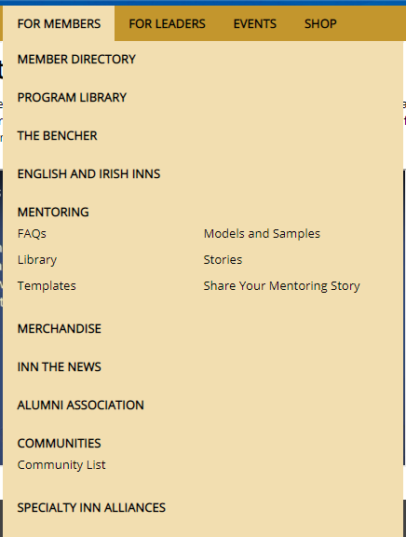
The AIC Website, cont.
The website provides members, inn leaders, and interested practitioners access to a multi-dimensional platform to find:
information on news and events,
links to on-line training,
available awards and scholarships,
and resources regarding the latest on ethics, civility and excellence in advocacy and legal practice.

Slide 4
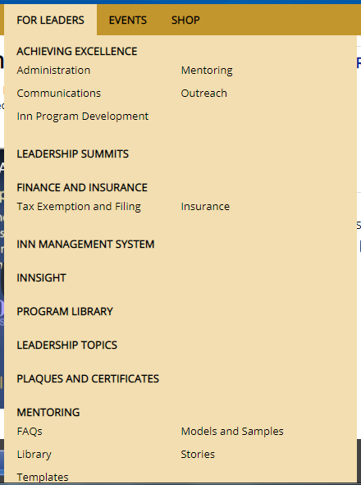
The AIC Website, cont.
By accessing the AIC website:
inn leaders can find specific topic materials and instructions on inn management and successful practices; and
members are granted access to merchandise, mentorship opportunities, alumni outreach, literature, and countless resources.

Slide 5
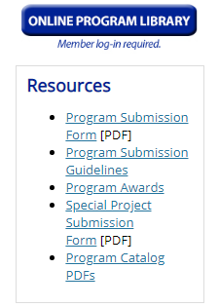
Online Resources Available through the AIC
Though providing numerous resources, member favorites include:
the Program Library – a collection of submitted programs containing new ideas, specific topics, practice areas, etc., that other chapters nationwide can use for direction or as starting points.

Slide 6
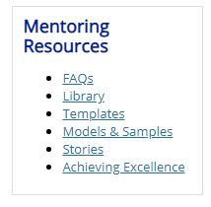
Resources Available, cont.
materials on mentoring – details on the principles and goals of inn mentoring, a library of mentorship articles, countless templates and samples to mentor with, and stories of mentor/mentee experiences.

Slide 7
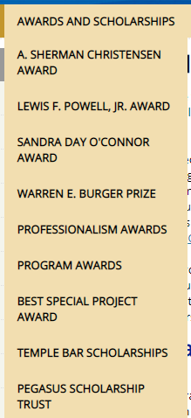
Resources Available, cont.
Awards and Scholarships – sponsored awards are open to members for exemplary leadership, public interest, and service in such fields as ethics, civility, and excellence, and also available for writing competitions and community-focused special projects.

