Slide 1
Issues Arising in Litigation Surrounding Standard Essential Patents, Including FRAND Obligations in the District Courts, the ITC and International Forums
Giles S. Rich Inn of Court September 26, 2018
ALJ Theodore Essex (ITC, retired) (Hogan Lovells)
ALJ Clark Cheney (ITC)
David Long (Essential Patent LLC)
Natalie Bennett (Morgan Lewis)

Slide 2
Roadmap
An Introduction to Standard Essential Patents
Litigating Standard Essential Patents in District Courts
The ITC’s Treatment of Standard Essential Patents
Approaches to Standard Essential Patents Around the World
FRAND in the United Kingdom
FRAND in Germany

Slide 3
Roadmap
An Introduction to Standard Essential Patents
Litigating Standard Essential Patents in District Courts
The ITC’s Treatment of Standard Essential Patents
Approaches to Standard Essential Patents Around the World
FRAND in the United Kingdom
FRAND in Germany

Slide 4
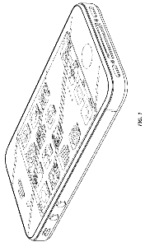
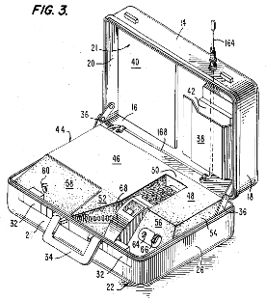
Standard Essential Patents (SEPs)
Patents with Claims Essential To Practice an Industry Standard
Technical Industry Standard
Standards Organization
Setting or Developing Standards
Interoperability
Intellectual Property Rights (IPR) Policy

Slide 5
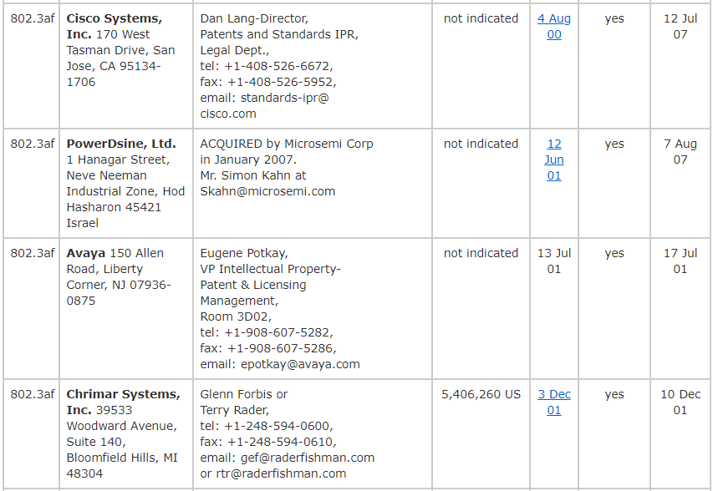
SEPs in the Real World
Essential Patent Claims
Specific patent claims that read onto final standard
Intellectual Property Rights (IPR) Policy may define “essentiality”
Letters of Assurance
What is F/RAND?

Slide 6
Misnomer: Patent “Declared” Essential to a Standard
SDO’s Intellectual Property Rights (IPR) Policy
Disclose patents that a participant reasonably believes may be essential to standard
Patentee’s IPR Commitment
IF patent claims are essential
THEN agree to license …
Declared
SEPs

Slide 7
What Did Patent Owner Actually Commit To Do?
Look at the specific standard-setting licensing commitment at issue
Sources of licensing commitment
Patentee’s declaration or letter of assurance (LOA) submitted to SDO
SDO’s IPR Policy
“[W]e must look at the patentee’s actual FRAND commitment. We need not be stampeded into abandoning the rule of law, or burden of proof simply because the respondents shout ‘FRAND’.”
ALJ Essex (ITC 337-TA-613)

Slide 8
Roadmap
An Introduction to Standard Essential Patents
Litigating Standard Essential Patents in District Courts
The ITC’s Treatment of Standard Essential Patents
Approaches to Standard Essential Patents Around the World
FRAND in the United Kingdom
FRAND in Germany

Slide 9
Comparable Licenses and “Real-World” Negotiations
Confidentiality/CBI restrictions → Imperfect Information for Parties to Negotiation
For a known license, sample considerations for assessing comparability (many of which can be confidential):
SEP only license or other consideration in license
Cross-license, one-way license, mix of rights
Portfolio license or licensing individual patents
Similarly situated counter-party or differently situated
Overlap in covered geographies and standards
Form of royalty paid and royalty base
RAND
Negotiation
RAND
Adjudication

Slide 10
“Top Down” FRAND Rate Model for SEPs
Difficult to determine an appropriate reasonable royalty rate
Comprehensive “Top Down” Approach: determine the total costs for practicing the industry standard and apportion so that is not excessive for any member of the standard setting organization
Determine the maximal royalty burden to obtain all necessary patent licenses for practicing the industry standards
Determine each patent owner’s value share based on their patent portfolio
Apportion each patent owner’s share of the maximal royalty burden

Slide 11
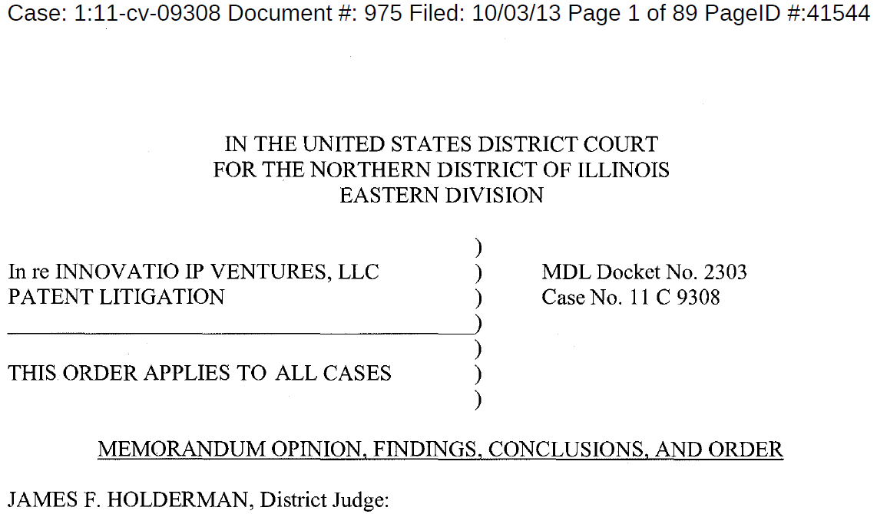
“Top Down” FRAND Rate Model for SEPs

Slide 12
$
Royalty Stacking
Patent Holdup
Holdout

Slide 13
FRAND Rates for SEPs
Licensor | Value Share | Rate
1 | A% | a
2 | B% | b
3 | C% | c
4 | D% | d
5 | E% | e
6 | F% | f
7 | G% | g
… | … | …
Total | 100% | Maximum Royalty Burden

Slide 14
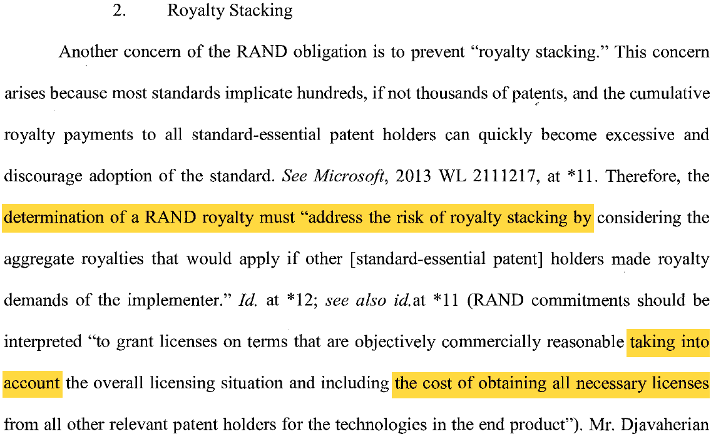
“Top Down” FRAND Rate Model for SEPs

Slide 15
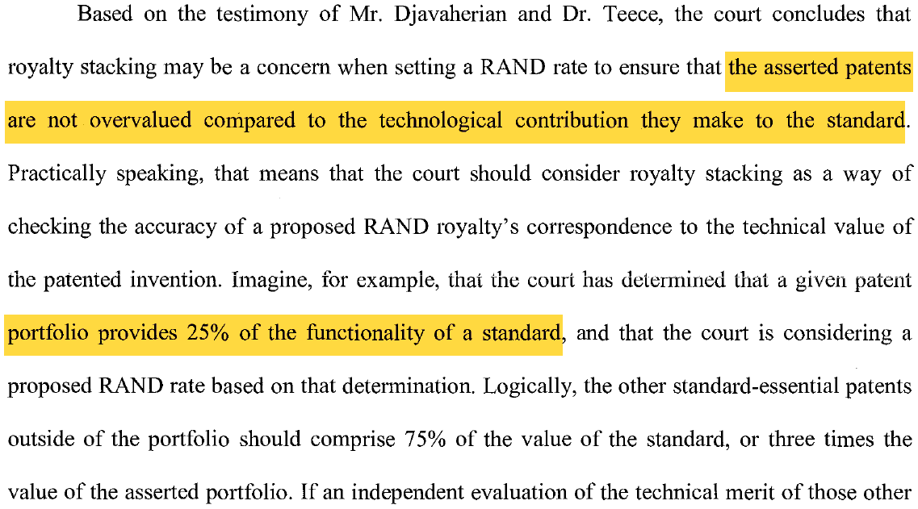
“Top Down” FRAND Rate Model for SEPs

Slide 16
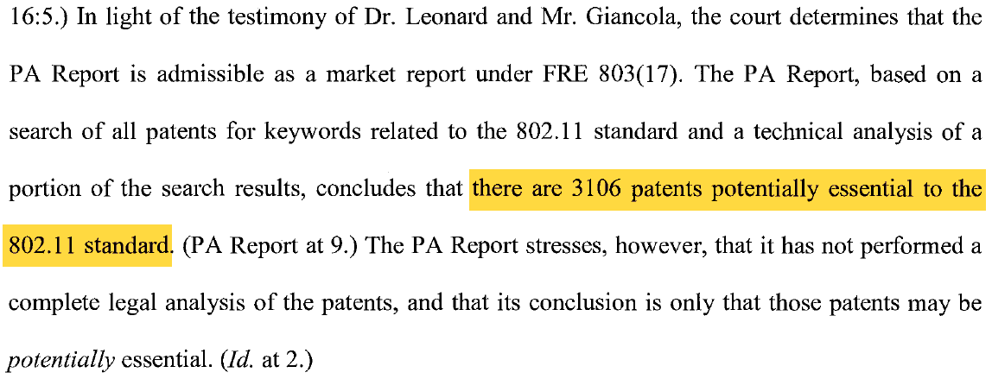
FRAND Rates for SEPs

Slide 17
Apportionment Using Combination of Royalty Base and Royalty Rate
“[T]he governing rule is that the ultimate combination of royalty base [B] and royalty rate [R] must reflect the value [V] attributable to the infringing features of the product, and no more.”
Ericsson Inc. v. D-Link Sys., Inc., 773 F.3d 1201, 1226 (Fed. Cir. 2014)
V = B x R
R
R
R
V
B
B
B

Slide 18
FRAND Rates for SEPs

Slide 19
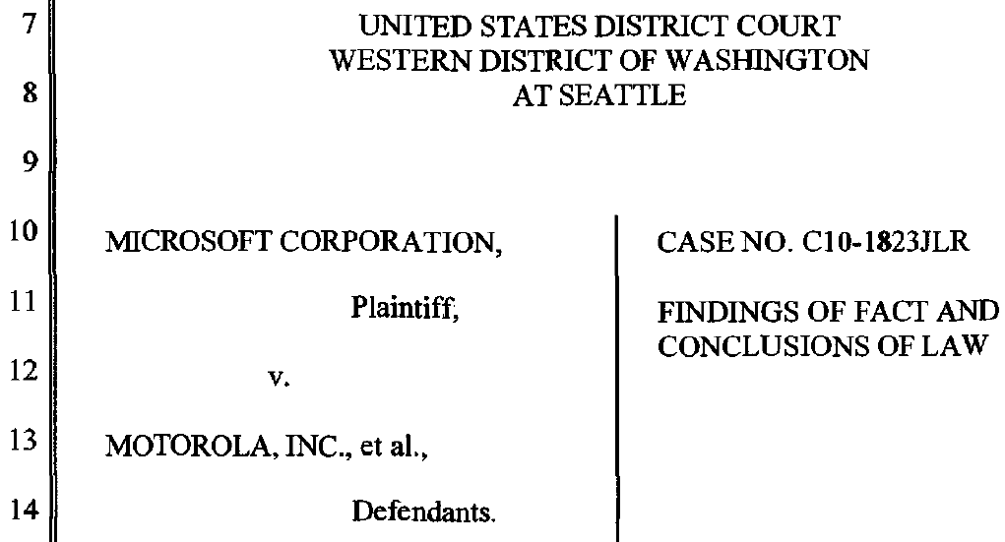
FRAND Rates for SEPs

Slide 20
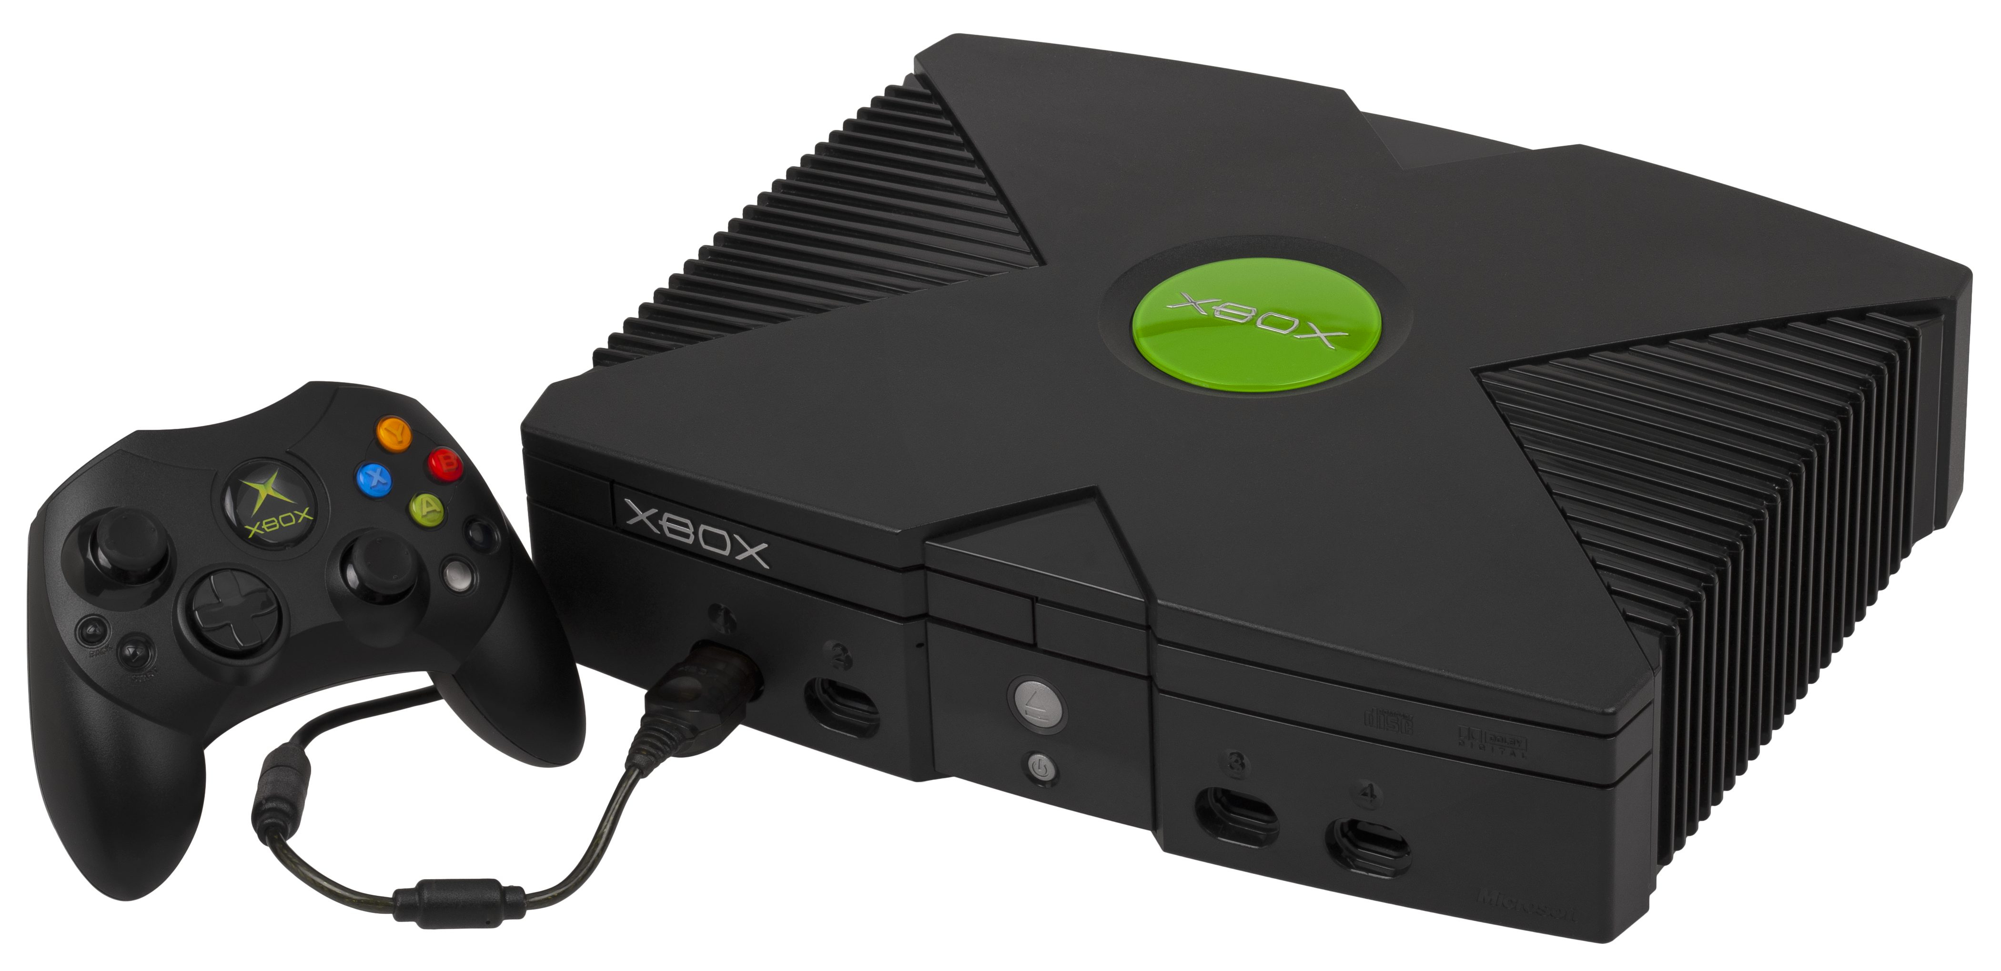
FRAND Rates for SEPs
WiFi Encrypted from Xbox to Access Point
Internet
WiFi
Access Point
Xbox Encrypted from Xbox to Server
Xbox
Remote Server

Slide 21
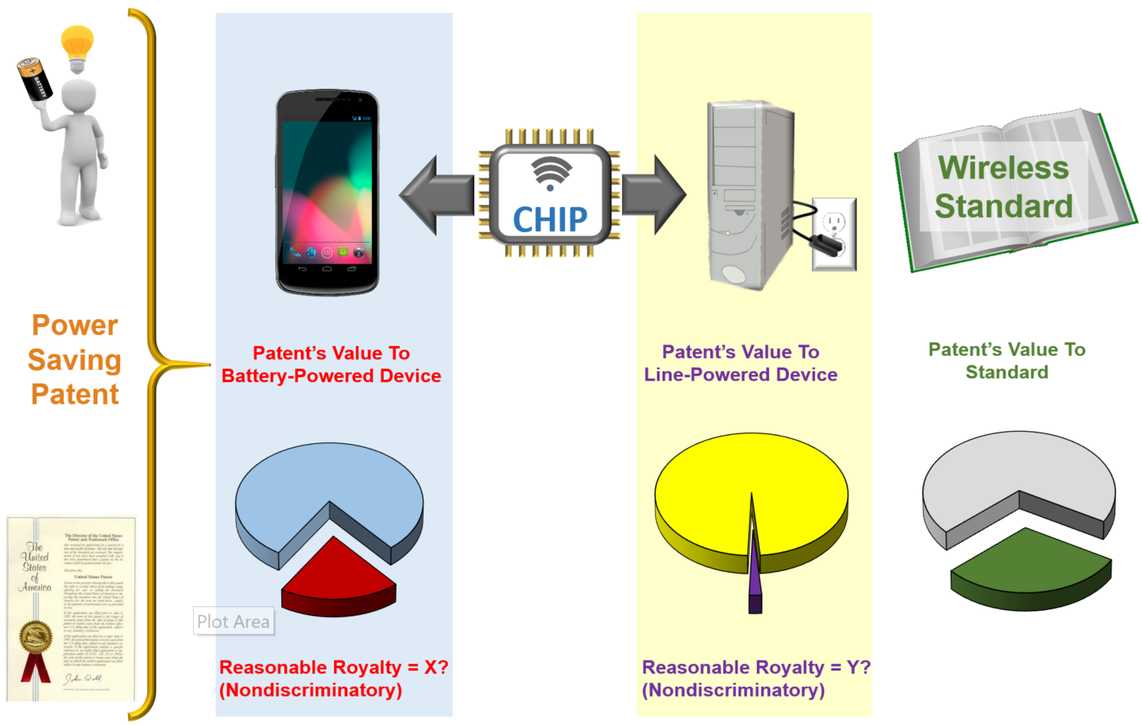
Patented Technology’s Value to Product –vs- Standard

Slide 22
FRAND Rates for SEPs
* * *

Slide 23
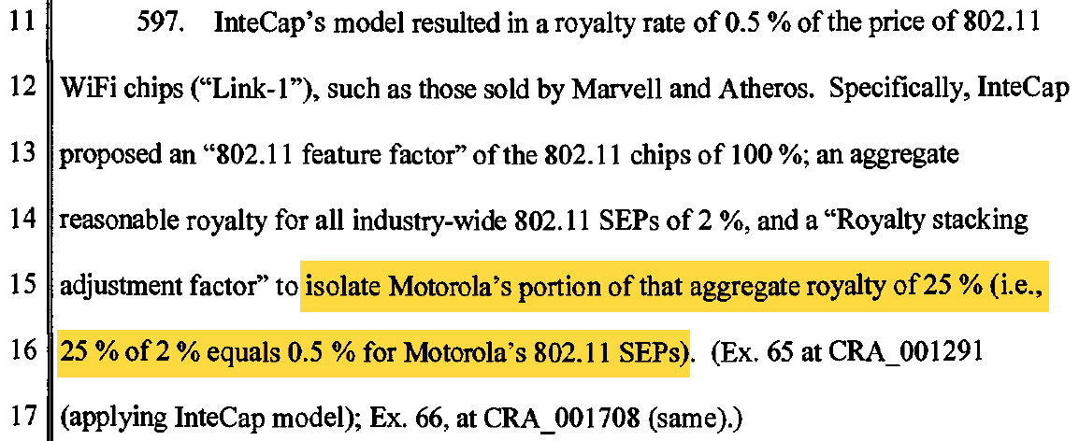
FRAND Rates for SEPs
* * *

Slide 24
Instructing a Jury What is Fair, Reasonable, and Non-Discriminatory
“In determining damages, you should not consider the value of the IEEE 802.3af/at standard as a whole, or any value the patented technology gained by its inclusion in the standard. You may, however, consider any added value resulting from the superiority of the patented technology.”
* * *
“[Plaintiff] committed to license the [asserted] patent on a worldwide, non-discriminatory basis and on reasonable terms and conditions to comply with IEEE 802.3-2008 Standard including the 802.3af amendment and 802.3at amendment. You must ensure that any damages award is consistent with and does not exceed the amount permitted under that obligation. The parties dispute whether the [asserted] patent is essential to the IEEE standard. By referring to standard essential patents, the Court is not instructing you that the [asserted] patent is actually essential to any standard. It is up to you, the jury, to decide whether or not the patent is standard essential.”
Network-1 Technologies, Inc. v. Hewlett-Packard Enterprise Co., No. 6:13-cv-72-RWS (Doc. No. 68) (Nov. 13, 2017)

Slide 25
Roadmap
An Introduction to Standard Essential Patents
Litigating Standard Essential Patents in District Courts
The ITC’s Treatment of Standard Essential Patents
Approaches to Standard Essential Patents Around the World
FRAND in the United Kingdom
FRAND in Germany

Slide 26
Roadmap
An Introduction to Standard Essential Patents
Litigating Standard Essential Patents in District Courts
The ITC’s Treatment of Standard Essential Patents
Approaches to Standard Essential Patents Around the World
FRAND in the United Kingdom
FRAND in Germany

Slide 27
Roadmap
An Introduction to Standard Essential Patents
Litigating Standard Essential Patents in District Courts
The ITC’s Treatment of Standard Essential Patents
Approaches to Standard Essential Patents Around the World
FRAND in the United Kingdom
FRAND in Germany

Slide 28
Issues
BACKGROUND: In March 2014, Unwired Planet sued Huawei, Samsung and Google for infringement of 6 UK patents, 5 of which were said to be SEPs
What are the FRAND terms of a licence to the UP portfolio of SEPS?
What is the right rate?
What is the right scope – UK or global?
Has Unwired Planet abused its dominant position?
What remedies are available to Unwired Planet for Huawei's infringement of its SEPs?

Slide 29
Takeaway Points From UP v. Huawei
There is one set of FRAND terms for a licence, and it may be worldwide
The Court cannot order either party to enter into it
But if it is offered, and the implementer does not take it, there may be an injunction
Past royalties may be due for the whole world
FRAND rates will be calculated based on ASP
But the Court did not rule out other methods, inc SSU
Technical merits may not be taken into consideration (although a finding of infringement will be required for an injunction)
Competition law and FRAND part company
The FRAND undertaking to ETSI is what is important

Slide 30
Roadmap
An Introduction to Standard Essential Patents
Litigating Standard Essential Patents in District Courts
The ITC’s Treatment of Standard Essential Patents
Approaches to Standard Essential Patents Around the World
FRAND in the United Kingdom
FRAND in Germany

Slide 31
"FRAND Injunction"
Birss J granted a "FRAND injunction" (his own invention) against Huawei
A "FRAND injunction" is one that takes effect when the implementer could take a licence, but has not done so
A "FRAND injunction" ceases to have effect at the point at which the implementer takes a licence, so that it is not in force e.g. when the licence expires
The "FRAND injunction" was stayed pending the appeal on the basis that Huawei would abide by the terms of the FRAND licence settled by the Court, as if they were in full force and effect, pending the appeal

Slide 32
Permission To Appeal
Huawei has permission to appeal on 3 points:
The "global licensing" point – Huawei argues that more than one set of terms can be FRAND, and that the court ought not to set terms for territories other than the UK
The "hard edged discrimination" point – Huawei argues that it should be entitled to the same terms as Samsung negotiated with UP
The "Huawei v ZTE" point – Huawei argues that the court got it wrong in relation to competition law
UP has permission to appeal against the court's decision in relation to the "blended rate"
Appeal decision is due in Oct 18, 2018

