Slide 1
LINCOLN INN PRESENTS
Difficult Clients and Compensation Issues

Slide 3
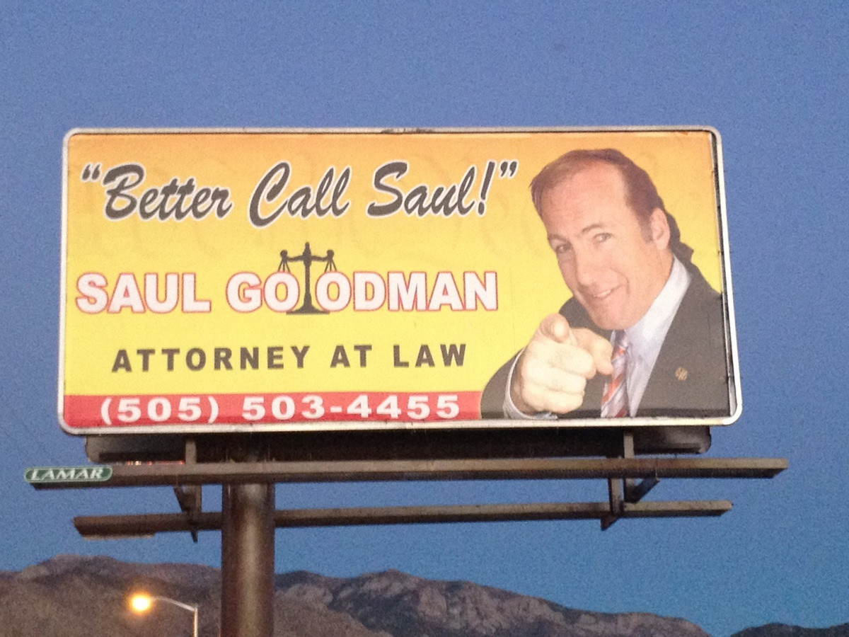

Slide 5
Should Kim Wexler’s Motion to Disqualify Jim McGill be granted?

Slide 6
Lieberman v. Lieberman, 160 So.3d 73
(Fla. 4th DCA 2014)
Former husband represented in post-dissolution proceedings by his current wife.
Former wife moved to disqualify the current wife, arguing she was a “material witness” to issues raised in contempt proceedings.

Slide 7
Lieberman
Fact that the current wife was a potentially necessary witness at a contempt hearing would not prevent her from serving as her husband’s attorney in other pre-trial, trial, and post trial proceedings.
KMS Rest. Corp. v. Searcy, Denney, Scarola, Barnhart & Shipley P.A., 107 So. 3d 552 (Fla. 4th DCA 2013).

Slide 8
Lieberman cites Caruso v. Knight, 124 So. 3d 962
(Fla. 4th DCA 2013)
“Disqualification of a party’s chosen counsel is a drastic remedy that should be used sparingly.”

Slide 9
Rule 4-3.7 Lawyer as Witness
A lawyer shall not act as advocate at a trial in which the lawyer is likely to be a necessary witness unless:
the testimony relates to an uncontested issue;
the testimony will relate solely to a matter of formality and there is no reason to believe that substantial evidence will be offered in opposition to the testimony;
the testimony relates to the nature and value of legal services rendered in the case; or
disqualification of the lawyer would work substantial hardship on the client.

Slide 10
Lieberman
An attorney who is too personally involved in the issues in a litigation consider withdrawing or risk violating ethical duties owed to the client, including the duty of competence, Rule 4-1.1, and the duty as adviser to exercise independent professional judgment and render candid advice, Rule 4–2.1

Slide 14
Is it ethical for Jim to disclose to Kim that HHM is paying his legal fees?

Slide 15
Is it ethical for Jim to disclose to Kim the amount of his retainer fee?

Slide 16
Rule 4-1.6 Confidentiality of Information
(a) A lawyer must not reveal information relating to representation except as stated in subdivisions (b), (c), and (d), unless the client gives informed consent.
(b), (c), and (d) do not relate to issues of who is paying a retainer or how much that retainer is.

Slide 17
Since HHM paid Jim’s retainer, HHM has a say in how Jim represents his brother, right?

Slide 18
Rule 4-1.8 Conflict of Interest; Prohibited and Other Transactions
(f) Compensation by Third Party. A lawyer shall not accept compensation for representing a client from one other than the client unless:
(1) the client gives informed consent;
(2) there is no interference with the lawyer’s independence of professional judgment or with the attorney-client relationship; and
(3) information relating to representation of a client is protected as required by rule 4-1.6

Slide 21
Tumelaire v. Naples Estates Homeowners Ass’n., Inc.,
137 So.3d 596 (Fla. 2d DCA 2014)
Tumelaire sued her HOA, raising allegations against board members and requested an accounting. The HOA responded that Tumelaire was not entitled to the documents because it suspected that Tumelaire was attempting to gain access for a third party’s benefit. The HOA then moved to compel Tumelaire to disclose her fee arrangements with her attorney and accountant.

Slide 22
Tumelaire
Any information concerning the fee arrangement is protected by the attorney-client privilege pursuant to section 90.502(2), Fla. Stat. (2013).
The identity of a client and payment of a fee appears to be within the ambit of the statutory privilege and are not expressly or impliedly excluded exceptions. See Corry v. Meggs, 498 So.2d 508, 511 (Fla. 1st DCA 1986).

Slide 23
Section 90.502 (2)
(c) A communication between lawyer and client is “confidential” if it is not intended to be disclosed to third persons . . . .
(2) A client has a privilege to refuse to disclose, and to prevent any other person from disclosing, the contents of confidential communications when such other person learned of the communications because they were made in the rendition of legal services to the client.

Slide 27
Will Jim’s Motion to Withdraw be granted?

Slide 28
Bowin v. Molyneaux, 100 So.3d 1197 (Fla. 5th DCA 2012)
Bowin represented Molyneaux family in a foreclosure action and eventually disagreed as to the scope of representation .
In a civil case, any attorney of record has the right to terminate the attorney-client relationship and withdraw on due notice to his client and approval by the court.
Approval should be rarely withheld, and then only when granting withdrawal would interfere with the efficient and proper functioning of the court.

Slide 32
Should Jim, who was appointed by the Court, represent Nacho in the appeal of his death sentence, even though Nacho does not want to appeal?

Slide 33
Robertson v. State of Florida, 143 So.3d 907 (Fla. 2014)
Robertson received a sentence of death and wanted to argue in favor of that sentence.
Appellate counsel sought to withdraw to avoid an alleged violation of his ethical responsibility to his client.
Withdrawal denied - there is no ethical violation in requiring counsel to prosecute the appeal fully for the benefit of the Court which must consider all death sentences.
Robertson may file a pro se supplemental brief setting forth his personal positions and interests.

Slide 34
How much input should Nacho have as to Jim’s Appellate Strategy?

Slide 35
Robertson
Robertson may file a pro se supplemental brief setting forth his personal positions and interests.

Slide 36
Rule 4-1.2 Objectives and Scope of Representation
(a) Lawyer to Abide by Client's Decisions . . . a lawyer shall abide by a client's decisions concerning the objectives of representation . . .
In a criminal case, the lawyer shall abide by the client's decision, after consultation with the lawyer, as to a plea to be entered, whether to waive jury trial, and whether the client will testify.

Slide 37
Would Jim face an ethical violation if he acquiesced in Nacho’s request not to fight the death sentence?

Slide 38
Robertson
It “is ‘ineffective assistance for counsel to simply acquiesce’ to a client’s desires to be executed . . .
In other words, not only does the client have no right to commit state-assisted suicide, but it is actually ineffective – and therefore unethical – conduct for an attorney to accede to this request.”

Slide 39
Rule 4-1.1 Competence
A lawyer shall provide competent representation to a client. Competent representation requires the legal knowledge, skill, thoroughness, and preparation reasonably necessary for the representation.

Slide 42
Compensation Issues?

Slide 43
Rule 4-1.2 (d) Criminal or Fraudulent Conduct
A lawyer shall not counsel a client to engage, or assist a client, in conduct that the lawyer knows or reasonably should know is criminal or fraudulent.

Slide 44
Rule 4-1.5 Fees and Costs for Legal Services
(f) Contingent Fees. As to contingent fees:
(3) A lawyer shall not enter into an arrangement for, charge, or collect:
* * *
(B) a contingent fee for representing a defendant in a criminal case.

Slide 45
THE END

