Slide 1
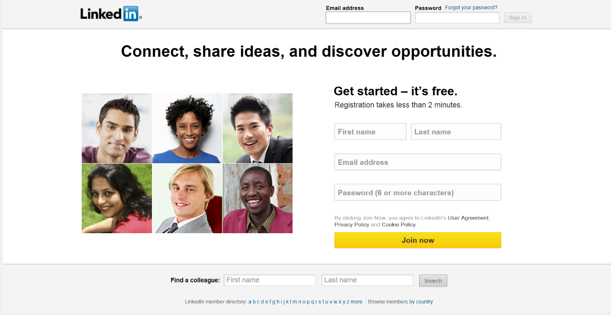
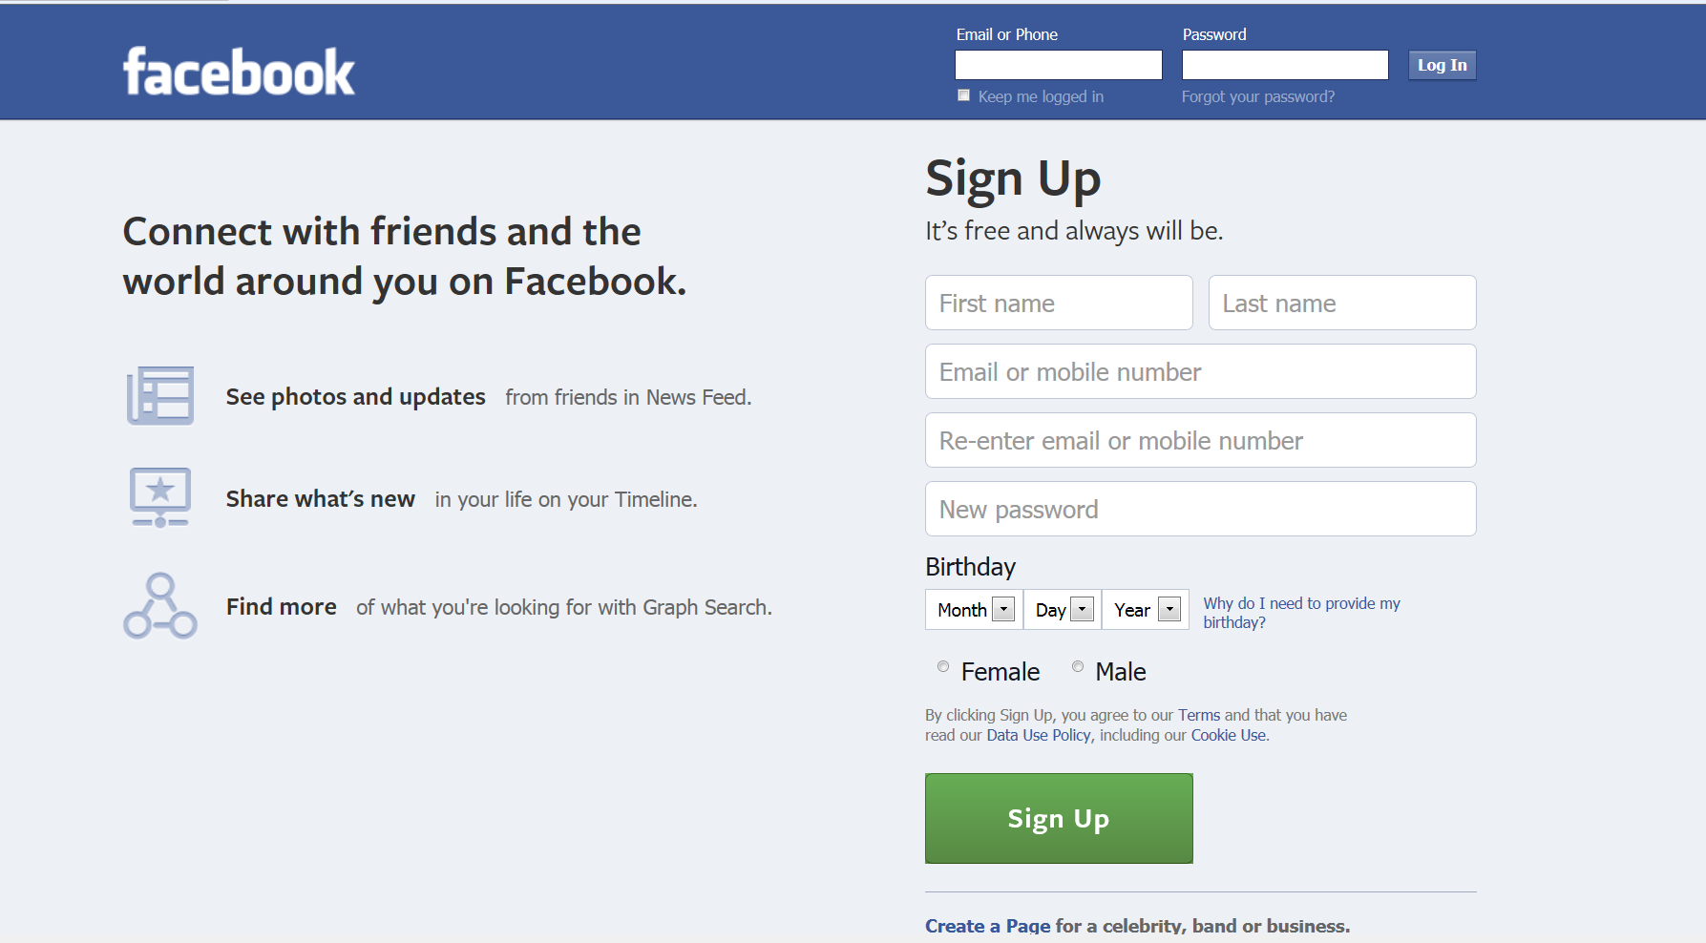
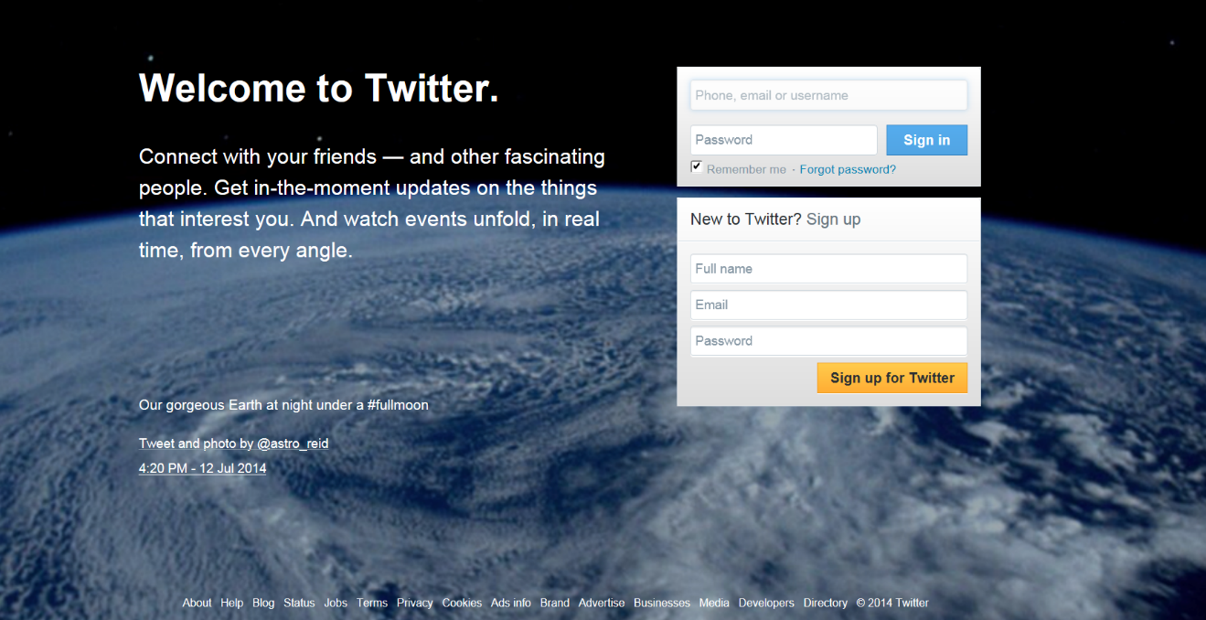
Ethical Issues and
Social Networking

Slide 2
Judges and Social Media

Slide 3
ABA Formal Opinion: Judge’s Use of Electronic Social Networking Media

Slide 4
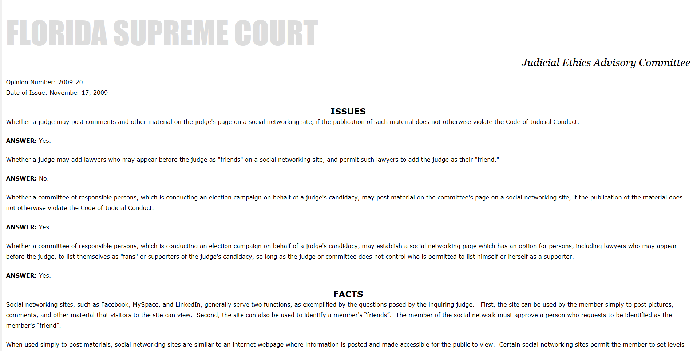
Florida Supreme Court Ethics Opinion on Social Media

Slide 5
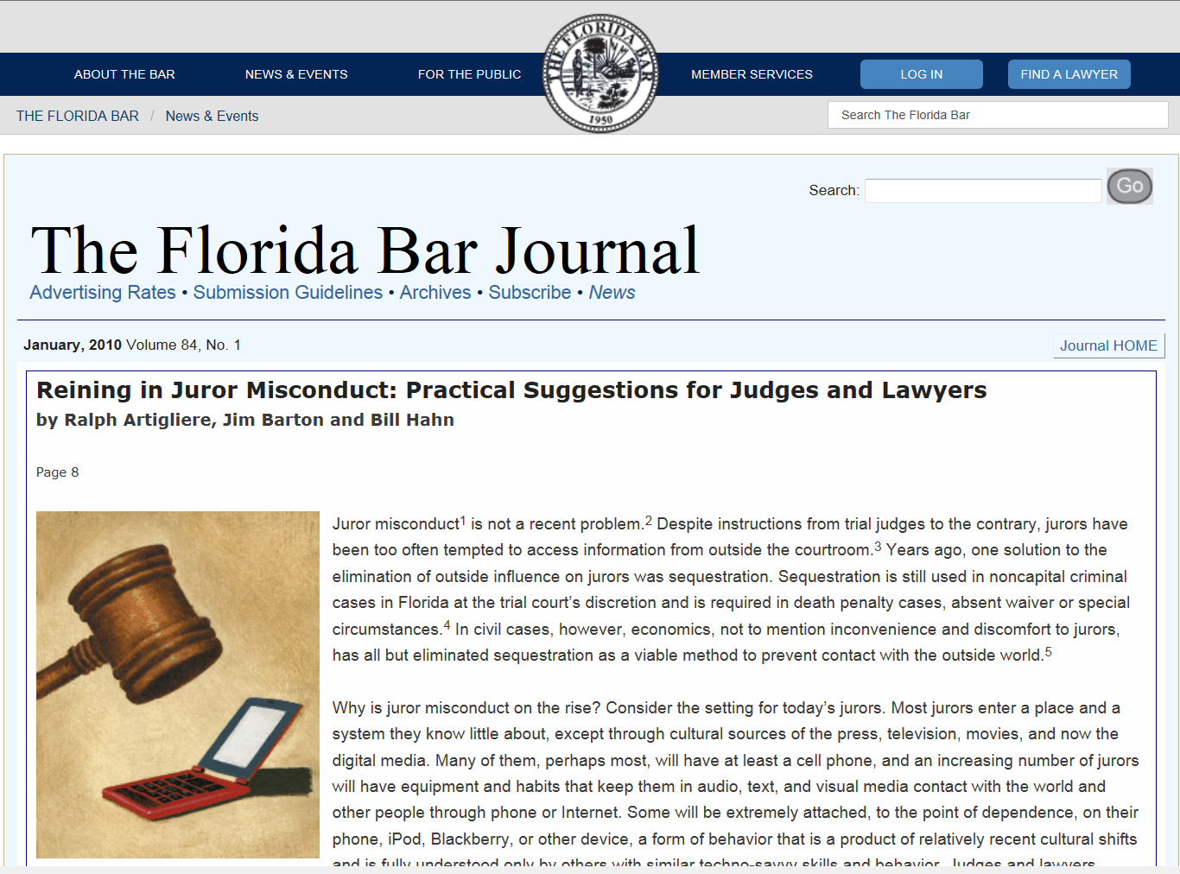

Slide 6
Florida Supreme Court Standard Jury Instructions – Civil Cases
Section 200 – Preliminary Instruction
(dealing with juror media usage)

Slide 7
Eleventh Circuit
Civil Pattern Jury Instructions
1. Preliminary Instructions
(dealing with juror media usage)

Slide 8
Jurors and Social Media

Slide 9
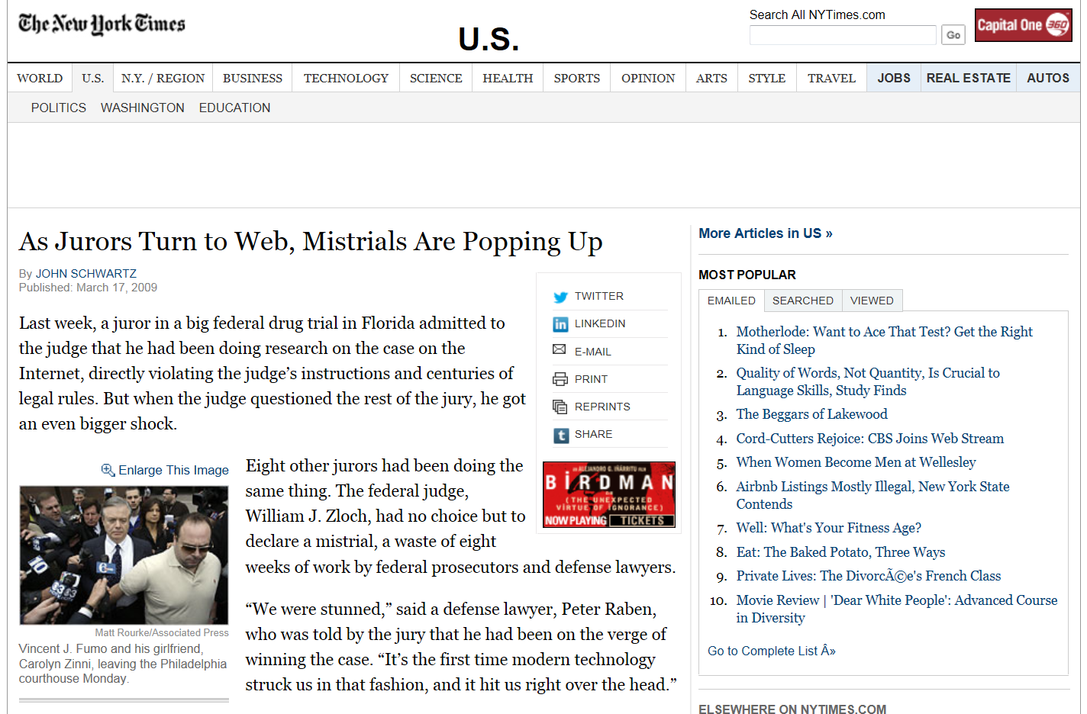

Slide 10
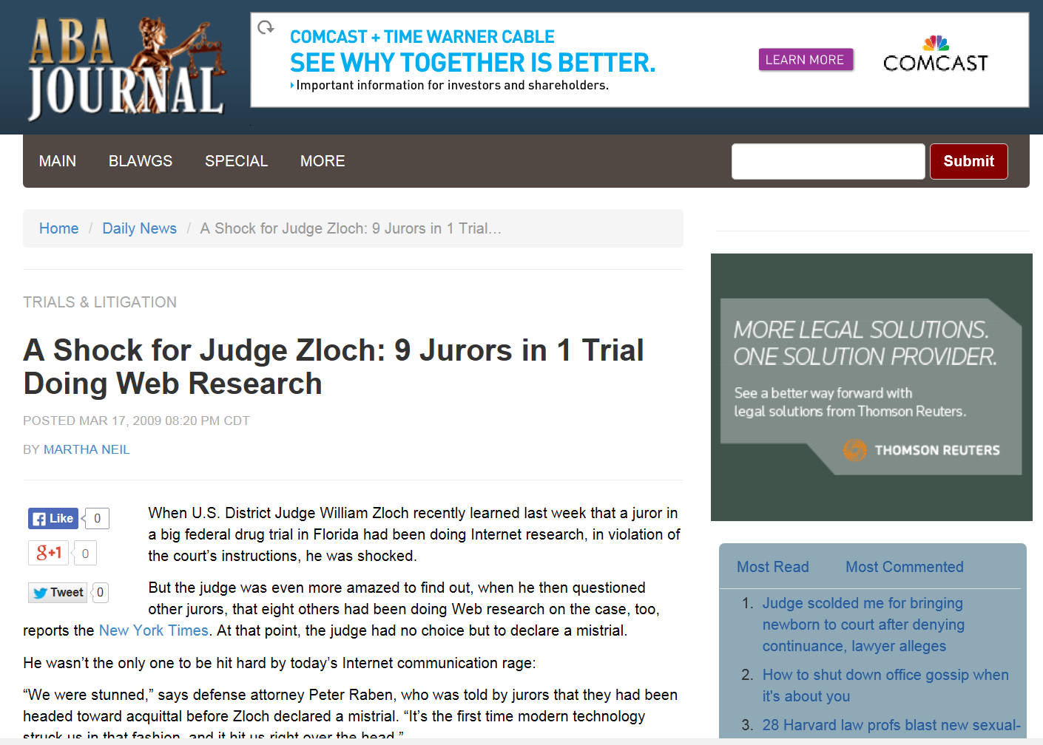

Slide 12
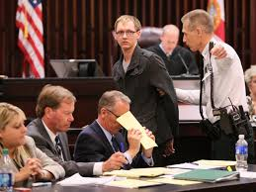
Prospective Juror in Goodman Case Arrested for Google Search
(Right – still photo; Below – News Coverage)

Slide 13
Social Media Evidence

Slide 14
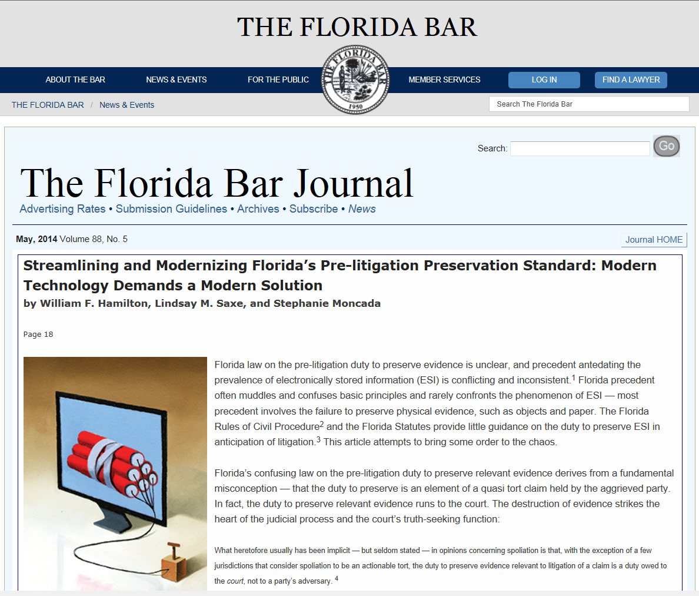

Slide 15
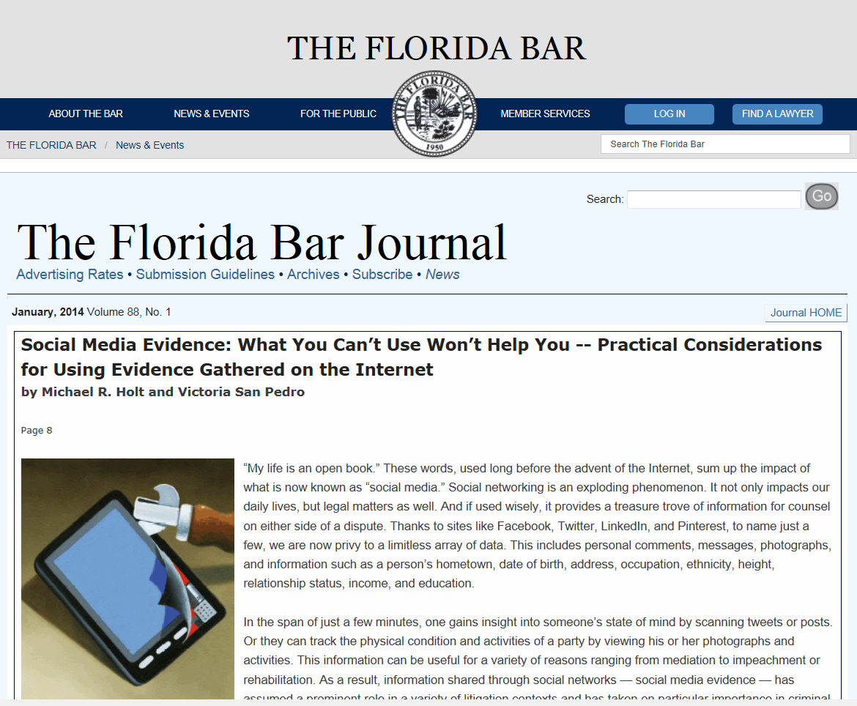

Slide 16
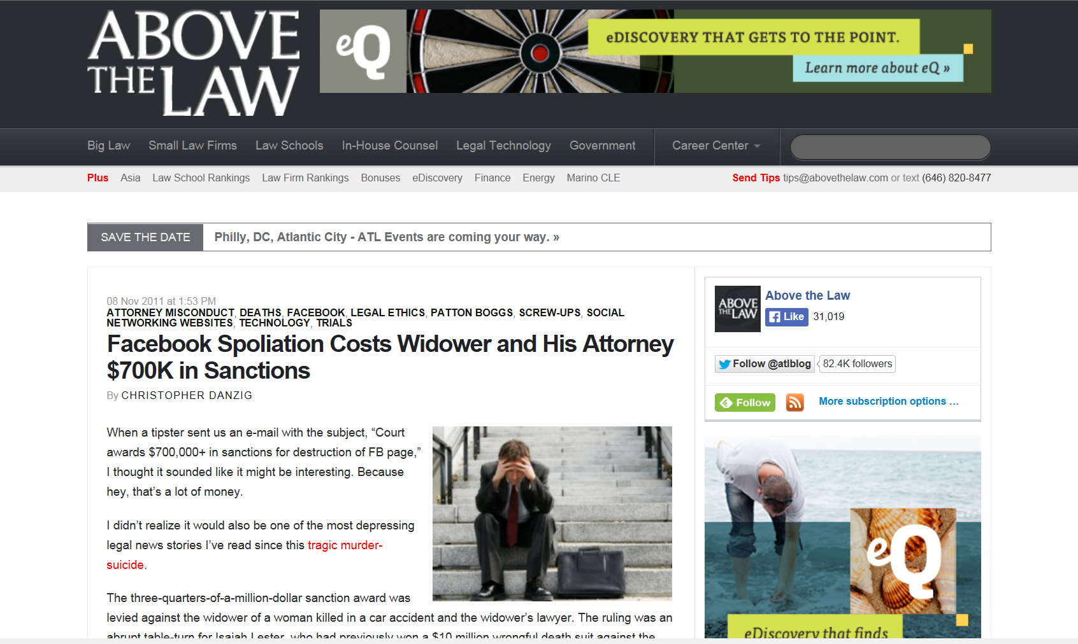

Slide 17
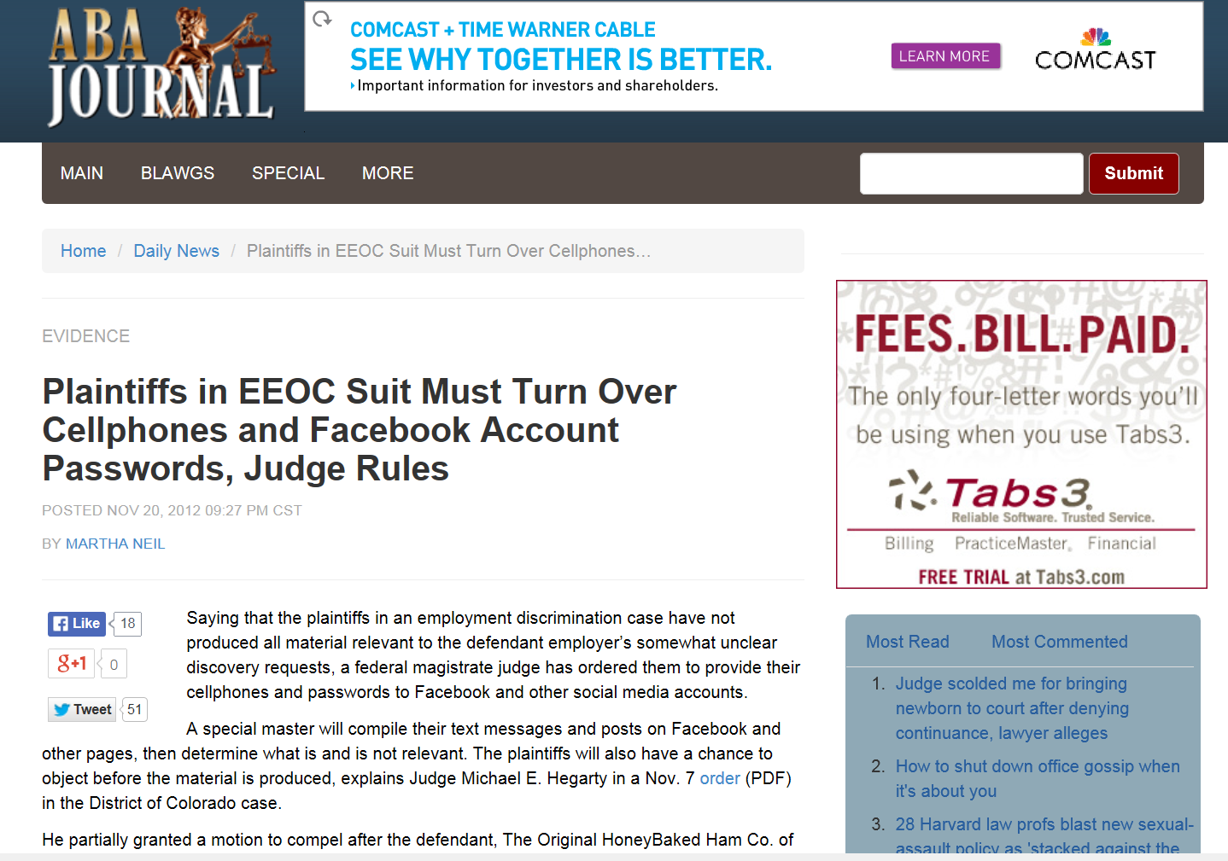

Slide 18
