Slide 1
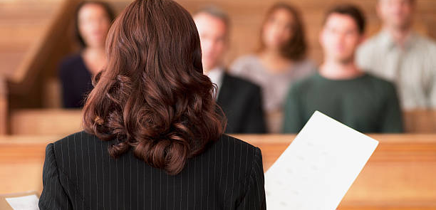
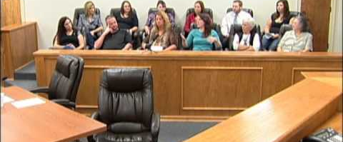
Gus J. Solomon’s Voir Dire Academy
January 2024

Slide 2
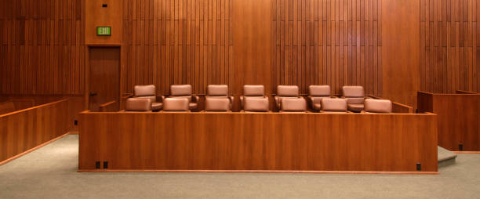
Voir Dire Academy

Slide 3
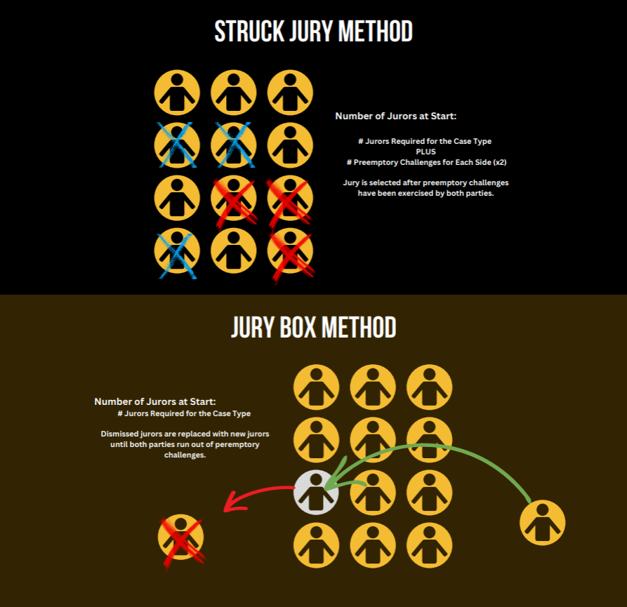

Slide 4
Voir Dire Academy

Slide 5
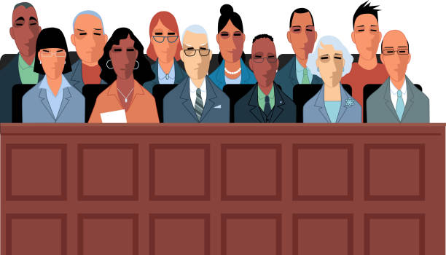
Federal and State Court Jury Orientation Videos
Federal Court
Called to Serve (https://vimeo.com/182585389/3d8a5b85da?share=copy)
Jury Service, Hands-On Justice (https://www.youtube.com/watch?v=4YwHLjZdebM)
We the People: The Honor of Jury Service (https://www.youtube.com/watch?v=49QVXbYsJ54)
Unconscious Bias (https://www.youtube.com/watch?v=hdjBbfdRLkA)
Understanding the Effects of Implicit Bias, Be Aware to Be Fair
(https://www.youtube.com/watch?v=BA-z4mS_Evg)
State Court
Justice for All (https://youtu.be/I58rNp87bPo)

Slide 6
Voir Dire Academy

Slide 7
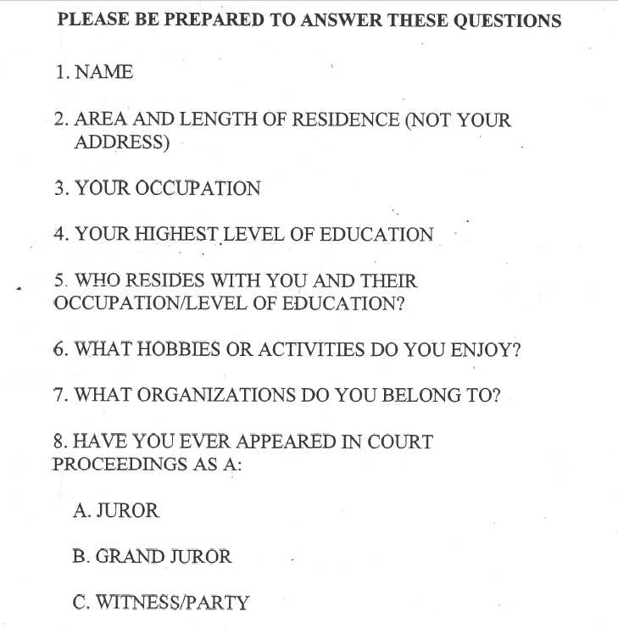

Slide 8
Voir Dire Academy

Slide 9
Open Ended Questions
-What was the first thing that came to your mind when you heard that this case includes a charge of domestic violence?
-Could you share an example of a time when you saw, or just knew about, someone being treated differently or badly because of their race?
-Describe a time when you felt that another driver on the road was making you feel unsafe?
-How do you feel about patients bringing lawsuits against doctors over the treatment they received?

Slide 10
Questions to Avoid in Voir Dire
-Does anyone have a problem with the fact that this case involves drinking and driving?
-Can you set aside your biased and decide the case on the facts?
-Will you promise me that you will follow the law and the judge's instructions in this case?
-I take it from your silence that no one disagrees with the proposition that you cannot use a defendant choosing not to testify as evidence of their guilt?

Slide 11
Voir Dire Academy

Slide 12
DR. PHIL

Slide 13
DR. BULL

Slide 14
Voir Dire Academy

Slide 15
WHEN IS SJS MOST LIKELY TO WORK?
When:
“cases are publicized”
“evidence is ambiguous and does not favor one side more than the other”
“juror views are related to demographic characteristics and personality attributes that can be directly observed”
“the predictors of juror voting are not immediately obvious to either attorney, even when they oppose lawyerly intuition”
“attorneys are permitted to conduct a thorough voir dire”
“the court is liberal in its allowance of peremptory challenges”
- Scientific Jury Selection: History, Practice, and Controversy, Audrey Cleary, Villanova University, citing Kressel and Kressel (2002).

Slide 16
Voir Dire Academy

