Slide 1
Law Talk: Access to Justice in Oregon Courts
Gus J. Solomon Inn || April 18, 2023

Slide 4
Title II of the ADA (42 USC 12132) applies to state and local governments, including state courts.
- Dr. G, a very smart guy

Slide 5
New and Historic Courthouses
Benton Co. Courthouse c. 1888
Multnomah Co. Courthouse c. 1914
Multnomah Co. Courthouse c. 2020

Slide 6
ADA Coordinators by County
Please see program materials
for complete list of all ADA Coordinators by County

Slide 7
UTCR 7.060 AMERICANS WITH DISABILITIES ACT (ADA) ACCOMMODATION
If an accommodation under the ADA is needed for an individual in a court proceeding, the party needing accommodation for the individual must notify the court in the manner required by the court as soon as possible, but no later than four judicial days in advance of the proceeding. For good cause shown, the court may waive the four-day advance notice.
Notification to the court must provide:
The name of the person needing accommodation;
The case number;
Charges (if applicable);
The nature of the proceeding;
The person’s status in the proceeding;
The time, date, and estimated length of the proceeding;
Whether the proceeding is scheduled to be conducted in person at the courthouse or by remote means, and, if by remote means, the type of remote means proceeding (e.g., by telephone, particular mode of video conference, etc.);
The type of disability needing accommodation; and
The type of accommodation, interpreter, or auxiliary aid needed or preferred.

Slide 8
Mult. Co. Reasonable Accommodation Form
Many counties have a specific form that can be used to request an accommodation under UTCR 7.060.
See program materials for a complete copy of the Multnomah County Reasonable Accommodation Form.

Slide 9
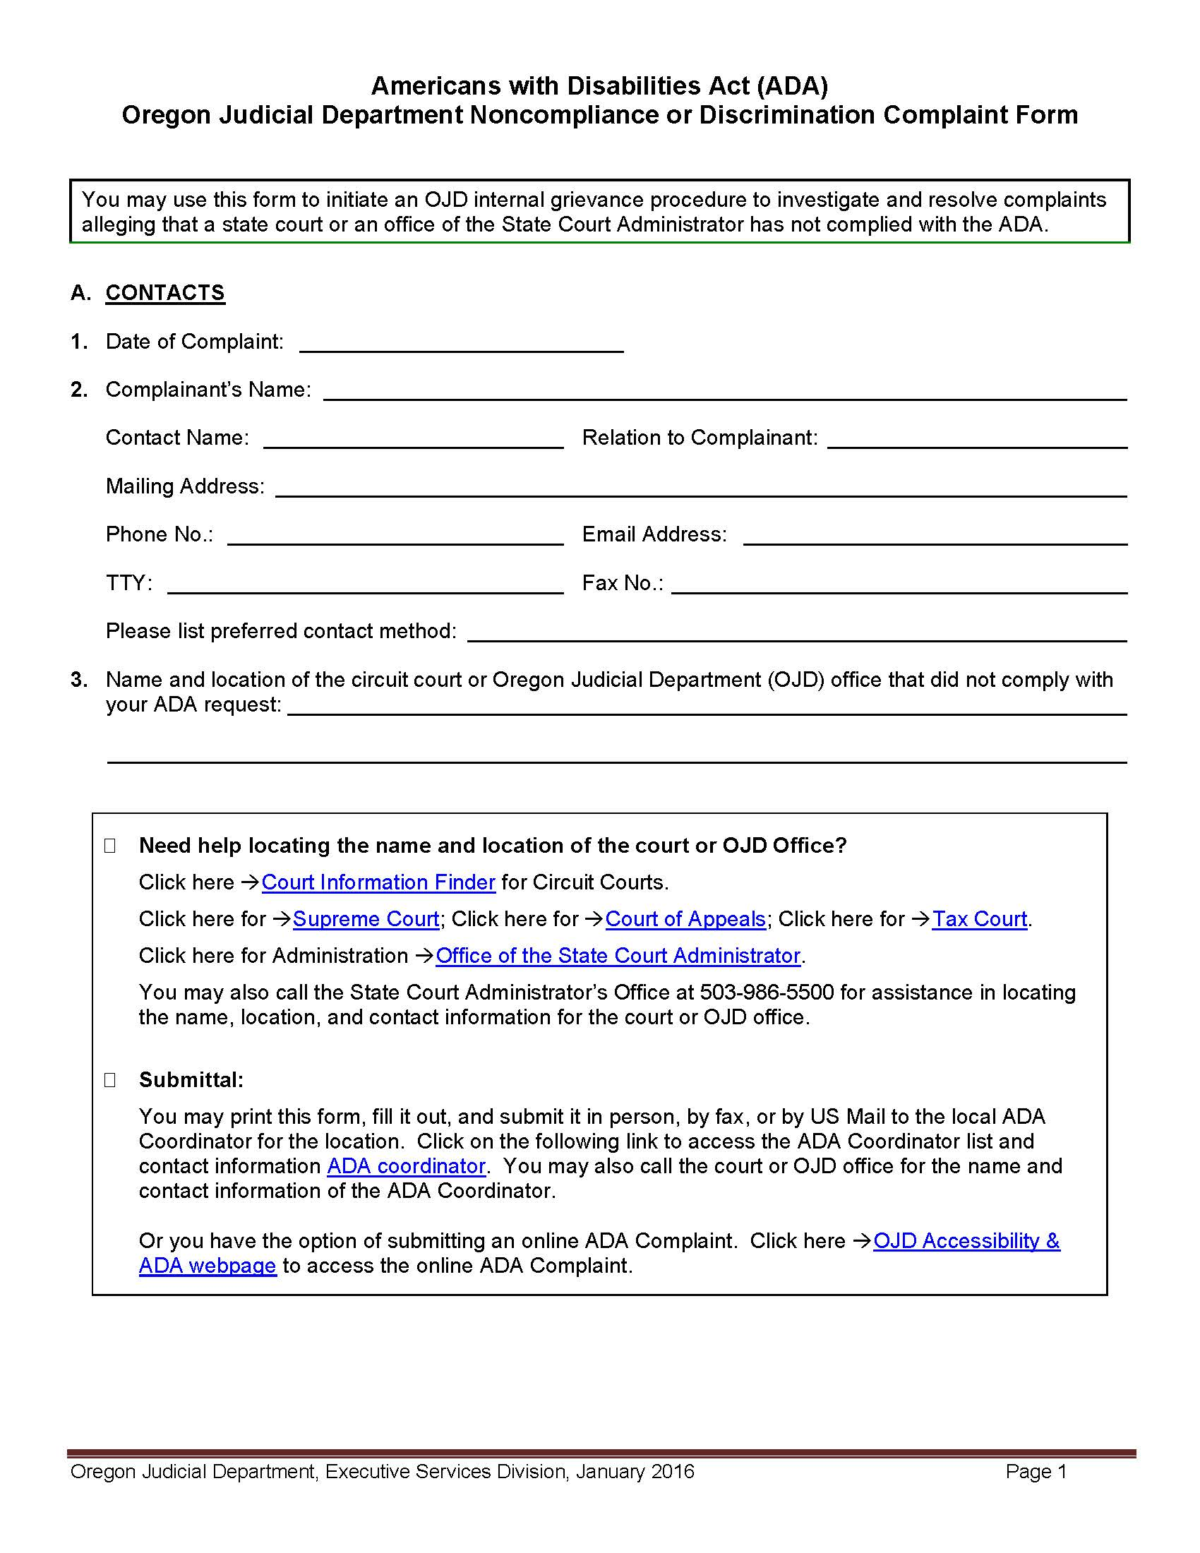
Oregon Judicial Department ADA Complaint Form
See program materials for a complete copy of the OJD ADA Form.

Slide 10
Don’t Get Lost in Translation!
ORS 45.275
UTCR 7.070
Provides that the Court “shall appoint a qualified interpreter in a civil or criminal proceeding, and a hearing officer or the designee of a hearing officer shall appoint a qualified interpreter in an adjudicatory proceeding, whenever it is necessary” to interpret the proceedings for to a non-English speaking party or witness, or to assist the court in performing its duties.
Outlines procedures for requesting foreign language interpreter.
Specifies minimum notice period required (4 judicial days). For good cause shown, court may waive 4-day period.

Slide 11
11
Access to Justice
2023

Slide 12
Top 5 Languages in OR
https://www.oregon.gov/languages/pages/most-common-state-language.aspx

Slide 13
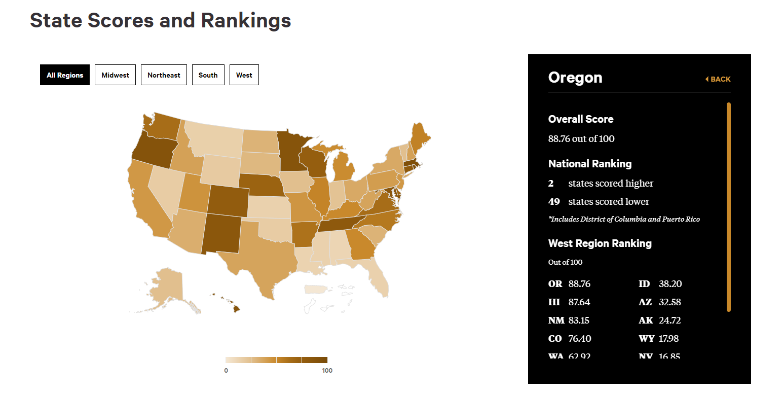
https://ncaj.org/state-rankings/2016/language-access
13
Law Talk
2023

Slide 14
Flesch Reading Ease Score
The Flesch Reading Ease gives a text a score between 1 and 100, with 100 being the highest readability score. Scoring between 70 to 80 is equivalent to school grade level 8. This means text should be fairly easy for the average adult to read. The formula was developed in the 1940s by Rudolf Flesch. He was a consultant with the Associated Press, developing methods for improving the readability of newspapers.
The Flesch Kincaid Grade Level is a widely used readability formula which assesses the approximate reading grade level of a text. It was developed by the US Navy who worked with the Flesch Reading Ease.
https://readable.com/readability/flesch-reading-ease-flesch-kincaid-grade-level/
Law Talk
2023

Slide 15
National Laws on Readability
Walters v. Reno 145 F.3d 1032 (9th Cir. 1998)
Plain Writing Act of 2010
Federal Plain Language Guidelines
Held that the US Immigration & Naturalization Services (INS)’s procedures were so confusing and misleading that they denied plaintiffs’ due process rights.
Designed to enhance citizen access to government information and services by establishing that government documents issued to the public must be written clearly.
https://www.plainlanguage.gov/guidelines/

Slide 16
Oregon Plain Language Laws
Employment: ORS 657.260(2)
Residential Building Codes: ORS 455.085(1)
Lawmaking: ORS 171.134
“…The printed statement [employers must provide] shall include notice to the workers in plain language of the potential disqualification from receipt of benefits for voluntarily leaving work or being discharged.”
“The text of the publications made under this section shall be readable at the ninth grade level of reading, as determined by the director under one or more standard recognized readability formulas, including, but not limited to, the Flesch, Fry or Dale Chall tests.”
“Any measure digest or measure summary prepared by the Legislative Assembly shall be written in a manner that results in a score of at least 60 on the Flesch readability test or meets an equivalent standard of a comparable test.”

Slide 17
Oregon Plain Language Laws
Contingency Agreements: ORS 20.340(1)(a)
Consumer: ORS 180.545(1)
“The agency to whom a consumer contract is submitted under ORS 180.540 shall review the contract to determine whether it complies with plain language standards. A consumer contract complies with plain language standards if it: (a) Uses words that convey meanings clearly and directly; (b) Uses the present tense and active voice whenever possible; (c) Primarily uses simple sentences; (d) Defines only those words that cannot be properly explained or qualified in the text; (e) Explains at the beginning that the form is a contract between parties; …..”
“…[I]f an attorney for a plaintiff in respect to any civil action enters into an agreement with the plaintiff whereby the attorney receives as a fee a percentage of the amount of any settlement or judgment awarded to the plaintiff: (a)
The contingent fee agreement shall be written in plain and simple language reasonably believed to be understandable by the plaintiff.”

Slide 18
What are these legal people tawlking about?!
Let’s play…

Slide 19
Ex parte

Slide 20
In Camera

Slide 21
Pro se

Slide 22
In pari delicto

Slide 23
Plain Language Movement
Plain language is more than just what words you use to communicate — it is the way in which you compose your sentences, and the tone and voice your communication. It is about making your text more user-friendly by adopting a consciousness of who your target audience is, thinking of how they would best understand what you’re trying to get across, and ensuring that you speak and write in the most direct way to get your point across to this audience in the most succinct yet clear way.
Research has found, in fact, that plain language is often more compelling and persuasive than legalese - further underscoring the benefits of writing plainly, with an eye towards generating understanding rather than obfuscating key points.
Sources:
https://www.openlawlab.com/2015/02/09/plain-language-legal-design/
https://www.michbar.org/file/barjournal/article/documents/pdf4article2972.pdf

Slide 24
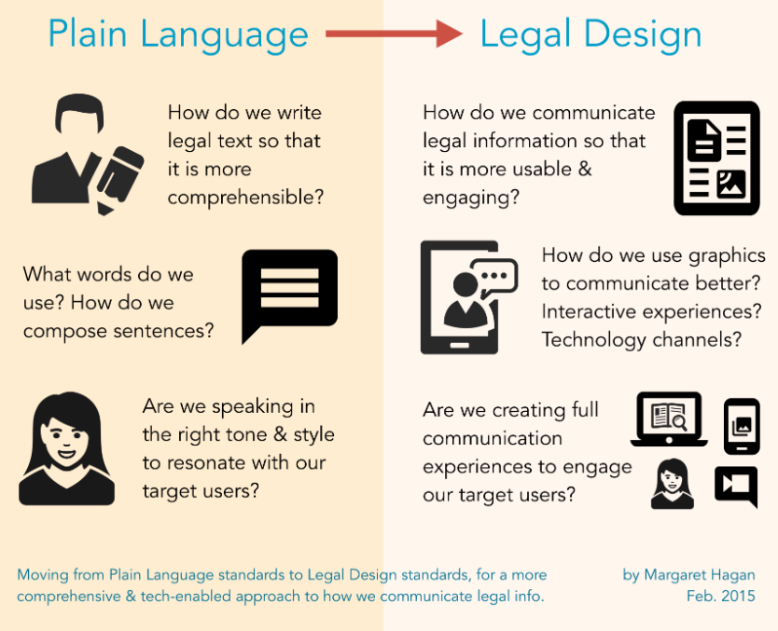
Plain Language & Legal Design

Slide 25
Accessibility Considerations
(Part 1 of 2)
Composition
How is it laid out?
How many characters go across the line?
How is it structured, indented, boxed, and otherwise made visually comprehensible?
Interactivity
Is the communication staged?
Can a user get a quickly glanceable version, and then dig selectively into the text for more detailed explanations?
Can we use digital tools to make the communication more engaging, customizable, and lively?
Access to Justice
2023

Slide 26
Accessibility Considerations
(Part 2 of 2)
Visuals
Are graphics, illustrations, and symbols used to enhance the user’s understanding?
Is there a way to shorten the amount of text we present, or to better show priorities and warnings within the text through the use of graphics?
Is there a way to ground the text in more context & situational understanding by showing illustrations or photographs?
Service flows
What is the role of this communication in a larger service experience of the end user?
Law Talk
2023

Slide 27
Accessibility Considerations

Slide 28
Pro Se Litigants in Oregon
The Oregon Supreme Court reported from a study in 2019 that 83% of parties in landlord/tenant cases were unrepresented and 71% of parties in marital dissolution cases were unrepresented.
The number of pro se litigants is leading to extensive delays, particularly in family court. The problem is particularly acute in rural areas.
Oregon piloted and then expanded the Informal Domestic Relations Trial program statewide.
Both parties must agree to IDRT. The parties speak directly to the Court.
The Rules of Evidence do not strictly apply, but may go to weight.

Slide 29
OSB Paraprofessional Program
In 2019 the OSB Board of Governors created a committee to study that issue.
Based upon that study, last year the Oregon Supreme Court directed the Bar to implement a new program to license paraprofessionals to provide limited legal services in family law and landlord-tenant cases.
They will be regulated by the Oregon State Bar.
They will be subject to their own Rules of Professional Conduct,
Will be required to have malpractice insurance, etc.
OSB is currently developing the specifics of the program now.
And a Bill is currently pending before the State Senate, SB 306, that would address some statutory language issues (statutory definition of “attorney”) to allow the program to proceed

Slide 30
www.Real-law-real-ppl-real-cheap.org.com

Slide 31
How to access legal services in Oregon
Your local lawyer
Internet legal services (law depot, legal zoom, legal match, etc)
Oregon State Bar
Legal Aid Services of Oregon
Oregon Law Center
American Bar Association

Slide 32
How to access legal services in Oregon
Consumer Protection Division (Oregon Attorney General) Consumer Hotline at 1-877-877-9392
Bureau of Labor & Industries (BOLI) 971-245-3844
Veterans Service Officers (all counties) & ODVA (800) 692-9666 or (503) 373-2085
District Attorney

Slide 33
Native American Rehabilitative Agency (NARA)
Inpatient and Outpatient Addiction Treatment
Mental Health Programs
Youth Residential Treatment Center
NARA NW Administration Oyate Building 1776 SW Madison Portland, OR 97205 Phone: 503-224-1044 Email: info@naranorthwest.org

Slide 34
How to access legal services in Oregon
Non-Profits
St. Andrews Legal Clinic
The Commons Law Center (unbundled services)
Fort Kennedy (Veteran’s Pro Bono Services)
Faith based and veterans service based
VFW,
AMVETS
NABVETS, (Black Veterans Assoc.)
Easter Seals,
Catholic Relief, Lutheran Family Services

Slide 35
Oregon State Bar
Need to get free/low cost legal advice in Oregon?
To access these services, visit the bar online (www.osbar.org) or call 1.800. 452.7636 for services, or 1.800. 452.4776 for recorded legal information on specific topics.
Recorded Legal Information Guides
Modest Means Program
Veterans Law Section Program

Slide 36
Oregon Farmworker Program
Legal Aid (LASO)
Hillsboro
Oregon Law Center
Woodburn
Gresham

Slide 37
Immigration Counseling Service (ICS) Portland & Hood River (oldest non-profit)
503 221-1689 – 519 SW Park Ave, Portland, OR 97205:
www.ICS-law.org
Permanent residency (Green Card)
Naturalization and citizenship
Deferred Action for Childhood Arrivals (DACA)
Survivors of domestic violence, sexual assault, and child sexual abuse (VAWA)
Visa for crime victims (U Visa)
Survivors of human trafficking (T Visa)
Temporary Protected Status (TPS)
Asylum
Refugee Adjustment of Status/Family Petition

Slide 38
American Bar Association
Free legal help at website:
https://abafreelegalanswers.org/
Also, pro bono listing of attorneys
https://www.americanbar.org/groups/center-pro-bono/resources/pro-bono-resource-directory

Slide 39
This public service announcement is brought to you by:
Gus Solomon Inns Of Court

Slide 40
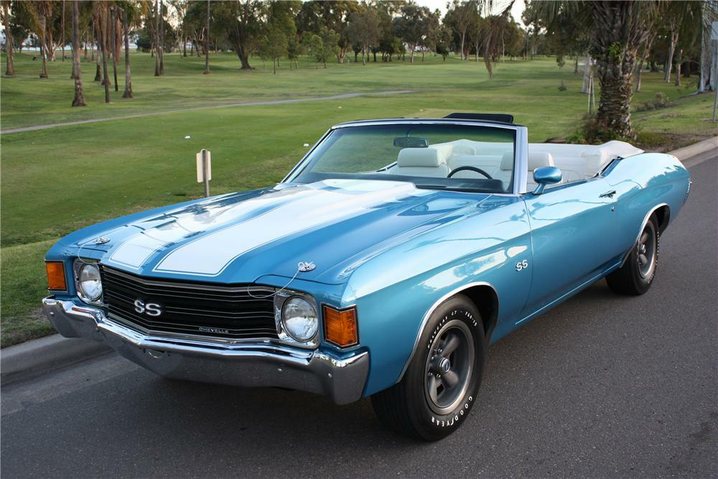

Slide 41
What is Restorative Justice? Restorative justice is a philosophy that encourages constructive responses to harm. It brings the needs and voices of those who have harmed, those impacted, and the community into processes that repair harms and rebuild relationships.
Law Talk
2023

Slide 42
Victim’s Rights under the Oregon Constitution
Art. I, Sec. 42. Rights of victim in criminal prosecutions and juvenile court delinquency proceedings. (1) To preserve and protect the right of crime victims to justice, to ensure crime victims a meaningful role in the criminal and juvenile justice systems, to accord crime victims due dignity and respect and to ensure that criminal and juvenile court delinquency proceedings are conducted to seek the truth as to the defendant's innocence or guilt, and also to ensure that a fair balance is struck between the rights of crime victims and the rights of criminal defendants in the course and conduct of criminal and juvenile court delinquency proceedings, the following rights are hereby granted to victims in all prosecutions for crimes and in juvenile court delinquency proceedings:
(a) The right to be present at and, upon specific request, to be informed in advance of any critical stage of the proceedings held in open court when the defendant will be present, and to be heard at the pretrial release hearing and the sentencing or juvenile court delinquency disposition;
(b) The right, upon request, to obtain information about the conviction, sentence, imprisonment, criminal history and future release from physical custody of the criminal defendant or convicted criminal and equivalent information regarding the alleged youth offender or youth offender;
(c) The right to refuse an interview, deposition or other discovery request by the criminal defendant or other person acting on behalf of the criminal defendant provided, however, that nothing in this paragraph shall restrict any other constitutional right of the defendant to discovery against the state;
(d) The right to receive prompt restitution from the convicted criminal who caused the victim's loss or injury;
(e) The right to have a copy of a transcript of any court proceeding in open court, if one is otherwise prepared;
(f) The right to be consulted, upon request, regarding plea negotiations involving any violent felony; and
(g) The right to be informed of these rights as soon as practicable.

Slide 43
Victim’s Rights under the Oregon Constitution
Art. I, Sec. 43. Rights of victim and public to protection from accused person during criminal proceedings; denial of pretrial release. (1) To ensure that a fair balance is struck between the rights of crime victims and the rights of criminal defendants in the course and conduct of criminal proceedings, the following rights are hereby granted to victims in all prosecutions for crimes:
(a) The right to be reasonably protected from the criminal defendant or the convicted criminal throughout the criminal justice process and from the alleged youth offender or youth offender throughout the juvenile delinquency proceedings.
(b) The right to have decisions by the court regarding the pretrial release of a criminal defendant based upon the principle of reasonable protection of the victim and the public, as well as the likelihood that the criminal defendant will appear for trial. Murder, aggravated murder and treason shall not be bailable when the proof is evident or the presumption strong that the person is guilty. Other violent felonies shall not be bailable when a court has determined there is probable cause to believe the criminal defendant committed the crime, and the court finds, by clear and convincing evidence, that there is danger of physical injury or sexual victimization to the victim or members of the public by the criminal defendant while on release. * * *

Slide 44
Mail Inspection
“Very Big Brother!” -RR
Courts have long recognized the “possibility that contraband will be enclosed in letters, even those from apparent attorneys[.]” Wolff v. McDonnell, 418 U.S. 539, 577 (1974).
Prison officials may open mail from attorneys in the presence of inmates. Id.
In Oregon, all incoming and outgoing non-legal mail is subject to inspection or examination. OAR 291-131-0015.
Legal mail is generally inspected in the presence of an inmate under OAR 291-131-0030.
Law Talk
2023

Slide 45
Law Library Access
“Books should be free for all, this is ridiculous” - VV
Inmates have a constitutional right of access to the courts. Lewis v. Casey, 518 U.S. 343, 346.
This right of access vis-à-vis a prison law library requires that inmates be provided with the tools they need to attack their sentences – directly or collaterally – and to challenge the conditions of their confinement. Id.
To adequately state a denial of access to the courts under the First Amendment, an inmate must show he suffered an actual injury, which requires actual prejudice with respect to contemplated or existing litigation such as the inability to meet a filing deadline or present a claim. Lewis, 518 U.S. at 349
Access to Justice
2023

Slide 46
PRO BONO APPOINTMENTS
Civil pro se litigants with a case pending before the USDC in Oregon can file a Motion for Appointment of Pro Bono Counsel at any time during the case. The Court can also appoint counsel on its own motion.
In assessing a pro se party’s need for legal counsel, the Court looks at several factors, including: the legal complexity of the issues, the apparent legal sophistication of the pro se party, and the importance of protecting the rights implicated by the claim.
Appointments can be made for all purposes or for a specific purpose.

Slide 47
PLRA & Tort Claims
“Tort reform, boo!” --VV
ORS 30.275(1) requires notice to the applicable public body prior to bringing a tort claim
Notice must be given within 1 year of the incident for wrongful death claims and within 180 days for an alleged loss or injury. ORS 30.275(2).
The Prison Litigation Reform Act (“PLRA”) requires inmates to exhaust administrative remedies before brining any lawsuit, including § 1983 claims. 42 U.S.C. § 1997e(a).
Exhaustion is mandatory for any claim challenging prison conditions, even if the relief sought – monetary damages – cannot be granted by the administrative process. Woodford v. Ngo, 548 U.S. 81, 85 (2006).
Access to Justice
2023

Slide 49
CAST & CREW
Stacie Beckerman, Reporter …
Ricky Romain …
Vikki Valentine …
Esmerelda Martinez …
Dr. Garrulous / Banjo Player …
Kate …
Heather …
Neal …
John The Sponsor …
Mickey No-Name …
Chris …
Jeremy …
Ali …
Haley, Tech …
… Hon. Stacie Beckerman
… Sonia Montalbano
… Jacqueline Swanson
… Lea Schneider
… Garrett Garfield
… Kathryn Mantoan
… Heather Busby
… Neal Shechter
… John Haub
… Michael Lee
… Christopher Larsen
… Jeremy Carp
… Allison Rothgeb
… Haley Morrison

