Slide 1
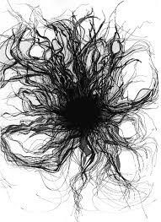
Alchemical Trade Dress: Demystifying the “tertium quid”
Dustin Marlan
Assistant Professor of Law
University of Massachusetts School of Law

Slide 2
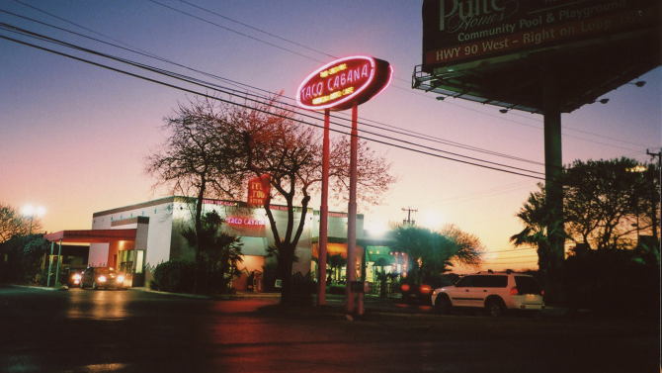

Slide 3
Roadmap
1. Trademark Distinctiveness
-Word Mark
-Logo Mark
-Trade Dress
-Product Packaging
-Product Design
-“Tertium Quid”
2. Tertium Quid – What is it? Why did Scalia use the metaphor?
-Alchemy
-Politics
-Theology
3. Service Mark – A better analogy for this third category of trade dress
4. Beyond the Service Mark – tertium quid trade dress as protecting experiential marketing

Slide 4
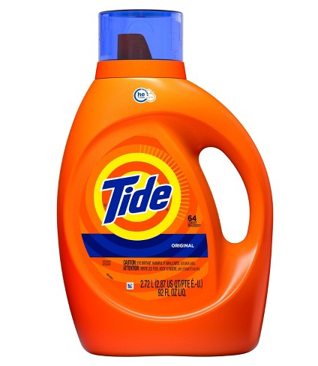
Trademark Distinctiveness
Relevant statutory provision: Lanham Act § 45; 15 U.S.C. § 1127
The term “trademark” includes any word, name, symbol, or device, or any combination thereof . . . used by a person . . . to identify and distinguish his or her goods, including a unique product, from those manufactured or sold by others and to indicate the source of the goods, even if that source is unknown.

Slide 5
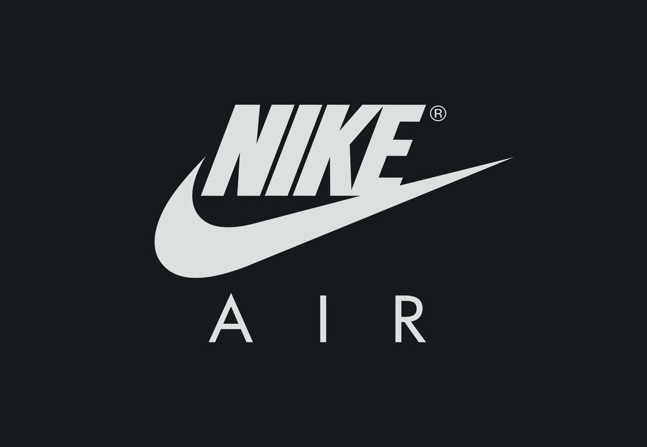
Two types of distinctiveness
Inherent distinctiveness – mark’s “intrinsic nature serves to identify a particular source”
Law assumes that consumers will instantly/automatically recognize mark as an indicator of source.
E.g., APPLE, NIKE
Acquired distinctiveness –mark develops an “acquired distinctiveness” such that consumers come to associate the mark with a particular product or service.
Mark develops “secondary meaning” in the marketplace., or through advertising.
E.G., AMERICAN AIRLINES, ENTREPRENEUR (magazine)

Slide 6
The Inherent Distinctiveness of Word Marks
Trademark law overwhelmingly uses the “Abercrombie spectrum to evaluate word mark distinctiveness.
Derives from Abercrombie & Fitch v. Hunting World, 537 F.2d 4 (2nd Cir. 1976) case.

Slide 7
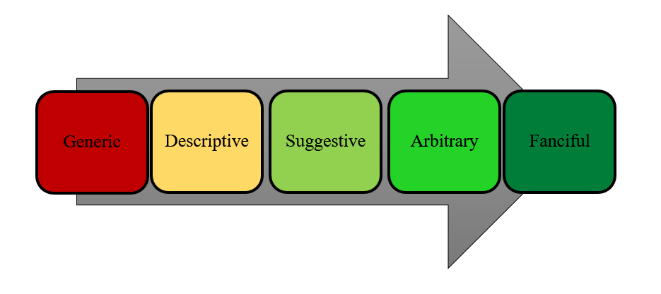
Abercrombie spectrum summary
Fanciful – Coined terms without other meanings (XEROX, KODAK,PEPSI)
Arbitrary – no obvious connection to goods or services, but often used metaphorically in invoking values or aesthetics of the product (NIKE, CAMEL, APPLE)
Suggestive – metaphors that requite “imagination, thought or perception” on the part of consumers to reach a conclusion as to related product or service (e.g., KLONDIKE for ice cream; GREYHOUND for a bus service)
-------------
Descriptive - convey an immediate idea of the ingredients, qualities, or characteristics of a related product or service (e.g.,AMERICAN AIRLINES for a U.S.-based airline, or SALTY for anchovies).
Protectable only upon showing of secondary meaning.
-------------
Generic – define a class of things; never protectable (e.g., LITE BEER for light beer; DESUGARED for a sugar-free beverage).
Never protectable.

Slide 8
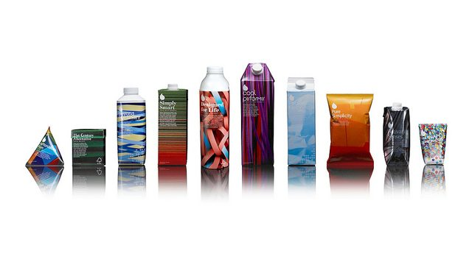
Distinctiveness Analysis for Nonverbal Marks
Includes:
Logos
Sounds
Scents
Colors (needs secondary meaning)
Trade Dress
Product packaging
Product design (needs secondary meaning)
Tertium Quid

Slide 9
The Distinctiveness of Logo Marks
Courts sometimes use the Abercrombie spectrum.
Others use the test from Seabrook Foods, Inc. v. Barwell Foods, Inc., 568 F.2d 1242 (C.C.P.A. 1976):
“In determining whether a design is arbitrary or distinctive this court has looked to whether it was [1] a ‘common’ basic shape or design, [2] whether it was unique or unusual in a particular field, [3] whether it was a mere refinement of a commonly-adopted and well known form of ornamentation for a particular class of goods viewed by the public as a dress or ornamentation for the goods, or [4] whether it was capable of creating a commercial impression distinct from the accompanying words.”

Slide 10
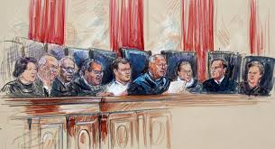
How do we decide whether nonverbal marks are distinctive?
The Abercrombie spectrum is suspect at best as extended to nonverbal marks.
Courts have difficulty interpreting the Supreme Court’s line of cases in this area:
Two Pesos, Inc. v. Taco Cabana, Inc., 505 U.S. 763 (1992) (analyzing the source-distinctiveness of a restaurant interior)
Qualitex Co. v. Jacobson Products Co., Inc., 514 U.S. 159 (1995) (analyzing the source distinctiveness of a single color)
Wal-Mart Stores, Inc. v. Samara Bros., Inc., 529 U.S. 205 (2000) (analyzing the source distinctiveness of an apparel design).

Slide 11
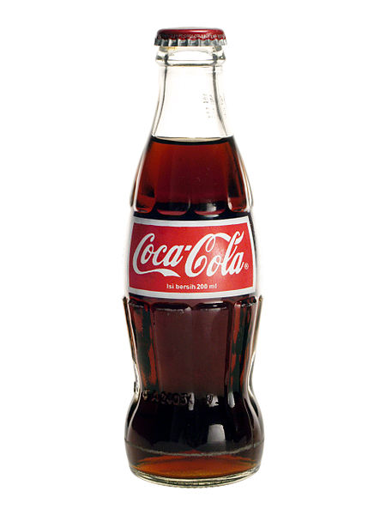
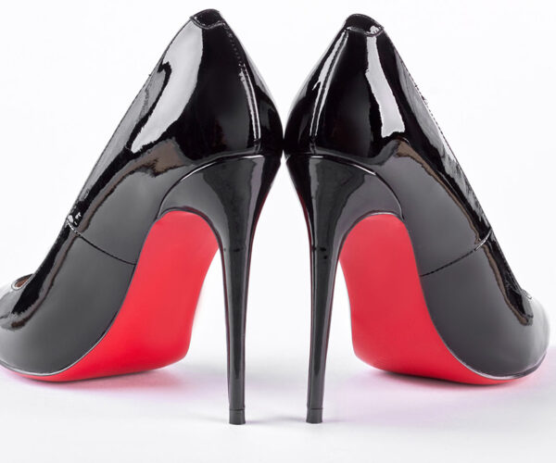
Trade Dress
Trade dress is a subset of trademark law.
It has been defined as consisting of the “total image of a product and may include features such as size, shape, color or color combinations, texture, graphics or even particular sales techniques.”
The protection of trade dress flows from the recognition that “anything at all that is capable of carrying meaning” can be afforded protection under the Lanham Act as a mark to be used in connection with advertising and commerce.
According to the Supreme Court in Two Pesos v. Taco Cabana:
“The breadth of the definition of marks registrable under Section 2 [of the Lanham Act], and of the confusion-producing elements recited as actionable by Section 43(a), has been held to embrace not just word marks, such as “Nike,” and symbol marks, such as Nike’s “swoosh” symbol, but also “trade dress”—a category that originally included only the packaging, or “dressing” of a product, but in recent years has been expanded by many Courts of Appeal to encompass the design of a product . . . . Since human being might use as a ‘symbol’ or ‘device’ almost anything at all that is capable of carrying meaning, this language, read literally, is not restrictive.”

Slide 12
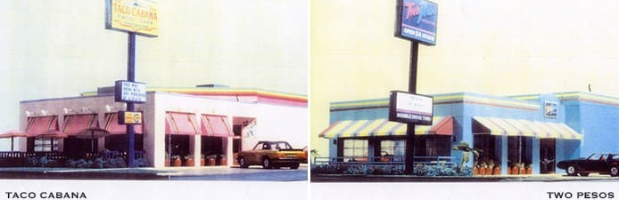
Two Pesos, Inc. v. Taco Cabana, Inc., 505 U.S. 763 (1992)
Supreme Court held that the trade dress of a chain of restaurants selling Mexican-inspired food was protectable as inherently distinctive without secondary meaning, allowing Taco Canaba’s suit against Two Pesos—a similar fast food restaurant—to go forward.
Taco Cabana described its trade dress as
“[A] festive eating atmosphere having interior dining and patio areas decorated with artifacts, bright colors, paintings and murals. The patio includes interior and exterior areas with the interior patio capable of being sealed off from the outside patio by overhead garage doors. The stepped exterior of the building is a festive and vivid color scheme using top border paint and neon stripes. Bright awnings and umbrellas continue the theme.”

Slide 13
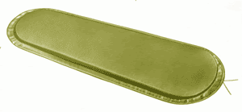
Qualitex Co. v. Jacobson Products Co., Inc., 514 U.S. 159 (1995)
Case involved registration of Qualitex Co.’s green-gold “Sunglow” dry cleaning pads.
Qualitex registered the color with the UPSTO and sued competitor Jacobson Products Co. for infringing on the color with its own pads.
Court affirmed Federal Circuit and Eighth Circuit in holding that a mark consisting solely of a single color could be registered.
However, secondary meaning was required.
Colors, unlike the décor of a restaurant, are not capable of inherent distinctiveness because according to the Court, they are not immediately recognizable as a source indicator.

Slide 14
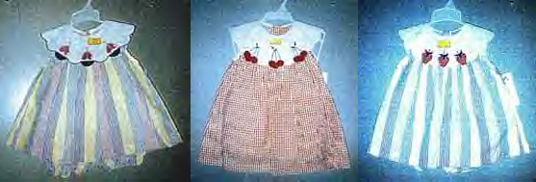
Wal-Mart Stores, Inc. v. Samara Bros., Inc., 529 U.S. 205 (2000)
Involved the question of whether Samara Brothers’ clothing designs (product designs) could be protected from knock off brands.
Motivated by a concern that trade dress protection might lead to anti-competitive effects, the Court’s rationale for denying product design the capacity for inherent distinctiveness is that purchasers do not tend to view product designs as source-identifying in the way that other trademarkable symbols are. Rather, product design, according to Scalia “almost invariably serves purposes other than source identification.”
Moreover, Justice Scalia noted that a third, indeterminate, category of trade dress exists—“’some tertium quid.” This rhetorical move was perhaps necessary given that the court had previously ruled in Two Pesos that trade dress can be inherently distinctive in general, and needed a conceptual mechanism for distinguishing restaurant décor from the product design at issue in the instant case.

Slide 15
Wal-Mart Stores (cont.)
According to Justice Scalia:
“The trade dress at issue [in Two Pesos], the décor of a restaurant, seems to us not to constitute product design. It was either product packaging—which, as we have discussed normally is taken by the consumer to indicate origin—or else some tertium quid that is akin to product packaging and has no bearing on the present case.”

Slide 16
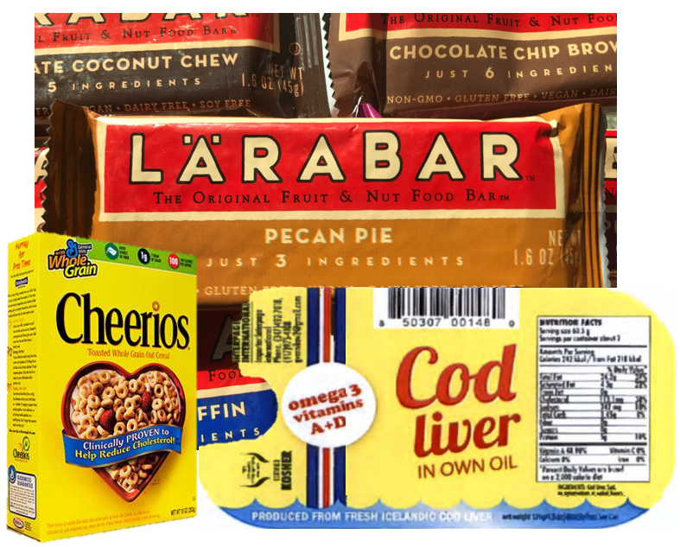
1. Product Packaging Protectable immediately
The overall combination of elements that make up a product’s dressing.
.

Slide 17
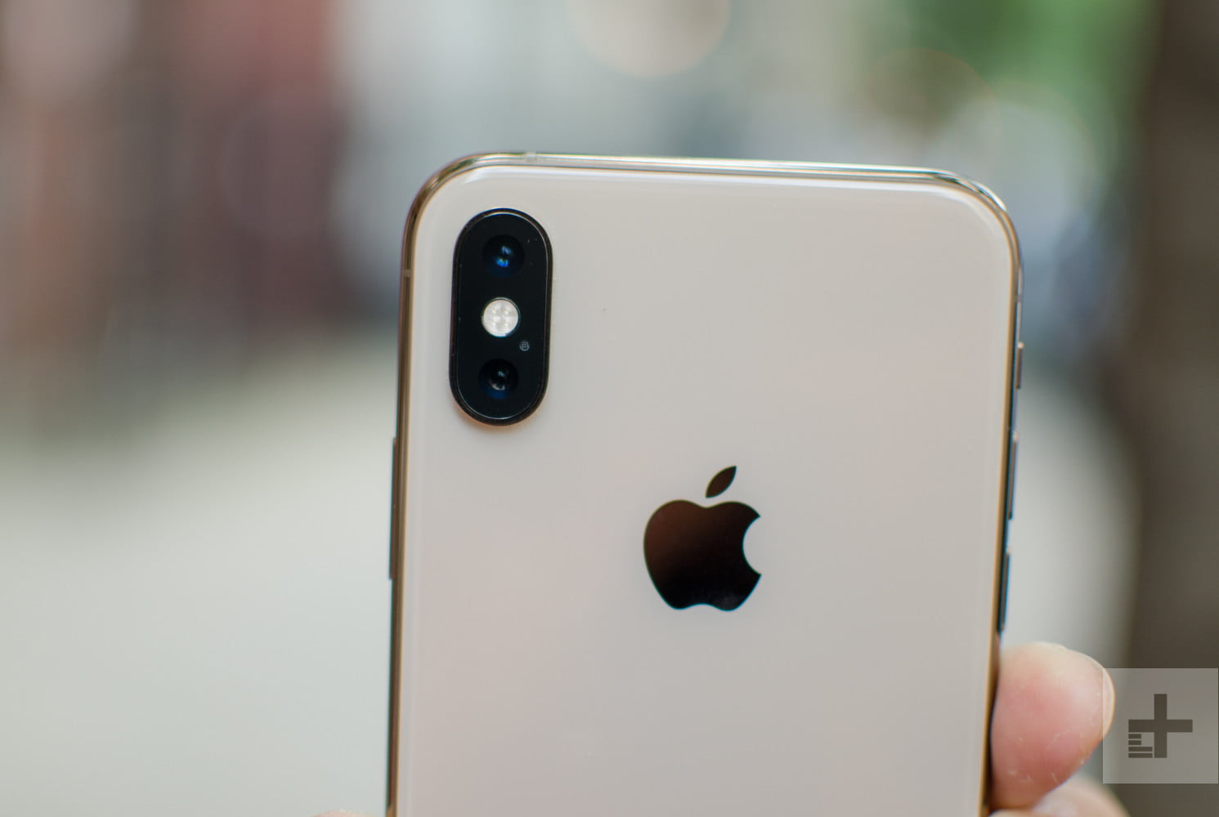
2. Product Design Protectable with secondary meaning
A product’s shape, configuration or other design features.

Slide 18
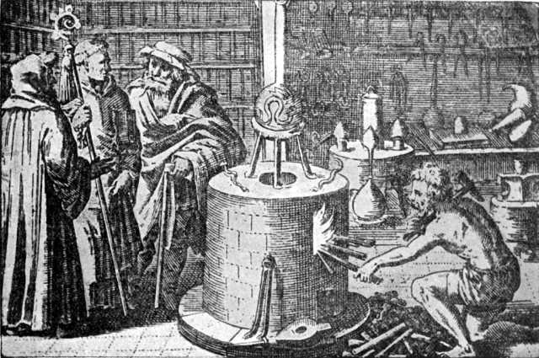
3. “Some Tertium Quid” like product packaging, so viewed as protectable immediately
Tertium quid: Among [alchemists], the Result of the Mixture of some two Things, which forms something different from both.
Bailey’s English Dictionary (1726)
Tertium quid: A third somewhat; something mediating, or regarding as being, between two diverse or incompatible substances, natures, or positions.”
Black’s Law Dictionary (2004)

Slide 19
Two Pesos Oral Argument
MR. CORSON: The analogy is packaging, sir.
JUSTICE SCALIA: Is—the analogy is—
MR. CORSON: Packaging.
JUSTICE SCALIA: Packaging.
MR. CORSON: Packaging for the product. Yes, I think this—the ambiance of the restaurant, the whole package there is analogous, as it were, to a wrapper on a label on a fertilizer jar.
JUSTICE SCALIA: I don’t think it is packaging. I think you’re disagreeing. You’re saying it is packaging? I don’t think it is packaging. I think you’re talking about the substance of what’s being sold. You’re selling atmosphere and food, the two of them. You can have wonderful food in a lousy atmosphere. I’m not going to pay as much money.
MR. CORSON: If that’s the case—
JUSTICE SCALIA: This is not the package. This is what I’m paying for.
MR. CORSON: If that’s the case, Justice Scalia, then what you are doing is protecting the delivery of a product, and making the provision of that particular product exclusive to one source so that the competitors may not sell that product. And that is a fundamental, massive limitation on competition. Consider an example: Let’s say you had McDonald’s, 15 or 20 years ago. It had pretty much—
JUSTICE SCALIA: You can sell the same kind of a product, you just can’t copy the other fellow’s ambiance.

Slide 20
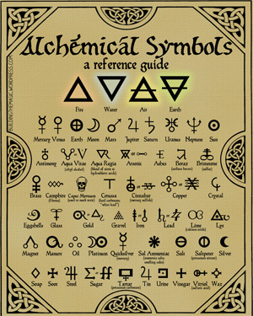
The ancient art of Alchemy
“Alchemy is a Science, teaching how to transform any kind of metal into another: and that by a proper medicine, as it appeared by many Philosophers' Books. Alchemy therefore is a science teaching how to make and compound a certain medicine, which is called Elixir, the which when it is cast upon metals or imperfect bodies, does fully perfect them in the very projection.”
Friar Roger Bacon, 1557

Slide 21
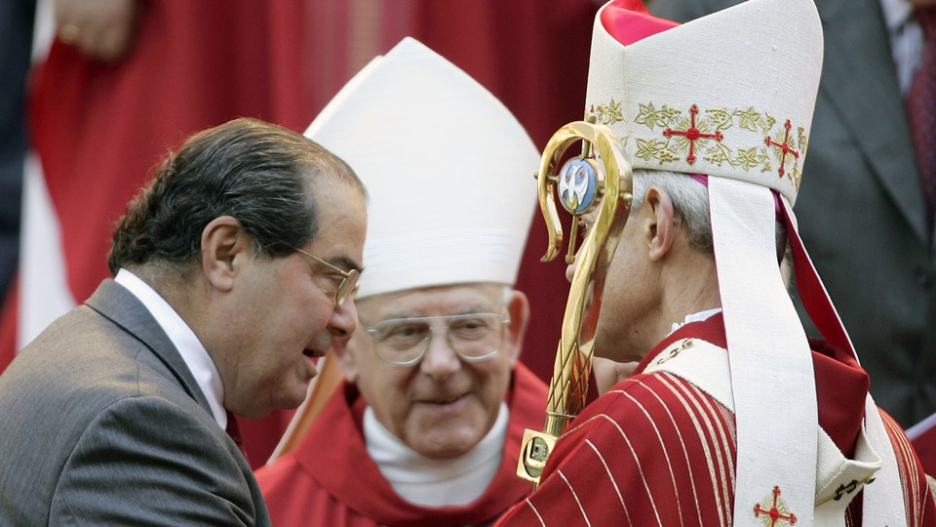
Why did Scalia use the term Tertium Quid?
Scalia was a devout Catholic who was unapologetic about interweaving his faith with his judicial philosophy—originalism.
“As a pre-Vatican II Roman Catholic, absorbed very early a particular formalistic vision of how one perceives and evaluates the world, as well as a particular literalistic view of what one does with texts.” George Kannar, The Constitutional Catechism of Antonin Scalia,99 Yale L.J. 1297 (1989).
Scalia’s family’s recent immigrant status, as well as his father’s professional careers in languages, suggests that linguistics was central to Scalia’s intellectual development, as well as “the fact that the daily experience of Catholics of his generation involved a considerable exposure to Latin.” Id.

Slide 22
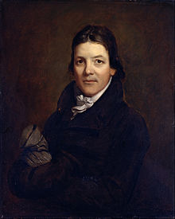
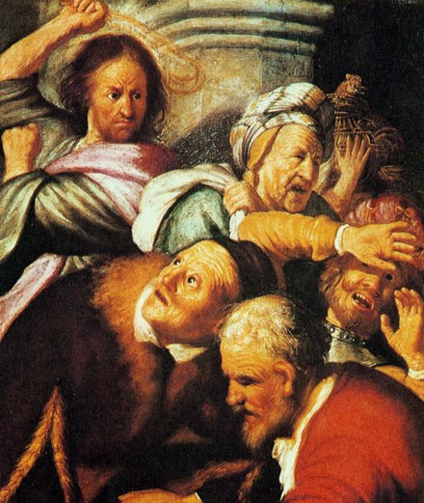
Where Did Scalia get the term ‘Tertium Quid’?
Probably from its uses in either (1) originalist politics or (2) Christian theology.
In terms of originalist politics, Scalia (who previously served as a law professor at the University of Virginia) was probably familiar with the term given its status as the name of a historic third political party in American politics arising in 1804 during Thomas Jefferson’s initial term in office. The Tertium Quids, or Quids for short, were reactionary members of the Democrat-Republican Party led by Virginia’s John Randolph of Roanoke. A central tenet of Roanoke’s campaign was his originalist stance.
In theology, tertium quid (“third thing”) is a theological formulation used in the controversies of the early Christian church over Christology—the aspect of theology concerned with the nature and work of Jesus Christ. A “tertium quid Christology” views Jesus Christ as neither truly God nor truly man, but instead a “third thing.” As a consequence of this heretical stance, certain dominations of Christian theology have condemned tertium quid Christology as heterodox or heretical.

Slide 23
Unclear Black Letter Law stemming from the Tertium Quid designation
The Supreme Court’s black letter law dealing with trade dress is essentially the following:
Decide whether the claimed trade dress is color, product packaging, or product configuration;
2. If it is product packaging, decide whether it is inherently distinctiveness. If so, it is automatically protectable; and
3. If it is color or product configuration, or if it is product packaging determined not to be inherently distinctive, decide whether it has meaning. If so, it is protectable.
But where does trade dress for services fit in here?

Slide 24
Tertium Quid leads to confusion
“Courts have felt no need to clarify what this tertium quid category consists of . . . the biggest fault of tertium quid is that so little is known about it, that it’s impossible to know what does or does not qualify for protection under it.” Crafting a New Universal Trademark Standard for User-Created Avatars, 8 Pace Intell. Prop. Sports & Ent. L.F. 120, 137 (2017).
This test is far from comforting . . . a new category of trade dress referred to as ‘tertium quid’ for which no test for application has been given, but for which inherent distinctiveness might exist. If the Supreme Court cannot decide what qualifies as product configuration, how can its new test of non-inherency be applied with any degree of predictability?” Musings on the Decline and Fall of the Intellectual Property Empire, 34 John Marshall L. Rev. (2001).
“It can be difficult in situations to distinguish packaging dress from design dress or what Justice Scalia referred to as ‘tertium quid’ dress.” Mark Lemley and Mark McKenna, Trademark Spaces (Draft, forthcoming 2022).
The Court’s dicta suggesting that the stricter rule [requiring secondary meaning] may not apply to packaging or some ‘tertium quid’ invites litigation on whether a claimed trade dress constitutes a ‘tertium quid’ akin to packaging rather than design.” Ian Ayres & Ziyin Tang, Consumer Expropriation of Aesthetically Functional Trade Dress: Results from a Randomized Experiment, 93 S. Cal. L. Rev. 1189, 1213 n. 104 (2020).

Slide 25
Service Mark: a better analogy for this third category of trade dress

Slide 26
International Service Classes
Class 35 Advertising; business management; business administration; office functions.
Class 36 Insurance; financial affairs; monetary affairs; real estate affairs.
Class 37 Building construction; repair; installation services.
Class 38 Telecommunications.
Class 39 Transport; packaging and storage of goods; travel arrangement.
Class 40 Treatment of materials.
Class 41 Education; providing of training; entertainment; sporting and cultural activities.
Class 42 Scientific and technological services and research and design relating thereto; industrial analysis and research services; design and development of computer hardware and software.
Class 43 Services for providing food and drink; temporary accommodation.
Class 44 Medical services; veterinary services; hygienic and beauty care for human beings or animals; agriculture, horticulture and forestry services.
Class 45 Legal services; security services for the protection of property and individuals; personal and social services rendered by others to meet the needs of individuals.

Slide 27
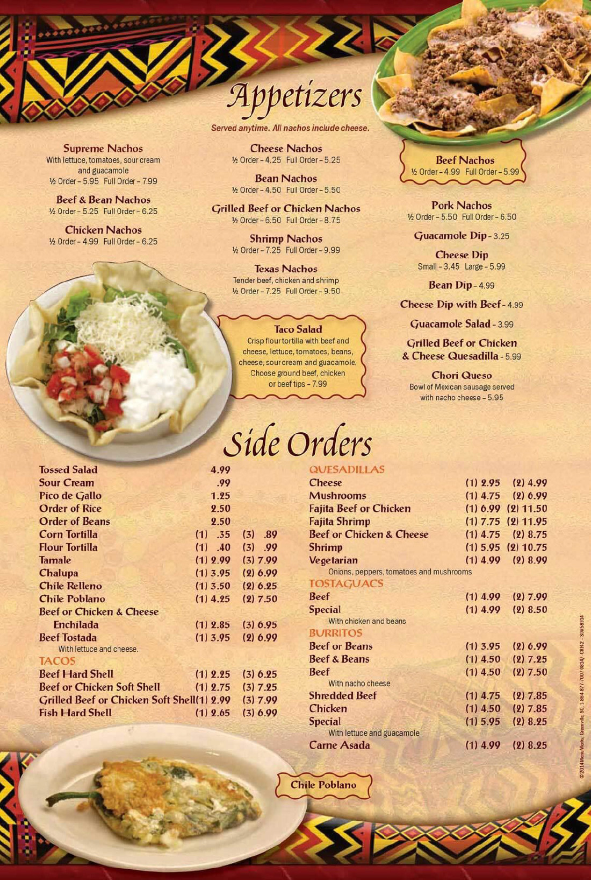
Vasquez v. Ybarra, 150 F. Supp. 2d 1157, 1175 n.18 (D. Kan. 2001)
Determining menus from a Mexican restaurant to be like product packaging, comparing them to the restaurant from Two Pesos.
Tertium quid reference: “This is not a case in which a product design is alleged to have been infringed and therefore the Supreme Court's recent decision in Wal–Mart Stores, Inc. v. Samara Bros., Inc., 529 U.S. 205, 120 S.Ct. 1339, 146 L.Ed.2d 182 (2000) is inapplicable. Wal–Mart held that a product's design is distinctive only upon a showing of secondary meaning. Rather, the menu in this case is akin to the restaurant decor in Two Pesos, a “tertium quid ” the Court found similar to product packaging.” Class 43 – services for providing food and drink; temporary accommodation.

Slide 28
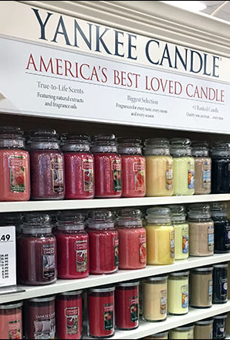
Yankee Candle Co. v. Bridgewater Candle Co., 259 F.3d 25, 40, (1st Cir. 2001)
Trade dress infringement suit focusing on “combination of elements comprising Yankee Candles’ candle sizes and shapes, quantities sold, labels, Vertical Design System, and catalog.”
Tertium quid reference: “Yankee argues that because its products are candles, all the trappings associated with the sale of the candle—i.e., the candle-holders, the Vertical Display System, the labels, and the catalog—constitute product packaging, or at the very least a “tertium quid ... akin to product packaging,” categories of trade dress that may be inherently distinctive.”
Class 35 – Retail store services

Slide 29
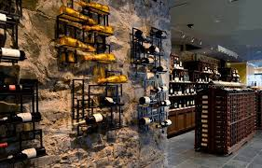
Best Cellars, Inc. v. Wine Made Simple, Inc., 350 F. Supp. 2d 60, 70 (S.D.N.Y. 2003)
In Best Cellars, the defendants allegedly copied the design of a unique wine retailer that displayed each variety of wine by taste category. The store displayed the wine in vertical rows of nine with a display bottle on top, a technique never before utilized by wine retailers. Trade magazines described the design and technique as “radically new” and “the most original approach to selling wine,” which the court found inherently distinctive.
Tertium quid reference: “The interior décor category fits awkwardly into the classifications of trade dress law, constituting either product packaging or a ‘tertium quid’ akin to product packaging.”
Class 35 – retail store services.

Slide 30
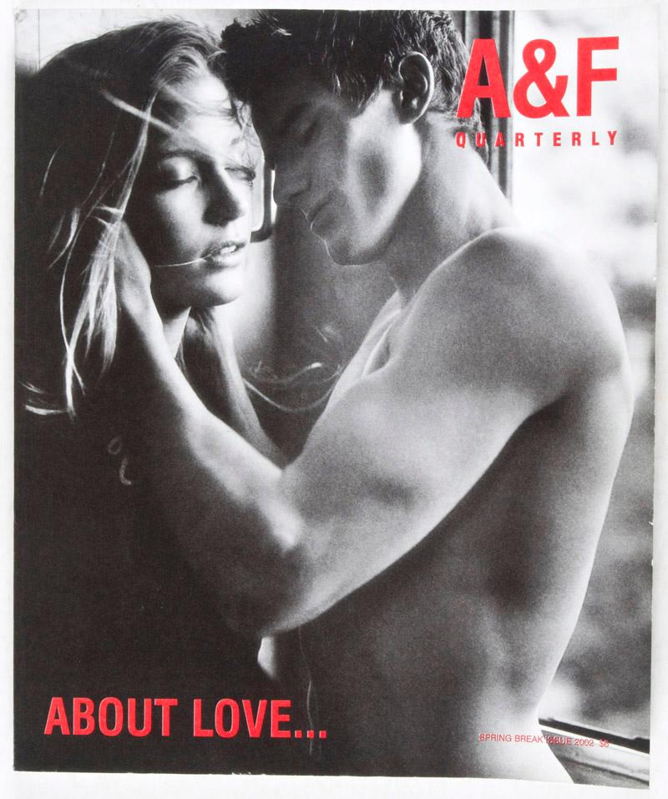
Abercrombie & Fitch Stores, Inc. v. American Eagle Outfitters, Inc., 280 F.3d 619, 629 (6th Cir. 2002)
Tertium quid reference: “Abercrombie can seek protection of its Quarterly because Abercrombie closely associates in time and space—as indicated by the Quarterly’s sales-related content and its display in Abercrombie’s stores—the visual images contained in the Quarterly with its products …. [T]he design of the Quarterly can properly be regarded as a component of the trade dress of Abercrombie’s clothing insofar as it constitutes a particular sales technique . . . or some tertium quid that is akin to product packaging that would normally be taken by consumers as an indication of source.”
Class 35 – catalog services
Class 41 – publication of catalogs

Slide 31
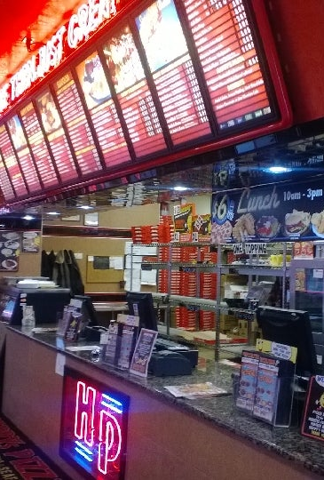
Happy's Pizza Franchise, LLC v. Papa's Pizza, Inc., No. 10-15174, 2013 WL 308728, at *3 (E.D. Mich. Jan. 25, 2013)
Involving copying of “uniform look and feel” of restaurant design and same combination of menu, food combinations, and recipes
Tertium quid reference: “The “interior décor category fits awkwardly into the classifications of trade dress law, constituting either product packaging or a ‘tertium quid’ akin to product packaging.”
Class 43 - services for providing food and drink; temporary accommodation.

Slide 32
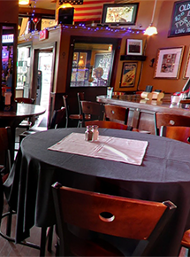
Dino Drop, Inc. v. Chase Bar & Grill, LLC, No. 09-CV-10759, 2011 WL 739094, at *11 (E.D. Mich. Feb. 24, 2011)
Tertium quid reference: “This language [“some tertium quid”] can apply to a restaurant menu. The Court finds that the menu in the instant case, and the items and descriptions in that menu, were so closely related to Plaintiff's restaurant so as to be an indication of their source.”
Class 43 - services for providing food and drink; temporary accommodation.

Slide 33
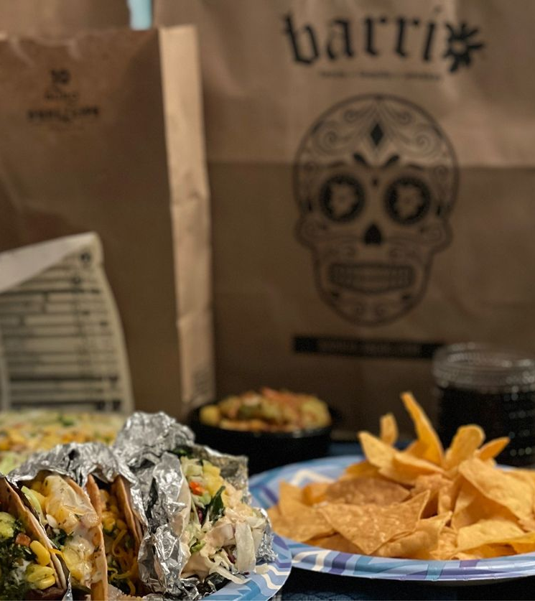
Barrio Bros., LLC. v. Revolucion, LLC, No. 1:18CV2052, 2018 WL 5960772, at *4 (N.D. Ohio Nov. 14, 2018)
Issue was whether Barrio’s “Day of the Dead” restaurant theme was distinctive.
Tertium quid reference: “Here, Plaintiffs allege a protectable trade dress in its combination and arrangement of design elements that “when taken together” are inherently distinctive. The “interior décor category fits awkwardly into the classifications of trade dress law, constituting either product packaging or a ‘tertium quid’ akin to product packaging.”
Class 43 - services for providing food and drink; temporary accommodation.

Slide 34
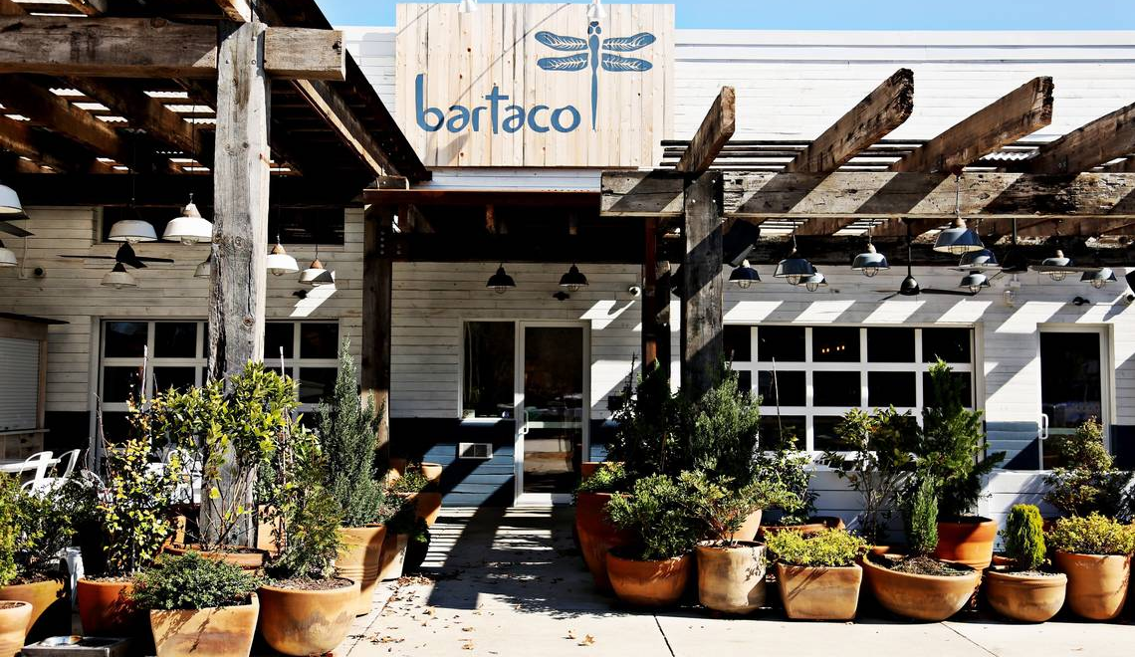
Barteca Holdings LLC v. Coastal Taco LLC., No. 1:16CV1498, 2016 WL 4168018, at *3 (N.D. Ohio Aug. 8, 2016)
Bartaco chain alleges a protectable trade dress in its exterior and interior ‘visual design elements.” But fails due to lack of uniformity
Tertium quid reference: “Here, Plaintiff alleges a protectable trade dress in its exterior and interior “visual design elements.” The “interior décor category fits awkwardly into the classifications of trade dress law, constituting either product packaging or a ‘tertium quid’ akin to product packaging.”
Class 43 - services for providing food and drink; temporary accommodation.

Slide 35
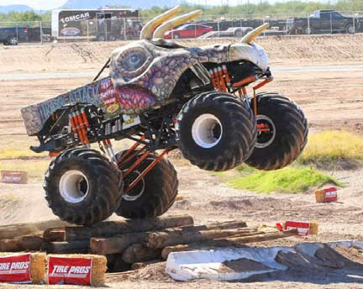
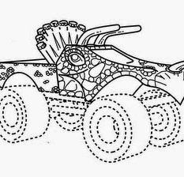
In re Frankish Enterprises Ltd. 113 U.S.P.Q.2d 1964 (TTAB 2015)
Three dimensional mark for “[e]ntertainment services, namely, performing and competing in motor sports events in the nature of monster truck exhibitions.” The applicant described the mark as follows: “The mark consists of a truck cab body in the design of a fanciful, prehistoric animal.
Tertium quid reference: None.
“Applicant does not seek registration of its design for a product, it seeks registration of its “fanciful, prehistoric animal” design for its monster truck exhibition services, and under Two Pesos, trade dress for services may be inherently distinctive. Indeed, Applicant’s service is exhibiting its monster truck in action, such as doing wheelies, jumping over and crushing smaller vehicles and otherwise entertaining fans with the truck’s size, power and sheer awesomeness, which could be performed with or without the “fanciful, prehistoric animal” design on the outside of the truck, just as Taco Cabana's service of offering Mexican food to restaurant customers could be performed without the particular interior design found to be inherently distinctive in Two Pesos. {T}he “fanciful, prehistoric animal” design is akin to the packaging of what is being sold, in this case Applicant's monster truck services.”

Slide 36
In re Chippendales USA, Inc., 622 F.3d 1346 (Fed. Cir. 2010)
“Trademark applicant sought review of examining attorney's decision refusing registration of “Cuffs & Collar” mark for adult entertainment services as inherently distinctive.”
Tertium quid reference: None
Class 41 – adult entertainment services

Slide 37
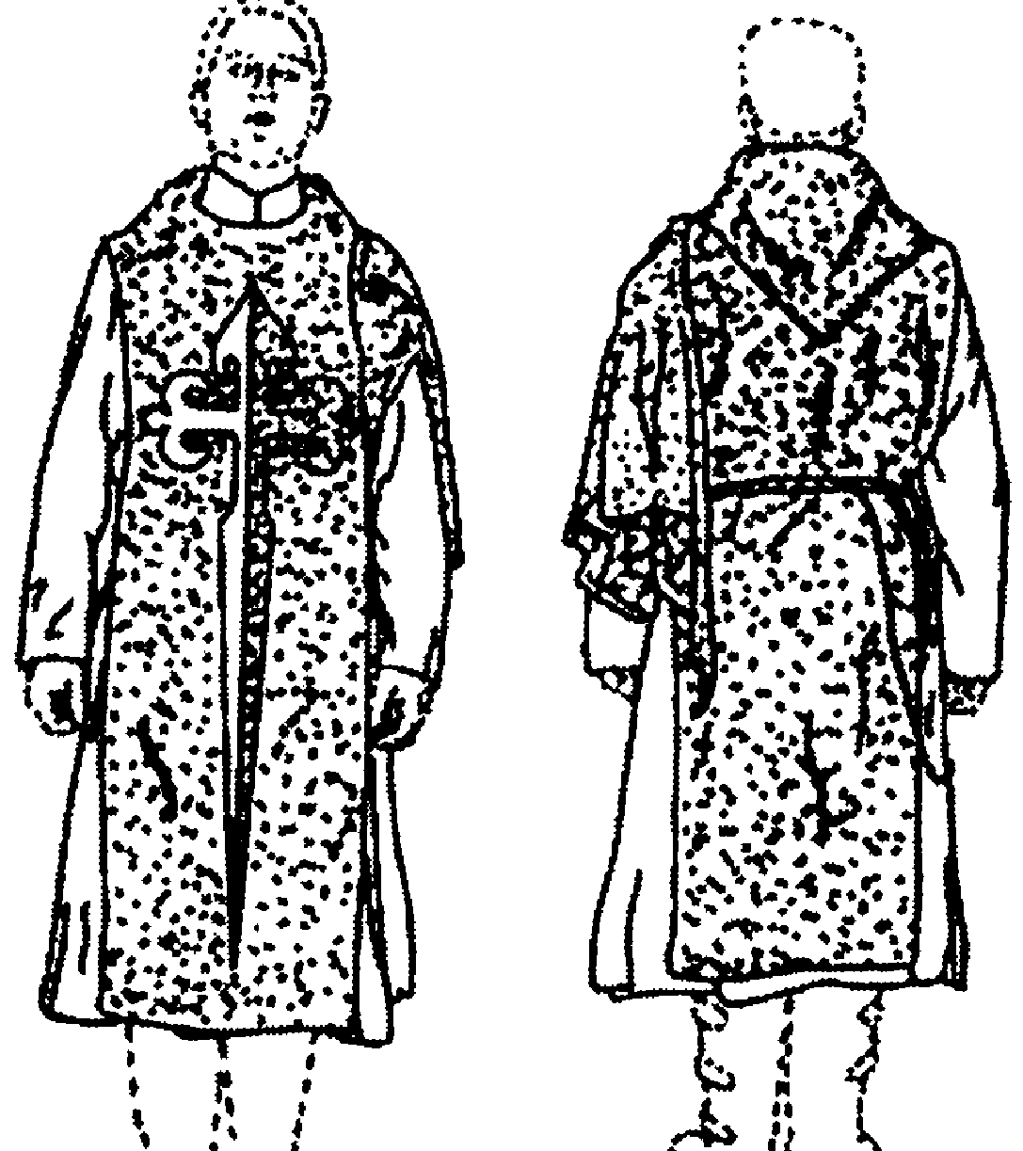
Mary Queen of the Third Millennium, Inc., No. 2001, 2009 WL 1017283, at *1 (Mar. 25, 2009)
For “clothing, namely ceremonial habit worn by distinguished religious representatives in certain ceremonies” (in International Class 25), and “promoting public awareness of the need for healthy and religious families in the United States” (in International Class 35).
Claimed acquired distinctiveness as to class 25 (product design).
Claimed inherent distinctiveness as to class 35 (services, or “tertium quid”)
Tertium quid reference: none

Slide 38
Recap so far
Tertium quid means services trade dress, or a subset of services trade dress.
Services trade dress is always eligible for inherent distinctiveness.
It is not a hybrid of product packaging and product design. It is neither because it relates to a service, not a product.
But nonetheless, the service mark is still an imperfect metaphor for experiential marketing—ambience, architecture, and atmosphere.
In looking at business research on the issue, it isn’t clear that experiential marketing is the same as services, or capable of inherent distinctiveness, because, like Scalia said regarding product design, experiential marketing “almost invariably serves purposes other than source identification.”

Slide 39
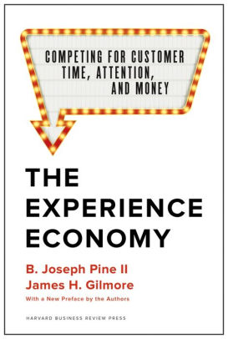
Pines and Gilcrest, The Experience Economy
“Economists have typically lumped experiences in with services, but experiences are a distinct economic offering, as different from services as services are from goods.”
They are rather, “staged experiences.”
In effect, “[i]n today’s service economy, many companies simply wrap experiences around their traditional offerings to sell them better.
To realize the full benefit of staging experiences, however, businesses must deliberately design engaging experiences that command a fee.”
“[I[n envisioning engaging experiences, [businesses] can and should consider a multiplicity of dimensions. These include…the multisensory nature of experiences, their level of personal meaningfulness, the way the experience is shared with others (if at all), the intensity and duration of various experiential elements, complexity (or simplicity), and untold other characteristics of how people spend time. Cultural considerations and national and local sensitivities, as well as the prior life experiences of guests, all impact how people perceive experiences. “

Slide 40
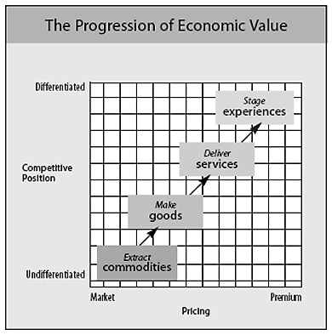
Tertium quid as experiential marketing
Pines and Gilcrest also draw a distinction between “the memory of an experience” and “the enjoyment of the experience in the moment (apart from how memorable it later proves.)”
[P]eople at least remember that they enjoyed the experience, even if they cannot recall or explain why. Of critical importance is how the experience concludes … the structure of compelling dramas . . . offers considerable insight. In a nutshell, failure to adequately establish proper context, interweave building action, or allow for falling action and a denoument adversely diminishes the audience’s memory of even the most climactic highs of an enjoyable experience (and even more adversely magnifies the memory of an unpleasant one). Bottom line: no, a strong memory is not required for every experience, but the greater the (positive) memory created and the longer it lasts, the more value is created.
This could have some relevance to the inherent distinctiveness versus acquired distinctiveness test for experiential trade dress.
Does distinctiveness for experiences equal engagement and compelling nature?

Slide 41
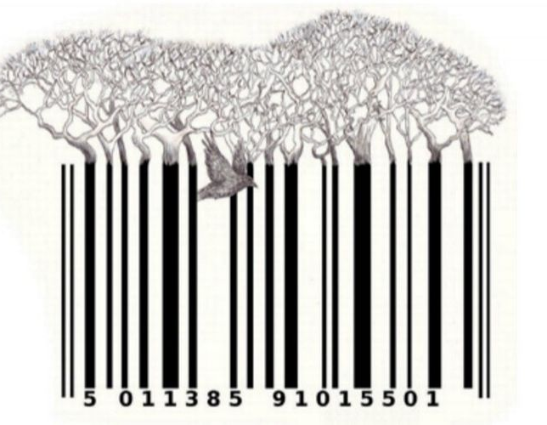
Ambience as (Intellectual) Property
The inherent protection of experiential marketing as IP expands the purview of IP law into the intangible qualities of spaces as experienced by customers.
This expansive understanding of trademark, while not well fleshed out in the law, coincides with broader attention to experience marketing in the business space over the last 20 odd years.
As Pine and Gilcrest put it, there is a transformation of the American marketplace from a market of goods and services into one that offers “staged experiences,” in which companies are “experience stagers,” labor is “performance,” and the “consumer is the product.”
Thus, the commodity of experience occurs within the consumer, who has been offered “sensations” and who “has been engaged on an emotional level with memories that “linger on.”
One is left wondering whether this commodification of experience is desirable. By allowing for inherent distinctiveness—or trademark protection at all—the law seeks to encourage, rather than discourage, this commodification.
Source: Winnie Won Yin Wong, Ambience as Property: Experience, Design, and the Legal Expansion of “Trade Dress,” 9 Future Anterior 1 (2012).

Slide 42
Thank you! Questions, Comments?

