Slide 1



Intellectual Property Inn of Court
​
Patent Litigation In Japan and the United States
    21 April 2021
Fostering Excellence in Professionalism, Ethics, and Legal Skills

Slide 2
Patent Litigation in the United States

Slide 3
これだけは知っておきたい― 米国の訴訟
Civil (Patent) Litigation in the United States
3

Slide 4
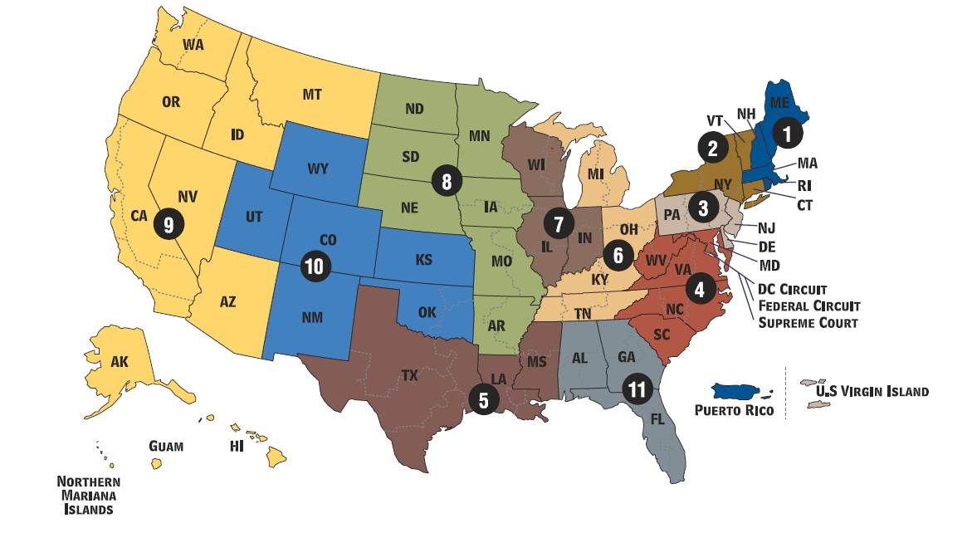


Federalism and Courts （連邦制）
  州と連邦は dual sovereign. 連邦法が州法に優先する。
連邦： Federal courts – patent law is a federal question
  District court & special courts Court of Appeals (Federal Circuit)
  United States Supreme Court
州： State courts- 50 states plus U.S. territories.
  Trial court
  Appellate court (some states)
  State Supreme Court
4

Slide 5
Life of a Typical Civil Court Case （訴訟の流れ）
Pre-litigation demand or negotiation
Motion to dismiss
Complaint
Summary judgment
Discovery
Answer
Trial
Verdict
Judgment
Appeal
5

Slide 6

Discovery -日本とはここは大きく違います。
Production of Documents
Litigation Hold
Spoliation
Document review & privilege
Federal Rule of Civil Procedure 26(b)(1):
“(1) Scope in General. Unless otherwise limited by court order, the scope of discovery is as follows: Parties may obtain discovery regarding any nonprivileged matter that is relevant to any party's claim or defense and proportional to the needs of the case, considering the importance of the issues at stake in the action, the amount in controversy, the parties’ relative access to relevant information, the parties’ resources, the importance of the discovery in resolving the issues, and whether the burden or expense of the proposed discovery outweighs its likely benefit. Information within this scope of discovery need not be admissible in evidence to be discoverable.”
Requests for Production
Interrogatory
Requests for Admission
Motion to compel
Depositions
Subpoena
Protective Order
6

Slide 7
Claim Construction
Claim construction is the process of deciding what the various terms of the asserted patent claims mean.
  The parties propose their definitions to each other.
  Then, the parties write briefs and argue at a hearing to the judge to advocate their own meanings. The hearing is called a Markman hearing after the US Supreme Court case that created this process.
  For each term, the judge can adopt either party’s definition or neither party’s definition.
Once the Markman opinion issues, it’s often clear whether the defendant infringes and whether the patent is valid.
This is a common settlement point.
7

Slide 8
Motions （申立て）
A motion is a request to the Court.
Examples
  Motion for preliminary injunction
  Motion to dismiss for lack of personal jurisdiction
  Motion for summary judgment
  Motion for directed verdict
  Motion for attorney’s fees
8

Slide 9
Summary Judgment
The purpose of summary judgment is to let the judge resolve issues where there isn’t any dispute about the facts.
  For example, if everyone agrees that a product uses a particular standard, the only issue left might be whether the patent-in-suit covers the standard. If the judge decides that no reasonable jury could find that the patent covers the standard, she/he would grant summary judgment of non-infringement.
Although moving for summary judgment isn’t cheap (it requires writing briefs and arguing in court), it’s still much cheaper than trial.
If the court allows the parties to file summary judgment motions, the court might delay trial until its ruling or might simply push ahead with the trial date anyway.
If summary judgment doesn’t resolve everything in the case, it’s on to trial.
9

Slide 10
Trial （トライアル）
Bench trial
Trial in front of the judge.
Jury trial
Trial in front of the judge and jury.
  Judge decides issues of law
  Jury decides issues of fact
  Number of jurors
    Federal court: 6-12 jurors, must be unanimous (満場一致) to reach verdict for plaintiff.
  Federal court: Have a right to a jury trial if the case would have been entitled to a jury in 1791.
10

Slide 11
Appeal - （上訴）‐ 日本とはここも少し違います。
Appellate Court reviews the trial court record for error only.
No new evidence. Generally, no new arguments. Everything must be presented to the trial court first.
Generally, both sides submit briefs and have one short hearing to argue the case.
Court looks for prejudicial error.
  If the error is harmless, the court will usually affirm the trial court.
11

Slide 12
Common Settlement Moments
Motion to dismiss
Pre-litigation demand or negotiation
Complaint
Summary judgment
Answer
Discovery
Trial
Settlement?
Settlement?
Appeal
Settlement?
Settlement?
12

Slide 13
Alternative Dispute Resolution
Mediation （調停）
  Mediator negotiates an agreement between the parties
  Can be with a judge or a private mediator
  Court may require mediation
  Parties sign a Settlement Agreement and agree to resolve the case
Arbitration （仲裁）
  Usually 1-3 arbitrators
  Usually paid by the hour, so can be expensive
  Limited discovery
  Contracts may require arbitration
13

Slide 14
Other Courts / Administrative Hearings （例）
Federal
International Trade Commission and Patent Trial and Appeal Board
    Federal Circuit Court of Appeals
14

Slide 15
Patent Litigation in Japan

Slide 16
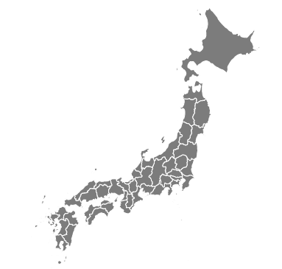
Overview of Patent Litigation in Japan
Supreme Court
IP High Court
Osaka
Tokyo
Tokyo or Osaka
District Court
JPO
(Board of Appeal)
Patent Infringement Lawsuit
Invalidation Trial

Slide 17
Timeline of Patent Litigation (1st Instance)
Patent Infringement Proceedings Are Split Into Two Stages:
The first stage (Shingai-Ron): where the court considers infringement the patent.
The second stage (Songai-Ron): where the court considers appropriate damages.
Settlement suggested by court
Could be more than 4 preparatory hearings
(5)
Technical Explanatory Session
Preparatory
Hearings for settlement
Settlement
(6)
Judges impressions revealed
Oral
Hearing (1)
Preparatory
Hearing (1)
Oral
Hearing (2)
(2)
(3)
(4)
Complaint
Filed
Judgment
30days
40-60 days
40-60 days
40-60 days
40-60 days
50-70 days
40days
Preparatory
Hearing (7)
Defendant
-Answer
Plaintiff
-Infringement argument
Defendant-Rebuttal to Infringement
Invalidity defense
Plaintiff
Rebuttal to Invalidity
Infringement arguments
(8)
Damages Calculation Stage
30- 60 days
Infringement Confirmation Stage
Damages Stage

Slide 18
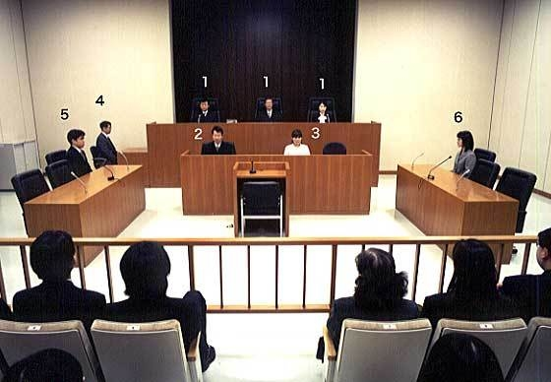
Court Proceedings in Japan
Japanese Legal System (Civil Law Country)
Legislatively passed patent laws govern patents.
Prior court judgments are rarely cited in decisions.
Lower courts will hesitate to render a judgment contrary to precedents set by higher courts, especially the Supreme Court, as they are likely to be overruled by these courts.
District Court Proceedings
Bench trials (3 Judges)
IP High Court Proceedings
3 Judges (5 Judges on Grand Panel)
May consider new evidence and review the case de novo.
Supreme Court Proceedings
5-15 Judges
Review limited to issues of law.
District Court Proceeding
5. Attorney for Plaintiff
1. Judges
2-4. Court staff
6. Attorney for Defendant

Slide 19
Patent Litigation: Preparatory Hearing
Purpose of Preparatory Hearing
Instead of a “trial”, infringement litigation includes a series of Preparatory Hearings and a Technical Explanatory Session.
Parties make arguments in their briefs and submitted evidence, and the importance of briefs cannot be overstated.
The court, however, sometimes requests that parties explain legal and technical issues before the court during preparatory proceeding hearings.
Preparatory Hearing Procedure
NOT open to the public
Two judges who are mainly in charge of the case attend (authorized judges)
Judges do not wear the judicial robe.
Preparatory Hearing

Slide 20
Use of Experts And Technical Explanatory Session
Expert Evidence
It is possible to submit expert opinion as part of evidence. However, expert testimony is rarely taken in Japan.
Technical Explanatory Session
It takes 2-3 hours.
2-3 experts are assigned by Court as “Technical Advisors” only for the Technical Explanatory Session.
Judicial Research Official, Technical Advisors and judges ask questions to the parties, and the parties answer to them.
❶ Attorneys for Plaintiff
❷ Technical Advisors
❸ Judges
❹ Judicial Research Official
❺ Attorneys for Defendant
❻ Court Clerk

Slide 21
Litigation Filing Costs in Japan
Calculation of Filing Fees
Infringement litigation filing costs are based on value of case.
Value of Case | Filing Fee*
JPY 100,000,000 (USD 1,000,000) | JPY 320,000 (USD 3,200)
JPY 1,000,000,000 (USD 10,000,000) | JPY 3,200,000 (USD 32,000)
JPY 10,000,000,000 (USD 100,000,000) | JPY 32,000,000 (USD 320,000)
*100 JPY = 1 USD
Possibility of Amending Value of Case
Value of the case is a combination of the requested damages and the value of the injunction.
It is possible to request a partial damages for the case, and later amend the amount requested after the stage in litigation on the determination of infringement.
  Must pay additional stamp fee.

Slide 22
Timeline of Patent Invalidation Action at JPO
Stay of Litigation or Invalidation Action
Both the courts and the JPO rarely stay proceedings in the case of actions in both the JPO and District Court.
Possibility of inconsistent decisions on validity. However, any inconsistency can be resolved in IP High Court.
Settlement
Oral Hearing
Closure notice
If patent is found valid
Invalidation Trial Request
Decision
30~ days
90 days
40-60~ days
40-60~ days
60-80~ days
2w
Served to
Patentee
Patentee
-Answer with or without Request for Amendment
If there is Amendment
Demandant
may file Rebuttal in light of Amendment
JPO’s Notice on issued to be discussed at hearing
Both parties submit Summary of Arguments for hearing
JPO’s preliminary decision (patent is found invalid)
Patentee may file Amendment to overcome the preliminary decision
90days

Slide 23
Overall Success Rates Japan
Statistics in Tokyo and Osaka District Courts: 2014-2017
Successful settlement
Japan
23

Slide 24
Questions & Discussion

Slide 25
Comparison of Patent Litigation in Japan and United States
 |  | US | Japan
Procedure | Evidence Collection | Discovery | Very limited discovery
 | Expert Evidence | Party submitted written expert reports + Testimony at trial | Party submitted written expert reports + Court appointed experts
 | Adjudicator | Jury (in damages cases) | Judges
Remedy | Injunction | No automatic injunction (Ebay rule) | Automatic injunction rule
 | Damages | Higher damages, and possible treble damages in willful infringement cases. | Lower No treble damages

Slide 26
Statistics on Damages in Japan
Lower than in US; but not so low comparing to other major jurisdictions
K (US$)
Median of the damage amounts in major jurisdictions between Jan 2007 – Nov 2017
See: https://www.globalipdb.inpit.go.jp/jpowp/wp-content/uploads/2018/11/b0b1f5ec0dfca9dc481dde56c9bf4b98.pdf

Slide 27
Use of 28 U.S.C. § 1782 Actions for Proceedings in Japan
Use of Evidence from Foreign Proceedings in Japan
Both the JPO and Courts in Japan are receptive to submission of evidence obtained through foreign proceedings.
Evidence obtained through 28 U.S.C. § 1788 actions in the United States have been accepted by both the JPO and Courts in Japan.
Obtaining Evidence in the United States
For global disputes it is possible to seek in the United States through a 28 U.S.C. § 1788 action an order from a US Court for a party who under the Courts jurisdiction to provide testimony or to produce documents or other evidence for use in a proceeding in a foreign or international “tribunal”.
In Akebia Therapeutics, Inc. v. FibroGen, Inc., 793 F.3d 1108 (9th Cir. 2015), the JPO was found to be a “tribunal” for the purpose of 28 U.S.C. § 1788.

