Slide 1
Understanding the Definition of
Hearsay in Virginia Courts
Gerald I. Fisher, Senior Judge
        D.C. Superior Court
Presentation to the George Mason American Inn of Court (Oct. 26, 2022)

Slide 2
Preliminary Principles
  The Virginia Rules of Evidence became effective July 1, 2012.
    “[A]dopted to implement established principles under the common law and not to change any established case law rendered prior to the adoption of the Rules.” Rule 2:102.
    Rejected adoption of the Federal Rules of Evidence
  The Rules, including the rules relating to hearsay, apply in both jury and non-jury trials, in preliminary hearings, in non-summary contempt cases, and in juvenile and domestic relations cases, but not in small claims cases. Rule 2:1101.

Slide 3
  The rules relating to hearsay apply when the witness is also the declarant
    i.e., a witness may not testify to his/her own hearsay statements unless they fall within exceptions to the bar against hearsay
  WORDS, ISSUES & CONTEXT MATTER!

Slide 4
What Information Can a Trial Judge Consider When Determining Whether Evidence is Admissible?
Fed. R. Evid. 104(a) provides that the court decides the admissibility of evidence, and when doing so, “is not bound by evidence rules, except those on privilege.” This means the court may consider otherwise inadmissible non-privileged evidence, including hearsay.
Va. Rule 2:104(a) is not as explicit but appears to operate the same way.

Slide 5
Rule 2:802 HEARSAY RULE
Hearsay is not admissible except as provided by these Rules, other Rules of the Supreme Court of Virginia, or by Virginia statutes or case law.

Slide 6
Why Does the Law Distrust Hearsay?
  Jury/Judge cannot see demeanor of witness
  Inability to test the declarant’s perception, memory, or narration.
  Statement usually not made under oath
  No ability to cross-examine/confront
  Concerns about motivation, sincerity of statement (i.e., fraud or perjury)

Slide 7
What is Hearsay?
Rule 2:801 DEFINITIONS
The following definitions apply under this article:
*****
(c) Hearsay. “Hearsay” is a statement, other than one made by the declarant while testifying at the trial or hearing, offered in evidence to prove the truth of the matter asserted.

Slide 8
Fed. R. Evid. 801. Definitions.
* * * * *
  (c) Hearsay. “Hearsay” means a prior statement — one the declarant does not make while testifying at the current trial or hearing — that a party offers in evidence to prove the truth of the matter asserted by the declarant.

Slide 9
Essential Terms
  “witness” – one who testifies in court about an out-of-court statement
  “testimony” – what a witness says in court
  “declarant” – person who makes an out-of-court statement
        A person can be both a declarant and a witness if s/he testifies about statements they made out-of-court.
  “statement” – “(1) an oral or written assertion or (2) nonverbal conduct of a person, if it is intended as an assertion.” Rule 2:801(a).

Slide 10

Under this definition, a “statement” may be in any one of the following forms:
    1. Oral statement
    2. Written statement
    3. Conduct
    4. Silence

Slide 11
Hypothetical #1
Wife is charged with the murder of Husband. At trial, the Commonwealth calls Police Officer who will testify that when the police arrived at the couple’s home, Husband was lying on the floor dead from a bullet wound to the heart. Right next to him was his beloved parrot Squawker, who was saying over and over, “Doris, why are you pointing that gun at me? Please don’t point the gun at me!” Defense counsel objects to the evidence as hearsay. Is this hearsay?

Slide 12
Answer #1
No. Only persons can be declarants and make assertions/statements. Rule 2:801(b). Animals and inanimate objects, e.g., radar guns, breathalyzers, cannot.
    See Wimbish v. Commonwealth, 51 Va. App. 474 (2008) (intoxilyzer results not a declarant’s statement); see also Penny v. Commonwealth, 6 Va. App. 494 (1988) (telephone monitoring device not a declarant).

Slide 13
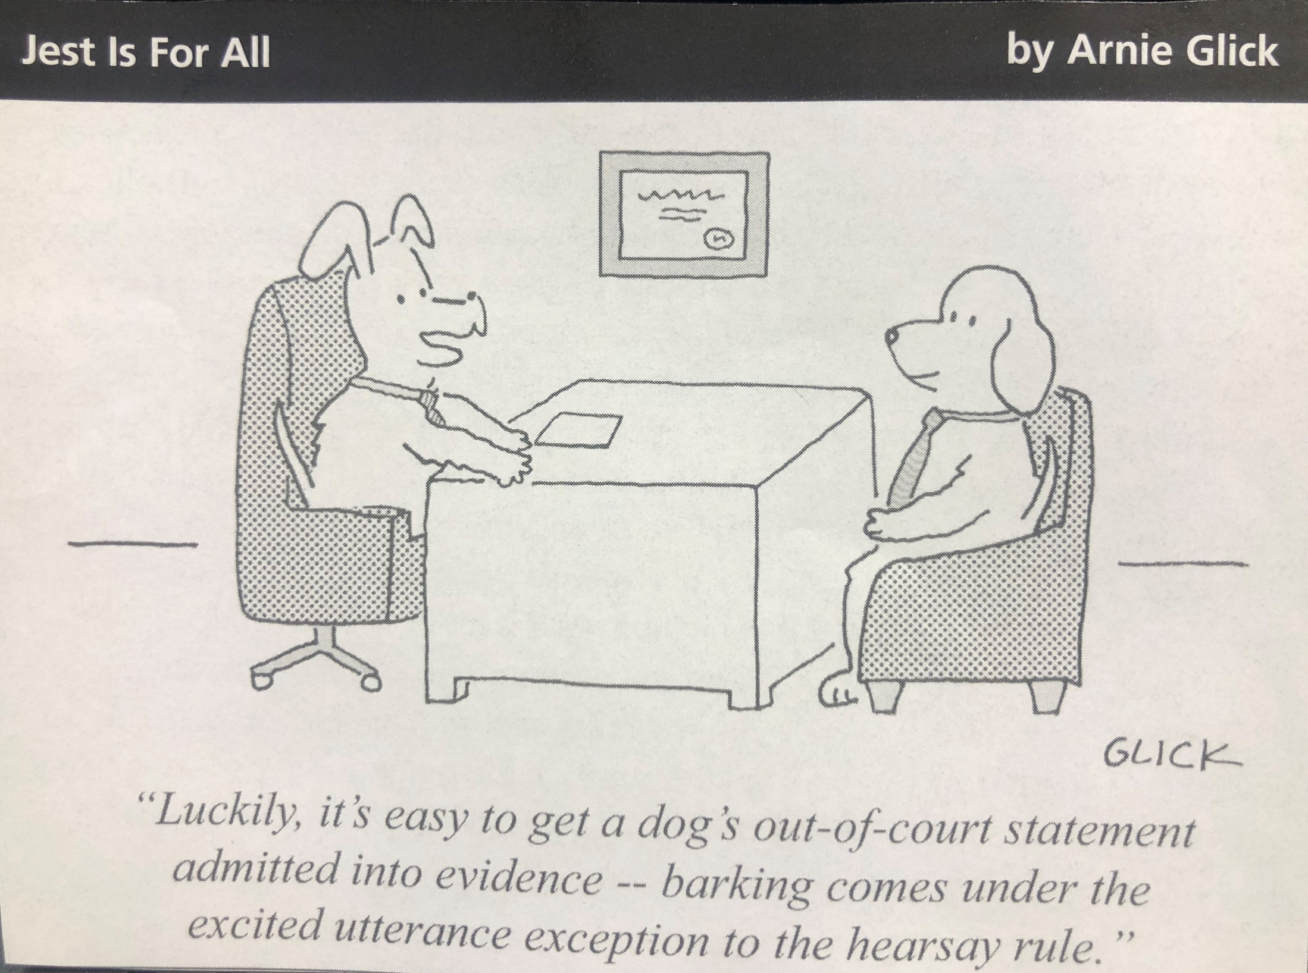

Slide 14
Questions to Ask When Analyzing Hearsay
    Was the statement/communication made “out of court,” i.e., outside of the current proceedings?
    Does the statement/communication that was made contain an assertion?
    Is it offered to prove the truth of the assertion or, instead, offered for some other relevant purpose?
    If it is being offered for its truth, does it satisfy an exception to the bar against hearsay?

Slide 15
First Question: Was the Statement Made
Out-of-Court ?
Whenever a witness testifies to words that were spoken by anyone (including himself/herself) other than during the trial/hearing currently being held, those words are an “out-of-court” statement for the purposes of Rule 2:801(c).

Slide 16
Second Question: Does the Statement (i.e., the Words, Conduct, or Silence) Contain an Assertion ?
Rule 2:801. Definitions.
  (a) Statement. A “statement” is (1) an oral or written assertion or (2) nonverbal conduct of a person, if it is intended as an assertion.
  Accord Fed. R. Evid. 801(a).

Slide 17
What is an “Assertion?”
An assertion is a communication (oral, written, conduct or silence) by the declarant containing facts or beliefs that the declarant seeks to be accepted as true.

Slide 18
Examples
To determine whether it is raining, you look out the window and
  Notice that several people are walking around with open umbrellas over their heads – Not an Assertion.
  Call out to someone you know on the street and ask if it’s raining, and that person moves the umbrella up and down – Assertion (by conduct).
To determine whether a light had changed to green
  Cars that were stopped at the light start moving – Not an Assertion.
  The car closest to the light doesn’t do anything and the car behind him honks and the first car starts moving forward – Assertion (by conduct) by the driver of the second car (and, arguably, by the driver of the front car).

Slide 19
Hypothetical #2
In a will contest, the testator’s heir challenges the will, which left part of the testator’s estate to his servant. The heir claims that the testator lacked capacity/competence when he made the will. In response, the servant seeks to introduce letters written by friends to the testator during the time when he made the will, where the letters are written in a manner that suggests the writers believed the testator to be of sound mind. The heir objects to the letters as hearsay. Is this an assertion (and hence hearsay)?

Slide 20
Answer #2
Under English common law, the letters were deemed an “implied assertion” and thus hearsay. Wright v. Tatham, 112 Eng. Rep. 148 (Eng. 1837).
But under the law in the majority of American courts, even before the enactment of the Federal Rules of Evidence, there would be no assertion, because there was no intention by the writers to communicate that the testator was of sound mind, and therefore no hearsay. That approach is specifically incorporated as part of the Federal Rules:
    “The effect of the definition of ‘statement’ is to exclude from the operation of the hearsay rule all evidence of conduct, verbal or nonverbal, not intended as an assertion. The key to the definition is that nothing is an assertion unless intended to be one.” Adv. Comm. Note, Fed. R. Evid. 801(a).

Slide 21
The rationale for requiring that an assertion be a “positive declaration” rather than “implied assertion” is best expressed as follows:
    “Where the declarant does not intend to assert a fact or communicate a belief, his or her truthfulness in making a comment is not considered to be an issue... . Thus, ‘an unintentional message is presumptively more reliable’ than an intentional one. ... Such evidence is not generally excludable under the hearsay rule ... .” Burgess v. United States, 608 A.2d 734, 740 (D.C. 1992) (Rogers, C.J. concurring) (citations omitted).

Slide 22
Hypothetical #3
Defendant is charged with murder of a hotel manager. The next day, the police go to defendant’s home and ask his wife to give them the clothes her husband was wearing the previous night. Wife says nothing but leaves the room and returns a few minutes later with a sweater that she gives to the police and that is later found to contain blood on it that matches the victim’s rare blood type. The Commonwealth seeks to introduce this evidence at trial, but defense counsel objects that it is hearsay. Is this an assertion (and hence hearsay)?

Slide 23
Answer #3
Yes. The Virginia Supreme Court finds this to be an assertion by conduct, and thus hearsay. Stevenson v. Commonwealth, 218 Va. 462 (1977).
  This is a direct/express assertion by conduct.

Slide 24
Hypothetical #4
Defendant is charged with sexual assault. His defense is consent and he claims that he and the Complainant knew each other and had agreed to an exchange of sexual favors for drugs. During the Commonwealth’s case-in-chief, Complainant testifies that she did not know Defendant.
In the defense case, Defendant calls the arresting officer to testify that when Defendant was arrested, he asked the officer, “Does Peggy (Complainant’s first name) know I am here?” The Commonwealth objects that Defendant’s question is hearsay. Is Defendant’s question an assertion (and thus hearsay)?

Slide 25
Answer #4
The Court of Appeals, in Brown v. Commonwealth, 25 Va. App. 171 (1997), ruled that this was an implied assertion by Defendant that he knew Complainant, and thus was hearsay. But see id. at 186-91 (Benton, J. dissenting).
  This analysis is at odds with the interpretation of the definition of hearsay given by the overwhelming majority of American courts, both state and federal, and also appears to be at odds with the Rule 2:801(a)’s language – “if it is intended as an assertion.” See Sinclair, K., A Guide to the Rules of Evidence in Virginia, Note to Rule 2:801 (“This Rule of Evidence provision excludes implied assertions which permit the fact-finder to infer something other than the intended content of a statement.”).

Slide 26
Hypothetical #5
In a murder prosecution, Witness testifies that he drove Victim to meet two persons whom Witness did not know. After the car stopped, two men approached the passenger side of the car and began talking to Victim. Victim calls one of the men “Tony,” and the other man, “Leroy,” asks for cocaine. After a dispute, Victim gets shot and killed. Other evidence demonstrates that Defendant’s name is “Tony.” Defendant objects to Witness’s testimony about Victim’s statement of “Tony” as hearsay. Is this an assertion (and thus hearsay)?

Slide 27
Answer #5
Not hearsay. When Victim referred to the man as “Tony,” it was a mere salutation and there was no intention on Victim’s part to introduce or otherwise identify “Tony” to anyone. The mere use of the name in the context recounted served no assertive purpose. Burgess v. United States, 608 A.2d at 737, 739-40; see also Little v. United States, 613 A.2d 880, 882 (D.C. 1992) (victim’s statement directed at shooter just before shooter fired, “No, Marvin,” not an assertion).
    Could also analyze this statement as a party admission by silence or conduct.

Slide 28
Whose Burden is it to Show That the Statement is an Assertion?
Although it is the burden of the proponent of evidence to establish the criteria for its admission, when addressing purported hearsay, “it is the party challenging admission of the declaration that bears the burden of demonstrating the declarant’s requisite intent.” United States v. Summers, 414 F.3d 1287, 1300 (10th Cir. 2005); see also Adv. Comm. Note, Fed. R. Evid. 801(a) (“When evidence of conduct is offered on the theory that it is not a statement, and hence not hearsay, . . . [t]he rule is so worded as to place the burden upon the party claiming that the intention existed; ambiguous and doubtful cases will be resolved against him and in favor of admissibility.”).

Slide 29
Silence as an Assertion
Silence cannot be considered an assertion unless one concludes that by remaining silent the declarant intended to assert something. Silence is usually ambiguous. The FRE Advisory Committee has indicated that ambiguous cases are resolved in favor of concluding that there was not an assertion (thus no hearsay): “The rule is so worded as to place the burden upon the party claiming that the intention existed; ambiguous and doubtful cases will be resolved against him in favor of [classifying the conduct as non-assertive and therefore non-hearsay].” Adv. Comm. Note, Fed. R. Evid. 801(c).

Slide 30
Hypothetical #6
Plaintiff sues for injuries he suffered because the railway car in which he rode was allegedly too cold. Defendant Railroad wants to call the porter to show that other passengers did not complain, thereby indicating that the car was not too cold. Plaintiff objects to the proposed testimony as hearsay. Is this an assertion (and thus hearsay)?

Slide 31
Answer #6
No. The lack of complaint(s) by the other passengers is relevant, non-assertive silence. Silver v. N.Y. Central R.R., 105 N.E.2d 923 (Mass. 1952).

Slide 32
Hypothetical #7
What if, instead, the porter asked if anyone else thought that the car was cold, “please raise your hand,” and no one raised his/her hand? Is this an assertion (and thus hearsay)?

Slide 33
Answer #7
Yes. If the opponent could demonstrate that the passengers would have been able to hear the porter, this would be assertive silence and hearsay conduct – by their silence the passengers are indicating agreement.

Slide 34
Questions & Directives as Assertions
Questions usually are intended to acquire information, not to impart it, so questions usually are not characterized as intentional assertions and hence are not hearsay. Directives also do not normally convey information for the purpose of having it accepted as true.
  But that is not invariably so. Sometimes questions or directives do contain explicit assertions of fact or, in the language or tone used, are intended as assertions and not as genuine requests for information.
  Thus, the issue concerning questions and directives oftentimes is whether the declarant is actually asking a question, i.e., seeking information or making a request or, instead, intending to assert a fact – the court must determine the declarant’s actual intent.

Slide 35
In either circumstance, it is the party challenging admission of the declaration that bears the burden of demonstrating the declarant’s requisite intent, and ambiguous and doubtful cases should be resolved in favor of the statement not being an assertion and therefore not hearsay.

Slide 36
Hypothetical #8
Defendant is charged with various firearms and narcotics charges after a police search of the apartment in which he was arrested. While officers were searching the apartment, a telephone rang, and police answered it. The unidentified caller first asked to speak with “Keith” [Defendant’s name] and then asked whether Keith “still had any stuff?” When asked as to the meaning of this question, the caller responded by indicating a quantity of crack cocaine. Defendant objects, arguing that the hearsay statement asserted that he was involved in drug distribution. Is this an assertion (and thus hearsay)?

Slide 37
Answer #8
No, according to the D.C. Circuit, which holds that Defendant had failed to provide any evidence to suggest that the unidentified caller actually intended to assert that Defendant was involved in narcotics distribution. United States v. Long, 905 F.2d 1572 (D.C. Cir. 1990).
    Query #1: Is the evidence relevant?
    Query #2: Why is the question “Does [Keith] still have any stuff” not an assertion?

Slide 38
Hypothetical #9
Defendant is prosecuted for bank robbery. At trial, the
prosecution seeks to introduce the statement of Codefendant made during his apprehension by police, which occurred shortly after the robbery. As he was being walked to the squad car, Codefendant stated, “How did you guys find us so fast?” Defendant objects to the statement as hearsay. [Assume there is no Confrontation Clause objection.] Is this an assertion (and thus hearsay)?

Slide 39
Answer #9
Yes. “[W]e hold that [defendant] has met his burden of demonstrating that by positing the question,... declarant intended to make an assertion. ... [Declarant’s] question clearly contained an inculpatory assertion. It begs credulity to assume that in positing the question [declarant] was exclusively interested in modern methods of law enforcement, including surveillance, communication, and coordination. Rather, fairly construed, the statement intimated both guilt and wonderment at the ability of the police to apprehend the perpetrators of the crime so quickly. This in turn is distinguished from the questions ... that were designed to elicit information and a response, rather than assert the defendant's involvement in criminal activity.” United States v. Summers, 414 F.3d 1287, 1297-98 (10th Cir. 2005).

Slide 40
Hypothetical #10
In an estate dispute, Brother #1 is challenging his father’s will, which disinherits him and makes Brother #2 the sole beneficiary. Brother #1 claims that the will is a forgery and/or the product of undue influence by Brother #2. Brother #1 wishes to introduce into evidence testimony from Sister that she was arguing with Brother #2 and angrily asked him, “Did Brother #1 ever steal money from Dad?” Is this an assertion (and thus hearsay)?

Slide 41
Answer #10
Yes. This is a question, but it contains an assertion – by means of sarcasm or irony – that Brother #2 stole from their father. Thus, it would be hearsay (although arguably an adoptive admission by silence by Brother #2 if Brother #2 is a party and did not respond, which is an exception to the bar against hearsay under Virginia law. Rule 2-803(0)).

Slide 42
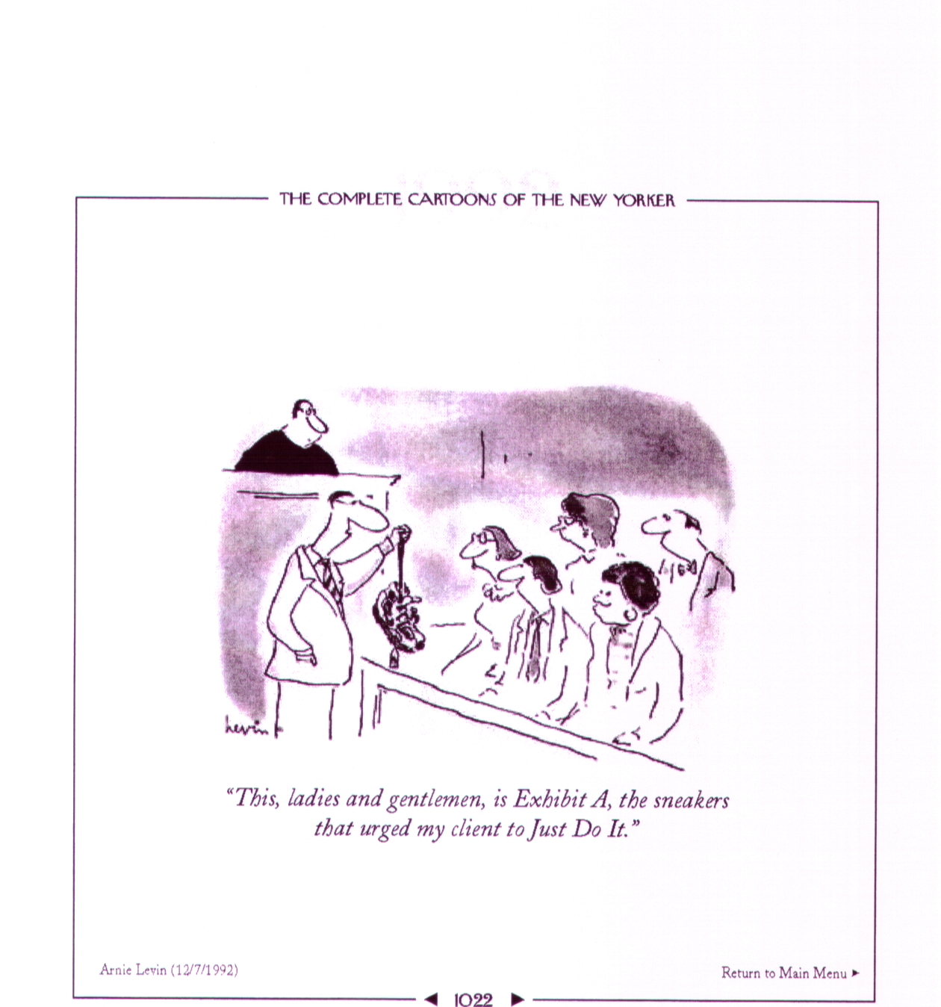
“This, ladies and gentlemen, is Exhibit A, the sneakers that urged my client to ‘Just Do It.’”(Not an assertion)

Slide 43
Definition of “Assertion” – Recap
Hearsay is a “statement” (oral, written, conduct, silence) if it is intended by the declarant as an assertion.
An assertion is a “positive declaration” and, generally, not an “implied assertion.” But see Brown v. Commonwealth, supra.
With respect to each “statement”, the critical issue is analyzed from the point of view of the declarant, i.e., did the declarant intend to communicate a fact with the expectation that the fact will be accepted as true.

Slide 44
Third Question: Is the Statement Offered for the Truth of the Matter Asserted?
“Hearsay” is a statement . . . offered in evidence to prove the truth of the matter asserted. Rule 2:801(c)
For each statement you have to ask:
  Is the party trying to prove the truth of the out-of-court statement or conduct or, instead, trying to prove that the statement or conduct occurred, and that the occurrence is relevant to an issue in the case?
  If the statement is not offered to prove the truth of the matter asserted in the statement, then it is not hearsay.

Slide 45
Assertions Not Being Used For Their Truth –
“Verbal Acts” (or Legally Operative Acts)
“Legally operative language is language that establishes a new legal relationship by itself or when uttered with a particular intent. It is not considered an assertion and, hence, is not hearsay. It is not offered for what it says, but for what it does.” Park, Orenstein & Nance, “Evidence Law, A Student’s Guide to the Law of Evidence as Applied in American Trials (5th ed. 2022) § 14.04; see also McCormick on Evidence, Hornbook Series, Student Edition (8TH ed. 2020) § 249.
  “The effect [of the definition contained in Fed. R. Evid. 801(c)] is to exclude from hearsay the entire category of “verbal acts” and “verbal parts of acts” in which the statement itself affects the legal rights of parties or is a circumstance bearing on conduct affecting their rights.” Adv. Comm. Note, Fed. R. Evid. 801(c)

Slide 46
  E.g., marriage vows; statements of donative intent accompanying a gift; statements of guaranty; words of offer or acceptance of a contract; words of slander or libel.

Slide 47
Hypothetical #11
In an estate dispute, decedent Mother’s children seek return of a valuable necklace that Mother’s Niece has and which she claims was a gift from Mother. At trial, Niece testifies that on the day before her 18th birthday Mother gave her a wrapped box and said, “This is a birthday present from me. Don’t open it until tomorrow” When Niece opened the box the next day, the necklace was inside. She immediately called Mother to thank her, and Mother said, “Enjoy it. I was glad to give it to you.” Mother’s children object to the testimony as hearsay. Are the statements hearsay?

Slide 48
Answer #11
Yes and no. The first statement is not hearsay because under Virginia common law, a statement of donative intent accompanying the delivery of a gift is considered a “verbal act” or “legally operative act.” The second statement, however, was not contemporaneous with the delivery, and thus is hearsay.

Slide 49
Other Primary Situations Where the
Statement is Not Offered for its Truth
  Mental state of the party – (a) were actions willful (b) malicious (c) with intent to defraud (d) with intent to murder, etc.
  To show the effect on the hearer such as duress, self-defense.
  To show knowledge or proof of notice.
  To show the state of mind of the declarant.
  Use of prior inconsistent and consistent statements to challenge or bolster credibility. Rule 2:801(d); Tackett v. Commonwealth, 2008 Va. App. LEXIS 535

Slide 50
Hypothetical #12
Husband and Wife, who are both in their second marriage, are involved in an automobile accident and both die. Who died first will determine the distribution of their joint estate. At the estate trial, Husband’s executor seeks to introduce the testimony of Police Officer, who was the first person to arrive on the scene, to testify that when he arrived, he asked, “Is everybody okay?” and Husband responded, “I am alive.” Wife said nothing, and when Police Officer checked for her pulse, he could not detect one. Moments later, he checked on Husband, but he, too, had no pulse.
Wife’s executor objects to the testimony as hearsay. Is this hearsay?

Slide 51
Answer #12
No. Husband’s words are not being introduced for their truth. Rather, they are being introduced to show he was able to speak, which is circumstantial evidence that he was alive.
  See also Karika .v Commonwealth, 2016 Va. App. LEXIS 288, *6-10 (trial court committed reversible error by excluding as hearsay a 911 call made by the complainant that the defense sought to introduce for the purpose of showing complainant’s demeanor, i.e., that he was calm and civil, and thus arguably inconsistent with that of someone who had just been assaulted).

Slide 52
Hypothetical #13
Defendant is charged with possession with intent to distribute drugs from an apartment. The prosecution seeks to introduce as evidence “pay/owe” sheets (documenting drug transactions, in code) found in the apartment when a search warrant was executed. Defense objects. Is this hearsay?

Slide 53
Answer #13
Not hearsay. The pay/owe sheets are not being offered to prove the truth of the documents, i.e., what individual buyers paid or owed for the purchase of drugs, but merely to show the presence of the pay/owe sheets, which makes it more likely that the apartment was used for drug dealing and that persons associated with the apartment were engaged in drug dealing. United States v. Jamarillo-Suarez, 950 F.2d 1378 (9th Cir. 1991).

Slide 54
Hypothetical #14
In a prosecution for attempted capital murder of a police officer where Defendant shot at an unmarked police car that had stopped him in order to arrest him on drug charges, Defendant, in support of his defense of self-defense, seeks to introduce into evidence statements by Defendant’s girlfriend’s former boyfriend that he would kill Defendant the next time he saw him. Commonwealth objects as hearsay. Is this hearsay?

Slide 55
Answer #14
No. Court of Appeals concludes that the statements were admissible as non-hearsay circumstantial evidence of Defendant’s state of mind of reasonable fear, which supported his claim of self-defense. Wynn v. Commonwealth, 5 Va. App. 283, 292-93 (1987).

Slide 56
Hypothetical #15
In murder prosecution where Defendant was found in possession of rings belonging to the Decedent and claimed he had them before the murder, the Commonwealth seeks to introduce Decedent’s statement to her sister the day before the murder, that she wanted the sister to take her rings to be repaired the next time she visited. Defendant objects to the testimony as hearsay. Is this hearsay?

Slide 57
Answer #15
No. Court of Appeals finds the statement not to be hearsay; rather, it was admissible as circumstantial evidence that the decedent had the rings in her possession the day before the homicide. Weller v. Commonwealth, 16 Va. App. 886 (1993).
  Query: If this is not hearsay – i.e., not an implied assertion that the declarant was in possession of the jewelry the day before her murder – then how is Defendant’s question in Brown v. Commonwealth an implied assertion and thus hearsay?

Slide 58
Hypothetical #16
In a bench trial where the defendant was charged with robbery, carjacking and related offenses, the Commonwealth seeks to introduce Police Officer #1’s testimony that another officer (Police Officer #2) stopped and detained Defendant approximately two blocks away from the location where the stolen car was stopped by the police and four men ran from the car, after Police Officer #2 saw Defendant emerge from a backyard, out of breath and wearing dirty black clothes. Defendant objects to the testimony as hearsay. Is this hearsay?

Slide 59
Answer #16
No. Court of Appeals finds the evidence not to be hearsay because the trial court stated it was not considering the testimony for its truth, but rather, to explain what the testifying officer said to Defendant after Defendant’s apprehension (unspecified in the opinion). Turner v. Commonwealth, 2017 Va. App. LEXIS 57.
  Query #1: Why were the officer’s subsequent statements relevant?
  Query #2: If the statements were relevant, why was the information other than Defendant having been apprehended necessary?

Slide 60
Hypothetical #17
Defendant is charged with the murder of his Girlfriend. In the defense case, Defendant testifies that he invited Girlfriend over to view his gun collection and was showing Girlfriend a new gun he had purchased and it accidentally discharged, killing her. In its rebuttal case, the Commonwealth calls Girlfriend’s Best Friend, who testifies that a few days before the shooting Girlfriend told her (Best Friend) that Defendant had threatened to kill her if she ever left him and that she was afraid of him. Defendant objects to the statements as hearsay. The ACA asserts they are not being used for their truth. Are the statements hearsay?

Slide 61
Answer #17
No and yes, but both are admissible if the jury is correctly instructed. The first statement is circumstantial evidence of Girlfriend’s state of mind of fear of defendant and is not being introduced for its truth. The second statement is hearsay and is being introduced for its truth, but it falls within the “state of mind” exception. Va. Rule 2:803(3). Girlfriend’s state of mind – fear of Defendant – is relevant because it makes it unlikely that she would put herself in a situation where Defendant is showing her guns, which tends to undermine Defendant’s defense of accident. Both statements are admissible with a limiting instruction that the statement could only be used to determine Girlfriend’s state of mind and that the first statement could not be used for its truth.
  The evidence tells us about the declarant’s state of mind but nothing about Defendant’s; otherwise, it would be hearsay.
  Difference between the “state-of-mind” exception to the hearsay bar and circumstantial evidence of state of mind.

Slide 62
Hypothetical #18
Defendant is charged with the murder of his roommate. Defendant testifies that he did not kill roommate, that they were on good terms, that he left their home while roommate and another individual were involved in a heated argument, and he discovered roommate’s body when he returned home.
In its rebuttal case, the Commonwealth calls two witnesses to testify that, in the weeks and months preceding Roommate’s murder, Roommate had told them several times that he was dissatisfied with Defendant because he wasn’t contributing his share of the household expenses and he was going to ask Defendant to move out. Trial judge overrules Defendant’s hearsay objection and instructs the jury they could not use the statements to conclude Defendant owed Roommate a debt or had not paid his expenses. Although it did not so instruct the jury, the trial court also ruled that the evidence could be used to determine Roommate’s state of mind. Are the statements hearsay?

Slide 63
Answer #18
Yes. In Hanson v. Commonwealth, 14 Va. App. 173, 187-89 (1992), the Court of Appeals finds that despite the trial judge’s instruction and ruling, the statements were hearsay because Roommate’s state of mind was not relevant to Defendant’s state of mind (or his defense), since there was no evidence that Roommate’s concerns/dissatisfaction had been communicated to Defendant.
  “The state of mind of a homicide victim is relevant and material only in cases where the defense contends that the death was the result of suicide, accident, or self-defense. In those instances, the state of mind must have been communicated to the accused. When those defenses are not in issue, and when the accused has not been made aware of the victim's state of mind, the statement would become relevant only through ‘a circuitous [tenuous] series of inferences.’” Id. at 188 (citations omitted).

Slide 64
  “For the state of mind of the victim to be relevant to prove the state of mind of the accused, some nexus must exist which inferentially implicates the accused, such as by showing ‘previous threats made by the defendant towards the victim, narrations of past incidents of violence on the part of the defendant or general verbalizations of fear of the defendant.’” Mere uncommunicated dissatisfaction is insufficient to suggest conduct by the declarant that is relevant to the defense raised in this case. Id. at 188-89.

Slide 65
Hypothetical #19
Defendant is prosecuted for the murder of his girlfriend, with whom he was living. In its case-in-chief, the Commonwealth presented evidence that Defendant shot Girlfriend after she came home and told him she had been with her lover. In the defense case, Defendant testifies that he was trying to pull his gun out of a shoulder holster that he was wearing wrongly, when the gun accidentally discharged, killing Girlfriend. Defendant also testified that his relationship with Girlfriend was “fabulous.” In its rebuttal case, the Commonwealth calls (1) a friend of Girlfriend to testify that a few months before the shooting Girlfriend had told him that Defendant had threatened to kill her if she left him and (2) Girlfriend’s lover to testify that on the day of the shooting Girlfriend told her that she wanted to leave Defendant. The defense objects that both statements are hearsay. Are the statements hearsay?

Slide 66
Answer #19
Relying on Hanson, the Court of Appeals finds both statements admissible under the hearsay exception for state of mind. Elliot v. Commonwealth, 30 Va. App. 430 (1999). As to the first statement, the court finds, “In this instance the state of mind of the victim is relevant to prove the state of mind of the accused and the nature of their relationship. … [I]t relates a conversation between the defendant and victim which demonstrated the nature of their relationship and provided a motive for murder.” The second statement “establishes [Girlfriend’s] state of mind, namely, her intention to leave [Defendant]. [The first statement] proves [Defendant’s] state of mind in response to [Girlfriend’s] intention to leave him. … The nexus to the defendant is his prior threat to [Girlfriend] relating to the subject of any intent she may have to leave him. Also, the evidence rebuts [Defendant’s] characterization of the relationship as ‘fabulous’ and provides a motive for murder.”

Slide 67
This analysis appears to erroneously apply the “state-of-mind” hearsay exception, Va. Rule 2:803(3), and uses Girlfriend’s statements for their truth. The first statement does not fall within the “state of mind” exception; it is circumstantial evidence of Girlfriend’s state of mind of fear of Defendant. The second statement may express a state of mind – the desire to leave Defendant – and it also may be circumstantial evidence of Girlfriend’s fear of Defendant, but it does not express an intent to convey the desire to leave to Defendant (Thus it is not a statement of present state of mind to do a future act, Mutual Life Insurance v. Hillmon, 145 U.S. 285 (1892)) and there is no evidence she told Defendant she wanted to leave him. More importantly, Girlfriend’s state of mind tells us nothing about her conduct and there is nothing about her state of mind that is relevant to the specifics of Defendant’s “accident” defense. Unless you accept the statements for their truth – thus rendering them hearsay – they tell us nothing about Defendant’s state of mind.
The court is correct that the two statements are relevant to Defendant’s testimony that his and Girlfriend’s relationship was “fabulous,” which might have some impact on his defense, but the defense would have been entitled to have the jury correctly instructed as to their proper use.

Slide 68
Principle: Whenever a party claims that it is not using a hearsay statement for its truth, particularly when the statement is being used to prove the declarant’s state of mind, the court must ask whether the non-hearsay purpose is relevant and if it is, whether the evidence contained in the statement is probative of that purpose and can be properly used for that purpose and not for its truth. If the purpose is not relevant or if the statement is not probative of the purpose, it is hearsay.

Slide 69
Differences Between Rule 2:801(d) and FRE 801(d)
In Virginia, prior inconsistent statements made by a witness, even if made under oath, can only be used for impeachment.
  In federal court, prior inconsistent statements made by a witness under oath at a prior proceeding or deposition are substantive evidence.
In Virginia, prior consistent statements can only be used to bolster credibility and only if the witness has been impeached (i) by means of a prior inconsistent statement or (ii) as having an improper influence or motive to testify falsely or by an express or implied charge that the in-court testimony is a recent fabrication, and the prior statement must have been made before the improper motive.
  In federal court, prior consistent statements that meet these criteria are substantive evidence.
In Virginia, prior identifications are hearsay.
  In federal court, prior identifications, even if denied by the witness at trial, are substantive evidence.

Slide 70
Va. Rule 2:801(d)
(d) Prior statements. When a party or non-party witness testifies . . ., a prior statement (whether under oath or not) is hearsay if offered in evidence to prove the truth of the matters it asserts, . . .
    (1) Prior inconsistent statements. A prior statement that is inconsistent with the hearing testimony of the witness is admissible for impeachment . . .
    (2) Prior consistent statements. A prior statement that is consistent with the hearing testimony of the witness is admissible for purposes of rehabilitating the witness's credibility, but only if
      the witness has been impeached using a prior inconsistent statement . . ., or
      (i) the witness has been impeached based on alleged improper influence, or a motive to falsify testimony, such as bias, interest, corruption or relationship to a party or a cause, or by an express or implied charge that the in-court testimony is a recent fabrication; and
        (ii) the proponent of the prior statement shows that it was made before any litigation motive arose for the witness to make a false statement.

Slide 71
Fed. R. Evid. 801(d)
(d) Statements That Are Not Hearsay. A statement that meets the following conditions is not hearsay:
  A Declarant-Witness’s Prior Statement. The declarant testifies and is subject to cross-examination about the prior statement, and the statement:
  is inconsistent with the declarant’s testimony and was given under penalty of perjury at a trial, hearing, or other proceeding or in a deposition;
  is consistent with the declarant’s testimony and is offered
      (i) to rebut an express or implied charge that the declarant recently fabricated it or acted from a recent improper influence or motive in so testifying; or
      (ii) to rehabilitate the declarant’s credibility as a witness when attacked on another ground.
  (C) identifies a person as someone the declarant
  perceived earlier.

Slide 72
Hypothetical #20
Driver #1 and Driver #2/Defendant were involved in an automobile accident. Shortly after, but unrelated to, the accident, Driver #1 died. His estate then sued Driver #2. At a pretrial deposition, Witness testified that Driver #2/Defendant was at fault because he ran a red light. At trial, however, Witness testifies that the light was yellow when Driver #2/Defendant went through it. Counsel for Plaintiff estate then impeaches Witness with his sworn deposition testimony. At the end of Plaintiff’s case, defense counsel moves for a directed verdict, arguing that there is no evidence to support Plaintiff’s claim of Defendant’s negligence. Plaintiff’s counsel disagrees, asserting that Witness’s sworn deposition provides sufficient evidence to overcome a motion for directed verdict.
Should the motion for directed verdict be granted or denied?

Slide 73
Answer #20
The motion for a directed verdict should be granted. Under Virginia law, the prior sworn testimony may only be used to impeach the witness. Rule 2:801(d). Thus, there is no substantive evidence of Driver #2/Defendant’s negligence.
  In federal court, the motion would be denied, because prior inconsistent statements given under penalty of perjury at a trial, hearing, or other proceeding or in a deposition are admissible as substantive evidence. Fed. R. Evid. 801(d)(1)(A).

Slide 74
  With regard to prior consistent statements, the Supreme Court of Virginia has observed:
    As a general rule, the prior consistent statement of a witness is hearsay. Graham v. Danko, 204 Va. 135, 138 (1963); Crowson v. Swan, 164 Va. 82, 94 (1935); Scott v. Moon, 143 Va. 425, 434 (1925). To allow such a statement to corroborate and buttress a witness’s testimony would be an unsafe practice, one which not only would be subject to all the objections that exist against the admission of hearsay in general but also would tend to foster fraud and the fabrication of testimony. Scott, 143 Va. At 434. Indeed, it has been said that “’the repetition of a story does not render it any more trustworthy.’” Faison v. Hudson, 243 Va. 397, 404 (1992).

Slide 75
Other Differences Between Rule 2:801 and FRE 801
Fed. R. Evid. 801(e) – Statements of the opposing party and its agents excluded from the definition of hearsay and thus can be used as substantive evidence.
Va. Rule 2:803(0) – Statements of the opposing party and its agents are an exception to the bar against hearsay and thus can be used as substantive evidence.

Slide 76
Hypothetical #21
In a tax fraud prosecution where the Defendant, a CPA, is accused of submitting numerous false tax returns, the Government wishes to call IRS Agent as a witness – whom the defense concedes is an expert on taxation – to testify that she has reviewed all of the tax returns at issue and has spoken with the taxpayers, and it is her expert opinion that 90% of them contain overstated deductions. Defense counsel objects on hearsay grounds. Is the testimony hearsay?

Slide 77
Answer #21
Yes. See United States v. Brown, 548 F.2d 1194 (5th Cir. 1977) (In a tax fraud prosecution against defendant CPA, IRS agent’s trial testimony that of 160 returns she examined 90-95% contained overstated deductions was hearsay because it necessarily was based upon, and the produce of, her conversations with the taxpayers).
  Principle: Even if a witness’s testimony is not presented in the form of hearsay, if the witness’s knowledge of the subject matter of the testimony is based on inadmissible hearsay, then the testimony may be hearsay and, therefore, inadmissible. This may also be true for expert witnesses, even though they are permitted to rely on hearsay that is commonly relied upon within their field of expertise, if their opinion is not sufficiently independent of the truth of the hearsay statement(s).

Slide 78
