Slide 1

Conversation with Atlas and Lynn IP Inns of Court
The Copyright Claims Board:
What, When and How
Brad R. Newberg
COPYRIGHT CLAIMS OFFICER
May 24, 2022

Slide 2
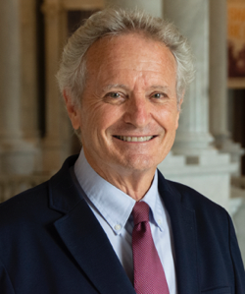
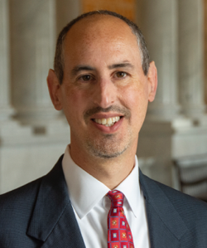
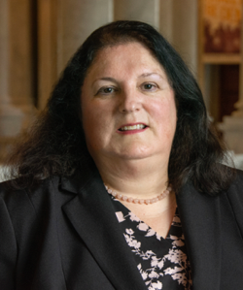


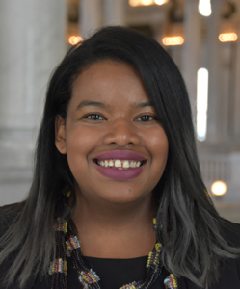
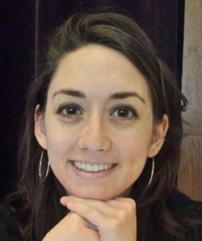
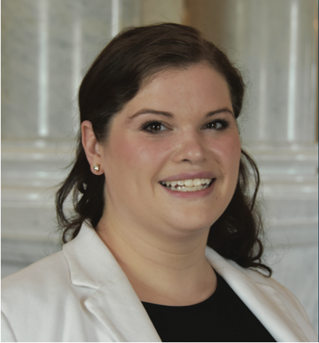
WHO MAKES UP THE CCB?
The Copyright Claims Board is made up of
Three Copyright Claims Officers:
David Carson, Brad Newberg,
and Monica McCabe
One Supervisory
Copyright Claims Attorney:
Whitney Levandusky
Two Copyright Claims Attorneys:
Dan Booth and Maya Burchette
One Paralegal: Laura Kaiser
One Program Specialist: Natalie Cronin
David Carson
Brad Newberg
Monica McCabe
Whitney Levandusky
Dan Booth
Maya Burchette
Laura Kaiser
Natalie Cronin

Slide 3

What is the issue?
What do you do if you have a copyright dispute?
Federal court was the ONLY avenue to get judicial resolution of copyright disputes, regardless of size.
But, federal court litigation can be:
Procedurally complicated
Lengthy and time-consuming
Very expensive
Unpredictable
Notes:
Section 301 of the copyright act, Federal copyright law preempts common law and state law
28 USC 1338 grants US District courts original jx of all actions arising out of copyright

Slide 4
Why did that matter?
As a practical matter, except for large corporate copyright owners, our current copyright laws are virtually
unenforceable when it comes to the infringement of visual works.
Graphic Artists Guild
People with disputes that didn’t have a high monetary value might not have the resources to pursue federal court
Few attorneys willing to handle small cases
Examples include creators with high volume/low yield works like photographs OR users accused of infringement who believe their use was fair
Such small claims and random infringements may seem unimportant, [but] taken in the aggregate, they have an effect on the livelihoods of individual creators akin to the infamous torture “death by a thousand cuts.”
Songwriters Guild of America
Right holders are often deterred from bringing suit for copyright infringement due to the expense of litigation.
Kernochan Center for Law, Media and the Arts

Slide 5
TIMELINE
Congress asks Copyright Office for study
Bill introduced in House (HR 5757)
Bills introduced in House and Senate (HR 2426, S 1273)
2006
2013
2017
2021
2011
2016
2019
Hearing involving small claims and orphan works
Copyright Office releases report
Bill introduced in House (HR 3945)
ENACTED 12/27/20

Slide 6
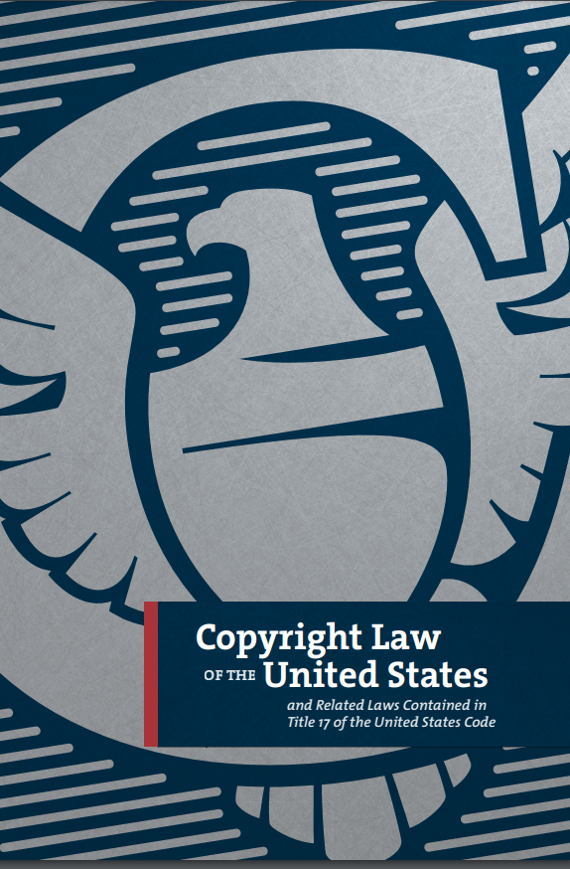
THE CCB HAS A NARROW FOCUS
In federal court, total damages are unlimited, statutory damages can be up to $150,000 per work infringed, and you can claim and counterclaim anything in addition to copyright claims.
CCB has:
$30,000 total damages limit, lower statutory damages
A streamlined discovery system
Virtual hearings and conferences
Copyright-related claims only (infringement, declarations of noninfringement, misrepresentation)
Importantly, the CCB is VOLUNTARY. A claimant can choose instead to file in federal court and a respondent can opt out of proceedings.

Slide 7
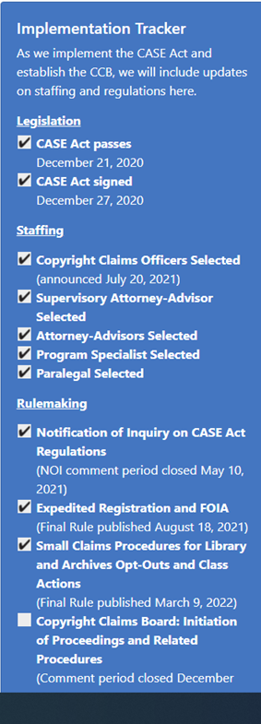
CASE ACT IMPLEMENTATION
After the CASE Act was passed in December 2020, the Copyright Office immediately began implementation.
  Staffing
  The Office has hired eight full time staff members.
  Regulations
  We have published five specific notices of proposed rulemaking and have almost completed publication of all final rules.
Technology
  We are working with developers to build the technology that will allow CCB participants to file and participate in claims virtually.
  Resources and Outreach
  The Office is developing a wide range of educational materials that will assist participants in navigating the process.

Slide 8

IMPLEMENTATION—REGULATIONS & RULEMAKINGS
The Office solicited input on regulations and rules required by the CASE Act including:
Filing a Claim
Service of Process and Designated Agents
Opt Out (including Library/Archive Opt Out)
Discovery
Default/Failure to Prosecute
“Smaller Claims” Proceedings
Various Procedural Rules and Evidentiary Rules
Reconsideration and Register Review
Permissible Number of Cases
Fees
Controlling Bad Faith Actors
Final Rules Published as of May 1, 2022
Small Claims Expedited Registration Procedures and FOIA Conforming Amendment (§221.2) (August 18, 2021; revised, April 22, 2022)
Designated Service Agent Database (§ 222.6) (March 8, 2022)
Procedures for Library and Archives Opt-Outs and Class Actions (§§ 223.2-223.3) (March 9, 2022)
Initiation of Proceedings and Related Procedures (Parts 220, 222-224) (March 25, 2022)
Representation by Law Students and of Business Entities (§§ 232.6; 234.1-234.2) (April 8, 2022)

Slide 9
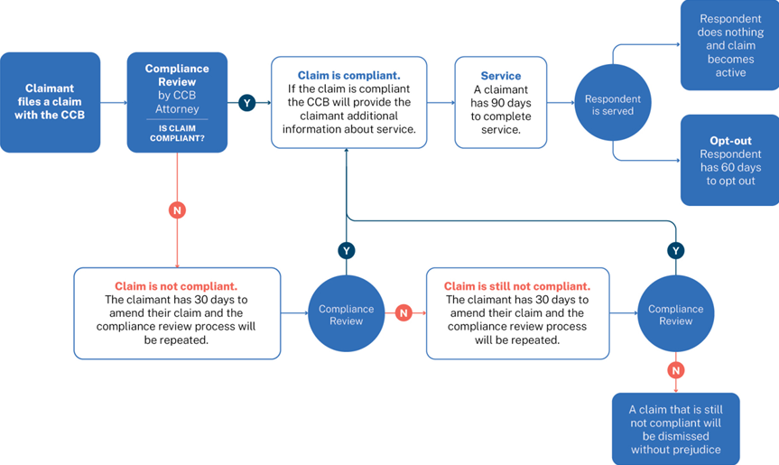
INITIATING PROCEEDINGS
Claimant files
Attorney reviews
Claimant serves
Respondent decides
Board delivers second notice
Opt out? Dismissed
No opt out? Active!

Slide 10
STRUCTURE: ACTIVE PROCEEDINGS
Respondent files response and any counterclaim
Limited discovery
Written testimony
Virtual hearing (optional)
Determination
Settlement can be accomplished at any time; the CCB will facilitate settlement conferences
There are safeguards against Defaults

Slide 11
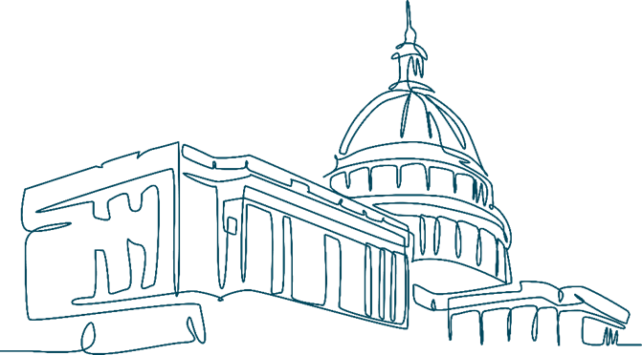
POST DETERMINATION PROCEEDINGS
Requests for reconsideration
    After issuing final determination
    Correct a mistake of fact or law
Register’s review
    After request for reconsideration
    Abuse of discretion
Federal court review
    Fraud, misrepresentation, or other misconduct
    CCB exceeded its authority/ failed to render a final determination
    If default, set aside for excusable neglect

Slide 12
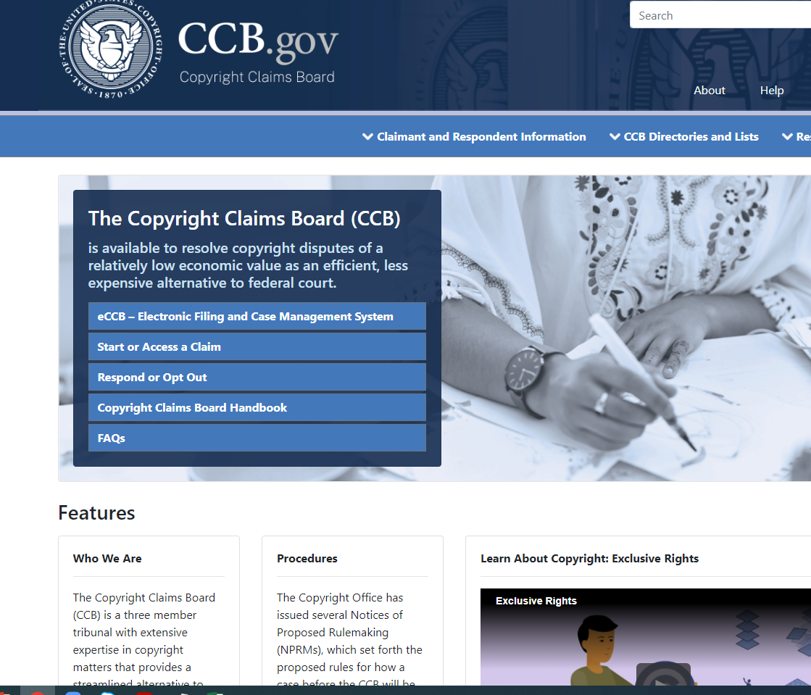
IMPLEMENTATION— RESOURCES
Dedicated Website
On April 7, the CCB launched its website, which will have information about the CCB including:
Portal to eCCB
Designated Service Agent Database
Libraries and Archives opt-out list
Handbook
Educational resources, graphics, and tutorials

Slide 13

IMPLEMENTATION—TECHNOLOGY
eCCB: Electronic Filing and Case Management System
Will be the online filing system for the CCB.
Participants will be able to register for eCCB to file, respond, receive, and review documents related to CCB proceedings.
Anyone will be able to view unrestricted documents through the public case search feature without registering.
Designated Service Agent Database
Under the CASE Act, corporations, partnerships, or unincorporated associations may elect to receive CCB claim notices and other documents via a designated service agent.
The CCB plans to maintain a public directory of service agents for these business entities.

Slide 14
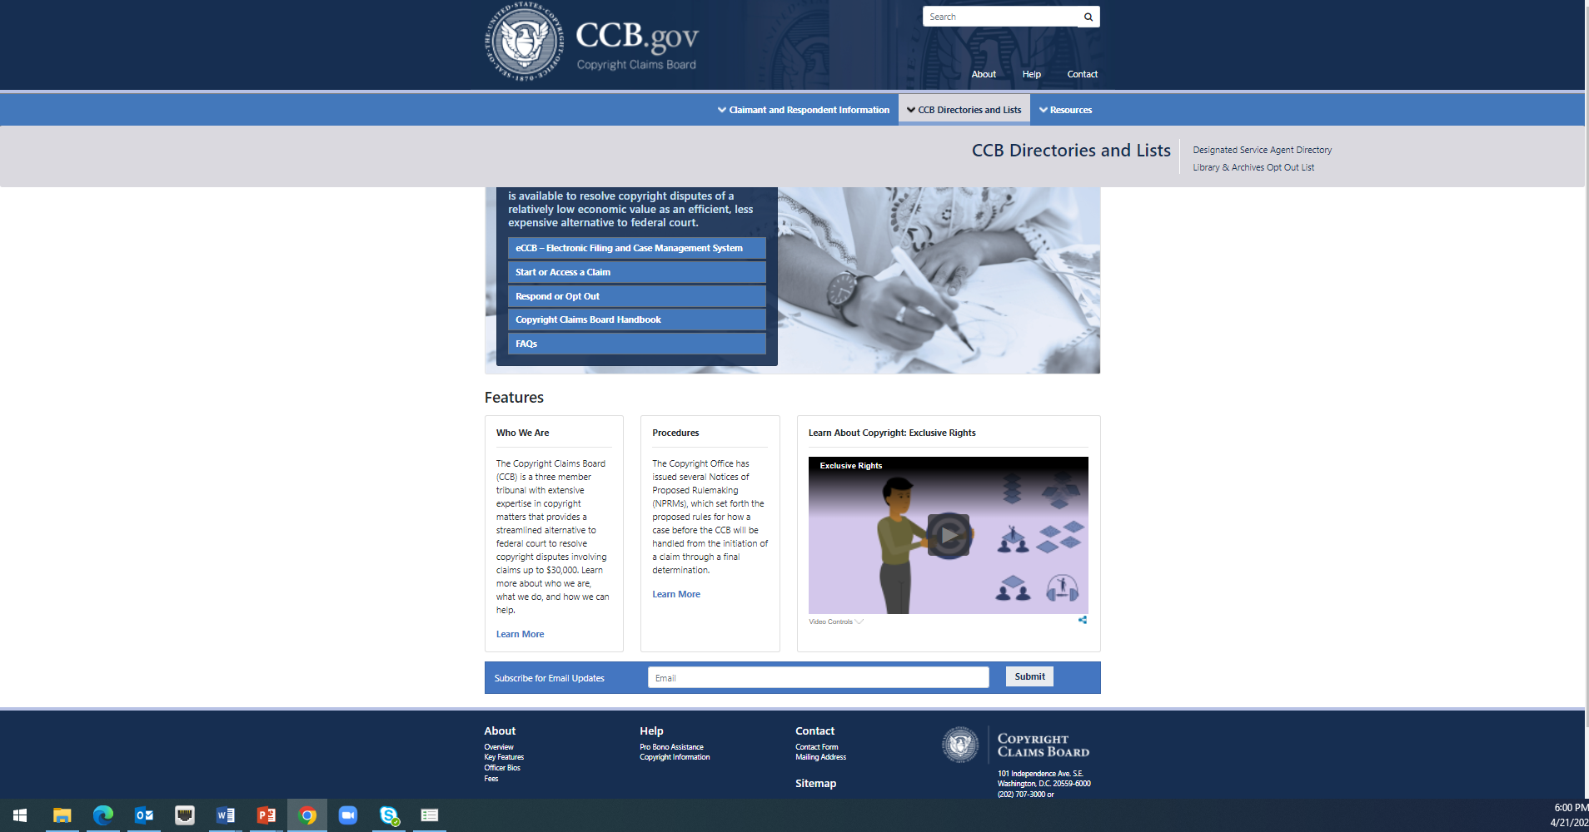
IMPLEMENTATION—TECHNOLOGY

Slide 15
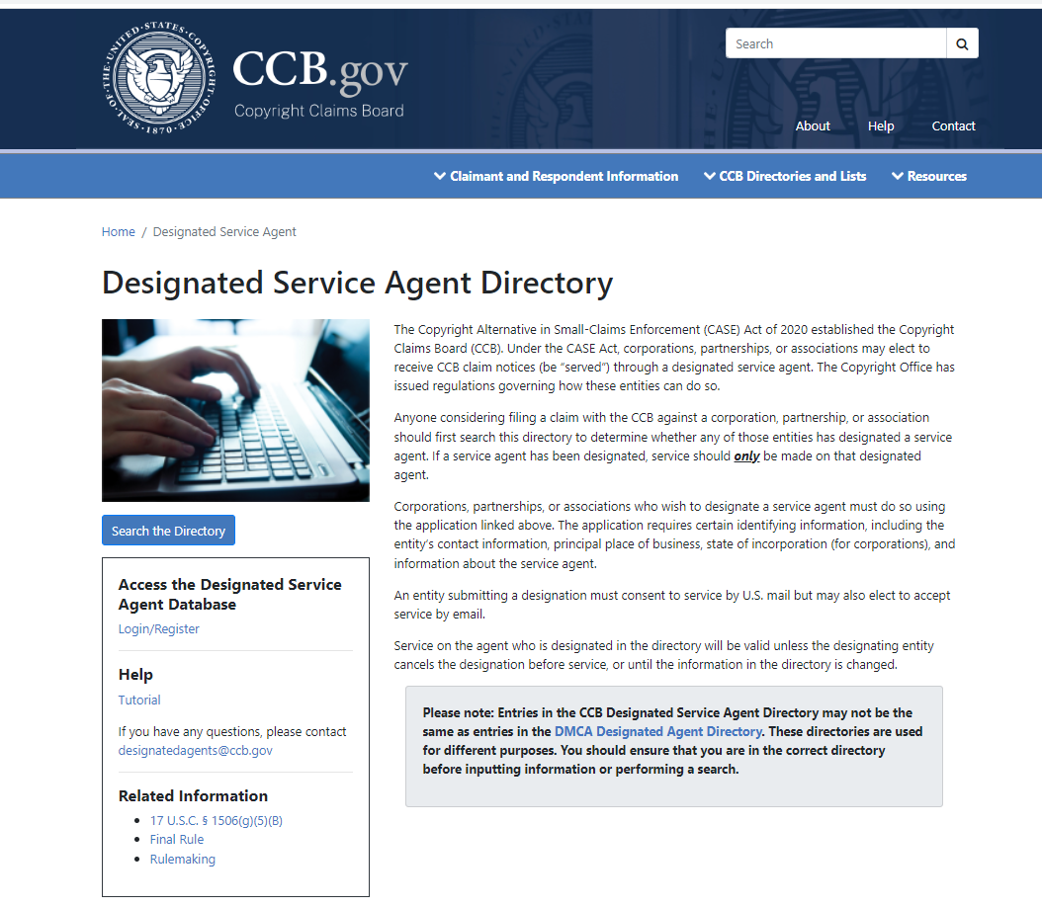
IMPLEMENTATION—TECHNOLOGY

Slide 16
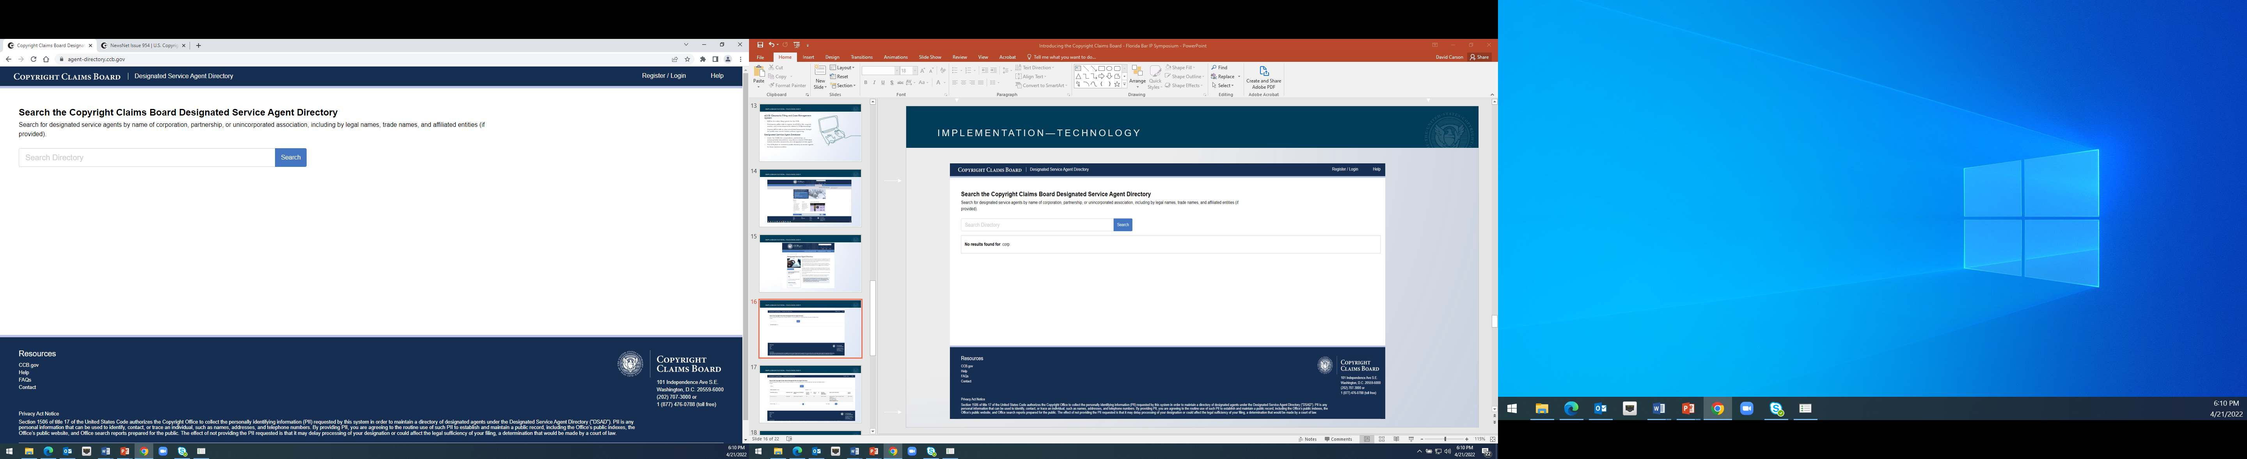
IMPLEMENTATION—TECHNOLOGY

Slide 17
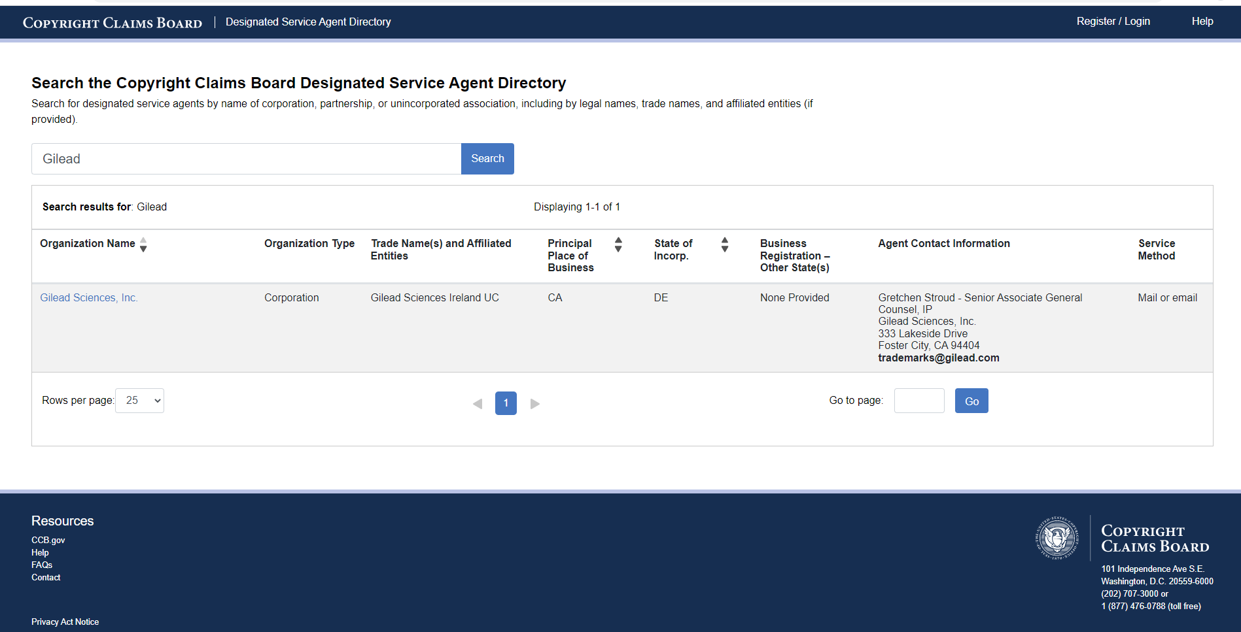
IMPLEMENTATION—TECHNOLOGY

Slide 18
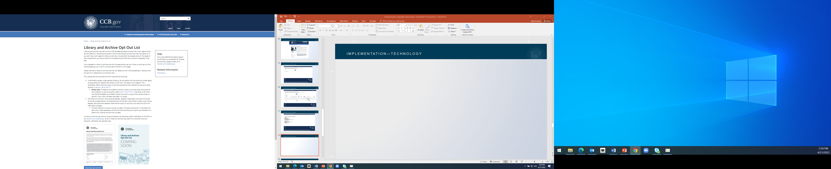
IMPLEMENTATION—TECHNOLOGY

Slide 19
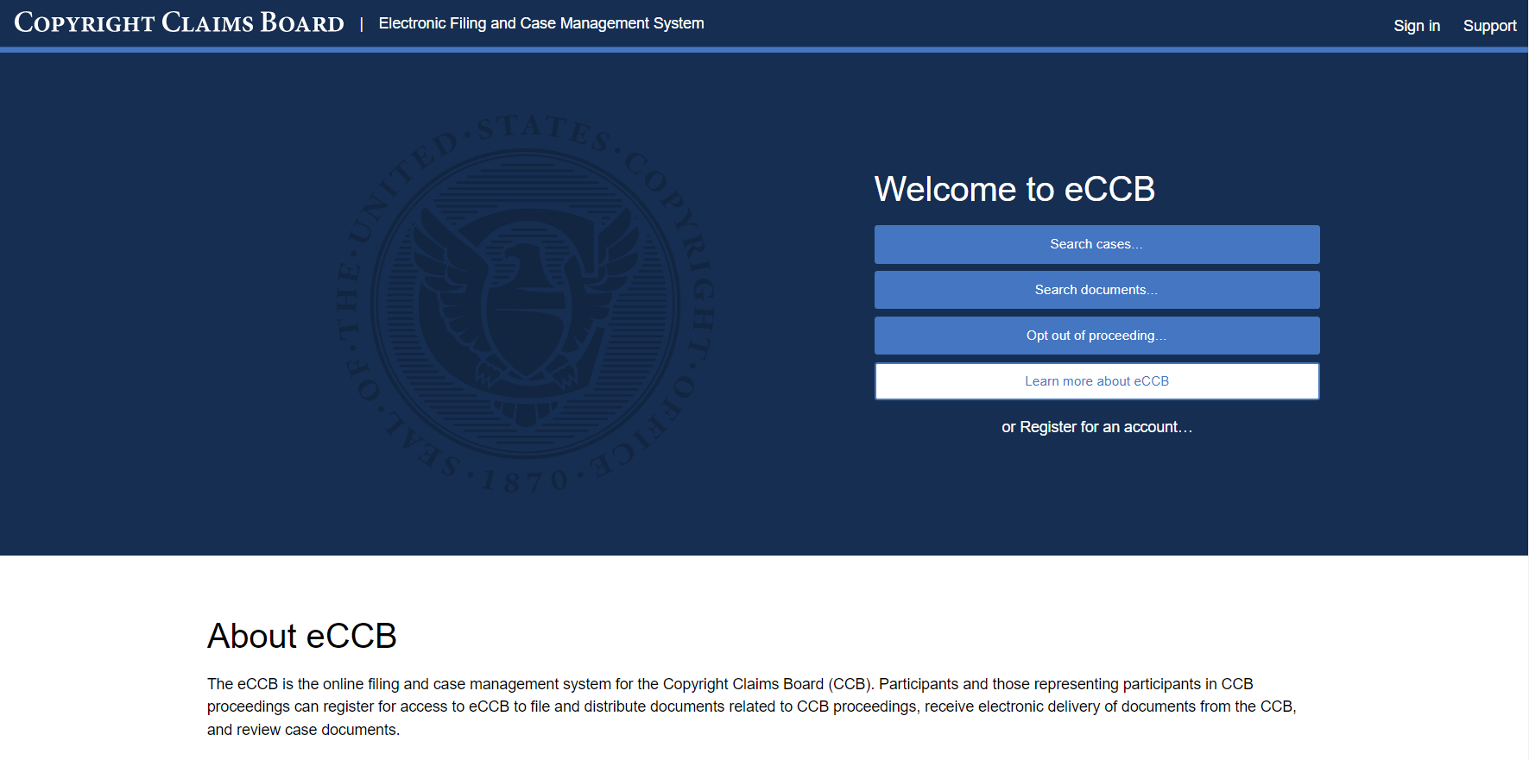
eCCB: The Electronic Filing and Case Management System of CCB

Slide 20
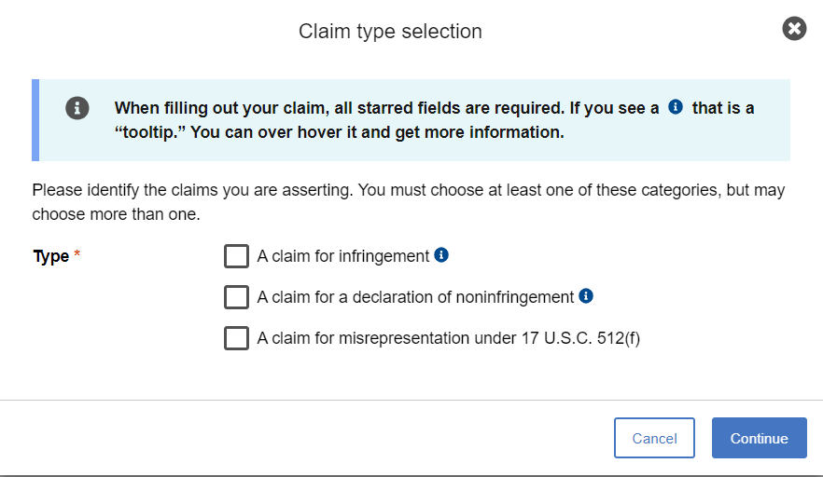
eCCB: Step-by-Step Instructions

Slide 21
IMPLEMENTATION— RESOURCES
Participant Support
The Handbook will be a comprehensive guide to help participants file or respond to a claim before the CCB.
  Includes resources written with non-lawyers in mind
  Expands on service, discovery, and other procedural issues
There will be standardized forms for certain aspects of the case and eCCB will walk users through various filings.
CCB staff is available to provide assistance to the public with respect to the procedures of the CCB.

Slide 22
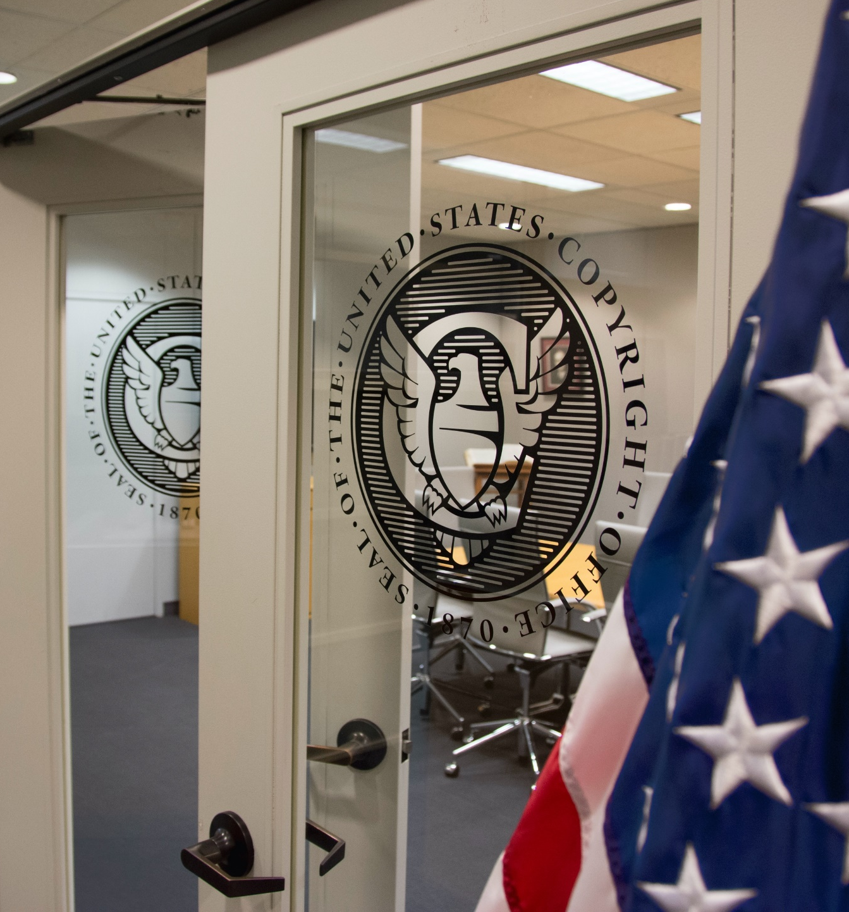
WHAT WE HOPE FOR THE CCB
The CCB will be successful if:
It can be a cost-effective, streamlined alternative for copyright disputes; and
It issues decisions, which are fair for both copyright owners and users, so that both decide it is a preferable venue for claims of smaller monetary value.

Slide 23
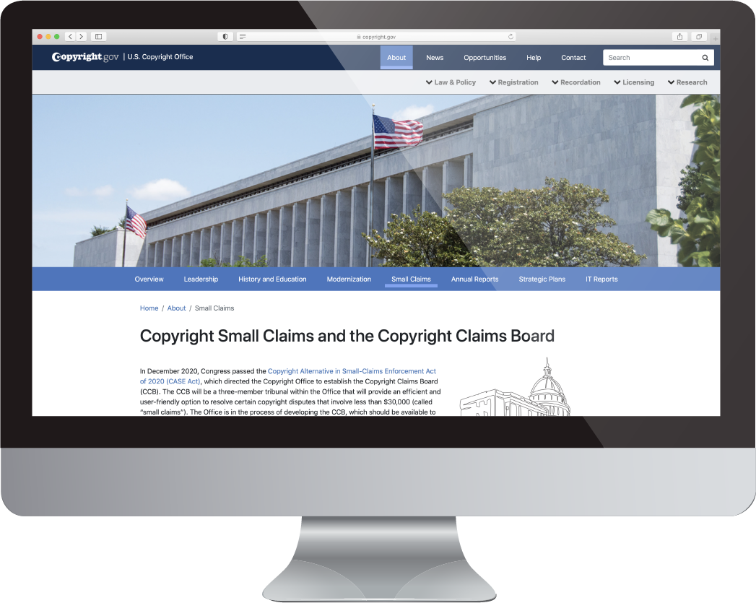

Visit ccb.gov and copyright.gov/
about/small-claims for more history, facts, and FAQs
Visit copyright.gov/subscribe/
to sign up for our NewsNet service

