Slide 1
NY Inn of Court – SPACs
September 22, 2021

Slide 2
Have you ever heard of a SPAC?
Special Purpose Acquisition Company (“SPAC”)
Formation
A SPAC is formed by a sponsor as a “blank check” company.
A SPAC typically forms and then undergoes an initial public offering (“IPO”) without an underlying business.
Potential investors consider the sponsor when deciding to invest in the SPAC.
Target / Lifecycle
A SPAC must identify an acquisition target and initiate a business combination within 18 to 24 months from the IPO (may be extended to 36 months with a shareholder vote).
Until merger, the IPO proceeds are held in a trust account and usually invested in short-term US government securities.
De-SPAC
When the businesses combine (i.e., SPAC + its target), this is referred to as the De-SPAC transaction.
If no acquisition takes place within the time frame, the SPAC is liquidated and all shares are redeemed on a pro rata basis from the trust account.
Notes:
PART 1 START

Slide 3
SPAC Lifecycle and Structure
IPO – usually 2-3 months
Preparing for the Business Combination – usually 18-24 months
De-SPAC Transaction – usually 3-6 months
1
2
3
Notes:
Stage 1: IPO – incorporate SPAC in US vs. offshore; sell founder shares; file S-1 and amend SEC comments; prepare final prospectus; negotiate additional deal documents (i.e., underwriting agreement, exchange listing, FINRA filing); commence roadshow; price and close.
Stage 2: Preparing for the Business Combination – consider target options; choose target; conduct due diligence; negotiate merger agreement; secure additional financing; begin preparing docs for De-SPAC transaction (i.e., proxy or tender offer); maintain applicable SEC filings.
Stage 3: the De-SPAC Transaction – file preliminary proxy/tender offer materials; publicize merger agreement and secure shareholder support; redeem public shares at shareholder’s request; complete merger; file Super 8-K.
During the IPO, SPACs offer units made up of 1 share of common stock and either a whole or fractional warrant. The warrants reward investors for agreeing to have their capital held in trust for a long period. The warrants authorize the purchase of common stock in the future.
Warrants can only be exercised if the SPAC completes a merger prior to the specified date. They generally have a strike price that is 15% higher than the IPO share price. Investors may want to utilize warrants to purchase stock either 30 days post-merger or 1 year post-IPO.
IPO revenue is kept in trust and released only if: (1) the revenue is needed to fund a merger or (2) the SPAC is being liquidated because no merger has occurred by the specific date.

Slide 4
Traps for the Unwary
Warrants
Founder Warrants
Public Warrants
Minimizing Risks
SPAC must redeem shares of all electing shareholders. So, shareholder support is essential.
Redemption risk can be lessened by using a forward purchase agreement (i.e., sponsor/investor agrees to purchase additional equity equal to a portion of redemptions.
Many can require holders of founder shares to commit to vote on shares in favor of the De-SPAC transaction (and any public shares purchased during/after IPO) to help minimize risk.
Comparing Typical IPO
Traditional IPO
*6 months for an IPO; detailed registration
*180 day lock up from IPO date for control persons
*Underwriter discount 5-7% of gross IPO proceeds
SPAC IPO
*2 months for an IPO; less disclosures, minimal info for registration
*1 year lock up from closing of De-SPAC.
*Underwriter discount of 2% of gross IPO proceeds + 3.5% of the proceeds held in trust
Notes:
Founder Warrants: priced to cover the underwriter discount and IPO expenses; sponsors typically net-settle warrants instead of paying cash for stock upon redemption, sponsors will receive an amount of common stock – number of shares equal to the market value of the strike price.
Public Warrants: only whole warrants can be exercised; typically investors are given fractional warrants; depends on SPAC size and sponsor reputation; public warrants are cash-settled; investors must pay cash to exercise their warrants and receive stock; company has right to redeem public warrants for a token amount post-merger in the event shares trade above a certain price for a specified period of time; holders of public warrants may be pressured to exercise them or watch them decline in value.

Slide 5
Why are SPACs so popular?
Sponsors
Wide range of potential investors to market to; eases burden of capital raising.
Raise capital ahead of time, immediately target the right opportunity.
Use SPAC as co-investment vehicle alongside an existing investment fund (use more equity rather than leverage for side-by-side transactions).
Investors
Guaranteed full redemption; clear sense of timing.
Exercise of warrants.
Lower risk than typical private equity investments.
Sponsor’s interests and investors’ interests align because sponsor has capital at risk.
Cost of investment on the sponsor.
Target Companies
Simpler, quicker, less expensive than a traditional IPO or for companies going public.
Lessens risk when markets are unstable; pre-negotiated price removes uncertainty of IPO pricing.
Acquisition increases target’s liquidity and is quicker / simpler way to increase liquidity than traditional capital market offerings.

Slide 6

SPACS UNLIMITED
Presents
SNACC
STRATEGIC NEO ACQUISITION OF
CANINE-FRIENDLY COMPANIES
Notes:
PART 2 START

Slide 7
BarkBath
Business model resembles Rover. BarkBath provides a marketplace for mobile groomers and dog owners to connect online.
BarkBath charges fees to the groomers and dog owners. BarkBath’s cut is approximately 25% of the dog owner’s cost for mobile grooming.
Dog owners use BarkBath for convenience and the peace of mind provided by its groomer screening service. Using our app, dog owners can “shop” for a mobile groomer who is available when needed. No need to make two round trips to the groomer.
Mobile dog groomers use BarkBath as a turnkey solution for marketing, scheduling, payment systems and customer service. BarkBath’s systems and support allow mobile groomers to operate with minimal staff and systems.
Website screenshots

Slide 8






BarkBath
log in
t
Before
After
Before
After

Slide 9

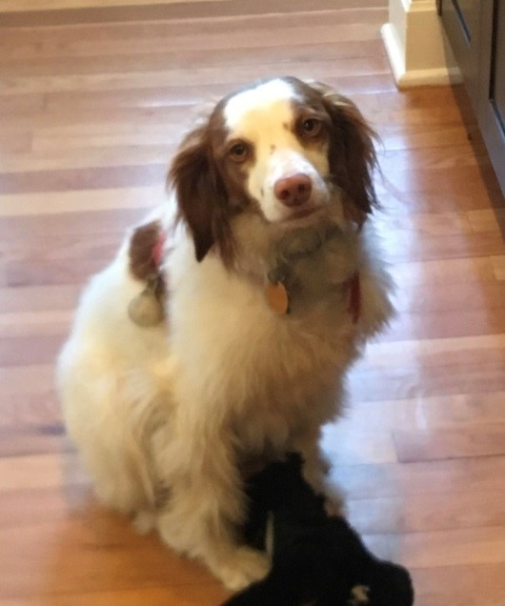
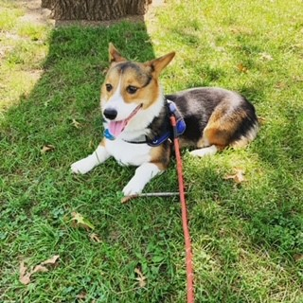



I look like
a rock star!
5 stars. Fast!
No crate! No barky dogs
Like going to a spa, tasty snaccs
******
Floofy!

Slide 10
BarkBath
With funding from a SPAC IPO BarkBath could scale up to all major metro areas and become profitable.
BarkBath Financial Summary & Forecast 2018-2022 (millions)

Slide 11
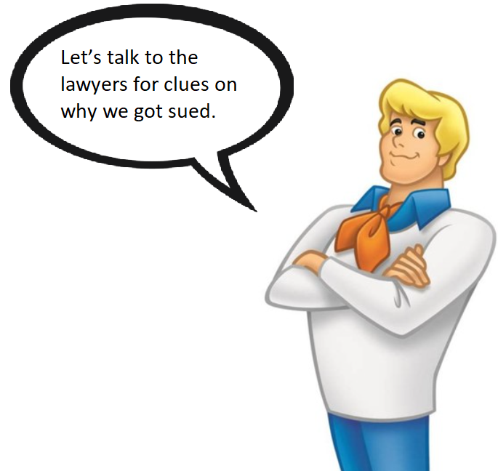
Board Member:
Getting Ready for The Board Meeting
Notes:
BM: [LAWYER], I asked for this meeting to help me prepare for a SNACC Board meeting and make sure it will be the usual formality that we can address with some resolution or consent in lieu of an actual meeting? Who wants a meeting these days if you can help it. No news is good news right? We acquired BarkBath, we are now public. I can add my phone to alert me when the price goes up by at least 10% and have a countdown clock before I can start cashing in on some warrants.
Lawyer: Not so fast. I wouldn’t start shopping for … another … boat right away.
BM: What do you mean?

Slide 12
Notes:
Lawyer: You got served. Well, I accepted service on your behalf, to save you the trouble of hiding out from the process server like last time. It seems the entire Board and sponsor’s affiliates have all been sued by someone activist hedge fund with a vendetta. At least it’s not those RobinHood gamers trading in their parents’ basement this time.
BM: How can these people sue us? The stock has gone up a bit after we de-SPACced. So this can’t be one of those stock drop shakedowns. I’ve been through those. How can anyone say they were harmed?
Lawyer: This is a novel theory it seems. The plaintiffs are alleging that SNACC is really an “investment company” [use scare quotes], and the sponsor is an “investment adviser” under the “Investment Company Act” and the “Investment Advisor Act.”
BM: I seem to recall you told the Board “don’t worry.” And that the SEC had blessed hundreds of SPACs so it would not take that position now.
Lawyer: I don’t think “don’t worry” is in my lawyerly vocabulary. I worry about everything for my clients. And yes the SEC gave no indication it wanted to make this argument, but that doesn’t stop a creative activist fund. But we are where we are. Which is facing a lawsuit that seeks to nullify all those fancy offering and subscription documents I drafted. Which would mean giving people their money back, even though the company has not much cash.
BM: That sounds bad. At least I have my warrants and the stock keeps going up, so we can just slow-play this.
Lawyer: Not so fast. The lawsuit goes after the warrants too, including the buy-back of some of them last month. If you do anything with the outstanding warrant now, you’d likely have a fraudulent transfer claim on top of the current allegations.
BM: Not my warrants! Now, you’ve got my attention. Go back to the beginning and about that “investment company” [scare quotes] issue. Seems like if you can just win on that issue, and any don’t have to be Clarence Darrow to do that. It would be a jump ball at least for Rudy.

Slide 13
WHAT IS AN INVESTMENT COMPANY?
An investment company is a corporation or trust engaged in the business of investing the pooled capital of investors in financial securities.
Section 3(a)(1) of the 1940 Act defines the term “investment company.”
It means “any issuer which is or holds itself out as being engaged primarily, or proposes to engage primarily, in the business of investing, reinvesting, or trading in securities.”
There are exceptions
Notes:
Lawyer: An investment company is considered anything that is or holds itself out as being engaged primarily, or proposes to engage primarily, in the business of investing, reinvesting, or trading in securities. XXX.
We can say SPAC is not an investment company under the 1940 Act if it (i) follows its stated business plan of seeking to identify and engage in a business combination with one or more operating companies within a specified period of time and (ii) holds short-term treasuries and qualifying money market funds in its trust account pending completion of its initial business combination.
BM: That’s great. So we are going to win.
Lawyer: Ugh. Don’t start with the winning again……Here’s the problem. We are basically arguing that SPACs have a “grace period” for complying with the Act—say, the 24 months that many SPACs give themselves to close a deal. But where does this grace period come from? There is more SEC guidance, or other authority, just “the plain statutory text.” But the statute does not say anything about future business plans; on the contrary, the “is” in the ‘40 Act refers to the present tense. And the only regulatory guidance says that “transient” investment companies cannot exceed 12 months.
BM: Why am I only hearing this now?
Lawyer: And it gets worse. We are basically suggesting that safe investments—“short-term treasuries and qualifying money market funds”—are sufficiently conservative to obviate the need for registration. If that’s true, then why do money-market funds and other mutual funds that hold treasuries or other conservative securities need to register?
BM: I don’t, but again. This doesn’t sound like winning. Listen, I didn’t go to law school, but even I can see our argument. SNACC isn’t in the business of investing or trading. Our business is acquiring a company. We operate a real company. As real as a publicly traded company whose business model is turning local dog groomers into looking like a billion dollar company with exponential growth.
Lawyer: Plaintiffs argue that the investor funds were held in T Bills until the Board found a merger target, and T Bills are securities.
BM: I told you we should have been investing in bitcoin. If it is safe enough for the government of El Salvador, it’s fine for our investors. We could have just held all our money in cash. We don’t trigger the ’40 Act if you hold nothing but cash. And easier to make a quick get away I hear.

Slide 14
WHAT IS AN INVESTMENT ADVISER?
“Investment adviser” is a legal term that appears in the Investment Advisers Act of 1940, the federal law that governs investment advisers.
Generally, this law defines an investment adviser as someone who, for pay, is in the business of advising others on investing in stocks, bonds, and other securities.
(11)“Investment adviser” means any person who, for compensation, engages in the business of advising others, either directly or through publications or writings, as to the value of securities or as to the advisability of investing in, purchasing, or selling securities, or who, for compensation and as part of a regular business, issues or promulgates analyses or reports concerning securities;
There are exceptions.
Notes:
Lawyer: And more bad news. The plaintiffs allege that the SPACs' management companies were "Investment Advisors" to the SPACs under the Investment Advisers Act of 1940 ("IAA"). Based on this premise, the complaint challenges various transactions between the SPACs and the SPAC sponsors and directors such as (i) the management company was not registered as an Investment Advisor to the SPAC, (ii) various transactions between the SPAC and SPAC sponsor were not made available to all investors and (iii) the SPAC directors were not elected by the shareholders.
BM: Whatever. This doesn’t really affect me. That all sounds like stuff the company can deal with.
Lawyer: Well, the complaint alleges that the warrants you received are improper compensation outside compensation permitted, arguably.
BM: If we are targeted in this suit, the same thing could be true of almost any SPAC. Warrants are normal. Holding money in securities while you wait to find the investment is normal—otherwise people would be hoarding the money stuffed in warehouses of mattresses. Having a Board that has some skin in the game is also normal. This lawsuit isn’t just an attack on SNACC. This is an attack on capitalism . No, this is an attack on America. You should cut your fee as part of your patriotic duty.
Lawyer: I don’t know about fee-cutting, but I’ve put out the call and asked my brothers and sisters in revolution to join our fight.
BM: Now you are talking. Who’d you get?

Slide 15
What is Section 205(a)(1)?
Section 205(a)(1) of the Advisers Act provides that no registered investment adviser shall enter into or renew any investment advisory contract that “…provides for compensation to the investment adviser on the basis of a share of capital gains upon or capital appreciation of the funds or any portion of the funds or the client.”
Section 205(a)(1) is designed to eliminate "profit sharing contracts [that] are nothing more than 'heads I win, tails you lose' arrangement’s that "encourage advisers to take undue risks with the funds of clients.“
  The section was designed to eliminate the possibility of an investment adviser entering into a contract in which he or she "does not participate in the losses, but participates only in the profits."
Notes:
3 to speculate or to 2 S. Rep. No. 1775, 76th Cong., 3d Sess. 22 (1940).
3 H.R. Rep. No. 2639, 76th Cong .. 3d Sess. 29 (1940).
Investment Trusts and Investment Companies; Hearings on S. Morgan Lewis COUNSELORS AT LAW Douglas J. Scheidt August 18,2014 Page 4 overtrade. 4

Slide 16
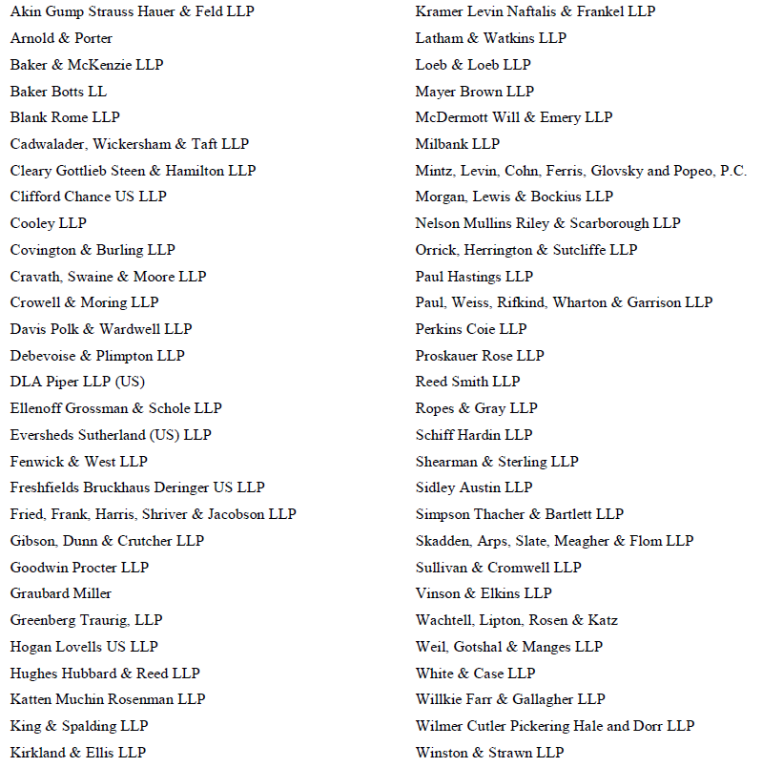
We are totally not worried about this lawsuit.
Notes:
Lawyer: You seem surprised. But it’s kind of like how Ah-nuld became the good guy in Terminator 2. This is more like Agent Smith leading the charge against the Matrix in the newest installment of that franchise. But face it, the SPAC business is a huge gravy train for all these big firms. So, I got all my friends at big firms to sign off on a public letter immediately after the lawsuit hit Law360 saying that SPACs are not investment companies.

Slide 17

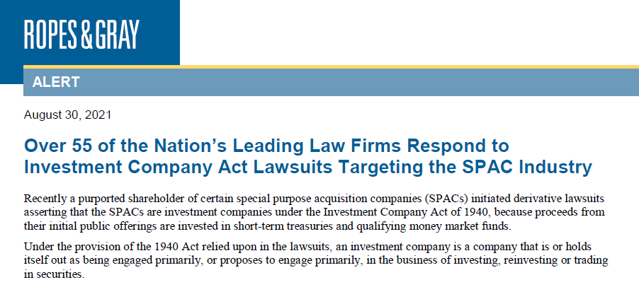
Notes:
BM: Sounds good except if all the law firms bill me even .2 of an hour for saying “me too” at their astronomical rates. But it’s nice that you had your “Avengers, assemble” moment. I only know that one because my grandson made me watch it. I would have said “Superfriends” like on Saturday morning tv, but that reference would have been lost on you. But this case isn’t going to be won in the press. And nice amicus briefs by corporate interests isn’t going to keep my warrants safe. What is our actual legal defense going to look like?
Lawyer: The lawsuit claims there were some other problems with the SPAC.
BM: Seriously. OK, fine. What else do they say?

Slide 18
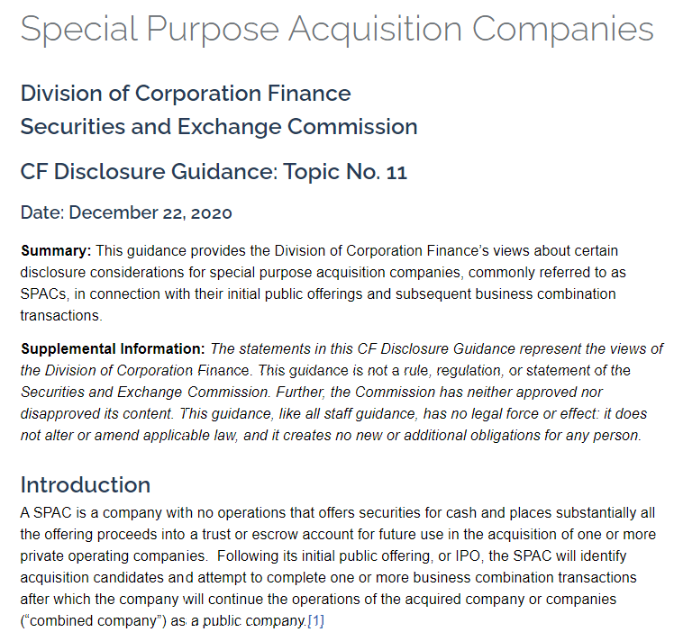
SEC Guidance on SPAC Disclosures
(SEC.gov | Special Purpose Acquisition Companies)
Notes:
Lawyer: The suit also says we violated our disclosure obligations as detailed in the SEC’s disclosure guidance (SEC.gov | Special Purpose Acquisition Companies) [put up first page as a slide]
BM: Disclosure obligations. Come on. Investors put more money in. More money comes out. We are all done here.
Lawyer: Not so fast Mr. black box.. The suit says we failed to properly disclose that our SPAC sponsors, directors and officers did not work exclusively on behalf of the SPAC to identify acquisition companies and that we had conflicts of interest.
BM: What difference would that make if I do work for other funds or companies.
Lawyer: Well, it could mean that you or those other companies might be competing with the SPAC for investment opportunities. You know, you find a great private company and buy it for your family office, instead of having the SPAC buy it.
BM: I would never. … This is is a privileged conversation tight?
Lawyer: The lawsuit also claims that we didn’t properly disclose the conflicts that arose from the time period issue.
BM: What time period issue. We clearly told everyone that there was 24 months to find a company and if we didn’t find one, then the deal would unwind. For example, we committed to find a target operating company and complete a business combination transaction within a specified timeframe. Under the terms of the SPAC’s governing instruments, if the SPAC does not complete a business combination transaction within the specified timeframe, it must liquidate and make a pro rata distribution of the net offering proceeds held in trust to its public shareholders. That sounds pretty disclosed to me.
Lawyer: But what we didn’t say was as the SPAC nears the end of that timeframe, its options may narrow, giving acquisition targets significant leverage in negotiating the terms of a business combination transaction. They had as over a box, a bark box that that is.
We also did not clearly describe the financial incentives of SPAC sponsors, directors and officers to complete a business combination transaction. They have a lot of allegations here.
We did not disclose how these incentives may differ from the interests of public shareholders We did not information about the losses the sponsors, directors and officers could incur if the SPAC does not complete a business combination transaction
We did not disclose the amount of control that SPAC sponsors, directors and officers and their affiliates will have over approval of a business combination transaction
We did not disclose whether the SPAC may amend provisions in its governing instruments to facilitate the completion of a business combination transaction. We did not describe how the SPAC may amend such provisions, whether shareholder approval is required, and, if so, the requisite voting standard for approval and whether the sponsors have sufficient voting power to approve it
We did not disclose whether, and if so how, the SPAC may extend the time it has to complete a business combination transaction
BM: I get it, but that’s it right.
Lawyer: Almost. Remember how proud you were when you got our underwriter to defer its fee until the business combination happened?
BM: I sure do. That save us a ton in up front legal fees. Oh by the way, you aren’t billing for this right
Lawyer: The lawsuit says that because the underwriter provided additional services such as identifying potential targets, providing financial advisory services, we did not properly describe those services or disclose the conflict of interest the underwriter may have in providing such services given any deferred underwriting compensation.
BM: What. I don’t even understand that
Lawyer: You forgot to tell your investors that the underwriters don’t get paid if there is no deal. So they had an undisclosed incentive to find a deal.
There was one more disclosure problem They said we failed to properly disclose the additional financing that is necessary to complete the business combination.
BM: What do you mean. That was a separate financing instrument.
Lawyer: That is exactly their point.
BM: Huh?
Lawyer: They say we didn’t clearly disclose the additional financing necessary to complete the business combination transaction and how the terms of such financing may impact public shareholders. They said they didn’t if the terms of additional financing involve were going to differ from the price and terms of those sold to the public investors (i.e at a different valuation of the company) . They also say they didn’t know that you and the other sponsors, directors, officers, were participating in additional financing.
BM: I think we can boil down all these problems into one word.

Slide 19
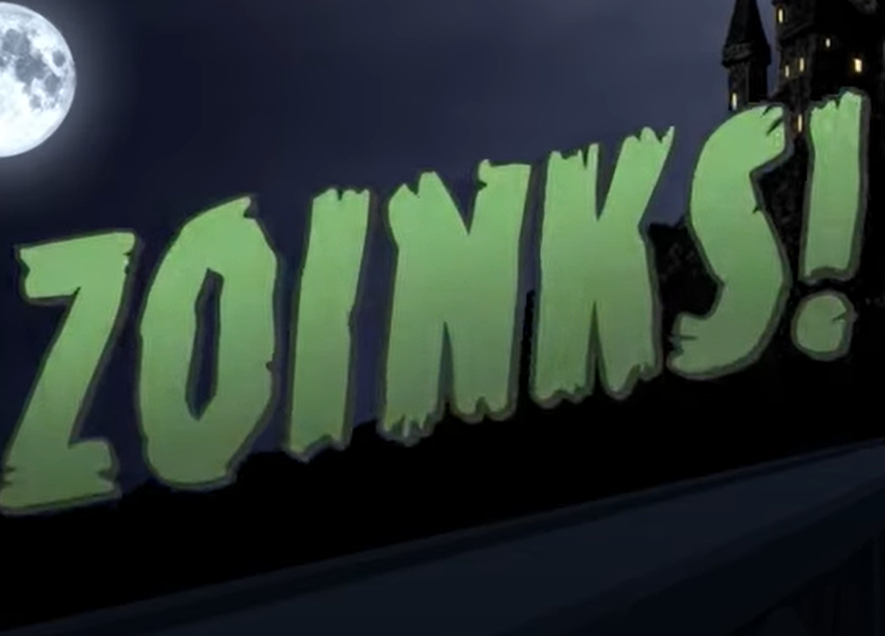
Notes:
BM: “Zoinks.” There is a lot of risk here. I think I want counsel to attend that Board meeting.

Slide 20


Wow. I’m just glad the SEC isn’t looking into this.
Notes:
BM: Wow. I’m just glad the SEC isn’t looking into this.

Slide 21

US Securities and Exchange Commission Division of Enforcement –
Reaction to the SPAC Boom
Paul, Weiss, Rifkind, Wharton & Garrison LLP
Month Year
Paul, Weiss, Rifkind, Wharton & Garrison LLP
Notes:
PART 3 START

Slide 22
In response to the SPAC boom, which took off in late 2020,
the SEC has issued a string of pronouncements acutely focused on SPAC risks:
PRIVILEGED AND CONFIDENTIAL ATTORNEY WORK PRODUCT
-- investor releases;
-- disclosure guidance;
-- accounting guidance; and,
-- staff guidance.
On July 13, 2021, the SEC initiated its first Enforcement action of the SPAC boom charging a SPAC, its sponsor, its proposed merger target, and the CEOs of the SPAC and its target – In the Matter of Momentus, Inc.
Paul, Weiss, Rifkind, Wharton & Garrison LLP
Month Year
Paul, Weiss, Rifkind, Wharton & Garrison LLP

Slide 23
The SPAC – Stable Road Acquisition Corp – completed its public offering in November 2019
The SPAC was required to complete a business combination in 18 months
The SPAC’s CEO was also one of three managing members of the SPAC sponsor, SRC-NI Holdings
On October 7, 2020 the SPAC announced a merger with Momentus, an early-stage space transportation company
On the same day, the SPAC raised $175 million of capital by entering into subscription agreements with PIPE investors in exchange for shares in the merged company after the business combination was approved

Slide 24
The SEC charged that the SPAC issued false and misleading disclosures in its initial Form S-4 and two amendments, which contained a combined proxy statement/consent solicitation statement/prospectus, which were in preliminary form, not yet declared effective or mailed to shareholders
According to the SEC, Momentus claimed that its propulsion technology had been successfully tested in space – In fact, the SEC alleged, its sole in-space test suggested that the technology lacked commercial potential
According to the SEC, Momentus misled investors about its CEO’s ability to obtain essential licenses by downplaying known national security concerns about him.

Slide 25
Momentus agreed to settle scienter-based securities fraud charges
(on a neither admit nor deny basis) and its CEO is litigating scienter based charges
The SPAC, its sponsor and its CEO settled negligence-based charges for failing to perform reasonable due diligence (also neither admitting nor denying the charges)
The SPAC and Momentus agreed to offer every PIPE investor the right to terminate Its subscription agreement
The SPAC sponsor agreed to forego 250,000 founders shares that it would have been entitled to upon shareholder approval of the business combination
Momentus also agreed to retain an independent compliance consultant to review Its ethics and compliance programs and issue a written report to the SEC with findings and recommations
The SPAC and CEO also agreed to pay penalties of $1 million and $40,000

Slide 26
SEC Chairman Gary Gensler took the unusual step of commenting on the Enforcement action in the SEC’s press release:
“This case illustrates risks inherent to SPAC transactions, as those who stand to earn significant profits from a SPAC merger may conduct inadequate
due diligence and mislead investors. . . . Stable Road, a SPAC, and its merger Target, Momentus, both mislead the investing public. The fact that Momentus lied to Stable Road does not absolve Stable Road of its failure to undertake adequate due diligence to protect investors.”

