Slide 1
Background on Exhaustion (January 15, 2019)
Philip Schwartz
philip.schwartz@uspto.gov
Slides used and adapted with permission from Patrick J. Coyne

Slide 2
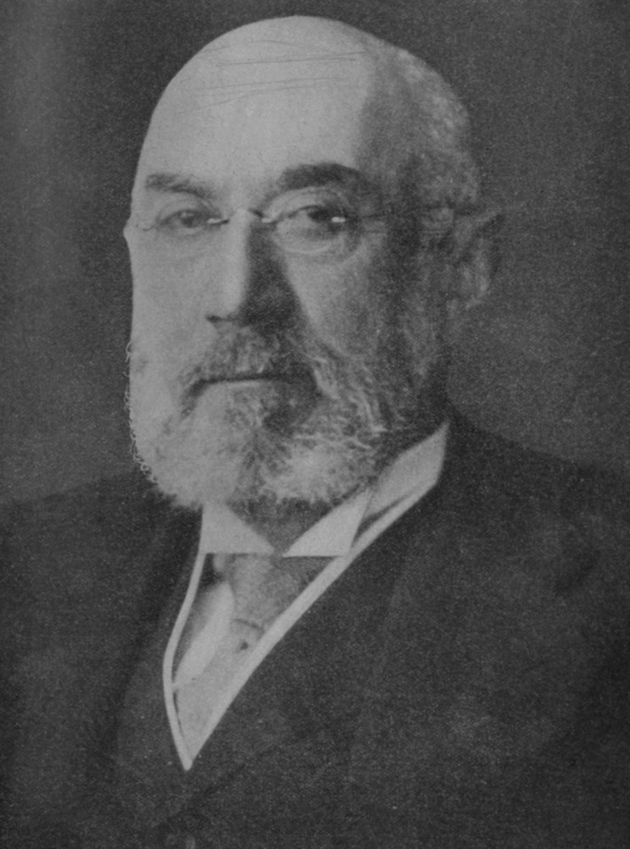
First Sale
Bobbs-Merrill Co. v. Straus, 210 U. S. 339 (1908)
First sale exhausts the exclusive rights in that copy of the work

Slide 3
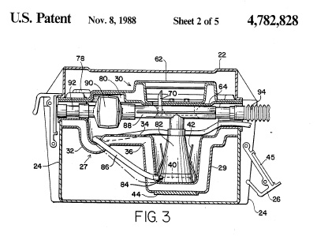
Mallinkrodt
Post-sale restrictions upheld in spite of contrary Supreme Court authority
Mallinckrodt, Inc. v. Medipart, Inc., 976 F.2d 700 (Fed. Cir. 1992)

Slide 4
Quanta
Patent license language insufficient to create limited license and avoid effect of exhaustion doctrine.
Quanta Computer, Inc. v. LG Electronics, Inc., 553 U.S. 617 (2008)

Slide 5
Quanta
Exhaustion doctrine applies to method claims and to authorized sale of article that substantially embodies claimed invention.
Quanta Computer, Inc. v. LG Electronics, Inc., 553 U.S. 617 (2008)

Slide 6
Kirtsaeng
International sale exhausts exclusive rights in the copy of the work that is sold
Kirtsaeng v. John Wiley & Sons, Inc., 568 U.S. 519 (2013)

Slide 7
Outside of the EU and before Lexmark, no country imposed international patent exhaustion

