Slide 1
Criminal Justice Reform in Virginia
George Mason American Inn of Court
November 20, 2019
Team Members: Erin Blanch, Tim Davis, Paul Hayden, Lindsay Greene, Joshua Grossman, Matthew Kapuscinski, Bryan Kennedy, Rich Licarai, Ryan Reynolds

Slide 2
Key Themes in Reform Efforts
Decarceral
Evidence based
Anti-racist
Reforms have been adopted all over the country, including leading states like
Texas
South Carolina
Oklahoma…

Slide 3
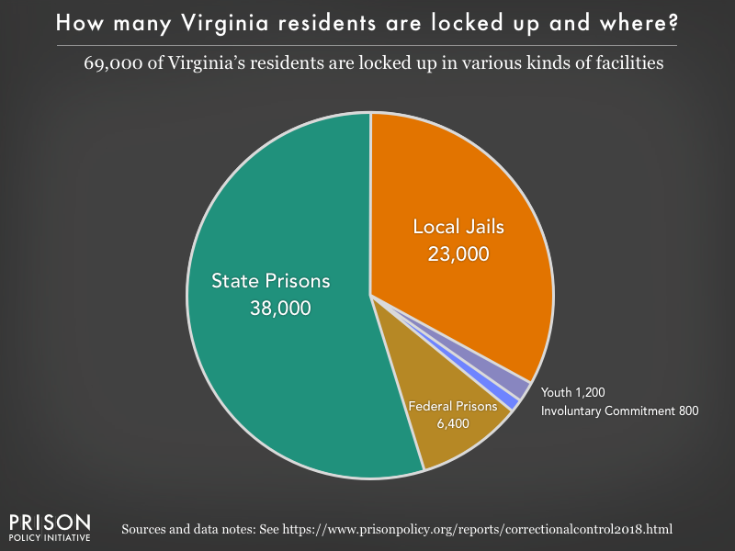

Slide 4
Causes of Mass Incarceration
Alexander Model
- The War on Drugs, staring mainly under the Nixon Administration, is responsible for the rise in mass incarceration.
- This, and the proliferation of non-violent felony offenses, has had a disproportionate impact on the black community.
-Reform needs to start with non-violent offense and the over policing of minority communities.
Pfaff Model
- Violent offenses are the ones driving mass incarceration, not the War on Drugs
- The issue is the increasing longer sentences that are being given for these offenses
- Longer sentences do not make anyone safer (and they might make people less safe)
- Start with sentencing reform (mandatory minimums, parole, etc.)

Slide 5
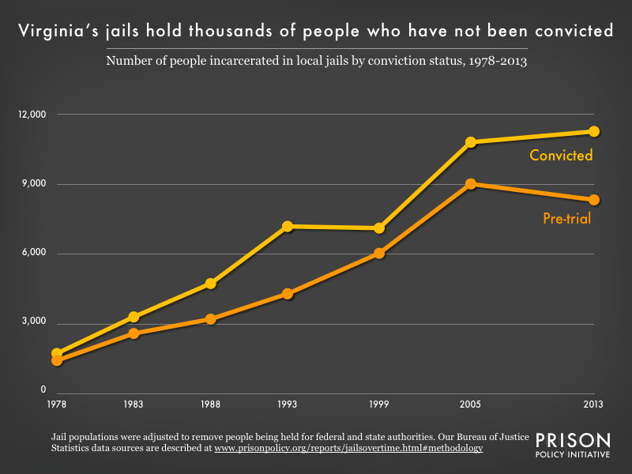

Slide 6
Really expensive
Over 220 dollars per day to have someone stay at Fairfax ADC
Approximately 25,000 dollars for a year in VA DOC
Budget for incarceration is around 1.5 billion per year (just jail and prison operation)

Slide 7
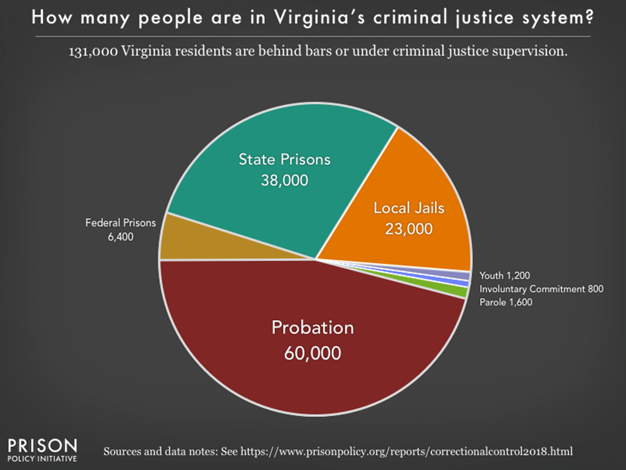
It is about more than incarceration

Slide 8
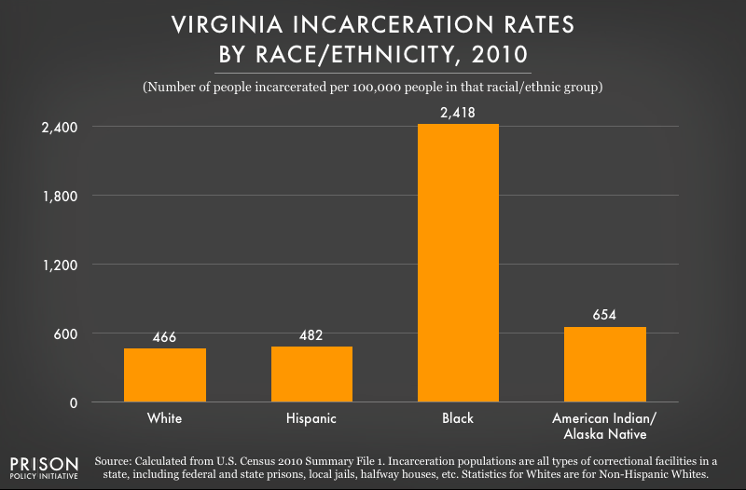
Race and Criminal Law in Virginia

Slide 9
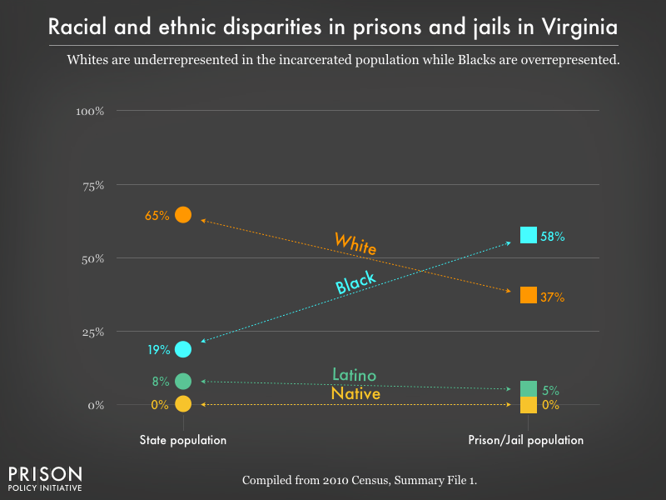

Slide 10
RACIAL DISPARITIES IN FAIRFAX ADC

Slide 11
Data Collection, Knowledge of Bias
Marijuana Arrest disparity
  Arlington: Black rate of arrest per 100k is 8.1x the white rate
  Fairfax: Black rate of arrest per 100k is 3.2x the white rate
- Problem is not overt racism
- Florida leading the way in data collection efforts

Slide 12
Hot topics in Criminal Legal Reform
Bail Reform
Restorative Justice
Court appointed Counsel
Criminalization of Poverty
Conditions of confinement
Death penalty litigation
Misdemeanor reform
Parole
Community/ police interactions
Juvenile Justice Reform

Slide 13
Suggested Reading
Ordinary Injustice- Amy Bach
Punishment without Crime- Alexandra Natapoff
Charged- Emily Bazelon
The New Jim Crow- Michelle Alexander
Locked In- John Pfaff
Let’s get Free- Paul Butler
Slavery by Another Name- Douglas Blackmon
Stamped from the Beginning- Ibram X. Kendi
Faces at the Bottom of the Well- Derrick Bell

Slide 14
Restorative Justice

Slide 15
What is Restorative Justice?
Restorative justice views crime as more than breaking the law – it also causes harm to people, relationships, and the community, and attends to these three players. Accordingly, restorative justice seeks to elevate the role of crime victims and community members; hold offenders directly accountable to the people they have harmed; and restore, to the extent possible, the emotional and material losses of victims by providing a range of opportunities for dialogue, negotiation, and problem solving.
Notes:
“Crime victims have traditionally been given virtually no legal standing in the process of doing justice in American courts, even though the justice system exists because individual citizens have been hurt by criminal behavior. Victims of crime feel increasingly frustrated and alienated by the current system of justice. The crime is against "the state" and state interests drive the process of doing justice. Individual crime victims are left on the sidelines with little, if any, input.”
https://www.encyclopedia.com/social-sciences-and-law/law/law/restorative-justice
Restorative justice provides an entirely different way of thinking about crime and victimization. Under previous criminal justice paradigms the state was viewed as the primary victim of criminal acts, and victims and offenders played passive roles. Restorative justice recognizes crime as first and foremost being directed against individual people. It assumes that those most affected by crime should have the opportunity to become actively involved in resolving the conflict. The emphasis is on restoration of losses, allowing offenders to take direct responsibility for their actions, and assisting victims in moving beyond their sense of vulnerability and achieving some closure.
It also recognizes that crimes harm not only victims, but offenders as well – causing huge damage to their relationships, and the community around them.
https://www.encyclopedia.com/social-sciences-and-law/law/law/restorative-justice
Widely starting to be considered and implemented for juvenile justice programs.
http://restorativejustice.org/restorative-justice/about-restorative-justice/tutorial-intro-to-restorative-justice/lesson-1-what-is-restorative-justice/#sthash.X1LYocEm.dpb
https://charterforcompassion.org/restorative-justice/restorative-justice-some-facts-and-history

Slide 16
Concepts of Restorative Justice
To have restorative justice , the process needs:
Repair the harm that the crime caused to justice
Reconciliation between the Victim and Offender
Enable the offender to make life changes to reduce the chance they will offend again
Notes:
Since restorative justice is not just about broken laws, but broken lives. This means that simple punishment isn’t enough to solve the problem; any particular crime is the product of a complex web of causes, and simply giving fair punishment doesn’t do anything to address those causes. By getting to the root of the problem and attempting to transform the persons responsible for the crimes, another benefit of restorative justice is that it seeks to right not only the immediate wrongs, but the wrongs that made the crime possible in the first place.
https://www.restorativepartners.org/blog/restorative-justice-how-does-it-work.php
Restorative Justice requires three important things to happen
First, you need to repair the harm that the crime caused to justice – this refers to the fact that the crime needs to be punished and to restore justice. How can the victim and the community be restored?
Next, Acknowledging that crime causes broken relationships, in a way which can lead to further crime in the future and the victim and offender need the opportunity to reconcile
Third, you need to enable offenders to transform their lives for the better, restoring the balance in relationships and communities, and making it less likely that they will reoffend.
https://www.restorativepartners.org/blog/restorative-justice-how-does-it-work.ph

Slide 17
What does Restorative Justice Look Like?
Victim and offender agree to engage in restorative justice
Open discussions between the victim(s) and offender about how their crime has caused harm.
Victim Offender Mediation in which the participants include the victim, offender, and facilitator.
Group activities, such as support groups and accountability circles, to help the healing of both the victim and offender and promote understanding.
Legal Awareness that can help offenders (often times young) understand the legal repercussions of their crimes so that they understand the consequences, both presently and for potential future crimes.
Notes:
Restorative justice views offenders as individuals who can make amends, transform into better people, reconcile with their victims, and eventually re-establish a functional and working relationship with friends, family, and their society at in general. In practice restorative justice may look something like this.
If both the victim and offender agree to engage in restorative justice, they may engage in things like:
Agreement to engage in the process Making a restorative justice session happen requires the agreement of all parties, but most states require that the process be initiated by the victim. “Take the family of a homicide victim,” “When someone is murdered, a whole bunch of crime victims are created by that act. It should be their choice to talk to the offender, not the offender’s choice to talk to the victims. https://www.pbs.org/newshour/nation/states-consider-restorative-justice-alternative-mass-incarceration
An Open Discussion. Where the offenders meets with their victims and are given a chance to understand the exact ways in which their actions have caused harm. By openly discussing the impact of a crime, offenders are required not only to suffer for their crimes, but to understand how others have suffered too.
Victim Offender Mediation in which the participants include the victim, offender, and facilitator. The face-to-face meeting is centrally focused on the victim and the offender, accompanied by a small number of support persons (such as parents or friends).
Group Activities. Restorative justice programs also include activities where offenders, their victims, and support groups (if they’re available), engage in a number of activities together. This helps promote a sense of belonging and understanding.
Legal Awareness. A number of offenders (often young offenders, or juveniles) are unaware of the legal repercussions of their crimes. Restorative justice programs might try to help them understand the law, so they know what consequences their actions can have.
Educational Programs. Promoting academic awareness plays a part in most restorative justice programs, particularly when it comes to juvenile offenders. Youth are exposed to regular school programs, and receive aid with schoolwork. As an investment of time in their lives, this can be a powerful sign that they are worth investing in; leading them to reconsider their lives and choose a different path.
https://www.restorativepartners.org/blog/restorative-justice-how-does-it-work.php
https://charterforcompassion.org/restorative-justice/restorative-justice-some-facts-and-history

Slide 18
Consider the case of Rikki Spector
Two boys car jacked Baltimore City Councilwoman Rikki Spektor. They punched her in the face, called her a name, and threw her into a concrete pillar before stealing her car.
https://www.baltimoresun.com/opinion/op-ed/bs-ed-op-0125-restorative-justice-20180124-story.html
Notes:
Can either tell about the story or play the two minutes of the clip about the car jacking and the restorative justice that Spector used with the teens.

Slide 19
Concerns about Restorative Justice
Does it actually work?
Does it just let people “off the hook” for their crimes?
Can the victim actually forgive and work with the offender?
If we let the offender off that easy, will they commit more crimes?
Are these programs expensive to put on?
"Oh, OK, so we're not going to prosecute you? We're going to sit around in a circle with, like, the hippies down the hallway, and we're going to have a talk and then you don't have any punishment?” - DC Prosecutor Erika Clark on her first reaction to a restorative justice proposal
Notes:
Although these concerns are legitimate. This is not what has been playing out in practice
https://www.npr.org/2019/07/02/735506637/d-c-prosecutors-once-dubious-are-becoming-believers-in-restorative-justice

Slide 20
Why use Restorative Justice?
Research is indicating that it is effective!
Reduces recidivism
  Systematic analysis of studies of restorative juvenile justice programs and practices showed a moderate reduction in future delinquent behavior relative to more traditional juvenile court processing.
It helps address the multifaceted harms that a crime may have caused.
  Victim participants in these programs appear to experience a number of benefits and are more satisfied with these programs than traditional approaches to juvenile justice.
Studies show restorative practices not only promote healing but also reduce offender recidivism, which saves the state $8 for every $1 spent.
Notes:
Since the Restorative justice program in DC has been implemented and proven some early success, Prosecutor Clark now says that she is referring some of the most serious cases on her docket into the program, including one involving a transit police officer who tore his rotator cuff and strained his knee trying to apprehend a teenager fighting on a subway platform.
https://www.npr.org/2019/07/02/735506637/d-c-prosecutors-once-dubious-re-becoming-believers-in-restorative-justicerm.
Statistics:
according to Lawrence Sherman, professor at the University of Maryland. https://www.baltimoresun.com/opinion/op-ed/bs-ed-op-0125-restorative-justice-20180124-story.html
https://www.ncjrs.gov/pdffiles1/ojjdp/grants/250995.pdf
Although restorative justice may not be appropriate for every crime, such as sexual assaults or frequently violent crimes, it can be very effective in many cases at providing a more just resolution to the offender, victim, and community.
It can also be used years after the crime and whatever punishment to give the offender and victim an opportunity to dialogue about the harm that has been caused to give both parties a sense of reconciliation and healing.

Slide 21


BAIL REFORM
Matt Kapuscinski and Joshua Grossman

Slide 22
Overview
Following an arrest, a person’s ability to leave jail and return home pending trial often depends on money.
Many defendants are released on personal recognizance or pretrial supervision pending trial.
However, in Virginia and most states, bail bonds are often set for defendants in effort to ensure their presence at trial and to assure their good behavior pending trial.
If a defendant cannot afford to pay the bond with the Court or pay a nonrefundable fee to a bail bond company, he or she remains in jail until the case is resolved.
Incarceration data reflects that this system disproportionately affects poor, minority, and rural defendants, leaving many stuck in jail awaiting trial, sometimes for months or years, and raises serious constitutional, statutory and policy concerns.

Slide 23
Virginia Statutes
Virginia Code § 19.2-120(A)
“A person who is held in custody pending trial or hearing for an offense, civil or criminal contempt, or otherwise shall be admitted to bail by a judicial officer, unless there is probable cause to believe that:
    1. He will not appear for trial or hearing or at such other time and place as may be directed, or
    2. His liberty will constitute an unreasonable danger to himself or the public.”
Virginia Code 19.2-120(B)
The general presumption in favor of bail does not apply to, inter alia, acts of violence (murder, robbery, kidnapping, malicious wounding, arson), offenses in which the maximum sentence is life imprisonment or death, certain drug offenses, certain firearm offenses, certain sexual offenses, and felonies committed on release pending trial.

Slide 24
Virginia Statutes Cont.
  “Bail” is defined as “the pretrial release of a person from custody upon those terms and conditions specified by order of an appropriate judicial officer.” Va. Code § 19.2-119.
  “If the person is admitted to bail, the terms thereof shall be such as, in the judgment of any official granting or reconsidering the same, will be reasonably fixed to assure the appearance of the accused and to assure his good behavior pending trial.” Va. Code § 19.2-121.
  Virginia law requires the judicial officer to take into account multiple factors, including “the financial resources of the accused or juvenile and his ability to pay bond.” Va. Code § 19.2-121.
  “Bond” is defined as “the posting by a person or his surety of a written promise to pay a specific sum, secured or unsecured, ordered by an appropriate judicial officer as a condition of bail to assure performance of the terms and conditions contained in the recognizance.” Va. Code § 19.2-119.

Slide 25
Virginia Statutes Cont.
When a judicial officer determines that release on the defendant’s unsecured promise (recognizance) will not assure appearance at trial, the judicial officer “may impose any one or any combination of the following conditions of release:”
  Placing the defendant in the custody and supervision of a designated person, organization or agency;
  Restricting travel, association or place of abode during pretrial release;
  Requiring the execution of a secure bond or the deposit of cash;
  Requiring the defendant to maintain employment or an educational program, avoid contact with the victim or potential witnesses, comply with a curfew, refrain from possessing a firearm or weapon, and refrain from illegal drug use or excessive alcohol consumption, or submit to drug testing; or
  Imposing any other condition the officer believes is reasonably necessary to assure the appearance of the defendant.
Va. Code § 19.2-123.

Slide 26
Virginia
The Virginia State Crime Commission (VSCC) is currently conducting a comprehensive study of the pre-trial process, including the bail bond system.
In October 2018, Virginia’s Attorney General Mark Herring called for reforms to Virginia’s cash bail system citing constitutional and policy concerns.
In the meantime, local prosecutors and judges have begun to institute reforms in their communities. For example,
  In April 2018, Richmond Commonwealth’s Attorney Mike Herring announced that prosecutors in his office would no longer seek cash bail bonds for defendants awaiting trial.
    In the same year, Fairfax County Circuit Court Judge David Bernhard stopped setting cash bonds for defendants awaiting trial.

Slide 27
Virginia Cont.
In 2005, Virginia implemented the Virginia Pretrial Risk Assessment Instrument (VPRAI) to help pretrial services objectively calculate a defendant’s likelihood of failure to appear and level of danger to society. The tool consists of eight factors that are weighted to create a risk score, and defendants eligible for bail are then assigned to one of five risk levels ranging from low to high.
As of 2017, 74% of Virginia’s localities (99 of 134) were served by pretrial services. Encouraging pretrial services in all Virginia localities will help assure that the VPRAI is properly utilized and that judicial officers making bail decisions consider the recommendation of pretrial services throughout the Commonwealth.

Slide 28
Current Reforms in Other States
State legislatures and city councils are eliminating the use of cash bail, judges and prosecutors are instituting reforms in local jurisdictions, and courts are striking down existing bail systems as unconstitutional.
ATLANTA:
  With the backing of Atlanta Mayor Keisha Bottoms, the City Council approved an ordinance in February 2018 to eliminate the cash bail requirement in municipal court for nonviolent misdemeanor charges or city ordinance violations.
CALIFORNIA:
  The California Money Bail Reform Act, which would have eliminated money bail and replaced it with an assessment of defendants’ risk to public safety, was signed by Governor Jerry Brown on August 28, 2018, and would have gone into effect on October 1, 2019. However, a successful referendum in the state has now placed the issue on the ballot for voters in the November 2020 election.

Slide 29
Current Reforms in Other States Cont.
CHICAGO:
  In 2017, a Cook County judge issued an order requiring Chicago judges to consider a defendant’s ability to pay before setting bail. A 2019 report showed that the number of inmates at Cook County jail dropped by more than 1,600 in the 15 months following the order. The data also shows that the average bond amount fell from $5,000 to $1,000, while the percentage of inmates picking up new charges while on bond dropped slightly, the report states. Violent crime in Chicago dropped 8% during same period, according to crime data reported to the FBI, the report states.

Slide 30
Current Reforms in Other States Cont.
HOUSTON:
  In April 2017, a federal judge put a pause on Houston’s use of its bail system, which it considered probably unconstitutional. [ODonnell v. Harris County]
    The Fifth Circuit largely upheld this decision, recognizing the two-tiered system of justice in Houston, although it allowed the county to take up to 48 hours after the arrest to provide the defendants with a hearing.
NEW YORK:
  In New York, the state Legislature eliminated cash bail for most misdemeanor and non-violent felony offenses. The law goes into effect in January 2020. Once enacted, most people charged with misdemeanor and non-violent felonies will be automatically released.

Slide 31
Where Can We Go From Here?
1. Involve Stakeholders at Every Stage of Reform
2. Limit Pretrial Detention
3. Eliminate Money Bail
4. Optimize Pretrial Services
5. Tread Carefully with Risk Assessment Tools

Slide 32
Involve Stakeholders at Every Stage of Reform
A hallmark of successful reforms has been the repeated, consistent involvement of a broad range of stakeholders, including judges, prosecutors, public defenders, law enforcement, civil rights and civil liberties groups, community organizations, and people from communities that are most impacted by the criminal justice system.
Across jurisdictions, a key to success has been the consensus-building value of in-person meetings of diverse stakeholders with different viewpoints, goals, and experiences. Stakeholders and the public should also be given the opportunity to learn about the harms of the money bail system, the feasibility of reform, and the effectiveness of pretrial systems that maximize release and minimize unnecessary release conditions.

Slide 33
Limit Pretrial Detention
The Supreme Court affirmed over thirty years ago that “in our society, liberty is the norm, and detention prior to trial or without trial is the carefully limited exception,” United States v. Salerno, 481 U.S. 739, 755 (1987).
In the United States, every person is presumed innocent until proven guilty. Consistent with that principle, jurisdictions should implement strong procedural protections in favor of release pending trial.
Jurisdictions may consider the requirement that prosecutors meet a certain evidentiary burden (such as “clear and convincing evidence”) in order to detain a defendant or impose restrictive conditions of release.
Because even short stays in jail can cause outsized harm to the accused, their families, and the broader community, release decisions should be made within 24 hours of arrest, and defense counsel should be appointed as early as possible to ensure that judges make informed release decisions.

Slide 34
Eliminate Money Bail
The Eighth Amendment to the United States Constitution and Article I of the Virginia Constitution both prohibit the use of “excessive bail.” U.S. Const. amend. VIII (“Excessive bail shall not be required, nor excessive fines imposed, nor cruel and unusual punishments inflicted.”); Va. Const. art. I § 9 (“That excessive bail ought not to be required, nor excessive fines imposed, nor cruel and unusual punishments inflicted[.]”).
The Equal Protection Clause of the Fourteenth Amendment also protects against this type of wealth based discrimination.
As described in this presentation, many jurisdictions have eliminated money bail as a condition of release, at least for low-risk, non-violent offenders, in an effort reduce disparities in how wealthy and indigent defendants are treated in connection with bail determinations.

Slide 35
Optimize Pretrial Services
As jurisdictions strive to release more people pending trial, they should adopt pretrial interventions that work and reject interventions that overburden defendants without significant benefits to public safety or court appearance rates.
Conditions of release that infringe on a person’s liberty should be narrowly tailored and relate to specific, individualized concerns (such as mental health or drug treatment).
Pretrial services should be fully funded by the government and the accused should not be forced to pay a “user fee” to pay for pretrial services or monitoring.
Phone and text message reminders can be a cost-effective means of increasing court appearance rates.

Slide 36
Tread Carefully with Risk Assessment Tools
Most jurisdictions have adopted algorithmic risk assessment tools (such as the VPRAI) meant to help magistrates and judges better predict the risk of releasing a defendant pending trial.
  Risk assessment tools use historical data to assess a particular defendant’s risk level based on the rate at which people with similar characteristics were arrested or missed court dates while on pretrial release. Many of these tools then offer a release recommendation based on that score.
However, risk assessment instruments are not required for meaningful bail reform, and any jurisdiction that contemplates adopting risk assessment tools should consider that pretrial risk assessment tools do not guarantee lower pretrial incarceration rates or more equal treatment, and the use of historical criminal history data that powers risk assessments may be biased given that research reveals that black and Latino individuals are more likely than white individuals to be arrested, prosecuted, convicted, and sentenced to harsher punishments for the same conduct.

Slide 37

Criminal Justice Reform:
Compensation for Court Appointed Counsel

Slide 38
Introduction
As decided in Gideon v. Wainwright 372 U.S. 335, 342 (1963) the 6th Amendment to the Constitution guarantees indigent defendants the right to representation in criminal cases.
Today, this constitutional requirement is met by both:
  Public Defenders
  Court Appointed Counsel

Slide 39
Public Defenders and Court Appointed Counsel
In Virginia, the Virginia Indigent Defense Commission (VIDC) protects the constitutional right to counsel for those who are indigent.
VIDC Overview:
  Established in 2004 replacing the Public Defenders Commission
  Supervises 24 public defenders offices across Virginia including four capital defenders offices
  Develops initial training courses for attorneys who wish to begin serving as court-appointed counsel, and to review and certify legal education courses that satisfy the continuing requirements for attorneys to maintain their eligibility for receiving court appointments.
  Statutory authority: § 19.2-163.01.
Notes:
Source:
http://www.vadefenders.org/about-us/
Law:
https://law.lis.virginia.gov/vacode/title19.2/chapter10/section19.2-163.01/

Slide 40
Process to Attain Court Appointed Counsel
The determination of the right to court-appointed counsel is made prior to the trial if no determination was made in a pre-trial procedure.
The judge will appoint a lawyer to represent the accused at public expense if the person indicates he is indigent and completes the required paperwork.
    DC-334, REQUEST FOR APPOINTMENT OF A LAWYER
    DC-333, FINANCIAL STATEMENT - ELIGIBILITY DETERMINATION FOR INDIGENT DEFENSE SERVICES.
Once the decision is made to give court appointed counsel, the court must determine counsel to represent the defendant:
  Per Va. Code § 19.2-159
    "Except in jurisdictions having a public defender, or unless (i) the public defender is unable to represent the defendant by reason of conflict of interest or (ii) the court finds that appointment of other counsel is necessary to attain the ends of justice, counsel appointed by the court for representation of the accused shall be selected by a fair system of rotation among members of the bar practicing before the court whose names are on the list maintained by the Indigent Defense Commission pursuant to § 19.2-163.01.”
Notes:
Laws:
https://law.lis.virginia.gov/vacode/title19.2/chapter10/section19.2-159/
https://law.lis.virginia.gov/vacode/title16.1/chapter11/section16.1-266/
Forms:
https://www.vbgov.com/government/departments/courts/juvenile-domestic-relations-court/Documents/court-forms/dc334instr.pdf
http://www.courts.state.va.us/forms/district/dc333.pdf
General information:
http://www.courts.state.va.us/courtadmin/aoc/djs/resources/manuals/ctapptatty/chapter02.pdf

Slide 41
Indigent Defense: Court Appointed Counsel vs. Public Defender
Large circle is indigent defense
Public Defender office are salaried positions
Some PD offices in the state have investigators, sentencing advocates, and administrative staff
Private attorneys who accept court appointed work representing persons charged with crimes who can’t afford an attorney are paid by the state at a fixed hourly rate with a fee cap
private attorneys appointed by the Court
Public Defenders

Slide 42
Quick Quiz

Slide 43
What is the hourly rate for court appointed work?

Slide 44
$90

Slide 45
What is the fee cap for misdemeanor cases?

Slide 46
$120

Slide 47
What is the fee cap for felony cases when the maximum punishment is 20 years or less?

Slide 48
$445

Slide 49
What is the fee cap for a felony when the punishment is more than 20 years?

Slide 50
$1235

Slide 51
What is the fee cap for a petition of appeal to the Virginia Court of Appeals for all felony cases?

Slide 52
$400 (+$100 for oral argument)

Slide 53
If petition is granted and the case is heard on the merits by the Virginia Court of Appeals, what is the total fee cap for all felony cases?

Slide 54
$725

Slide 55
Compensation for Court Appointed Counsel (VA)
According to a 2004 ABA report conducted by the Spangenberg Group, Virginia’s caps on court-appointed compensation placed its fees as the lowest in the nation.
Statutory Authority: § 19.2-163. Compensation of court-appointed counsel.
As set by the Supreme Court of Virginia, Hourly Rate: Up to $90
Fee Caps:
General District Court: Misdemeanors, Felony preliminary hearings where the felony is not resolved in the district court. | $120
Circuit Court Misdemeanor | $158
General District Court or Circuit Court: Felony with more than 20 years | $1,235.00
General District Court or Circuit Court: Other Felonies | $445
Notes:
Data: http://www.vadefenders.org/wp-content/uploads/2019/09/2019-VIDC-Annual-Report.pdf
$90 Dollar :http://www.courts.state.va.us/courtadmin/aoc/fiscal/chart.pdf

Slide 56
Fee Caps for Court Appointed Counsel on Appeal
Statutory Authority: § 19.2-326. Payment of expenses of appeals of indigent defendants.
Supreme Court of Virginia has a complex system of compensation.
Virginia Court of Appeals has a much clearer fee structure:
Source: Virginia Independent Defense Commission 2019 Annual Report
Writ Stage | Misdemeanor: $300 Felony: $400 + $100 (oral argument)
Total (Including Merit Stage) | If Misdemeanor: $625 If Felony: $725 If rehearing en banc: Additional $200
Notes:
Data
:http://www.vadefenders.org/wp-content/uploads/2019/09/2019-VIDC-Annual-Report.pdf
Statute:
https://law.lis.virginia.gov/vacode/title19.2/chapter19/section19.2-326/

Slide 57
Fee Cap Waivers
Statutory Authority: § 19.2-163. Compensation of court-appointed counsel.
Virginia law also allows for second level waivers in certain cases.
  “If at any time the funds appropriated to pay for waivers under this section become insufficient, the Executive Secretary of the Supreme Court of Virginia shall so certify to the courts and no further waivers shall be approved.” - § 19.2-163.
Misdemeanors or Juvenile cases in General District Court | Up to an additional $120
Class 2 Felony For Juveniles | Up to an additional $850
Felony Charges With a Penalty of 20 Years or More | Up to an additional $850
Other Felonies | Up to $155 with approval of the judge
Notes:
Data: http://www.vadefenders.org/wp-content/uploads/2019/09/2019-VIDC-Annual-Report.pdf
Statute: https://law.lis.virginia.gov/vacode/title19.2/chapter10/section19.2-163/

Slide 58
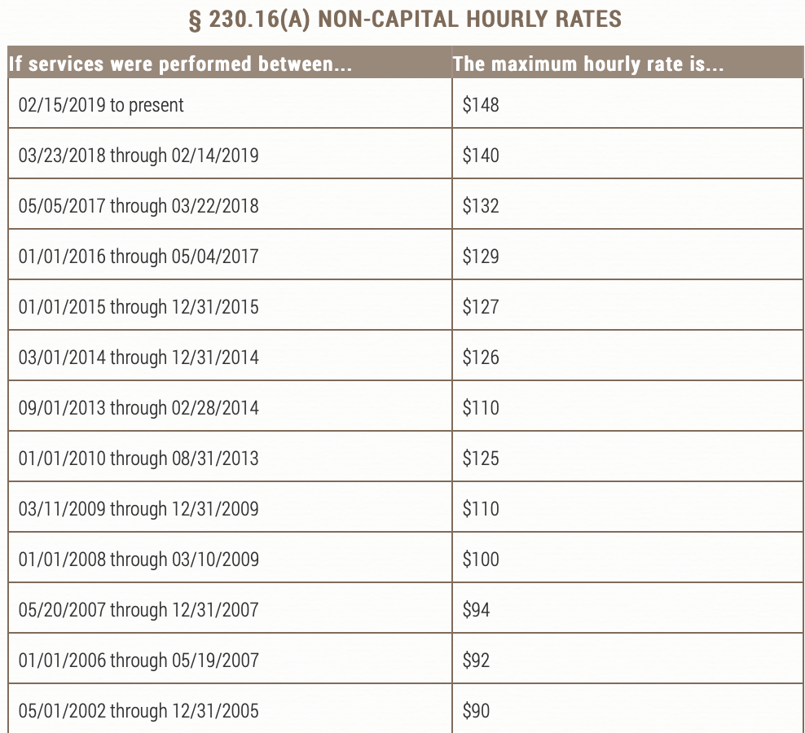
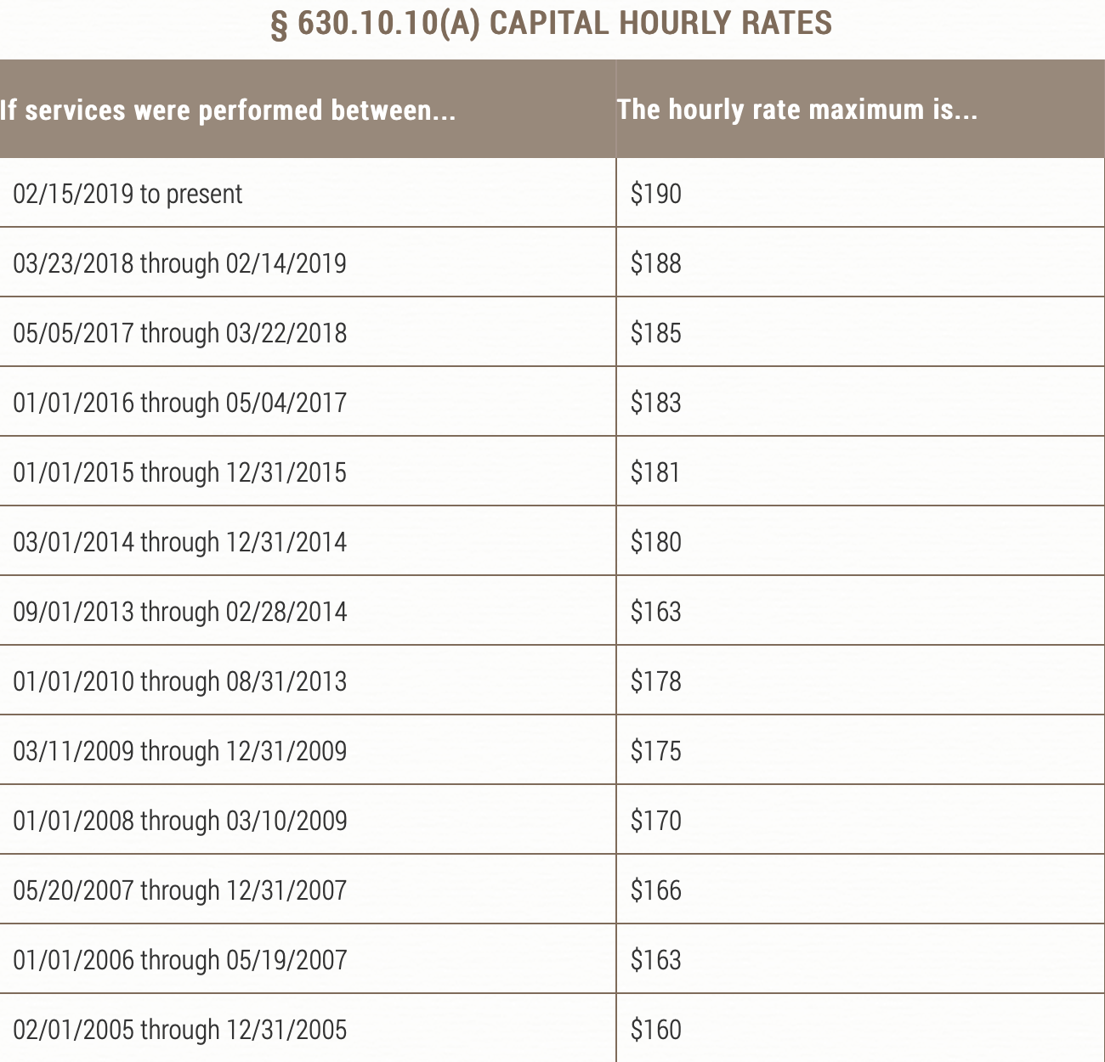
Compensation In Federal Courts
Notes:
https://www.uscourts.gov/rules-policies/judiciary-policies/cja-guidelines/chapter-2-ss-230-compensation-and-expenses#a230_23

Slide 59
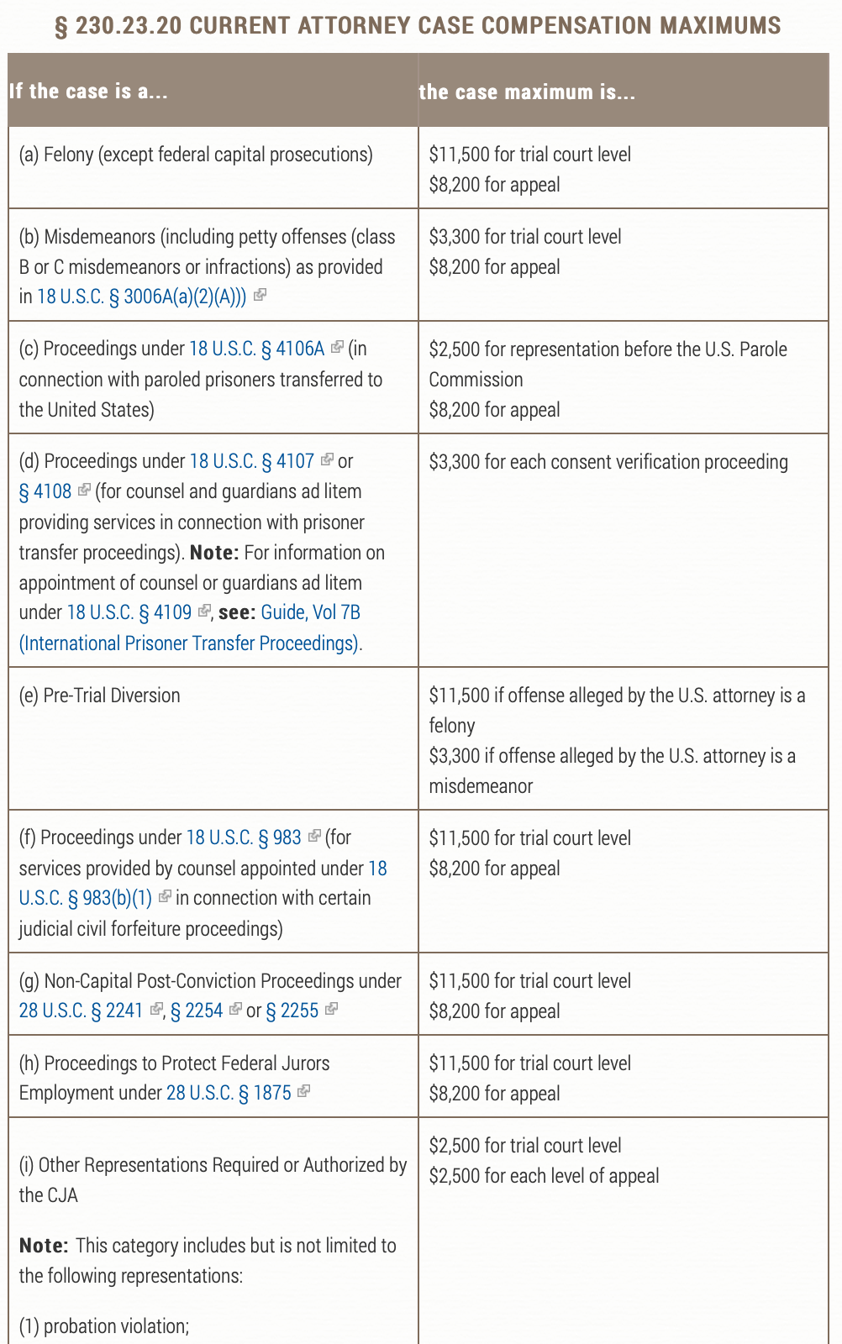
Federal Fee Caps
Notes:
https://www.uscourts.gov/rules-policies/judiciary-policies/cja-guidelines/chapter-6-ss-630-compensation-appointed-counsel#a630

Slide 60

COMPARISON

Slide 61
How Do We Match Up?
Source: Virginia Independent Defense Commission 2019 Annual Report
State | Compensation | Fee Cap
West Virginia | $80: In-Court $60: Out-of-Court | Felony with chance of life imprisonment: Judge’s discretion All other felonies: $3000
Maryland | $127 | District court: Federal Misdemeanor Circuit Court/Juvenile Court: Federal Felony
Delaware | $60: In Superior Court $50: In Supreme Court | Felony: $2000 (per attorney) Misdemeanors: $1000 (per attorney)
Pennsylvania | Set by court | Set by court
New York | $75: Felony both in and out of court $60: Misdemeanor in and out of court | Felony: $4,400 Misdemeanor: $2,400
California | Varies | Varies
Notes:
Current Maryland Pay:
https://www.mdd.uscourts.gov/panel-applicant-information
Data:
http://www.vadefenders.org/wp-content/uploads/2019/09/2019-VIDC-Annual-Report.pdf

Slide 62
Discussion: Implications?
Quality of Representation
  Misdemeanor
  Felony
  Appeals
Unpredictable Workload
  Even cases with the exact same crime charged can vary widely on hours spent
Results:
  Less effective representation
  Longer sentences
  Inequity based on economic circumstance of defendant

Slide 63
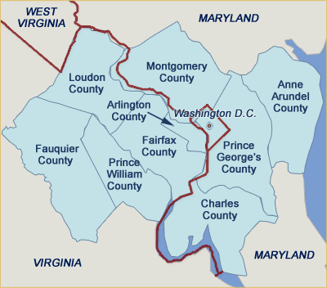
Notes:
https://www.pinterest.com/pin/90775748713555497/?lp=true

Slide 64
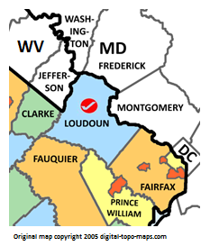
Commonwealth Attorney: Loudoun County
Buta Biberaj (Democrat)
  Platform
    Eliminate referrals of low-level nonviolent offenses to Juvenile Court Services Unit.
    Discovery reform
    Facilitate greater victim assistance
Notes:
https://www.familysearch.org/wiki/en/Loudoun_County,_Virginia_Genealogy
Info:
https://www.biberaj2019.com

Slide 65
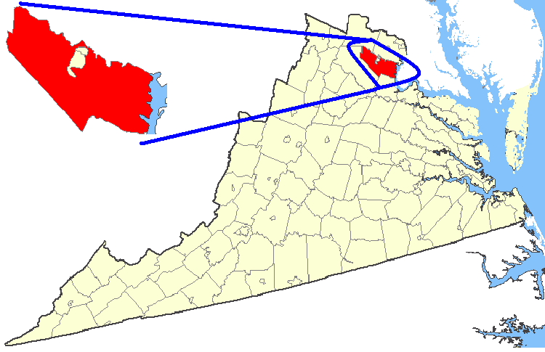
Commonwealth Attorney: Prince William County
Amy Ashworth (Democrat)
  Platform
    Open-file discovery
    Creation of public defender’s office
    Elimination of 287 (g) program
      Allowing deputies at county jails to act as U.S. Immigration and Customs Enforcement Agents.
Notes:
Map
https://commons.wikimedia.org/wiki/File:Map_showing_Prince_William_County,_Virginia.png
Platform:
https://www.washingtonpost.com/local/public-safety/in-northern-virginia-an-unprecedented-chance-to-shape-criminal-justice/2019/10/30/386a47f2-f998-11e9-8190-6be4deb56e01_story.html
More info
https://www.insidenova.com/news/election/ashworth-wins-commonwealth-s-attorney-race-for-prince-william-region/article_1b36abac-0038-11ea-9191-37087daccf52.html

Slide 66
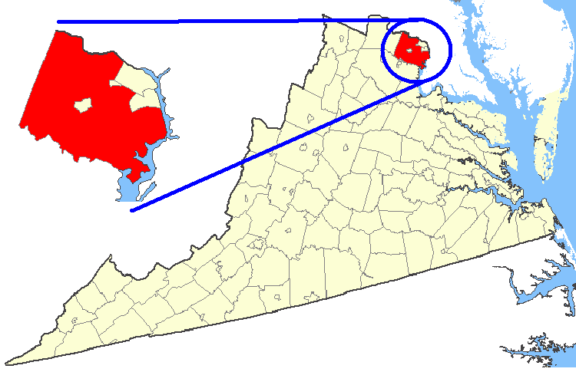
Commonwealth Attorney: Fairfax County
Steve Descano (Democrat)
  Platform:
    Drop prosecutions for marijuana possession
    Charge fewer felonies
    Discontinue death penalty
    End cash bond
Notes:
Platform
https://www.washingtonpost.com/local/public-safety/in-northern-virginia-an-unprecedented-chance-to-shape-criminal-justice/2019/10/30/386a47f2-f998-11e9-8190-6be4deb56e01_story.html
Map
https://upload.wikimedia.org/wikipedia/commons/7/7b/Map_showing_Fairfax_County%2C_Virginia.png

