Slide 1
Notice Regarding Pilot Program For Motion to Amend Practice in AIA Trials March 19, 2019 The Patent Trial and Appeal Board United States Patent and Trademark Office

Slide 2
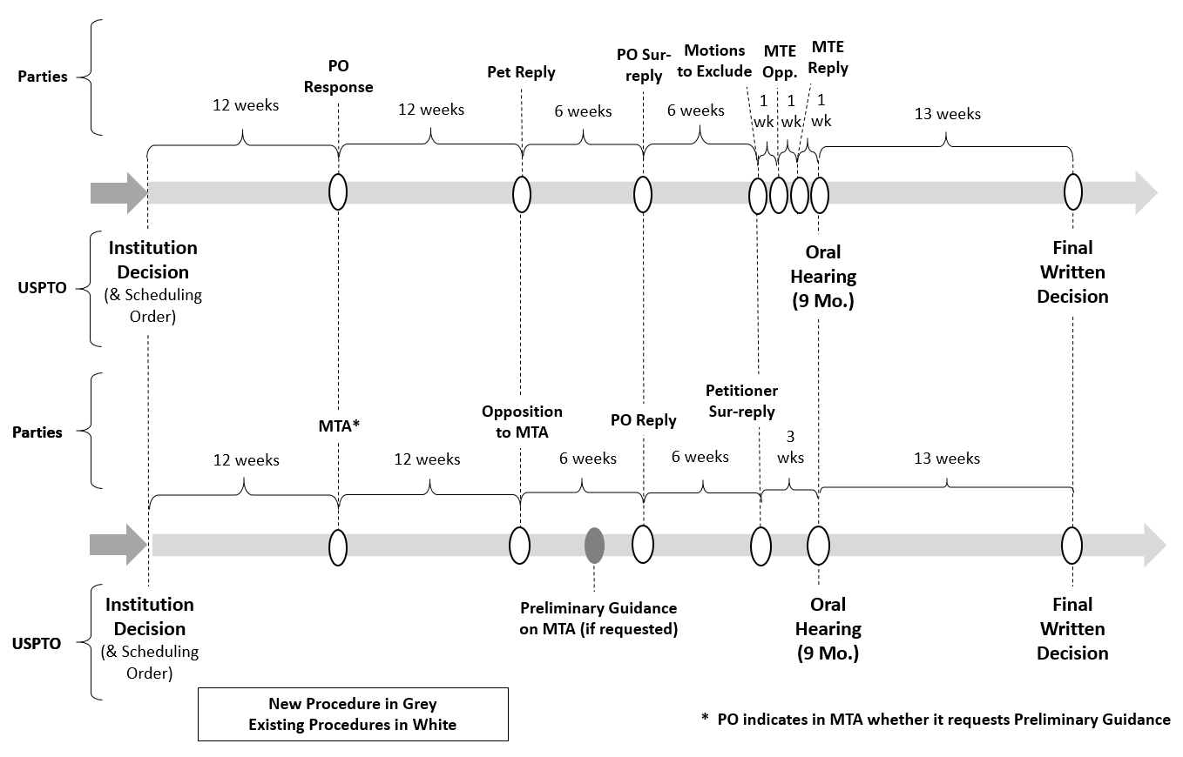
Schedule entered at institution (Appendix 1A)

Slide 3
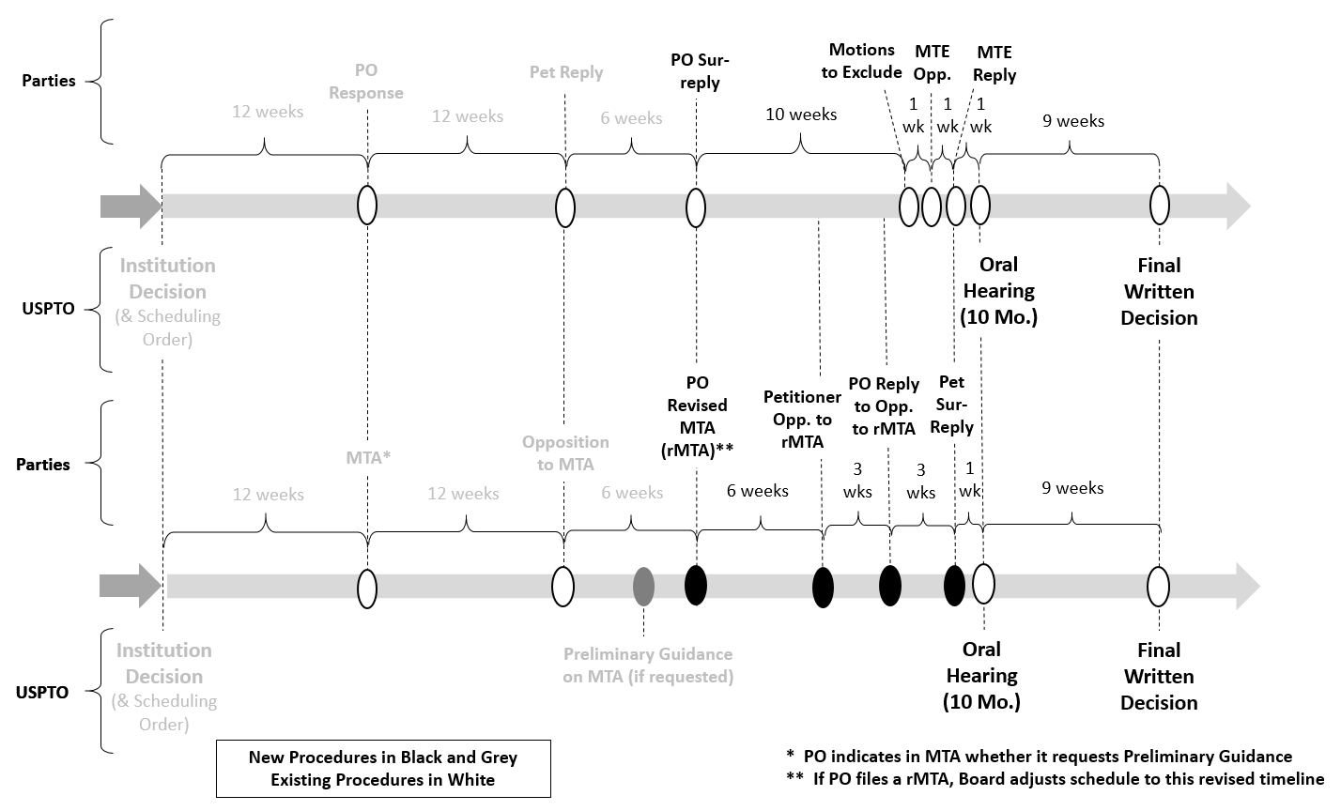
Revised schedule if revised MTA (Appendix 1B)

