Slide 1
English Inns of Court
Lincoln’s Inn
Gray’s Inn
Inner Temple
Middle Temple

Slide 2
English inns of court
Notes:
The picture of the Inns of Court School of Law, joint Coats of Arms of all four Inns of Court, which is taken from the front entrance to Gray's Inn Place.
Upper right : Lion = symbol of Lincoln’s Inn (1711)
Upper left: Lamb = symbol of Middle Temple
Lower right: golden Griffin = symbol of Gray’s Inn
Bottom left: Pegasus = symbol of Inner Temple
'Inner for the rich, Middle for the poor, Lincoln’s for the scholar, Gray’s for the bore' – These characterizations have been widely discredited and have no basis in fact.
The ICSL is housed in the Gray’s Inn Place. The school was established in 1852 by the Council of Legal Education, a joint effort of the four Inns of Court, and has been a branch of the City Univerity, London, since 2001. The School of Law provides post-graduate training for prospective barristers and solicitors.

Slide 3
Locations of the English Inns
Notes:
Thames River at the bottom of the map.
City of London to the east.
Covent Gardens to the west.

Slide 4
Lincoln’s inn
Notes:
Oldest of the 4 Inns, the earliest writing about the Inn was in 1422 but it is clear the Inn was established before that. Lincoln’s Inn is by far the biggest of the Inns in both physical size and membership. It covers 11 acres and has 24,000 members. A third of its current membership comes from outside the EU, primarily Pakistan and Bangladesh.
Notable members: Sir Thomas More, John Donne, Mohammad Ali Jinnah (founder and 1st Governor General of Pakistan), Margaret Thatcher & Tony Blair (plus another 14 prime ministers), William Penn, William Pitt, Dwight Eisenhower, and Dean Acheson.
Fun fact: It has been used a prime filming location, and has appeared in Downton Abbey and Wonder Woman. Renovations to the Great Hall, the Library, and Eastern Terrace mean that no filming or photography projects will be allowed until their completion in January 2019.
Tradition has it that the name comes from Henry de Lacy, third Earl of Lincoln (d. 1311) whose own house was nearby and may have been patron of the Inn. Tradition is not to be entirely gainsaid, and indeed the Earl’s arms form part of the Inn’s arms, but it is more likely that the name came from Thomas de Lincoln, one of the serjeants at law (senior practitioners, before the days of QCs) during the fourteenth century.
The library of Lincoln’s Inn is the oldest in London and dates back to 1475. Filming or photography is never permitted in the library.

Slide 5
Lincoln’s Inn – The Great Hall
Notes:
The Old Hall was built in 1490 and the larger Great Hall (or New Hall), shown, in 1845. The Great Hall is used for dining, for choral and orchestral concerts arranged by the Bar Musical Society, for moot courts and debates, and for the formal ceremonies for calling students of the Inn to the Bar (“[Mr./Ms. Name] by the authority and on behalf of the Masters of the Bench I publish you a barrister of this Honourable Society”).

Slide 6
Lincoln’s Inn – The Chapel
Notes:
The tolling of the Chapel’s bell, which is customarily rung between 12:30 and 1:00 following a Bencher’s death, is said to inspire John Donne to write his famous lines: “No man is an island, entire of itself; …any man’s death diminishes me, because I am involved in mankind, and therefore never send to know for whom the bell tolls; it tolls for thee.” According to a historian, Donne wrote those lines in 1623 when he was seriously ill and confined to bed in his house near St. Paul’s Cathedral. A deadly epidemic raged through London at the time and Donne was supposedly haunted by the incessant tolling of the Chapel bell and those of other nearby churches.

Slide 7
Gray’s Inn
Notes:
Gray's Inn is the smallest Inn, with 5,500 members. In medieval times when the Inns were established, Gray’s Inn was the most remote and still retains a more rural character to this day.
Notable members: Sir Francis Bacon, Thomas Cromwell, Lord Bingham, Baroness Hale (British judge and current President of the Supreme Court of the United Kingdom). Honorary members: Winston Churchill and Franklin D. Roosevelt.
Gray’s Inn suffered the much damage by German bombing during WWII. The ancient Hall and Chapel were heavily damaged but were still intact; everything else was pretty much destroyed. The stained glass, pictures, and treasurers’ shields were removed from the Hall during the bombing, and thus were saved. The buildings that stand now are 1950s red-brick recreations of the historic buildings.
Fun fact: Shakespeare's Comedy of Errors was first performed in the Hall of Grey's Inn in 1594.
Pre-WWII Gray’s Inn was described by Charles Dickens as “one of the most depressing institutions in brick and mortar known to the children of men.”

Slide 8
Gray’s Inn – The Walks
Notes:
The Inn’s gardens are known as ‘the Walks’ and are one of the largest privately owned gardens in London, with a history almost as old as the Inn itself. The current layout dates back to the early 17th century when Sir Francis Bacon was Treasurer of the Inn.
The Walks are open to the public Monday through Friday, from noon to 2:30.

Slide 9
Inner and Middle temples
Notes:
Author Timothy Tyndale Daniell described the Middle Temple as "a beautiful bride" and the Inner as "her dull husband."
Although the Middle and Inner Temples are within the boundaries of the City of London, they do not acknowledge the city’s jurisdiction and have asserted their independence for many centuries. The city has never pressed the matter in the courts.
Legend has it that the War of the Roses began in the Temple Gardens (the War of the Roses was a sustained conflict in the 1400’s between rivals claimants to the English thrown—the Yorkists [white rose] and the Lancastrians [red rose]). That is untrue. It was likely fostered by Shakespeare’s play, King Henry the Sixth, Part One, in which a quarrel among young aristocrats studying law in the Temple became so heated that they moved out to the adjacent gardens. Richard (a York who later became king) and the Duke of Somerset (a Lancastrian) each demanded that others show their loyalty to a side by plucking a white rose for York or a red rose for Lancaster.

Slide 10
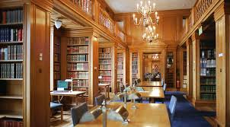
Inner temple
Notes:
Inner is the second largest of the Inns and has around 12,000 members.
Notable members: Sir Edward Coke (“the father of the common law”), Geoffrey Chaucer, Bram Stoker, Mahatma Gandhi (the chef in the Inner Temple dining room is said to have designed a vegetarian menu especially for him).
Inner Temple has been responsible for a number of notable female firsts. Ivy Williams, the first woman called to the Bar (in 1922), was a member, as was Elizabeth Lane, the first female High Court judge (in 1965). More recently Inner member Elizabeth Butler Schloss was the first female Court of Appeal judge (in 1988) and Rosalyn Higgins – an Inner Temple bencher – became the first female judge elected to the International Court of Justice in 1995.
The Inner Temple also figures prominently in fiction and literature. Horace Rumpole is a member of the Temple. Some of the action in a Sherlock Holmes story, A Scandal In Bohemia, takes place in the Inner Temple.
Fun fact: The Inner Temple, or "Inner", occupies the long deserted premises of the Knights Templar, an order of chivalry that flourished during the Crusades.

Slide 11
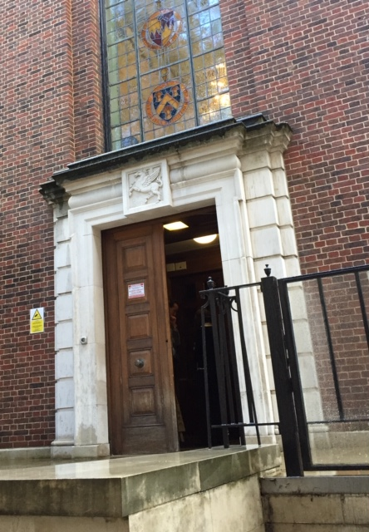
Inner Temple

Slide 12
Middle temple
Notes:
Only slight bigger than Gray’s Inn with 6,000 members.
Notable members: David Cameron (former Prime Minister), Sir Walter Raleigh, Charles Dickens, William Blackstone, and John Rutledge (CJ of SCOTUS).
Shakespeare’s Twelfth Night enjoyed its first performance here.
The Hall has a table this is purportedly made from a hatch cover from The Golden Hind. (Sir Francis Drake’s famous ship in which he circumnavigated the globe in 1577 – 1580). Every new barrister signs their name in a book on this table.

Slide 13
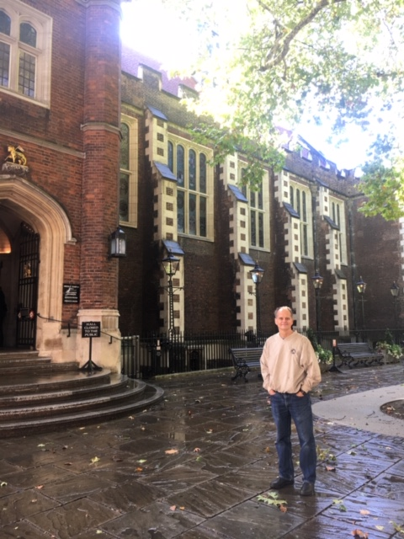
Middle Temple
Notes:
After months of renovation work over the summer, the Middle Temple Hall has re-opened.
Middle Temple Hall is open from 12:30 until 14:00 and guests can choose from the three course self-service buffet lunch at a cost of £25 per person for groups of under 5 people or for larger groups, of 6 and above, we offer a served three course lunch for £30 per person.

Slide 14
Middle Temple Hall
Notes:
Middle Temple Hall is the prototype for the Great Hall at Trinity College in Cambridge.
Dress code: Lunch is an informal meal and the dining regulations do not apply. Members should bear in mind, however, that Hall is the luncheon room of a professional body. The dress code is business suit, court dress or smart casual dress. Jeans may be worn if both clean and smart. We do not permit guests wearing inappropriate/ripped/dirty clothing. Shorts are not permitted at any time. Middle Temple reserves the right to refuse entrance to the Hall, without refund, if guests do not follow the dress code accordingly.
Today’s lunch entrees: Swordfish ala Siciliana, Corned silverside of beef, Lamb Rogan Josh. Every lunch includes a pudding for dessert. Today’s = pear & ginger crumble, custard.
Tonight there is a lecture as part of the Inn’s “Survive and Thrive Programme” on “Understanding body language and how to create the ‘golden halo’ effect.”

Slide 15
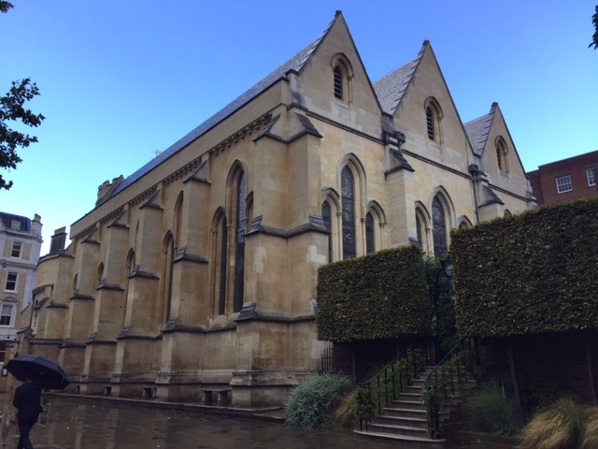
Temple Church
Notes:
The Church was built by the Knights Templar, the order of crusading monks founded to protect pilgrims on their way to and from Jerusalem in the 12th century. The Church is in two parts: the Round and the Chancel.
It was heavily damaged on May 10, 1941, during WWII and is a reconstruction of the medieval building.
The Inner and Middle Temples share ownership of the church, and their members (benchers) have repeatedly defended its independence from the Bishop of London, obtaining express Parliamentary recognition of such independence in 1843, 1874, and 1898. The southern half of the choir section has long been assigned to the Inner Temple and the northern half to the Middle Temple, with reserved seating for Benchers of each Society. The seating assignments are still observed by the temple members to this day.

Slide 16
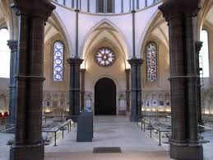
Temple Church
Notes:
The Round Church was consecrated in 1185 by the patriarch of Jerusalem. It was designed to recall the holiest place in the Crusaders’ world: the circular Church of the Holy Sepulchre in Jerusalem, which is believed to occupy the site of Jesus’ death and burial. The Chancel (the rectangular addition) was added a few decades later.

