Slide 1
James S. Bowman American Inns of Court Dealing with ‘Special’ People
Haar/Jones Group
February 11, 2015

Slide 2
Introduction
“Jerks”
Pro se parties
Non-lawyer professionals

Slide 3
Jerks – “Mine’s bigger than your’n”

Slide 4
Examples of Jerks
Abusive language
Lawyer is center of attention, not client
Dishonest or manipulates facts
Speaks about disputes in terms of war or combat
Fosters intimidation and misery

Slide 5
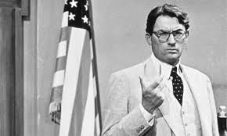
Differentiating the Jerk from the Advocate
“A lawyer zealously asserts the client’s position under the rules of the adversary system.”
- Preamble: A Lawyer’s Responsibilities, Pa. Rules of Professional Conduct

Slide 6
Suggestions
DO – master your case
- educate your client
- make a plan
- “phone a friend”
DO NOT – retaliate or escalate
- fold or quit

Slide 7
Discussion
If you were the lawyer taking the deposition in the “old lawyer fight,” how would you have responded to the outburst by all counsel?

Slide 8
Case Reviews
Grider v. Keystone HealthPlan
- 2004 U.S. Dist. Lexis 9014 (E.D. Pa. Apr. 26, 2004)
- Throwing darts at pictures of opposing counsel
- Dolls depicting lead counsel
Christian v. Mattell
- 286 Fed. 3d 1118 (9th Cir. 2003)
- Throwing dolls during depositions

Slide 9
Jerks

Slide 10
Jerks
Kill ‘em with kindness
Resist urge to use “go to hell” stamp
Greater duty to the public and the profession

Slide 11
Discussion
Is arrogance ever in the client’s best interests or the lawyer’s best interests?

Slide 12
Pro Se Litigants
C. Michael Weaver
Michael Barrett
Former Hearing Examiner – Bureau of Professional and Occupational Affairs
Former Secretary of the Commonwealth
Bureau of Professional and Occupational Affairs
Prosecutor

Slide 13
Dealing with Pro Se Litigants
Approaching an administrative proceeding or litigation with a Pro Se Litigant
Preparation
Communication
Notes:
Prehearing conferences

Slide 14
Dealing with Pro Se Litigants
Building a Record
Hearing Examiner’s role/responsibility
Prosecutor or Commonwealth attorney’s role/responsibility
Other parties
Notes:
Bob – add case

Slide 15
Pro Se Litigants
Balancing:
Neutrality
versus
Assistance

Slide 16
Dealing with Non-Lawyer Professionals
Ethics
Unauthorized Practice of Law
Strategy

Slide 17
ETHICS - FALSE STATEMENTS
A lawyer shall not knowingly make a false statement of material fact or law to a tribunal or fail to correct a false statement of material fact or law previously made to the tribunal by the lawyer.
-PA ST RPC Rule 3.3(a)(1).

Slide 18
ETHICS - FALSE STATEMENTS
If the non-lawyer misstates facts to the detriment of his case, do you have an obligation to correct?

Slide 19
LEGAL AUTHORITY
A lawyer shall not fail to disclose to the tribunal legal authority in the controlling jurisdiction known to the lawyer to be directly adverse to the position of the client and not disclosed by opposing counsel.
- PA ST RPC Rule 3.3(a)(2).

Slide 20
LEGAL AUTHORITY
You
CANNOT
take advantage of a non-lawyer.
Notes:
Duty of candor – higher duty to the court

Slide 21
ADVICE
A lawyer shall not give advice to a person who is not represented by a lawyer, other than the advice to secure counsel.
PA ST RPC Rule 4.3(b).
What about settlement negotiations with a non-lawyer?
Mazzacaro
Notes:
Mazzacaro case

Slide 22
UNAUTHORIZED PRACTICE OF LAW

Slide 23
G.R.A.P.P.
G.R.A.P.P. (1 Pa. Code § 31.22): Appearance by attorney
A person may be represented in a proceeding by an attorney at law

Slide 24
G.R.A.P.P.
G.R.A.P.P. (1 Pa. Code § 31.22): Other representation prohibited
A person shall not be represented at a hearing before an agency head or presiding officer except:
(1) As stated in § 31.21 or § 31.22;
(2) As otherwise permitted by the agency in a specific case.

Slide 25
Unemployment Compensation Board of Review (43 P.S. § 862):
An individual claiming compensation in a proceeding before the Board or referee, may be represented by counsel or other authorized agent.

Slide 26
Pennsylvania Labor Relations Board (§ 91.2(a))
An attorney or other representative desiring to participate in any proceeding before the Labor Relations Board or a designated agent of the Board, and who wishes to be served with papers, shall file an appearance.

Slide 27
Board of Finance and Revenue (72 P.S. § 9704(D.1)(1)):
Appearances in Proceedings before the Board may be by the Petitioner or by an attorney, accountant or other representative provided the representation does not constitute the unauthorized practice of law.

Slide 28
Dep’t of Public Welfare Office of Hearing and Appeals (55 Pa. Code § 275.4(a)(1)(iv):
An medical assistance applicant may be represented by an attorney, relative, friend or other spokesman

Slide 29
Discussion
Advantages for non-lawyer?
Ethical requirements for non-lawyer?
Should you bring this to the attention of the hearing officer? How?
Duty to report the potential unauthorized practice of law?

Slide 30
Strategy against Non-Lawyer…
As An Advocate
As An Expert

Slide 31
Non-Lawyer Professional Advocate
Prohibited from Making Legal Arguments
Disclose of controlling authority
Preservation of Legal Issues
Demeanor
Utilizing Advantage vs. Creating Sympathy

Slide 32
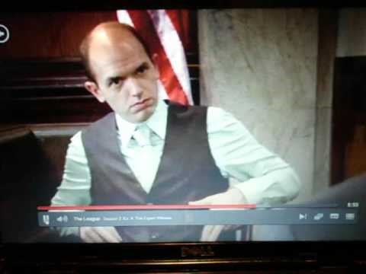
Non-Lawyer Expert

Slide 33
Non-Lawyer Professional Expert
Your Expert
Help Understand Issues or Evidence
Adversary's Expert
Expect Adversarial Interaction
Be in Control
Topics that support your opponents case but are not relevant
Ask specific questions

Slide 34
CLE over – still want to discuss?
Neeka Jones Matt Haar
Brett Woodburn Len Cowitch
Tricia Lontz Lara Antonuk
Shane Bodrick Josh Bonn
Anthony Bowers Kristen Brown
Bob Davis Anthony Holbert

